Slide 1


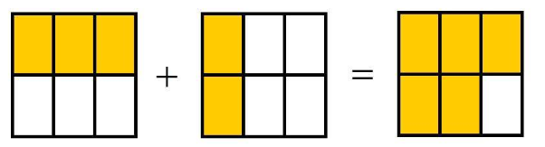

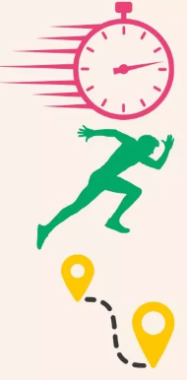


YEAR 7 Mathematics
Year 8
Maths
Convert mixed numbers to improper fractions
Highest common factor, Lowest common multiple
Solve problems with angles
Angles in a triangle
Add and subtract fractions
Parallel lines
MAY
HALF TERM
Assessment 3
Angles in quadrilaterals
Angles and polygons
Add and subtract fractions
Draw and measure angles
Add and subtract algebraic fractions
Factors
UKMT competitions
Speed distance time
Number
Find perimeter and area of 2D shapes
Calculate speed
Product of prime factors
Perimeter and area
END OF TERM
Percentages non calculator
Percentage increase and decrease
Multiples
Convert time
Calculate time and distance
Distance time graphs
Fraction and percentages of amounts
Equivalent fractions
Fractions, decimals and percentages
Fraction of amounts
Scatter graphs
Bar charts
Assessment 2
FEB
HALF TERM
Multiply and divide negative numbers
Compare and order fractions
Convert simple fractions
Time series
Pictograms
Directed number
Graphing data
END OF TERM
Add and subtract negatives
Round to decimal places
Four operations
Order of operations
Number and rounding
Estimation
OCT
HALF TERM
Assessment 1
Place value
Round to powers of 10
Add and subtract
Multiply and divide
Averages
Solve 2 step equations
Mean, Median, rang and mode
Collect like terms
Substitution
Find next term
Sequences
Solve 1 step equations
Baseline
Assessment
START
Expressions and equations
2 step function machines
Function machines
Non linear sequences
Describe sequences
Algebraic notation
LEARNING JOURNEY

Slide 2

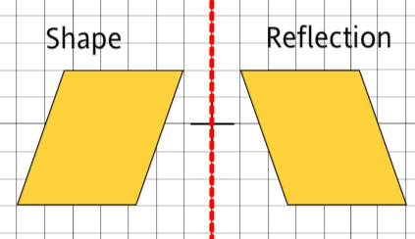
YEAR 8 Mathematics
Year 9
Maths
Circumference of a circle
Generate a sequence given a rule
Pie charts
Circles
Use property probabilities sum to 1
Nth term
MAY
HALF TERM
Assessment 3
Sequences
Graphs and charts
Area of a circle
Interpret and draw line graphs
Compound shapes
Two- way tables
UKMT competitions
Angles
Interior and exterior angles
Probability
Averages from tables
Interpreting data
Frequency trees
Negative powers of 10
END OF TERM
Probability scale
Standard form on a calculator
Angles in parallel lines
Prove geometric facts
Find unknown lengths
Write numbers in standard form
Standard form
Draw inequalities on a number line
Equations and inequalities
Calculate density, mass and volume
Units of density
Assessment 2
FEB
HALF TERM
Subtraction law of indices
Use multipliers to calculate percentages
Percentages
Solve 1 and 2 step equations
Volumes of shapes
Addition law of indices
Indices
Area, volume and density
END OF TERM
Coordinates and graphs
Gradients
Quadratic graphs
Symmetry
Reflection
OCT
HALF TERM
Assessment 1
Y=mx+c
Multiply and divide fractions
Reciprocals
Factorise expressions
Midpoints
Form expressions
Conversion graphs
Share into a ratio
Ratio
Expand brackets
Baseline
Assessment
START
Algebraic Manipulation
Similar shapes
Direct proportion
Proportion and scale
Ratio problems
Simplify ratios
LEARNING JOURNEY

Slide 3
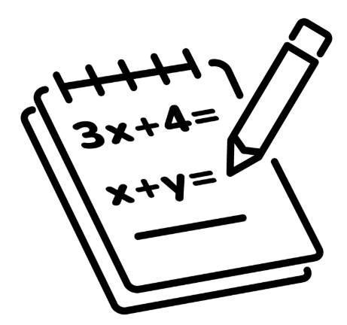
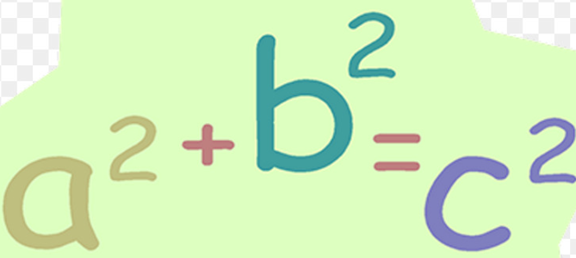
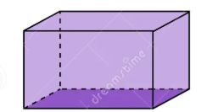
YEAR 9 Mathematics
Year 10
Maths
Enlargement
Find missing sides in a triangle
Solve simultaneous equations to find two values
Transformations
Expected outcomes and relative frequency
Label sides of a triangle
MAY
HALF TERM
Assessment 3
Trigonometry
Simultaneous equations
Rotation
Venn diagrams
Translation
Probability
Pythagoras
Calculate the shorter side
Expand and factorise
Expand double brackets
Draw a quadratic graph
Algebraic Manipulation
END OF TERM
Bisect a line
Interpret cubic graphs
Perpendicular bisectors
Calculate the hypotenuse
Non linear graphs
Recognise reciprocal and exponential graphs
Draw triangles accurately
Constructions
Draw straight line graphs
Straight line graphs
Investments
Bills and budgets
Assessment 2
FEB
HALF TERM
Maths and money
Inverse proportion
Ratio and proportion
Y=mc+c
Insurance
Tax
Ratio and algebra
Direct proportion
END OF TERM
Solve inequalities
Change the subject
Calculate density, mass and volume
Fractions
OCT
HALF TERM
Assessment 1
Equations and inequalities
Multiply, divide, add and subtract fractions
Rates
Standard form
Cones and spheres
Calculate speed distance, time
Surface area
Compound interest
HCF/LCM
Number
Volume of 3D shapes
Baseline
Assessment
START
Area and volume
Percentage change
Increase and decrease
Venn diagrams
Product of its primes
Percentages
LEARNING JOURNEY

Slide 4
YEAR 10 Mathematics
Year 11
Maths
Powers of 10 and standard form
Find the nth term of a sequence
Number and sequences
Expand and factorise
Estimation
Manipulating expressions
MAY
HALF TERM
Assessment 3
Bounds
Explore fractional and negative indices
Indices and roots
Explore quadratic sequences
Know laws for multiplying and dividing indices
Geometric sequences
Tree diagrams and Venn diagrams
Data
Non calculator methods
Probability
Scatter graphs
END OF TERM
Repeated percentage change
Surds
Iteration
Histograms
Cumulative frequency
Fraction arithmetic
Percentage and interest
Find the length of an arc
Working with circles
Solve problems including Pythagoras and trigonometry
Calculate bearings using angle rules
Solve problems with ratio
Assessment 2
FEB
HALF TERM
Angles and bearings
Express in for 1:n
Explore vector journeys in shapes
Vectors
Measure and draw bearings
Use scale diagrams
Ratios and fractions
Find the area of sectors
END OF TERM
Simultaneous equations
Solve when adjusting both equations
Solve a quadratic simultaneous equation
Represent inequalities on a number line
Assessment 1
Equations and inequalities
Solve using graphs
Solve by substitution
Form and solve a simultaneous equation
Draw straight line graphs
Use Sin, Cos and Tan to find a side
Congruence, similarity and enlargement
Solve equations
Similar triangles
OCT
HALF TERM
Baseline
Assessment
START
Find missing angles
Label a triangle
Scale factors
Enlarge a shape
Trigonometry
LEARNING JOURNEY

Slide 5
YEAR 11 Mathematics
Your future
Edexcel GCSE
Paper 1- Non calculator 90 mins
Paper 2- Calculator 90 mins
Paper 3- Calculator 90 mins
MAY
HALF TERM
GCSE EXAMS
Top revision sites:
1st class math's
Math's genie
GCSE pod
Onmaths
Exam practice and React
Bespoke topics based on QLA
Mock 2
FEB
HALF TERM
END OF TERM
Construct arguments to prove facts
Algebraic proof
Algebraic reasoning
Circle theorems (H)
Direct and inverse proportion
Geometric reasoning
Pressure and density
Show that
Vector problems (H)
Angles in parallel lines
Ratio problems
Multiplicative reasoning
Nth term
Completing the square (H)
Changing the subject
Iteration (H)
Use composite functions (H)
Inverse functions (H)
END OF TERM
OCT
HALF TERM
Mock 1
Expanding and factorising
Expand and factorise quadratics
Solve linear equations
Change the subject of a formula
Use function machines
Reflect in given lines
Functions
Area under a curve (H)
Recognise graph shapes
Understand y=mx+c
Gradients and lines
Distance time graphs
START
Using graphs
Plot and read quadratic and cubic graphs
Explore perpendicular lines (H)
Plot straight line graphs
Non Linear graphs
LEARNING JOURNEY

