Slide 1





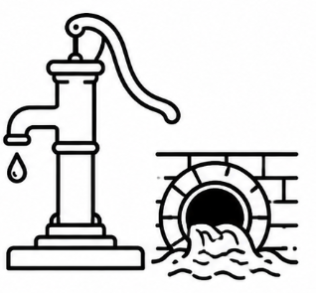






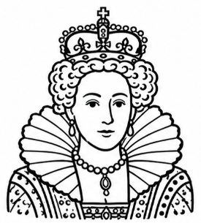
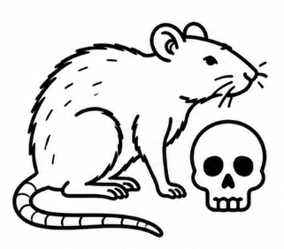
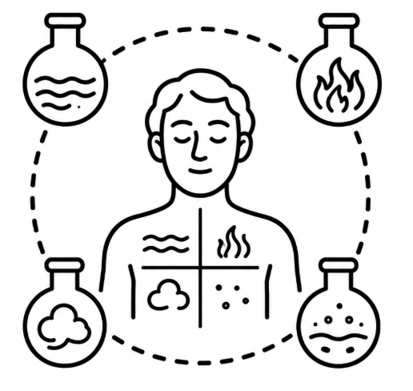

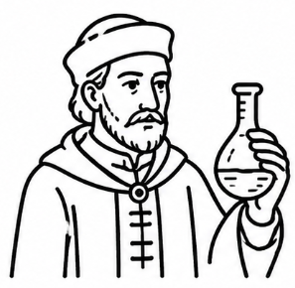
YEAR 10 – History
Year 11
History
How did war speed up medical progress?
Topic four – Has modern medicine solved the problem of disease?
How far did government improve public health?
MAY
HALF TERM
Assessment Three
Why did cholera force Britain to clean up?
Why was penicillin a medical breakthrough?
Why did England and Spain become enemies?
Topic four – Historic Environment
Britain: Health and the People 1000-Present day
Topic three – Why did medicine change so rapidly in the 1800s?
Did Lister make surgery safe?
Topic three – How close did Elizabeth come to losing control?
END OF TERM
Who really ruled Elizabethan England?
Was Drake a hero, pirate or empire-builder?
Was Elizabeth’s Church a clever compromise?
How did surgeons finally conquer pain?
How did germs transform medicine?
Assessed writing and feedback THREE
Was this a Golden Age for everyone?
Why did theatre boom under Elizabeth?
Topic two – Was life in Elizabethan England really golden?
FEB
HALF TERM
Why was a queen such a problem?
Assessment two
Why did poverty become a crisis?
How did fashion show power and status?
How dangerous was Norfolk’s challenge?
Why did Elizabeth refuse to marry?
END OF TERM
Did Paré make surgery safer?
Were Renaissance treatments really any better?
Did hospitals become places of cure?
Elizabethan England, c1568-1603
Part two – was the Renaissance the start of real medical progress?
OCT
HALF TERM
Assessment one
Topic one – How did Elizabeth keep control in a dangerous court?
Did Vesalius prove Galen wrong?
Who changed medicine more: Hunter or Jenner?
How did Islam affect Medieval medicine?
Britain: Health and the People 1000-Present day
How much did medieval doctors really understand?
Why was the Black Death so hard to stop?
START
Why were monasteries healthier than towns?
Did Christianity help or hold back medicine?
Part one - Did medicine really stand still in medieval Britain?

Slide 2








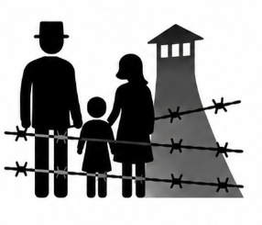





YEAR 11 – History
End of course
MAY
HALF TERM
GCSE Exams
Did the League keep peace in the 1920s?
Did Locarno and Kellogg-Briand make peace safer?
Why couldn’t the League stop Japan?
Did Abyssinia destroy the League’s reputation?
Topic three – Was war inevitable by 1939?
Was appeasement cowardly or cautious?
Part two – Could the League of Nations really keep the peace?
END OF TERM
Was the League built to succeed?
How dangerous was German rearmament?
Why did Hitler want Austria?
Did Munich bring peace or make war more likely?
Assessed writing and feedback THREE
How fair was the wider peace settlement?
Why did Versailles cause so much anger?
Topic one – Did the peacemakers create peace or future conflict?
Conflict and Tension: The Inter-War Years 1918-1939
Who won the peace: Wilson, Clemenceau or Lloyd George?
FEB
HALF TERM
Assessment two
Did the Allies get the peace they wanted?
What did the Big Three really want?
To what extent did fear and terror keep Germans loyal to the Nazi regime?
END OF TERM
How did Hitler establish his dictatorship?
Topic three – How did the Nazis control German lives?
What motivated some Germans to resist?
OCT
HALF TERM
Assessment one
Assessment one
How did the Hitler Youth shape young people's attitudes and loyalty to the Nazis?
Part two – How did crisis help Hitler take power?
How did the Depression impact political extremism?
How did Nazi propaganda win the hearts and minds of so many German people?
Germany 1890-1945: Democracy to Dictatorship
Why did the Germans hate the Treaty of Versailles?
What challenges faced Kaiser Wilhelm II before WW1?
To what extent had Germany recovered during the Stresemann era?
START
What problem did the £6.6 billion in reparations lead to?
What impact did the First World War have on Germany?
Part one - Was democracy ever secure in Germany?

