Slide 1







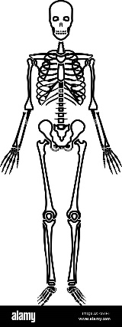
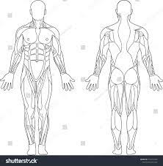
NCFE Health and Fitness – Year 10
Year 11 NCFE H&F
Analysis tools
AP3 Exam
Repetitions and sets
End of topic test
MAY
HALF TERM
End of topic test
Goal setting
Health and Fitness analysis and goal setting
Optimising health and fitness programme
Heart rate training zones
Using data
Lifestyle factors
Diet
Other factors e.g. Drugs
Complete tests
End of topic test
End of topic test
END OF TERM
Skill related fitness tests
Training methods
Activity levels
Rest and recovery
Health related fitness tests
EXAM
Fitness Testing
AP2 Exam
Health related fitness
Components of fitness
Principles of training
Revision
FEB
HALF TERM
End of topic test
End of topic test
Exam preparation
Health and Fitness
End of topic test
Principles of FITT
Principles of training
Skill related fitness
long term effects
Structure and functions
Measurements
END OF TERM
Lung volumes
Cardiovascular System
Blood pressure
Short term effects
End of topic test
End of topic test
OCT
HALF TERM
Structure of blood vessels
Heart and cardiac cycles
Energy systems
Effects of health and fitness on the body
Respiratory System
End of topic test
Muscle Fibers
Types of joint/bones
Structure of the Skeleton
Muscular System
Muscle Movement
AP1 Exam
End of topic test
START
Types of muscle and structure
Structure of synovial joint/spine
Function of the Skeleton
Skeletal System
Structure and Function of body systems
LEARNING JOURNEY

Slide 2

NCFE Health and Fitness – Year 11
GCSE Results
MAY
HALF TERM
Final Exam
Exam Preparation Content Area 1-8
Demonstrate 30 min session
Training log & Review
Task 6
Review and Evaluation
Task 5 Completion of Training Programme
Evaluate
END OF TERM
Submission date
Evaluation
Retest
Record
1-week diet plan
Task 4a Fitness Training Programme
Complete Synoptic project
Task 3
Goal Setting
SMART
Targets
ST, MT, LT Targets
Task 4b
Diet Plan
FEB
HALF TERM
Exam AP2
Designing a 4-week training programme
Principles of training
Exam Preparation
Complete
fitness testing
Record results
Compare results to normative data
Task 2 Fitness Assessment of client
END OF TERM
Task 1 Fitness Assessment of client
Food
Diary
Synoptic Project
OCT
HALF TERM
Evaluate & Analyse
PAR-Q
Lifestyle
Questionnaire
Analyse & Evaluate findings
Main activity
Health and safety
Components of a health & fitness programme
Analysis tools
Exam AP1
Goal Setting
Exam Preparation
START
Synoptic project preparation
Exam resit
Synoptic project
released
Warm up/ cool down
Structure of a health and fitness programme
Analysising Data
Health and Fitness analysis and goal setting
LEARNING JOURNEY

