Slide 1
NCFE EA 2026
Command Words
AO1 = State/Identify/Name/Define
AO2 = Describe/Explain/Give an example/Suggest
AO3 = Discuss/Analyse/Evaluate/Justify

Slide 2
NCFE EA 2026
Golden Rule
AO1 = STATE – What is it?
AO2 = EXAMPLE - Apply it to the activity or person in the question.
AO3 = EFFECT - Explain why this helps (or hinders) performance.

Slide 3
Sentence starters
AO1 = STATE – _________ is... ________ refers to...
AO2 = EXAMPLE - For example... In this activity...
AO3 = EFFECT - This means... Therefore...

Slide 4
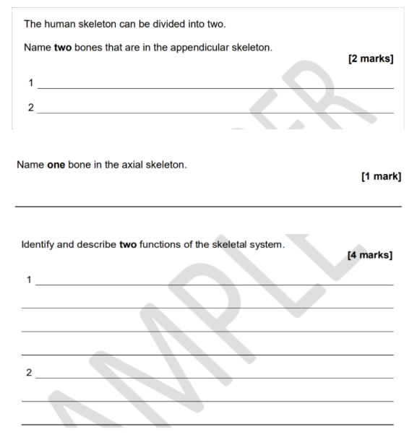
FEMUR
AO1
TIBIA
AO1
CRANIUM AO1
PROTECTION AO1
Protects vital organs, e.g. the ribs protect the heart and lungs. For example when tackling in contact sports like rugby or body shot in boxing AO2
MOVEMENT
Bones act as levers and work with muscles to create movement at joints.
For example when kicking a football, the quadriceps contract and pull on the tibia to extend the knee joint. The femur and tibia act as levers, allowing the leg to move and strike the ball. AO2

Slide 5
Name two bones that are in the APPENDICULAR SKELETON. [2]
Possible answers:
Humerus
Radius
Ulna
Carpals
Metacarpals
Phalanges
Scapula
Clavicle
Pelvis
Femur
Patella
Tibia
Fibula
Tarsals
Metatarsals
(Any two = 2 marks)

Slide 6
Name one bone in the AXIAL SKELETON. [1]
Possible answers:
Cranium (skull)
Vertebral column (spine)
Sternum
Ribs
(Any one = 1 mark)

Slide 7
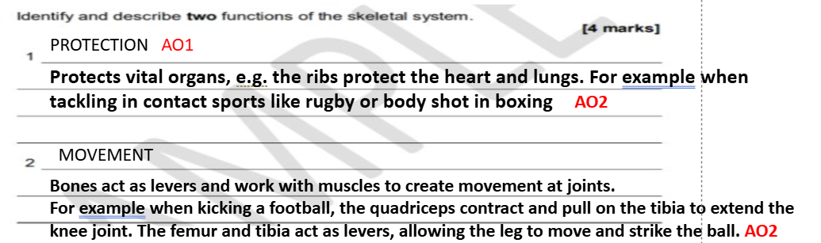
Identify and describe two FUNCTIONS OF THE SKELETON [4]

Slide 8
Identify and describe two FUNCTIONS OF THE SKELETON [4]
Function: Support
Description: Provides a framework for the body and helps maintain posture keeping it upright.
Function: Blood Cell Production
Description: Bone marrow produces red and white blood cells.
Function: Shape and Structure
Description: Gives the body its shape and can influence performance in different activities. (longer femur taller basketballer)
Function: Storage of minerals
Description: Bones store minerals such as calcium and phosphorus, which are important for healthy bones & muscle function.

Slide 9
Give one example of each of the following TYPES OF BONES. [3]
Flat bone
Possible answers:
Cranium (skull)
Ribs
Sternum
Scapula
Irregular bone
Possible answers:
Vertebrae
Short bone
Possible answers:
Carpals
Tarsals
Sesamoid bones
Possible answers:
Patella (knee bone)

Slide 10
Give the meaning of the term 'joint'. [1]
Model answer:
A joint is the place where two or more bones meet.
Acceptable alternatives:
Where bones meet.
The connection between two bones.
The point at which two or more bones articulate.

Slide 11
Fixed joints are a type of joint. Identify two other types of joint and state a location in the body where each is found (4)
Type of joint 1: Fixed
Location: Cranium
Type of Joint 2: Slightly moveable
Location: verterbrae
Type of joint 3: Synovial joints (6 in total)
Location: knee

Slide 12
State three different types of SYNOVIAL joints (3 marks)
Possible answers
Hinge joint e.g. elbow, knee
Ball and socket joint e.g. hip, shoulder
Pivot joint e.g. neck
Condyloid joint e.g. wrist
Gliding joint e.g. Shoulder (scapula and clavicle)
Saddle e.g. thumb

Slide 13
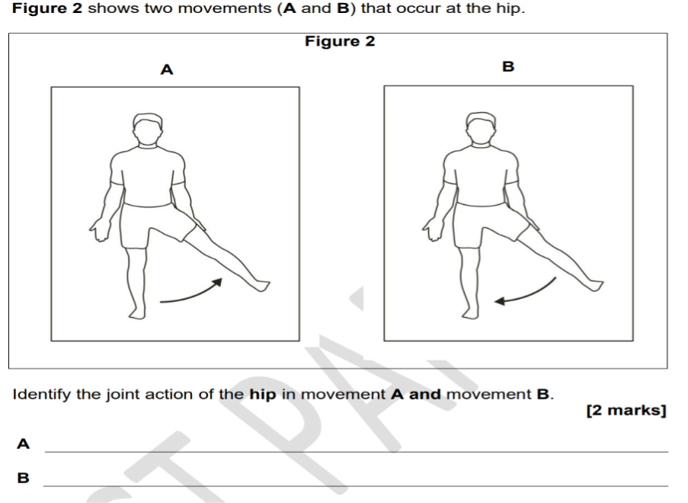
JOINT ACTIONS / MOVEMENT AT A JOINT

Slide 14
Identify the JOINT ACTION of the hip (2 marks)
Abduction
Adduction

Slide 15
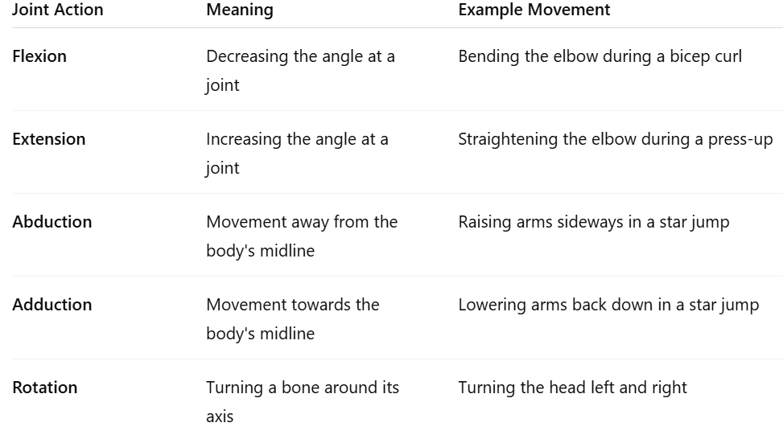
JOINT ACTIONS

Slide 16
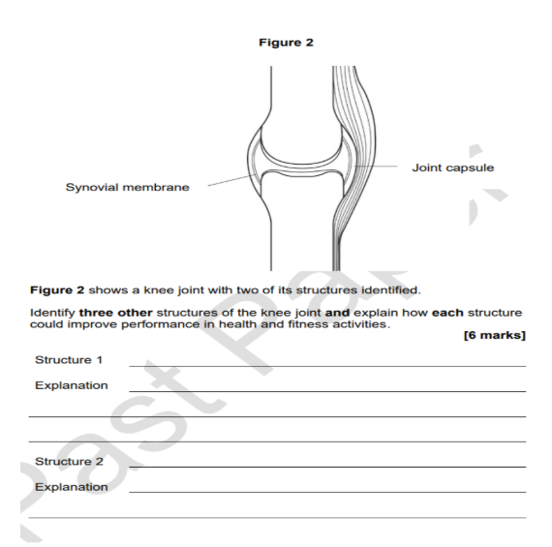
Articular cartilage AO1
Covers the ends of bones and reduces friction during movement. This allows the knee joint to move smoothly when running, jumping or cycling. AO2
Synovial fluid AO1
Lubricates the joint and reduces friction between the bones. This allows smoother movement and helps improve performance during exercise AO2
Ligaments AO1
Structure 3____________________________________________________
Explanation ___________________________________________________________________________________________________
Connect bone to bone and provide stability at the knee joint. This helps prevent excessive movement and reduces the risk of injury during activity AO2

Slide 17
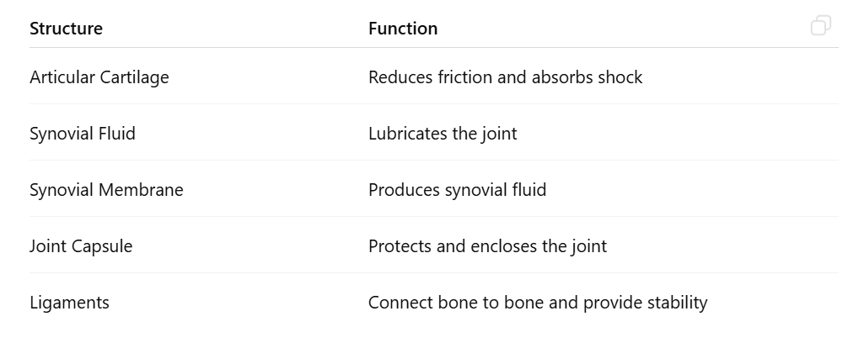
SYNOVIAL JOINT STRUCTURES

Slide 18
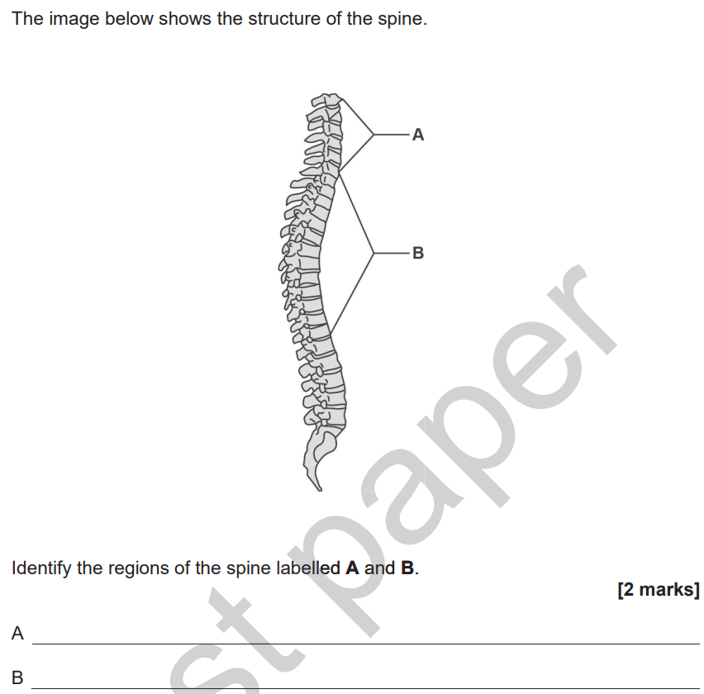
STRUCTURE OF THE SPINE

Slide 19
REGIONS OF THE SPINE
1st region of spine – CERVICAL (7)
2nd region of spine – THORACIC (12)
3rd region of spine – LUMBER (5 Largest & strongest)
4th region of spine – SACRUM (5 fused)
5th region of spine – COCCYX (5 tiny)

Slide 20
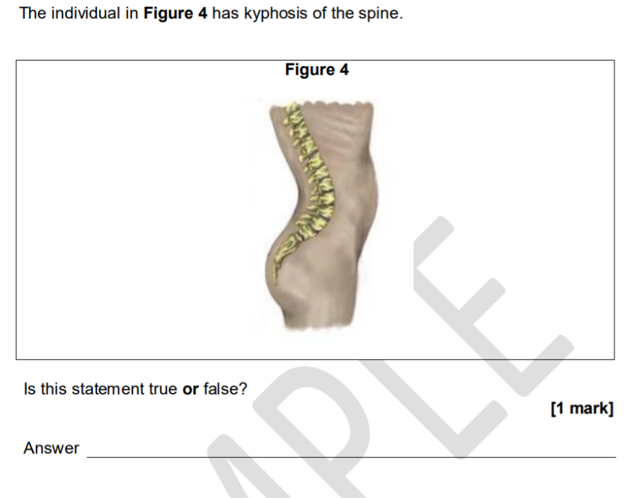
POSTURE

Slide 21
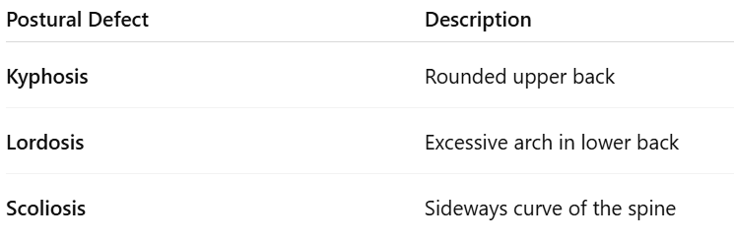
POSTURE

Slide 22
TYPES OF MUSCLE (NOT MUSCLE FIBRE TYPES 1 or 2)
Skeletal → movement
Cardiac → oxygen delivery to muscles
Smooth → controls movement within organs and blood vessels

Slide 23
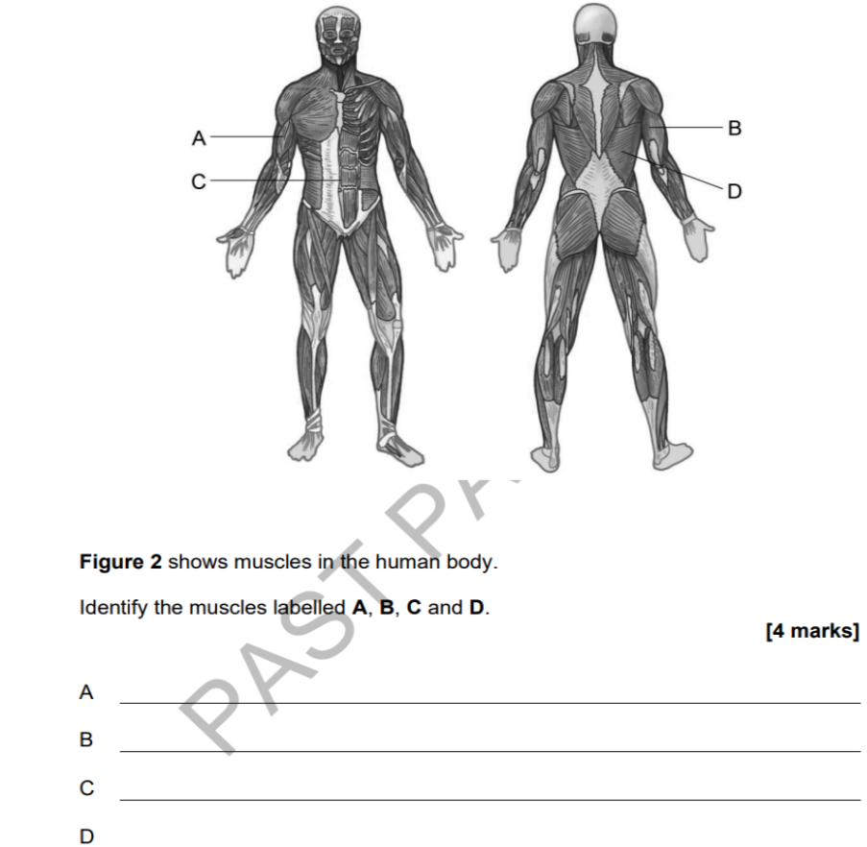
Names of muscles

Slide 24
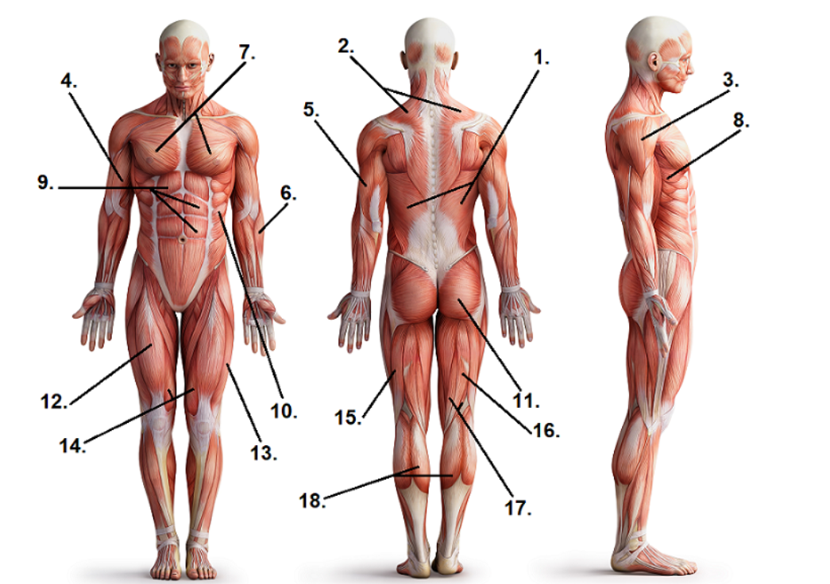
Names of muscles

Slide 25
Define the term 'agonist' and 'antagonist'.
The agonist is the prime mover, the muscle responsible for producing the movement (the main muscle that contracts)
The antagonist is the muscle that works opposite to the agonist and relaxes or lengthens to allow movement to occur.

Slide 26
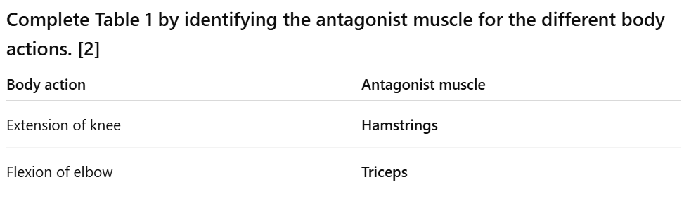
ANTAGONIST MUSCLES

Slide 27
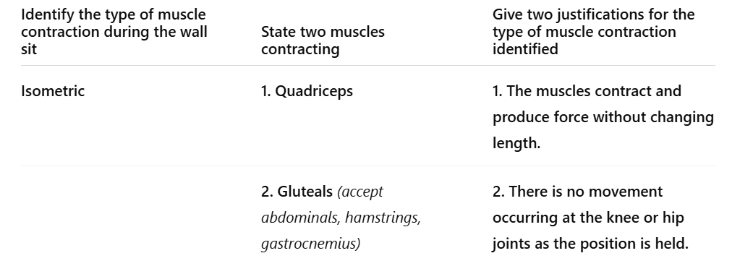
MUSCLE CONTRACTIONS
to hold the body in position

Slide 28
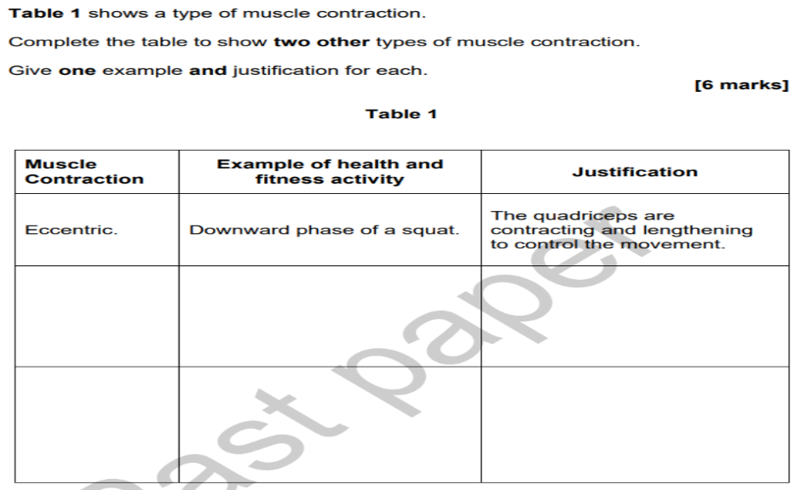
TYPES OF CONTRACTION
Isotonic Contractions (eccentric and concentric)
Eccentric = muscle lengthens as it contracts
Concentric = muscle shortens as it contracts
Isometric = muscle remains the same length
concentric
Upward phase of bicep curl
The biceps are contracting and shortening to allow flexion at the elbow
Planking
The muscles are contracting but there is no movement
isometric

Slide 29
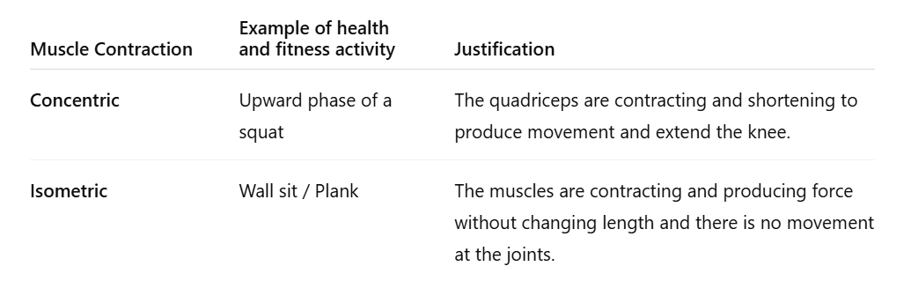
MUSCLE CONTRACTIONS

Slide 30
MUSCLE FIBRE TYPES
Type 1 Slow Twitch
Activity: Marathon running
Resistant to fatigue
Suitable for long-duration aerobic exercise
Type 2 Fast Twitch
Activity: 100 m sprint
Produce high force and power
Suitable for short-duration, explosive exercise

Slide 31
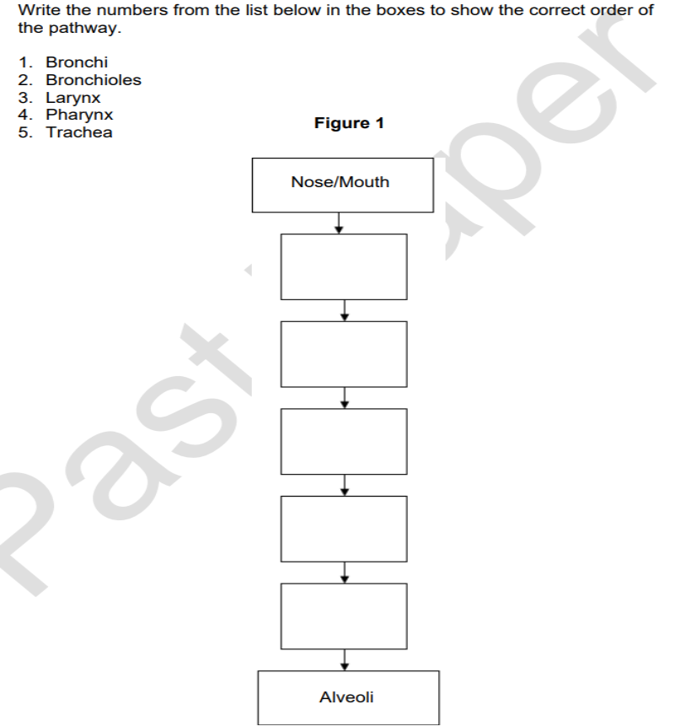
STRUCTURE OF RESPIRATORY SYSTEM

Slide 32
STRUCTURE OF RESPIRATORY SYSTEM
pharynx
larynx
trachea
bronchi
bronchioles

Slide 33
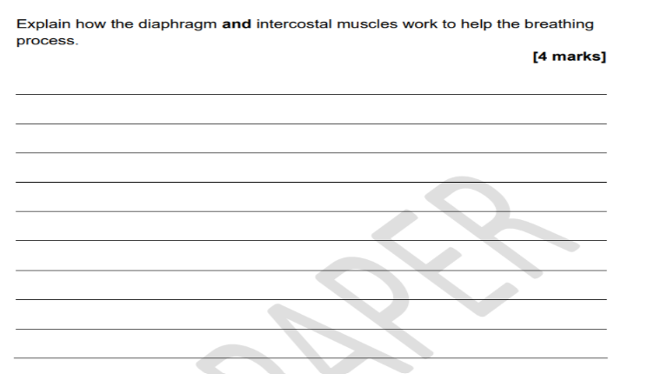
During inhalation, the diaphragm contracts and flattens while the external intercostal muscles contract, pulling the ribs up and out. AO1 Knowledge (Mark 1)
This increases the volume of the thoracic cavity and decreases pressure in the lungs, causing air to be drawn into the lungs. AO2 Applying knowledge to the breathing process (Mark 2 )
During exhalation, the diaphragm relaxes and returns to its dome shape while the intercostal muscles relax, causing the ribs to move down and in. AO1 Knowledge (Mark 3)
This decreases the volume of the thoracic cavity and increases pressure in the lungs, forcing air out. AO2 Applying knowledge to the breathing process (Mark 4)

Slide 34
RESPIRATORY MEASUREMENTS
What happens to tidal volume? Increases.
Reason 1: To take in more oxygen for the working muscles.
Reason 2: To remove more carbon dioxide produced during exercise.

Slide 35
BLOOD VESSELS
PEAJ Structure
AO1 (Knowledge)
Arteries: thick walls, elastic, narrow lumen, carry blood away from heart.
Veins: thin walls, wide lumen, valves, carry blood back to the heart.
AO2 (Apply)
Arteries deliver oxygenated blood to working muscles to keep exercising for longer.
Veins return deoxygenated blood from working muscles.
AO3 (Impact)
More oxygen available for respiration and energy production.
Carbon dioxide removed efficiently.
Delays fatigue and improves performance.

Slide 36
Outline the vascular shunt process. [2]
The vascular shunt process is the redistribution of blood flow during exercise (AO1).
Blood is diverted away from less active areas, such as the digestive system, and directed towards the working muscles through vasodilation of blood vessels supplying the muscles and vasoconstriction of blood vessels supplying inactive areas (AO1).

Slide 37
Give two ways that the vascular shunt process helps an individual doing health and fitness activities. [2]
1. More oxygen and nutrients are delivered to the working muscles.
2. Carbon dioxide and other waste products are removed more efficiently from the muscles.

Slide 38
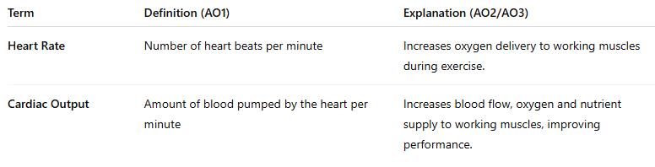
CARDIOVASCULAR MEASUREMENTS

Slide 39
BLOOD PRESSURE
IDEAL BLOOD PRESSURE RANGE
90/60 mmHg - 120/80mmHg

Slide 40
Factors Affecting Blood Pressure
1. Physical Activity Levels
Lack of exercise can increase blood pressure as the heart becomes less efficient.
2. Diet
Saturated fats increase bad cholestrol hardens walls of arteries making it harder for blood to flow through.
3. Smoking
Nicotine causes blood vessels to narrow (vasoconstriction), increasing blood pressure.
4. Alcohol Consumption
5. Stress / Anxiety
Stress hormones cause blood vessels to constrict, leading to higher blood pressure.
6. Age
Blood pressure often increases with age because arteries become less elastic.

Slide 41
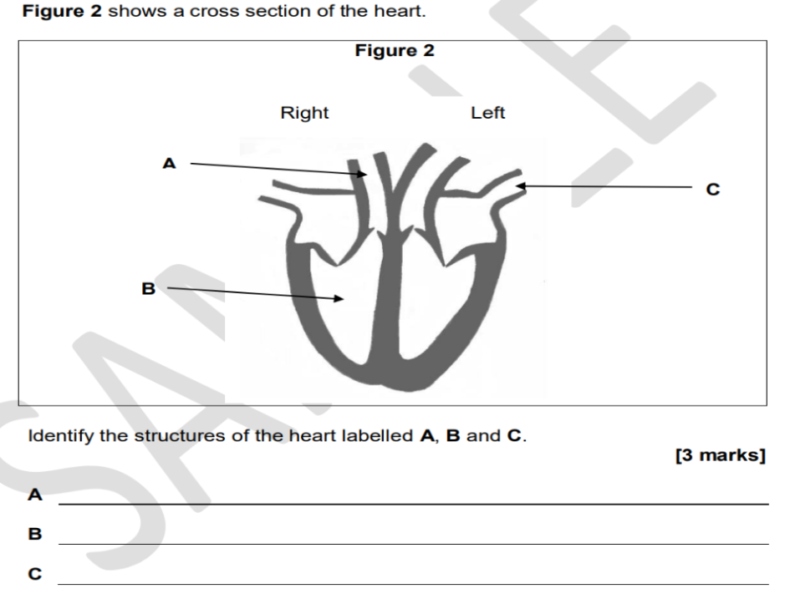
Structure of the Heart

Slide 42
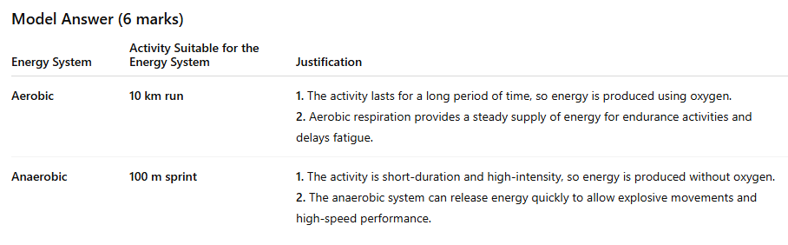
Energy Systems
Longer than
1 min
Less than
1 min

Slide 43
Energy Systems
Model Answer (3 marks)
Energy system:
Aerobic energy system
Justification:
An 800 m swim is a relatively long-duration activity lasting longere than 1 minute, so the body mainly uses the aerobic energy system. The aerobic system uses oxygen to release energy and can provide a steady supply of energy for the performer to continue exercising. This helps the swimmer maintain performance for the whole distance and delays fatigue.

Slide 44
SHORT TERM EFFECTS OF EXERCISE
Breathing rate
Short-term effect: Increases
Why: To take in more oxygen and remove more carbon dioxide.
Hydration levels
Short-term effect: Decrease
Why: Water is lost through sweating during exercise.

Slide 45
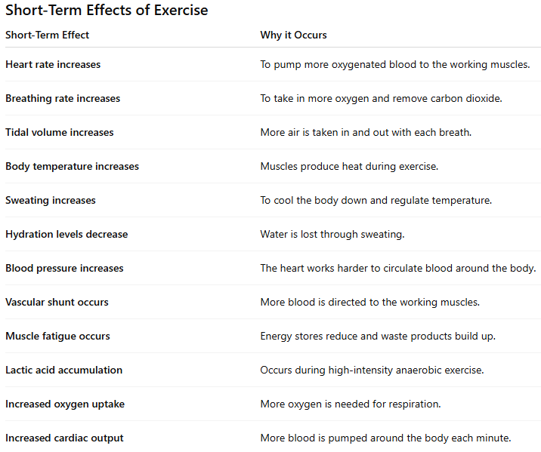
SHORT TERM EFFECTS OF EXERCISE

Slide 46
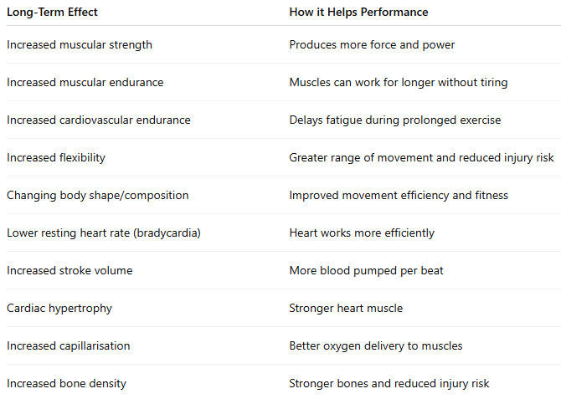
LONG TERM EFFECTS OF EXERCISE

Slide 47
BODY SHAPE
AO1: Identify the body type characteristics.
Ectomorph = slim, light frame.
Mesomorph = muscular, athletic build.
AO2: Apply to an activity.
Ectomorph → marathon.
Mesomorph → weight training.
AO3: Explain why the body type helps performance.
Ectomorph → efficient for endurance.
Mesomorph → strength and power advantages.

Slide 48
HEALTH RELATED COMPONENTS OF FITNESS (5)
Cardiovascular Endurance
Muscular Endurance
Muscular Strength
Flexibility
Body Composition

Slide 49
SKILL RELATED COMPONENTS OF FITNESS (6)
Agility
Balance
Co-ordination
Speed
Power
Reaction Time

Slide 50
COMPONENTS OF FITNESS
Balance
Definition: Keeping your body steady and upright during movement or while holding a position.
Example activity: A gymnast holding a handstand needs good balance to stay stable and avoid falling.
Agility
Definition: The ability to change direction quickly and under control while maintaining speed.
Example activity: Weaving in and out of cones during an agility test or changing direction quickly in football.
Body composition: The proportion of fat, muscle, bone and other tissues that make up an individual's body weight.

Slide 51
COMPONENTS OF FITNESS
Definition of Muscular Endurance
The ability of a muscle or muscle group to work repeatedly without tiring.
Example: Completing a long-distance cycle ride or performing lots of press-ups.
Definition of Speed
The ability to move all or part of the body as quickly as possible.
Example: Sprinting in a 100m race.
Definition of Reaction Time
The time taken to respond to a stimulus.
Example: A sprinter reacting to the starting gun or a goalkeeper reacting to a shot.

Slide 52
COMPONENTS OF FITNESS
Definition of Muscular Endurance
The ability of a muscle or muscle group to work repeatedly without tiring.
Example: Completing a long-distance cycle ride or performing lots of press-ups.
Definition of Speed
The ability to move all or part of the body as quickly as possible.
Example: Sprinting in a 100m race.
Definition of Reaction Time
The time taken to respond to a stimulus.
Example: A sprinter reacting to the starting gun or a goalkeeper reacting to a shot.
Definition of Power
The ability to exert a maximal force in the shortest possible time.
Example: A vertical jump, long jump or shot put.

Slide 53
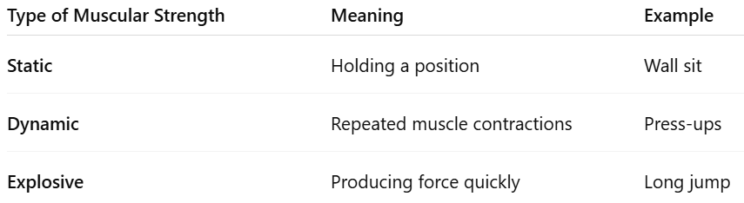
COMPONENTS OF FITNESS
Definition of Muscular Strength
The ability of a muscle or muscle group to exert a force against a resistance.

Slide 54
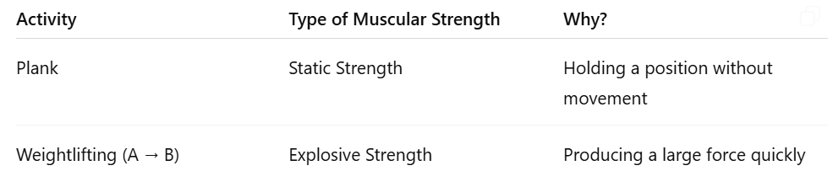
MUSCULAR STRENGTH

Slide 55
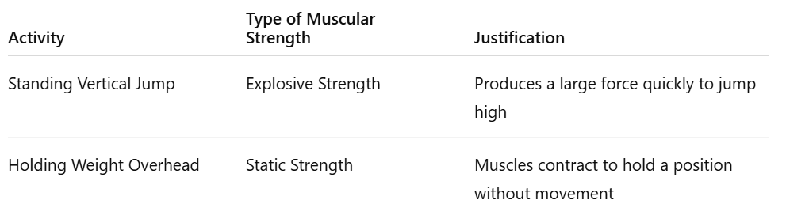
MUSCULAR STRENGTH

Slide 56
Components of Fitness
AO1 = Identify the component and give knowledge.
AO2 = Apply it to a triathlon.
AO3 = Explain the impact/benefit on performance.

Slide 57
Model Answer (Cardiovascular Endurance)
Cardiovascular endurance is the ability of the heart and lungs to supply oxygen to the working muscles for a prolonged period of time (AO1).
In a triathlon, the performer must swim, cycle and run continuously over a long distance (AO2).
Good cardiovascular endurance allows them to maintain their performance for longer and delay fatigue, helping them complete the event more efficiently (AO3).

Slide 58
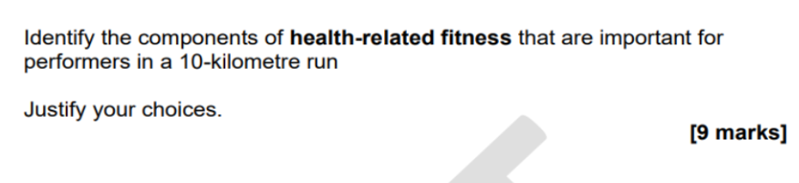
Components of Fitness (9 MARKER)

Slide 59
Components of Fitness (9 MARKER)
For a 9-mark NCFE style question, you should aim for 3 components and do the following for each:
AO1 = Define the component.
AO2 = Apply it to a 10 km run.
AO3 = Explain the impact on performance.

Slide 60
Model Answer (9 MARKER)
Cardiovascular endurance is the ability of the heart and lungs to supply oxygen to the working muscles for a prolonged period of time (AO1). During a 10 km run, the performer must exercise continuously for an extended period (AO2). Good cardiovascular endurance allows more oxygen to reach the muscles, helping the runner maintain their pace and delay fatigue throughout the race (AO3). 3 MARKS
Muscular endurance is the ability of a muscle or muscle group to repeatedly contract without tiring (AO1). In a 10 km run, the leg muscles must work continuously to produce movement over the whole distance (AO2). High levels of muscular endurance help the runner maintain efficient technique and reduce the likelihood of muscle fatigue affecting performance (AO3). 3 MARKS
Body composition is the proportion of body weight made up of fat, muscle, bone and other tissues (AO1). A 10 km runner generally benefits from a healthy body composition with lower levels of excess body fat (AO2). Carrying less non-functional weight means less energy is needed during the run, which can improve running efficiency and overall performance (AO3). 3 MARKS
Overall, cardiovascular endurance is likely to be the most important component because a 10 km run is a long-duration
aerobic event that requires a continuous supply of oxygen to the working muscles. (AO3 evaluation)

Slide 61
Model Answer (9 MARKER)
Cardiovascular endurance is the ability of the heart and lungs to supply oxygen to the working muscles for a prolonged period of time (AO1). During a 10 km run, the performer must exercise continuously for an extended period (AO2). Good cardiovascular endurance allows more oxygen to reach the muscles, helping the runner maintain their pace and delay fatigue throughout the race (AO3). 3 MARKS
Muscular endurance is the ability of a muscle or muscle group to repeatedly contract without tiring (AO1). In a 10 km run, the leg muscles must work continuously to produce movement over the whole distance (AO2). High levels of muscular endurance help the runner maintain efficient technique and reduce the likelihood of muscle fatigue affecting performance (AO3). 3 MARKS
Body composition is the proportion of body weight made up of fat, muscle, bone and other tissues (AO1). A 10 km runner generally benefits from a healthy body composition with lower levels of excess body fat (AO2). Carrying less non-functional weight means less energy is needed during the run, which can improve running efficiency and overall performance (AO3). 3 MARKS
Overall, cardiovascular endurance is likely to be the most important component because a 10 km run is a long-duration
aerobic event that requires a continuous supply of oxygen to the working muscles. (AO3 evaluation)

Slide 62
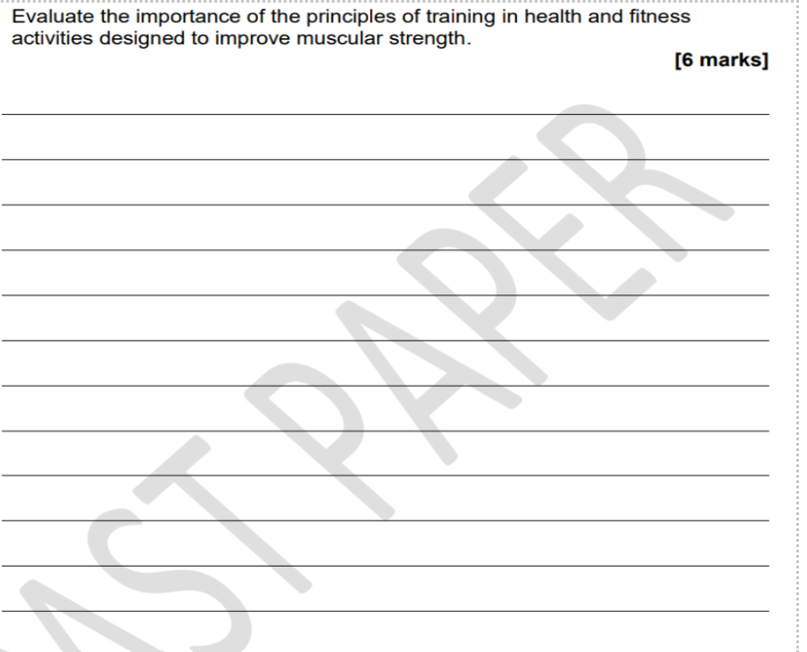
PRINCIPLES OF TRAINING (SPORT)
S
P
O
R
T

Slide 63
PRINCIPLES OF TRAINING (6 Mark Question)
Choose 2-3 principles of training and do the following for each
AO1: Knowledge of principles (specificity, progression, overload, reversibility, tedium)
AO2: Applied to improving muscular strength
AO3: Evaluation of why they are important and which are most important

Slide 64
PRINCIPLES OF TRAINING (6 Mark Question)
AO Breakdown
Principle 1: Specificity
AO1: One key principle is specificity. This means training should match the fitness component being improved. (Mark 1)
AO2: For example to improve muscular strength, an individual should use methods such as weight training with heavy loads and low repetitions. (Mark 2)
AO3: This helps the muscles adapt and become stronger. (Mark 3)

Slide 65
PRINCIPLES OF TRAINING (6 Mark Question)
AO Breakdown
Principle 2: Overload
AO1: Another important principle is overload. The muscles must be worked harder than normal to make improvements. (Mark 1)
AO2: For example, the performer could gradually increase the weight being lifted. (Mark 2)
AO3: Without overload, the muscles would not be challenged enough and strength gains would stop. (Mark 3)

Slide 66
PRINCIPLES OF TRAINING (SPORT)
Conclusion
Overall, the most important principles for improving muscular strength are specificity and overload because they directly ensure the muscles are trained in the correct way and are challenged enough to become stronger.

Slide 67
PRINCIPLES OF TRAINING: Model 6-Mark Response
The principles of training are very important when designing a programme to improve muscular strength.
Progression is also important because overload should be increased gradually over time. If the weight is increased too quickly, there is a greater risk of injury. Gradual progression allows the performer to continue improving safely.
Tedium should also be considered. Repeating the same exercises every session may lead to boredom and reduced motivation. Varying exercises, equipment or training methods can help keep the performer engaged and more likely to continue training.

Slide 68
PRINCIPLES OF OVERLOAD: FITT
Frequency: How often an individual trains (e.g. number of sessions per week). AO1
Intensity: How hard an individual trains (e.g. percentage of maximum heart rate or amount of weight lifted). AO1
Time: The duration of each training session. AO1
Type: The method or activity used during training that matches the fitness goal. AO1
.

Slide 69
Jacob can currently run 1 mile in 10 minutes.
Explain how Jacob could use the FITT principles to try and run 1 mile in a quicker time. [6 marks]
Frequency: Jacob could increase the number of running sessions he completes each week, for example from 2 sessions to 4 sessions. This would provide more training opportunities to improve his fitness. AO1 & AO2 (2 Marks)
Intensity: Jacob could run at a faster pace or include interval training with sprint efforts. This would challenge his cardiovascular system and help improve his running speed. AO1 & AO2 (2 Marks)
Time: Jacob could gradually increase the duration of some training sessions. This would improve his cardiovascular endurance and help him maintain a faster pace for longer. AO1 & AO2 (2 Marks)
Type: Jacob should use running-based training methods such as interval training, continuous training or fartlek training. These are specific to running and will help improve his mile time. AO1 & AO2 (2 Marks)

Slide 70
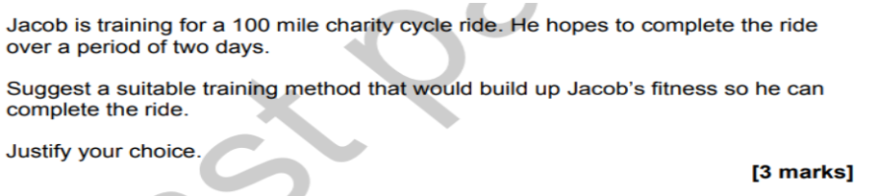
METHODS OF TRAINING
Model Answer [3 Marks]
Training method: Continuous training AO1 (Mark 1)
Justification: Continuous training involves exercising at a steady intensity for a prolonged period of time without rest. This would improve Jacob's cardiovascular endurance, which is important for completing a 100-mile cycle ride. It would also help his body become more efficient at using oxygen and delay fatigue during the two-day event. AO2 & AO3 (Mark 2 & 3)

Slide 71
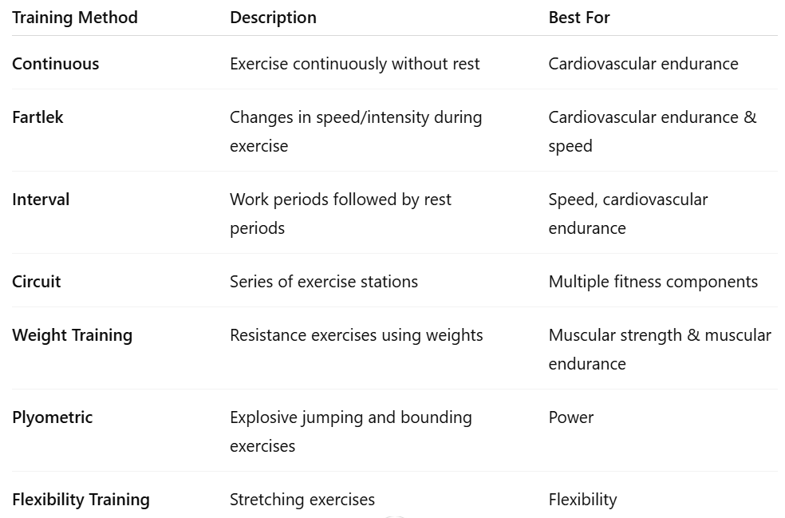
METHODS OF TRAINING

Slide 72
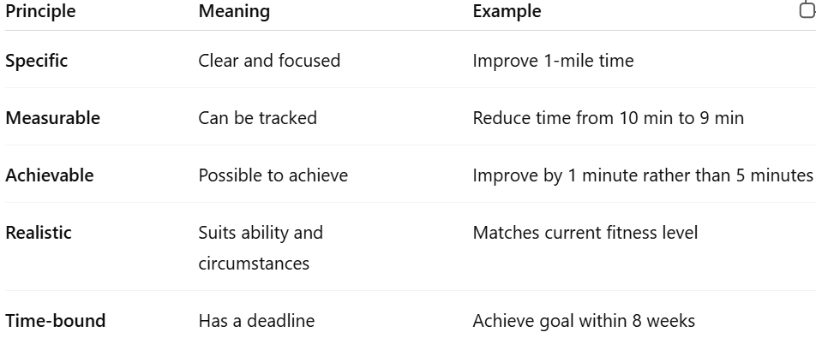
SMART TARGETS

Slide 73
When setting goals, it is important that they are realistic.
State two other principles of goal setting and explain how an individual could apply these to a health and fitness goal. [4 marks]
Specific
A goal should clearly state what the individual wants to achieve. For example, "Improve my 1-mile run time from 10 minutes to 9 minutes."
Measurable
The goal should be able to be tracked. For example, the individual could record their mile time each week to monitor improvement.

Slide 74
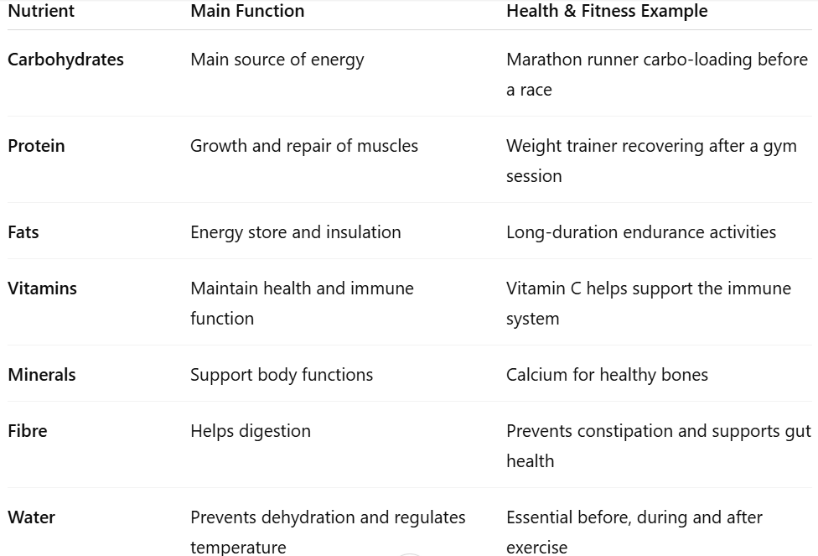
NUTRITION
Increase glycogen stores = more energy

Slide 75
NUTRITION
Key nutrient: Carbohydrates
Justification: Carbohydrates are the body's main source of energy during exercise. In the week before a marathon, Chloe can increase her glycogen stores by consuming more carbohydrates. This will provide energy for the muscles during the race and help delay fatigue, allowing her to maintain her pace for longer.

Slide 76
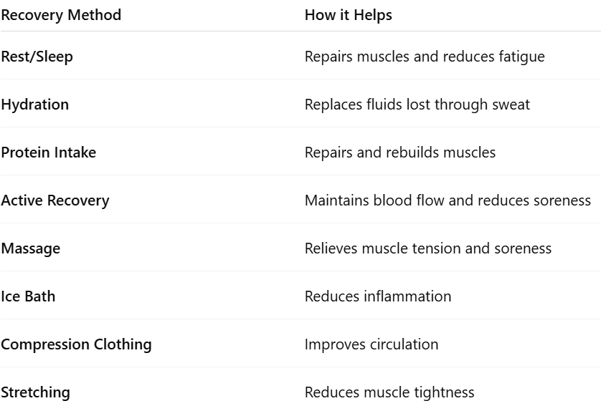
REST & RECOVERY

Slide 77
REST & RECOVERY
Model Answer [4 Marks]
Way 1: Rest / Sleep
Explanation
Sleep allows the body to repair damaged muscle tissue and recover from the physical demands of the marathon. It also helps reduce fatigue and prepares the body for future exercise. (2 Marks)
Way 2: Hydration
Explanation
Drinking water replaces fluids lost through sweating during the marathon. This helps prevent dehydration and allows the body to function normally during recovery. (2 Marks)

Slide 78
NEGATIVE LIFESTYLE FACTORS
Alternative Lifestyle Factors from the NCFE Specification
Smoking
Drug use / PEDs
Sleep
Stress
Sedentary lifestyle / lack of physical activity
Diet (given in question)
Alcohol

Slide 79
NEGATIVE LIFESTYLE FACTORS
Model Answer [6 Marks]
Lifestyle Factor 1: Smoking
Explanation
Smoking reduces the amount of oxygen that can be transported around the body. This can lower cardiovascular endurance and cause an individual to fatigue more quickly during exercise.
Lifestyle Factor 2: Drug Use / PEDs (Performance Enhancing Drugs)
Explanation
Drug use can have serious negative health effects such as heart problems, high blood pressure and injury risk. It may also result in bans from competition, preventing participation in health and fitness activities.
Lifestyle Factor 3: Lack of Sleep
Explanation
Insufficient sleep can reduce concentration, reaction time and recovery. This can lead to poorer performance and increase the risk of injury during exercise.

Slide 80
Explain how drinking alcohol could negatively affect performance in health and fitness activities. [2 Marks]
Alcohol can cause dehydration, which may reduce performance during exercise. It can also slow reaction time and impair balance and coordination, making it more difficult to perform skills effectively and safely.

Slide 81
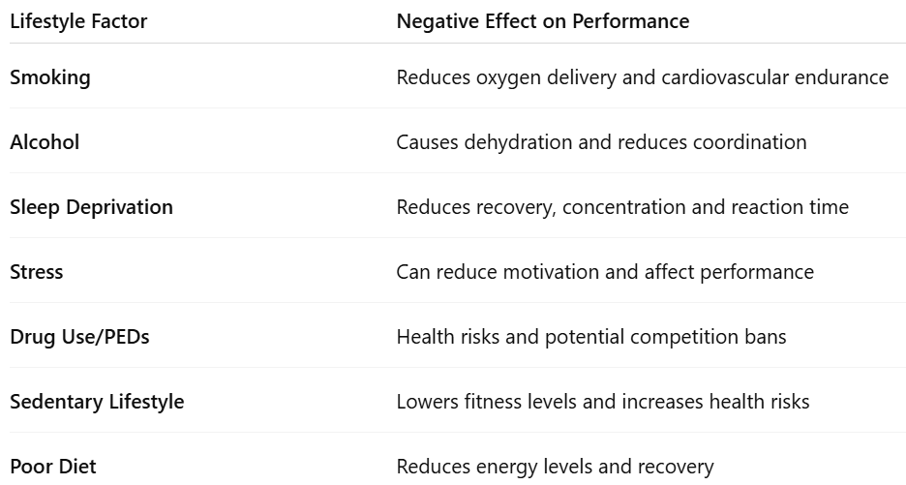
NEGATIVE LIFESTYLE FACTORS

Slide 82
Give three reasons why an individual would keep a food diary when they are completing a health and fitness programme. [3 marks]
Model Answers
To monitor the types of food and drink consumed.
To identify unhealthy eating habits that may need improving.
To check whether their diet supports their health and fitness goals.
Other Acceptable Answers
Track calorie intake.
Monitor nutrient intake.
Identify skipped meals.
Monitor hydration levels.
Help plan dietary improvements.
Measure progress towards goals.

Slide 83
WARM UP & COOL DOWN
Model Answers [2 Marks Each]
Warm-Up
Phase: Pulse raiser
Practical example: Light jogging around the training area.
Cool-Down
Phase: Stretching
Practical example: Holding a hamstring stretch for 15–30 seconds.

Slide 84
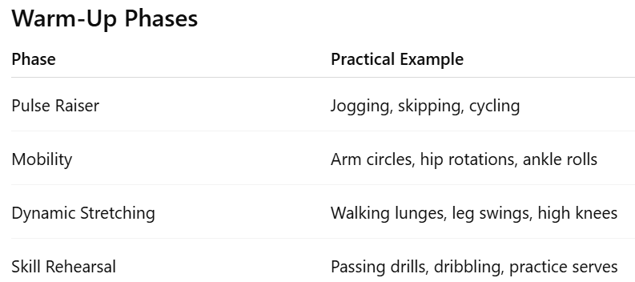
WARM UP & COOL DOWN

Slide 85
HEALTH & SAFTEY CONSIDERATIONS
Model Answer [4 Marks]
Health and Safety Consideration 1:Warm-up and cool-down
Explanation: Lily should include a warm-up before training and a cool-down afterwards. This will prepare the muscles for exercise and help reduce the risk of injury when lifting weights.
Health and Safety Consideration 2: Correct lifting technique
Explanation: Lily should ensure the client uses the correct technique when performing exercises. This will help reduce the risk of strains or injuries and allow the exercises to be completed safely.

Slide 86
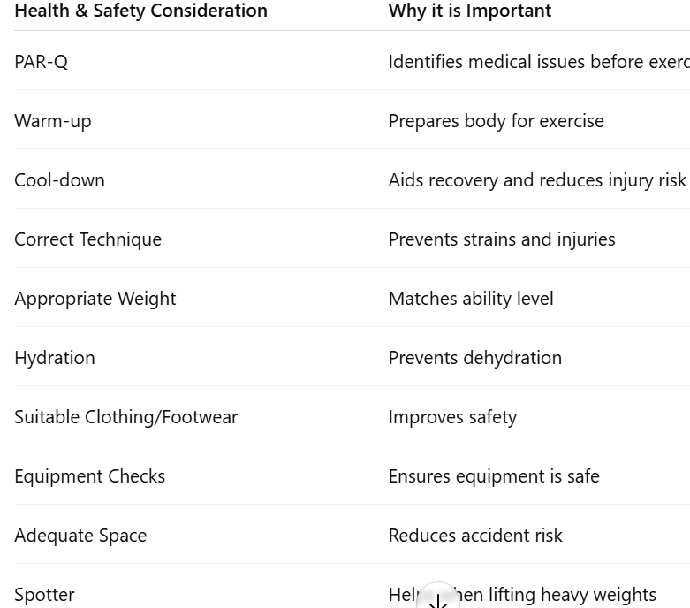
HEALTH & SAFTEY CONSIDERATIONS

Slide 87
NUTRIENT: PROTEIN
Model Answer [3 Marks]
A high-protein diet is important for Lily's client because she wants to increase her muscular strength.
Protein helps to repair and rebuild muscle tissue after training.
This supports muscle growth and recovery, allowing the client to train consistently and become stronger over time.

Slide 88
Key terms and words - GCSE P.E Team Challenge
State the three types of muscle? | State two immediate short term effects of exercise on the respiratory system? | State 5 muscles in the body? | What is the equation for aerobic respiration? | Describe what is meant by vascular shunting?
What is an antagonistic pair? | Describe the function of intercostal muscles during exhalation? | Give examples of isotonic contractions in sport? | What happens to the ribs during exhalation? | Describe the differences between vasodilation and vasoconstriction?
What does isometric contraction mean? | Define gaseous exchange? | What are the two types of muscle fibres? | Define diffusion? | What is the equation for anaerobic respiration?
State the characteristics of type 2 muscle fibre types? | What is tidal volume? | State the two muscles that flex the elbow and knee? | What is residual volume? | List the cardiac cycle in the correct order starting with the vena cava?
State the two muscles that extend the elbow and knee? | Which fitness test measures reaction time? | Which test measures power? | Which test measures body composition? | What is the equation to work out an persons maximum heart rate?

