Slide 1

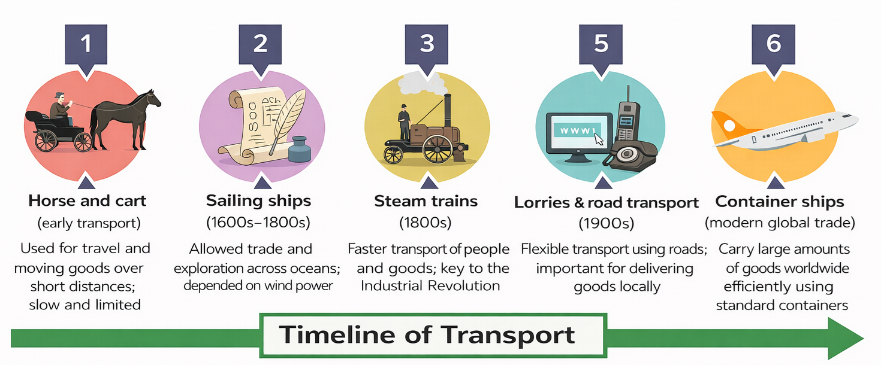
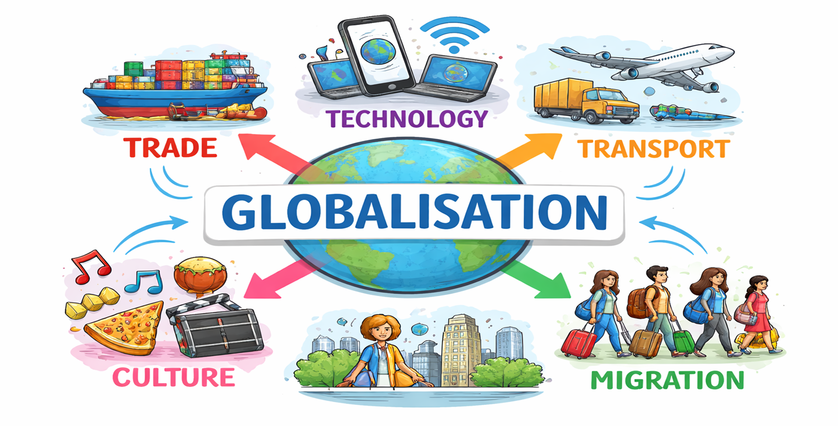
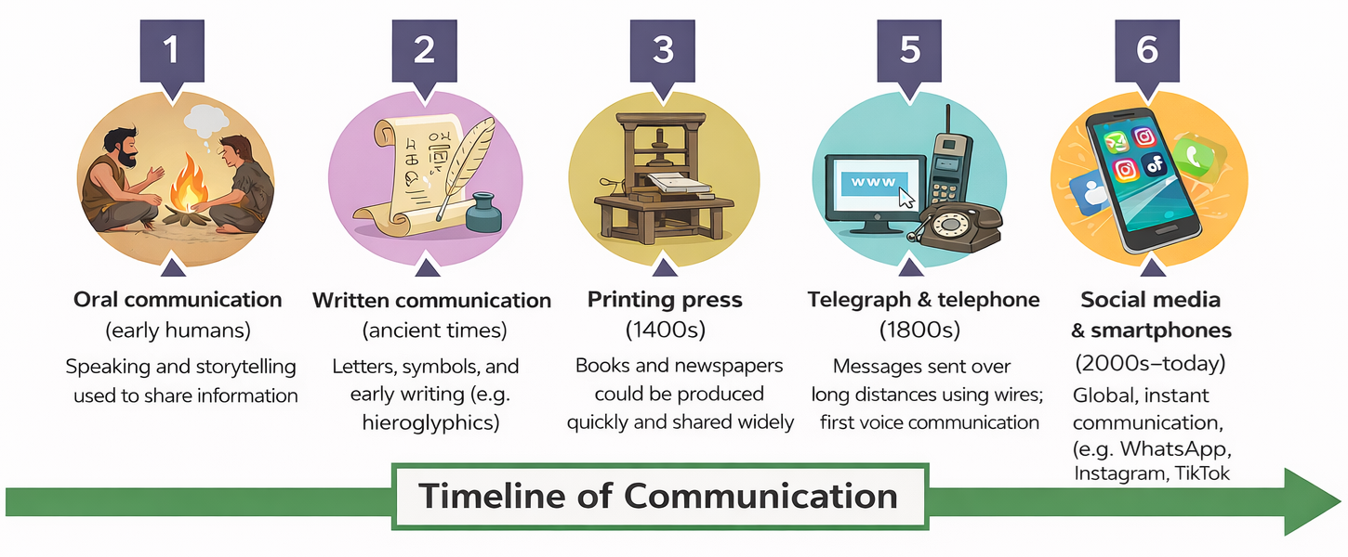
Big question: Are cheap goods worth the cost?
Year 9: Topic three – Globalisation
Knowledge Organiser
Key idea 1: What is Globalisation?
Globalisation is the process by which the world is becoming increasingly interconnected through trade, communication, the movement of people, and the exchange of ideas. It involves different types of flows, including people (migration and tourism), money (investment and remittances), products (trade and supply chains), and ideas (technology, media, and the internet). As a result, countries are becoming more interdependent, meaning they rely on each other for resources, goods, and services.
A key example of globalisation is the production of smartphones. Smartphones are made through a global supply chain, which involves several stages across different countries. First, raw materials such as cobalt from the Democratic Republic of Congo and lithium from Chile are mined. These materials are then transported to other countries where components are manufactured, such as microchips in Taiwan or South Korea and screens in China. The design and software are often created in high-income countries like the USA or parts of Europe, showing the global movement of ideas and technology. The phones are then assembled in countries such as China or Vietnam, where workers are employed in factories. Finally, the finished products are transported by ships, planes, and lorries to be sold around the world, including in the UK. Smartphones also help spread globalisation because they allow people to communicate instantly and share ideas across the world.
Transnational corporations (TNCs) play an important role in globalisation because they organise production across multiple countries, invest money into factories, and manage the global movement of goods. This shows how money flows between countries and how businesses operate on a global scale.
Globalisation has both advantages and disadvantages. On the one hand, it can create jobs, increase economic growth, and make products cheaper and more accessible. It also improves communication and helps countries become more connected. On the other hand, the benefits are not shared equally. Workers in poorer countries may experience low wages, long hours, and unsafe working conditions, while environmental damage can occur due to activities such as mining. In many cases, large companies and richer countries gain the most profit, which can increase inequality.
Globalisation is not always completely positive or negative. It brings many benefits, such as economic opportunities and global connections, but it also creates challenges, particularly for poorer countries. Therefore, globalisation has both costs and benefits, and its impacts are uneven across the world.
Global flows include:
People → migration, tourism
Money → investment, remittances
Products → trade, supply chains
Ideas → technology, media, internet
📱 Example: Smartphone Supply Chain
A smartphone is a clear example of globalisation because it is made across many different countries.
Stages of production:
1) Raw materials:
  Cobalt → DR Congo
  Lithium → Chile
  2) Manufacturing parts:
  Microchips → Taiwan / South Korea
  Screens → China
  Design → USA / Europe
  3) Assembly & transport:
  Assembled in China / Vietnam
  Transported by ships, planes, lorries
4) Sale & use:
  Sold globally (e.g. UK)
  Used for communication and sharing ideas
Helpful revision - KS3 Geography - BBC Bitesize

Slide 2
Big question: Are cheap goods worth the cost?
Year 9: Topic three – Globalisation
Knowledge Organiser
Key idea 2: Why do TNC’s operate in LIC’s/NEE’s?
A Transnational Corporation (TNC) is a large company that operates in more than one country. Many TNCs choose to produce goods overseas, particularly in Low-Income Countries (LICs) and Newly Emerging Economies (NEEs), because it helps them reduce costs and increase profits.
This process is known as outsourcing, where companies move production to another country to make goods more cheaply.
Main Reasons TNCs Locate in LICs/NEEs
TNCs choose to locate in LICs and NEEs because they can reduce costs and increase profits by taking advantage of economic differences between countries. One of the main reasons is low wages. In many LICs and NEEs, workers are paid significantly less than in high-income countries such as the UK. In some cases, workers may earn only a few pounds per day. This allows companies to lower their production costs, sell goods at cheaper prices, and increase their overall profits. This is often possible because workers may have fewer rights and less protection.
Another important reason is weaker regulations. In some countries, laws relating to health and safety, working conditions, and environmental protection are less strict or not strongly enforced. This means companies can spend less money following rules, making production cheaper and faster. However, this can result in unsafe working environments and environmental damage.
Tax incentives also play a key role in attracting TNCs. Governments in LICs and NEEs may offer lower taxes, tax holidays, or financial support to encourage companies to invest. This reduces business costs and makes these countries more attractive locations for global companies.
In addition, overall production costs are lower in these countries. Not only are wages cheaper, but land, raw materials, energy, and transport can also be less expensive. This makes it easier for companies to produce goods on a large scale at a lower cost.
Advantages | Disadvantages
TNCs create jobs and reduce unemployment, providing income for local people. | Workers are often paid very low wages compared to those in high-income countries.
Wages, although low, can improve living standards compared to previous conditions. | Working conditions can be poor, with long hours and unsafe environments.
TNCs encourage economic growth by increasing GDP, boosting exports, and developing industries. | Environmental damage can occur, including pollution and deforestation.
Investment from TNCs can improve infrastructure such as roads, ports, and factories. | Environmental laws may be weak or not enforced, making damage worse.
TNCs bring new skills, technology, and training to the workforce. | Profits are often sent back to headquarters in high-income countries.
Can increase global connections and development opportunities. | Host countries may not benefit as much as expected due to profit loss.
Other Factors Influencing Location: TNCs do not only consider costs; they are also influenced by political and social factors. Political stability is important because companies are more likely to invest in countries where governments are stable and predictable. Many LICs and NEEs also have pro-business policies that make it easier to set up factories and trade internationally. Governments often encourage foreign investment because it creates jobs and helps economic growth.
Social factors are also important. Many LICs and NEEs have large populations, which provide a ready supply of workers. This often includes a young workforce willing to work for lower wages due to limited job opportunities. However, workers in these countries may have fewer rights, less job security, and poorer working conditions compared to those in high-income countries.
Example (Bangladesh / India): For example, a clothing company may choose Bangladesh because wages are much lower than in the UK. This means the company can produce clothes more cheaply and make higher profits. However, workers may experience low pay and difficult working conditions.
Helpful revision - KS3 Geography - BBC Bitesize

Slide 3
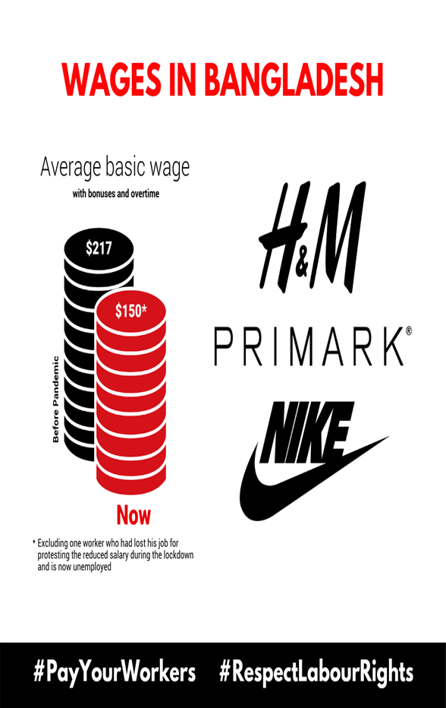
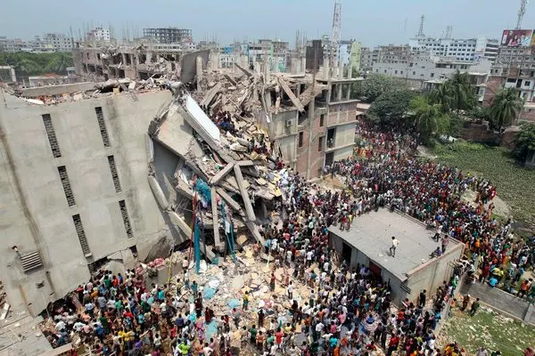
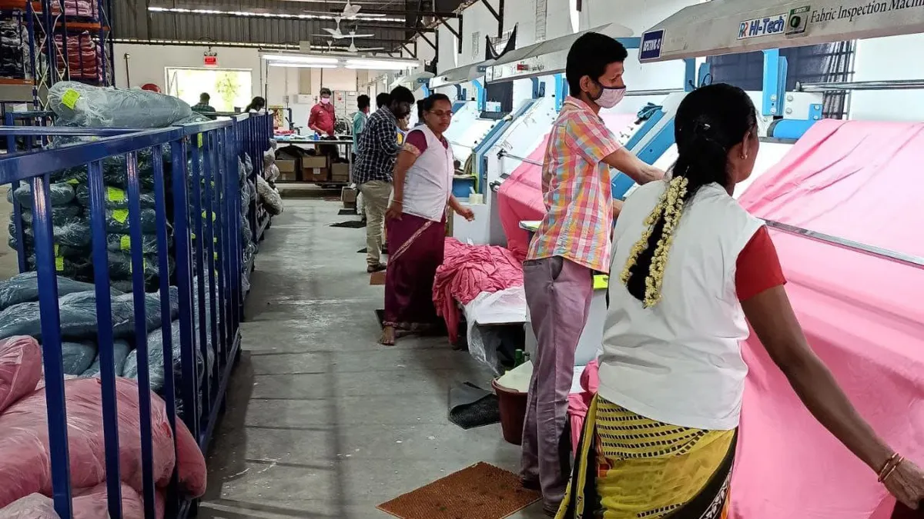
Big question: Are cheap goods worth the cost?
Year 9: Topic three – Globalisation
Knowledge Organiser
Key idea 3: How has globalisation changed working conditions?
How has globalisation affected working conditions in LICs/NEEs?
Globalisation has led to major changes in working conditions in LICs and NEEs, particularly in factories producing goods for global companies.
While it has created jobs and opportunities, it has also led to concerns about exploitation, especially in sweatshops where workers face long hours, low pay, and unsafe environments.
Many workers have limited labour rights, meaning they have little power to challenge unfair treatment.
As a result, working conditions can be poor, and wages are often too low to significantly improve quality of life.
Case Study: Rana Plaza, Bangladesh (2013)
The Rana Plaza disaster is one of the most important examples of Low wages how globalisation can negatively affect working conditions in LICs.
Rana Plaza was a factory building located in Savar, near Dhaka (Bangladesh).
On 24th April 2013, the building collapsed, killing over 1,100 workers and injuring thousands more.
The factories inside the building produced clothing for international brands, showing how global supply chains are linked to working conditions in poorer countries.
Working conditions before the collapse
Workers in Rana Plaza faced extremely poor conditions:
They were paid very low wages
Many worked 10–12 hours per day, sometimes longer
Factories were hot, crowded, and noisy
Workers often had few breaks
The building was not designed to hold heavy machinery
Despite these conditions, workers continued because they needed the income to support their families.
Why the Disaster Happened
The collapse was largely preventable and highlights exploitation:
Large cracks appeared in the building the day before
Workers were aware the building was unsafe
Many workers did not want to return to work
However, they were:
Forced to return
Threatened with losing pay or their jobs
This shows a lack of labour rights and worker protection.
This shows how consumer demand in richer countries can lead to exploitation in poorer countries.
Why Workers Stayed
Workers continued working in dangerous conditions because:
They needed money to survive and support families
There were few alternative jobs
They feared losing income
Poverty limited their choices
Impacts of Globalisation on Working Conditions
Advantages | Disadvantages
Provides jobs for people who may otherwise be unemployed. | Low wages mean workers may still struggle to meet basic needs.
Regular income can improve living standards and support families. | Long working hours (often 10 -12 hours per day).
Some workers gain skills and experience that may help future employment. | Poor and unsafe working conditions (e.g. overcrowded, hot factories).
Opportunities for independence and urban employment. | Weak labour rights mean workers cannot easily complain or refuse work.
In some cases, factories provide accommodation or benefits. | Workers may be forced to work or threatened with losing their jobs.
Helpful revision - KS3 Geography - BBC Bitesize

Slide 4



Big question: Are cheap goods worth the cost?
Year 9: Topic three – Globalisation
Knowledge Organiser
Key idea 4: What are the benefits and costs of TNC’s?
Case Study: TNCs in India (Unilever, BT, Coca-Cola)
India has attracted many TNCs due to its large population, growing economy, and availability of labour. Companies such as Unilever, BT, and Coca-Cola operate in India and show both the benefits and costs of globalisation.
Benefit | Explanation + Example
Employment | TNCs create jobs in factories and offices. For example, Unilever employs thousands of workers in India producing goods such as soap, shampoo, and food products.
Economic growth | Increased production and exports boost GDP. For example, Coca-Cola operates bottling plants across India, increasing industrial output and trade.
Investment | TNCs bring money into the country. For example, BT (British Telecom) invests in India’s telecommunications sector, supporting business growth and connectivity.
Coast | Explanation + Example
Pollution | Factories and transport increase pollution. For example, Coca-Cola has been criticised for water pollution and overuse of local water supplies.
Low wages | Workers may be paid low wages compared to HIC standards, especially in manufacturing jobs.
Poor working conditions | Some jobs involve long hours and unsafe conditions, particularly in factories supplying global brands.
Profit leaving the country | TNCs often send profits back to their headquarters (e.g. UK or USA), meaning less money stays in India.
Company | Type of Industry | What they do in India | Benefits (Advantages) | Costs (Disadvantages) | Overall Impact
Unilever | Manufacturing (consumer goods) | Produces products such as soap, shampoo, and food in factories across India. | Creates thousands of jobs in factories and offices. Provides regular income for workers. Boosts local economy through spending (multiplier effect). Develops skills in manufacturing and business. | Wages may still be low compared to HICs. Working conditions can be demanding. Profits often leave India and go to headquarters. | Strong economic benefits through employment but limited long-term gain if profits leave the country.
BT (British Telecom) | Services (technology & communications) | Provides IT services, telecommunications, and customer support centres. | Creates skilled jobs (e.g. IT, call centres). Improves digital infrastructure. Supports India’s growth in the service sector. Develops advanced skills and training. | Jobs mainly located in cities → increases regional inequality. Not accessible to low-skilled workers. Profits sent back to the UK. | High-skilled development and modernisation, but benefits are unevenly distributed.
Coca-Cola | Manufacturing (food & drink) | Operates bottling plants producing soft drinks across India. | Creates jobs in factories and transport. Increases industrial output and trade. Contributes to economic growth. Supports local supply chains. | Uses large amounts of water → shortages in local areas. Pollution from factories. Environmental damage (e.g. groundwater depletion). Community conflict over resources. | Significant economic benefits but major environmental and social costs.
Helpful revision - KS3 Geography - BBC Bitesize

Slide 5
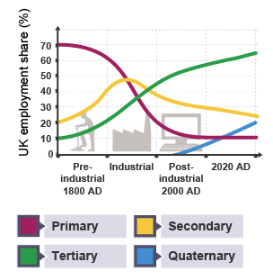
Big question: Are cheap goods worth the cost?
Year 9: Topic three – Globalisation
Knowledge Organiser
Key idea 5: How has globalisation effect the UK economy?
Globalisation has significantly changed the UK economy over time. In the past, the UK relied heavily on primary and secondary industries such as farming, coal mining, and steel production. However, due to globalisation, the UK has experienced deindustrialisation, where manufacturing industries have declined as factories moved overseas to countries with cheaper labour.
As a result, the UK has shifted to a post-industrial economy, which is now dominated by the tertiary (services) and quaternary (knowledge-based) sectors.
Primary & Secondary (Declining Sectors) | Tertiary & Quaternary (Growing Sectors)
Primary sector (farming, fishing, mining) has declined significantly over time. Around 70% of people worked in this sector in 1800, but by 2020 it had fallen to around 1–2%. This decline is due to mechanisation, cheaper imports, and technological improvements reducing the need for labour. | Tertiary sector (services) has grown rapidly and now dominates the UK economy. By 2020, around 75–80% of people were employed in services such as retail, healthcare, education, and finance. This growth is due to rising incomes, increased demand for services, and globalisation.
Secondary sector (manufacturing) peaked during the Industrial Revolution, employing around 40–45% of the workforce in the early 1900s. However, since the 1970s–1980s, it has declined due to deindustrialisation, outsourcing to countries like China and India, and automation. This led to major job losses, especially in northern England. | Quaternary sector (knowledge-based industries) has grown since the late 20th century (2000 onwards). It includes IT, research, and innovation. These jobs require high skills and education, contribute significantly to economic growth, and are often located in cities such as London and Cambridge, increasing regional inequality.
Advantage | Explanation
Cheaper goods | Products can be manufactured overseas at lower costs and imported into the UK, meaning consumers pay less.
Greater choice | Global trade means people can access a wider range of goods and food all year round.
Growth of service industries | Jobs have increased in sectors such as banking, retail, education, and healthcare.
Foreign Direct Investment (FDI) | Investment from overseas companies helps develop infrastructure and create jobs (e.g. energy projects).
Economic growth in some areas | Cities like London have benefited from globalisation through finance and technology industries.
Disadvantage | Explanation
Deindustrialisation | Many factories have closed or moved abroad, leading to job losses in manufacturing.
Unemployment in some regions | Areas that relied on industry (e.g. the North) have experienced higher unemployment.
North–South divide | The South (especially London) has benefited more, while the North has seen slower growth.
Loss of traditional industries | Industries such as coal mining and steel production have declined.
Economic inequality | Not all regions or people benefit equally from globalisation.
Helpful revision - KS3 Geography - BBC Bitesize

Slide 6



Big question: Are cheap goods worth the cost?
Year 9: Topic three – Globalisation
Knowledge Organiser
Key idea 6: What are the alternatives to cheap goods?
Globalisation and Cheap Goods - Globalisation is the increasing connection between countries through trade and communication. This has led to companies producing goods overseas where labour is cheaper. As a result, many cheap goods are sold in the UK. However, these low prices often come at a cost, as workers in countries such as Bangladesh or Vietnam may be paid very low wages and work in poor or unsafe conditions, sometimes in sweatshops.
Problems with Cheap Goods - Cheap goods can cause several social and environmental problems. Workers in factories may face long hours, low pay, and unsafe conditions. In addition, transporting goods over long distances increases carbon emissions. This contributes to climate change and environmental damage, meaning cheap products can have hidden global impacts.
Alternatives to Cheap Goods - There are more sustainable alternatives available to consumers in the UK. Fairtrade products ensure farmers receive a fair price and better working conditions, helping to reduce poverty. Local produce is grown in the UK, which reduces food miles and lowers carbon emissions while supporting local farmers. Ethical brands focus on using sustainable materials, reducing waste, and treating workers fairly.
Benefits of Sustainable Choices - Sustainable consumer choices can improve both social and environmental outcomes. Fairtrade supports farmers and encourages sustainable farming, local produce reduces pollution from transport, and ethical brands reduce environmental damage. These choices help protect the planet and improve global working conditions.
Challenges and Trade-Offs - Despite these benefits, sustainable products are often more expensive than cheaper alternatives. During times of rising living costs, many consumers cannot afford these options. This creates a trade-off between affordability and sustainability, meaning people must choose between saving money and making ethical choices.
Are cheap goods worth the cost?
Introduction: Overall, I agree that cheap goods are worth the cost.
PEE Paragraph 1: One reason cheap goods are worth the cost is that they are affordable for consumers.
In the UK, many people buy cheap products from supermarkets and fast-fashion shops because they are low in price and easily available. This is important because families on low incomes need to buy essential items such as food and clothing at the lowest possible price. This leads to more people being able to afford basic everyday products. Therefore, cheap goods can be useful in the short term, especially during times of rising living costs.
PEE Paragraph 2: However, cheap goods may not be worth the cost because they can cause problems for workers. For example, many cheap goods are produced in countries where workers may be paid very low wages and work in poor or unsafe conditions. This matters because companies often try to reduce costs by using factories with weaker labour laws. This leads to exploitation and poor quality of life for workers in places such as Bangladesh or Vietnam. Therefore, the low price paid by consumers can hide a much higher human cost for the people making the goods.
PEE Paragraph 3: Cheap goods may also not be worth the cost because they damage the environment. For example, products made overseas are often transported long distances to the UK, which increases carbon emissions. This is significant because more transport means more pollution is released into the atmosphere. This leads to climate change and greater environmental damage over time. Therefore, although cheap goods save money at the checkout, they can create long-term costs for the planet.
Conclusion: In conclusion, I think that cheap goods are worth the cost only to a limited extent. They are helpful because they are affordable and allow people to buy the things they need. However, they often depend on low wages, unsafe working conditions, and long-distance transport that harms the environment. For this reason, I believe cheap goods are not truly worth the cost when the wider social and environmental impacts are considered.
Helpful revision - KS3 Geography - BBC Bitesize

