Slide 1
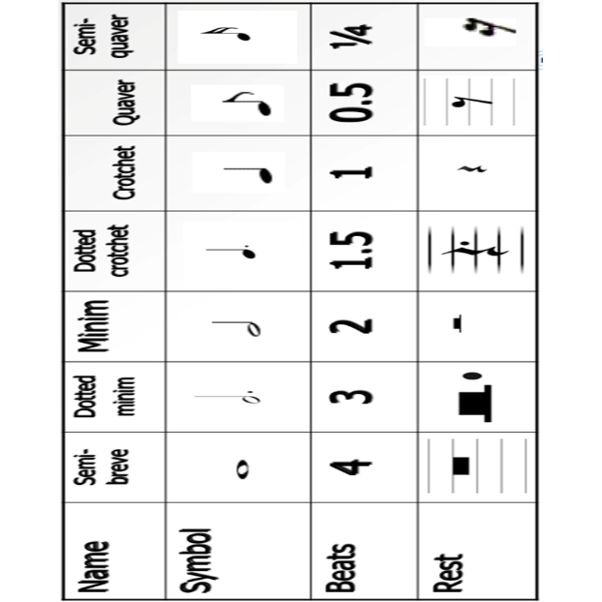

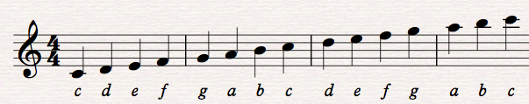
Foundation Vocabulary | Definition
Pitch | How high or low the notes are
Metre | The grouping of beats
Melody | Another name for the tune
Articulation | How smooth or detached the notes are
Attack and decay | How the notes begin, continue and end
Dynamics | How loud or soft the music is
Duration | How long or short the notes are
Tempo | How fast or slow the music is
Texture | The number of instruments/voices and how they are combined
Structure | How the music is put together
Harmony | When two or more notes are sounded at the same time
Instrumentation | The instruments or voices used
Rhythm | Patterns of long and short notes
Timbre | The tone quality of the music
Silence | When there is no music
MUSIC 9
Types of Texture:
Monophonic -one voice/instrument.
Homophonic – more than one voice/instrument, playing the same thing.
Polyphonic – more than one voice/instrument, playing different parts within the same piece: Melody and accompaniment – main tune and backing.
Contrapuntal – interweaving lines of music with equal importance.

Slide 2
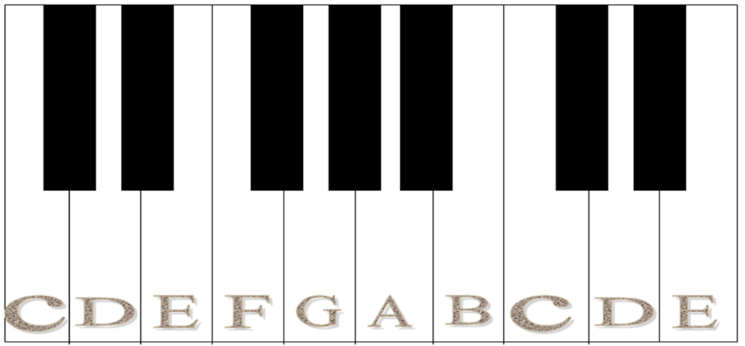
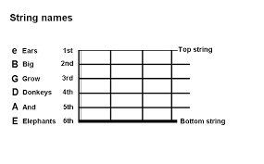
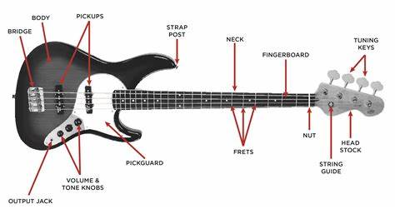
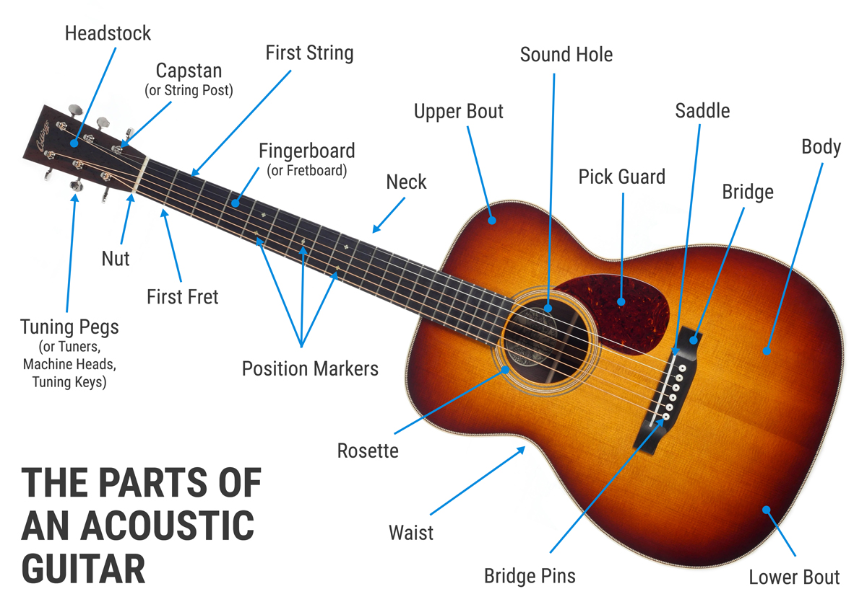
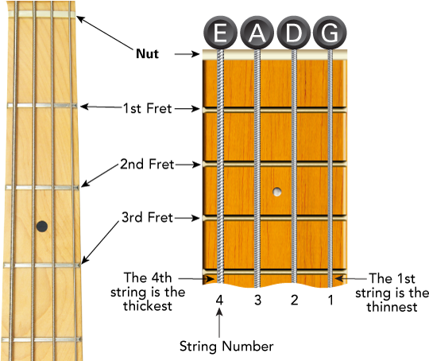
MUSIC 9

Slide 3
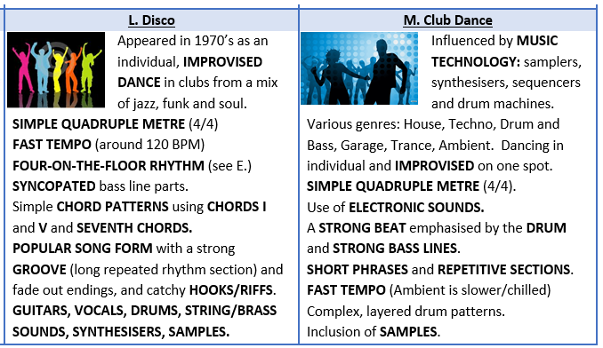
Key Term | Definition
Verse | A repeated section in a song that usually has a new set of lyrics on each repetition
Chorus | A repeated section that contains the main musical motifs , usually repeated at least twice.
Intro | At the beginning of the song, introduces the main musical material
Pre-Chorus | The music in-between the verse and the chorus
Bridge | A section of contrasting music that prepares for the return of the original music
Melody | The main tune of the piece of music. Usually one note at a time.
Chord | A group of two or more notes usually played simultaneously
Chord Scheme | A pattern of chords that is used throughout the piece of music.
EDM stands for Electronic Dance Music
Electronic dance music (EDM) is a range of electronic music genres made for clubs, raves and festivals. It is made mainly for DJ’s who can seamlessly mix one track to another.
There are many different genres or types of EDM including; House, Piano, Techno, Trance, Euphoria, Jungle, Garage, Hard-core and Drum & Bass.
Instruments and Equipment Commonly used
Drum Machines – such as the Roland TR 808
Bass Synths – such as the Roland TB 303
Synthesizers for Pads and Lead Instruments
Turntables for mixing records
Samplers and Sequencers
House Music
Started in the mid 1980s, in Chicago, following on from the Disco era.
Marshall Jefferson began experimenting with loops and manipulating old disco records.
Drum Machines and Bass synths were added over the top to create a beat.
DJs were playing this in the Chicago Warehouse – and people started asking for House Music.
Piano EDM
In the early 1990s, House and EDM were progressing.
Some DJs and producers began to incorporate other instruments into the music.
A key instrument for this was the piano.
Piano house continues to influence the music of today.
Euphoria. Key Features:
Female Vocal. Rap (in some) Catchy Chorus Memorable melody Faster Tempo than Acid house
MUSIC 9

