Slide 1
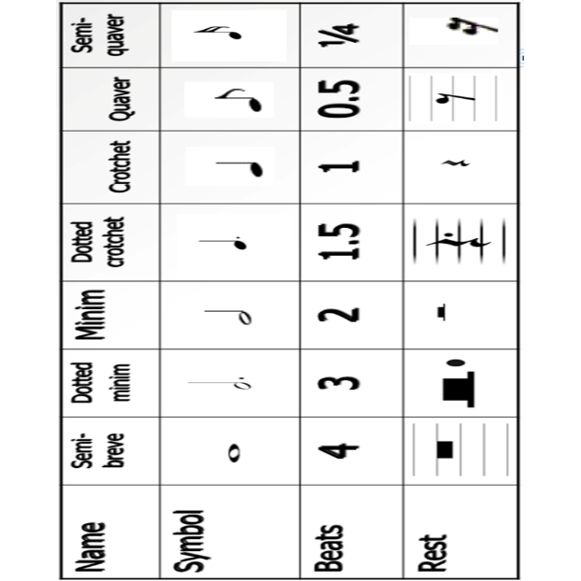
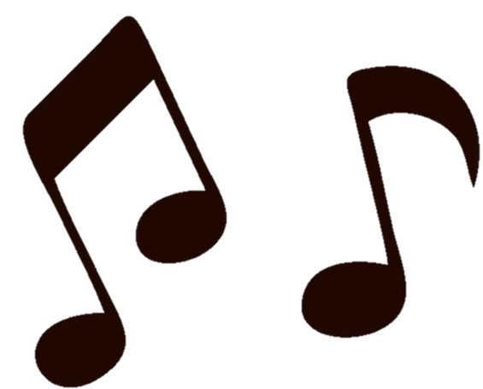
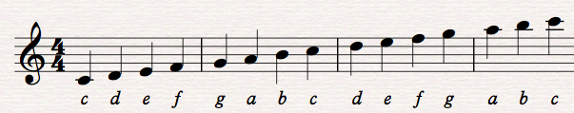
Foundation Vocabulary | Definition
Pitch | How high or low the notes are
Metre | The grouping of beats
Melody | Another name for the tune
Articulation | How smooth or detached the notes are
Attack and decay | How the notes begin, continue and end
Dynamics | How loud or soft the music is
Duration | How long or short the notes are
Tempo | How fast or slow the music is
Texture | The number of instruments/voices and how they are combined
Structure | How the music is put together
Harmony | When two or more notes are sounded at the same time
Instrumentation | The instruments or voices used
Rhythm | Patterns of long and short notes
Timbre | The tone quality of the music
Silence | When there is no music
MUSIC 8
Types of Texture:
Monophonic -one voice/instrument
Homophonic – more than one voice/instrument, playing the same thing
Polyphonic – more than one voice/instrument, playing different parts within the same piece: Melody and accompaniment – main tune and backing; Contrapuntal – interweaving lines of music with equal importance.
Types of Hook:
Structural Hook – a part of the structure that acts as the hook. The most commonly used structural hook is the chorus.
Instrumental Hook – used as an ostinato (repeated rhythmic or melodic phrase) or as a riff at the beginning or end of a section or line.
Storyline hook – the story of the song is more powerful than the music, beats or structure.
Production hook – these are the studio techniques used by the production.

Slide 2
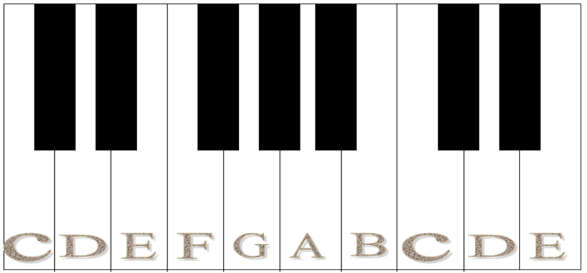
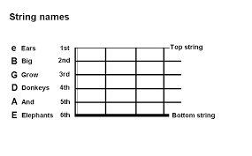
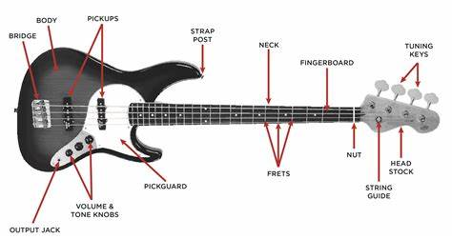
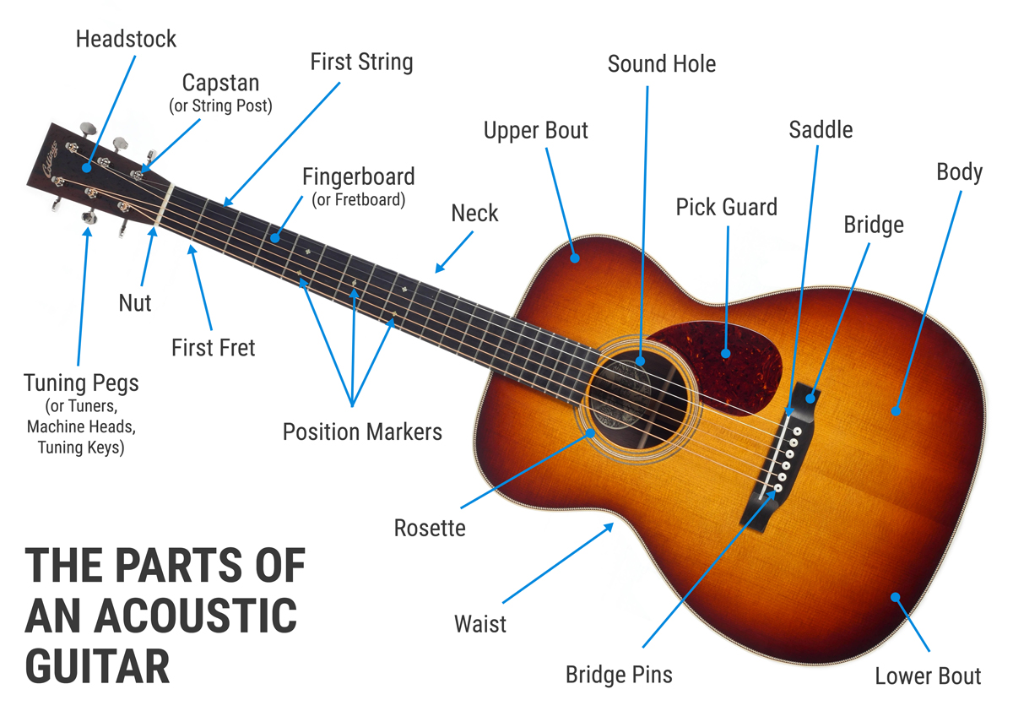
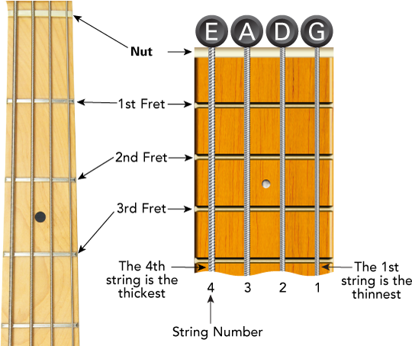
MUSIC 8

