Slide 1
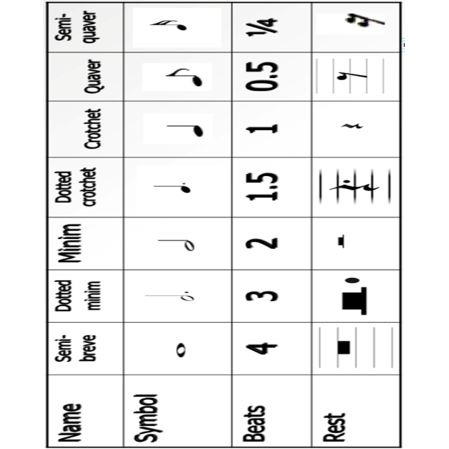

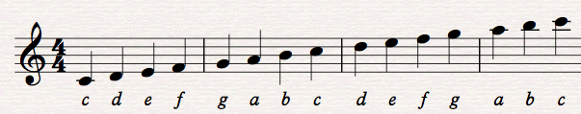
Foundation Vocabulary | Definition
Pitch | How high or low the notes are
Metre | The grouping of beats
Melody | Another name for the tune
Articulation | How smooth or detached the notes are
Attack and decay | How the notes begin, continue and end
Dynamics | How loud or soft the music is
Duration | How long or short the notes are
Tempo | How fast or slow the music is
Texture | The number of instruments/voices and how they are combined
Structure | How the music is put together
Harmony | When two or more notes are sounded at the same time
Instrumentation | The instruments or voices used
Rhythm | Patterns of long and short notes
Timbre | The tone quality of the music
Silence | When there is no music
MUSIC 7

Slide 2
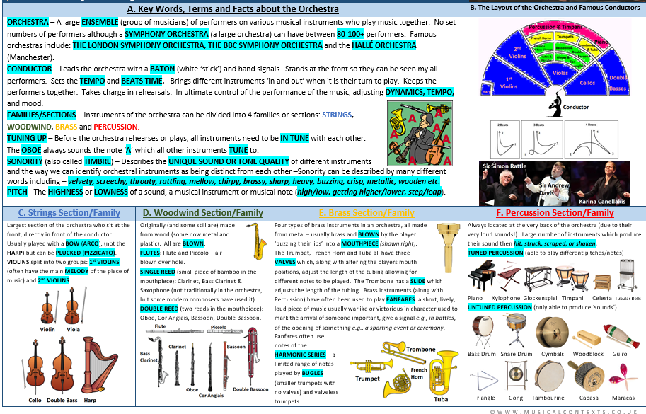
MUSIC 7

