Slide 1
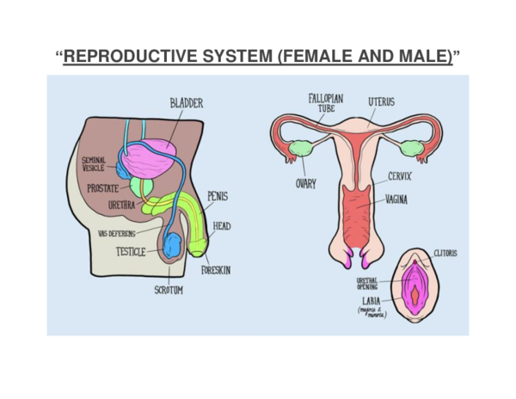
7.8 Reproduction KO
1. Puberty and Adolescence
Puberty: the stage of life when the body changes and becomes able to reproduce.
Adolescence: the period of physical and emotional development between childhood and adulthood.
Changes are caused by hormones.
Male changes
Voice deepens
Facial and body hair grows
Testes produce sperm
Female changes
Breasts develop
Hips widen
Menstrual cycle begins
2. Male and Female Reproductive Systems
Male reproductive system
Testes – produce sperm
Sperm duct – carries sperm
Penis – delivers sperm
Female reproductive system
Ovaries – produce eggs
Oviducts (fallopian tubes) – where fertilisation happens
Uterus – where a foetus develops
Vagina – birth canal
🔴 Common Misconceptions
Puberty happens at the same age for everyone
Only physical changes occur during puberty
🔴 Common Misconceptions
Fertilisation happens in the uterus
Organs have only one function

Slide 2
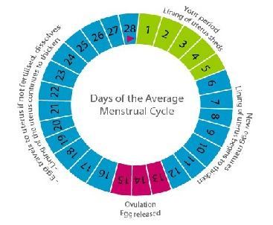
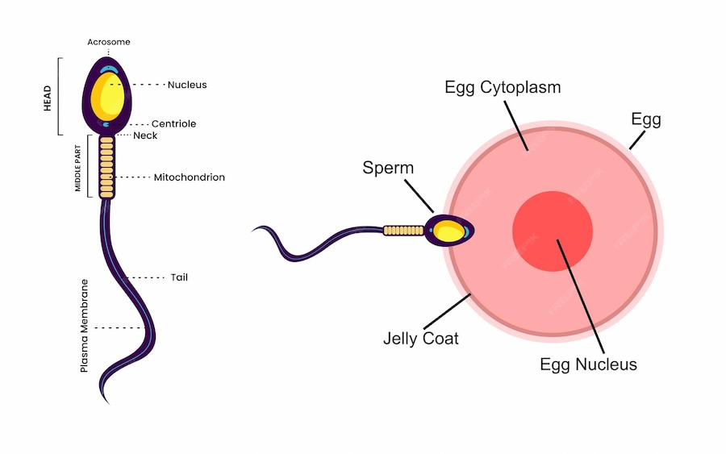
7.8 Reproduction KO
3. The Menstrual Cycle
The menstrual cycle prepares the body for pregnancy.
It lasts around 28 days (can vary).
Menstruation: lining of the uterus breaks down.
Ovulation: an egg is released from an ovary.
The uterus lining thickens ready for pregnancy.
4. Fertilisation and Gametes
Gametes: sex cells (sperm and egg).
Fertilisation: when a sperm joins with an egg.
Fertilisation usually happens in the oviduct.
Adaptations
Sperm – tail for movement, many mitochondria
Egg – large, contains food store
Infertility
When a person cannot conceive a baby naturally.
🔴 Common Misconceptions
A period is the whole menstrual cycle
Ovulation always happens on the same day
🔴 Common Misconceptions
Only females can be infertile
Fertilisation always leads to pregnancy

Slide 3
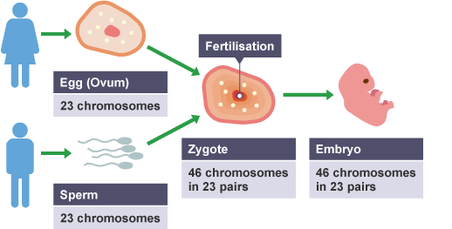
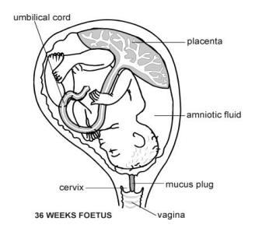
7.8 Reproduction KO
5. Contraception
Contraception prevents pregnancy.
Reasons include preventing pregnancy and spacing births.
Methods
Barrier – condoms
Hormonal – pill
Natural – avoiding fertile times
6. Development of a Foetus and Birth
Pregnancy structures
Placenta – exchange of nutrients and waste
Umbilical cord – connects foetus to placenta
Amniotic fluid – protects the foetus
Stages
Embryo develops into a foetus
Birth involves contractions and delivery of the baby
Health risks
Smoking and alcohol can harm the foetus.
🔴 Common Misconceptions
All contraception prevents STIs
Contraception is always 100% effective
🔴 Common Misconceptions
The foetus breathes with lungs
The placenta blocks all harmful substances

Slide 4
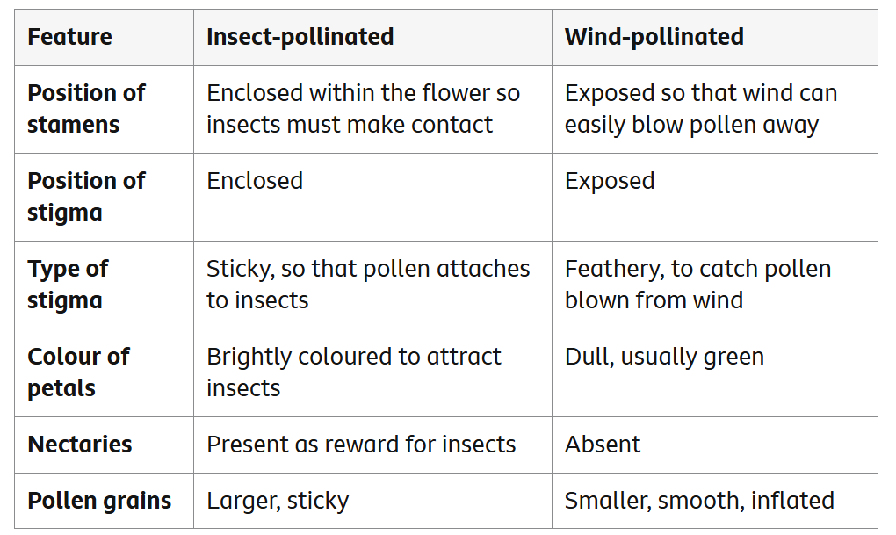
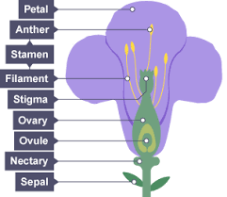
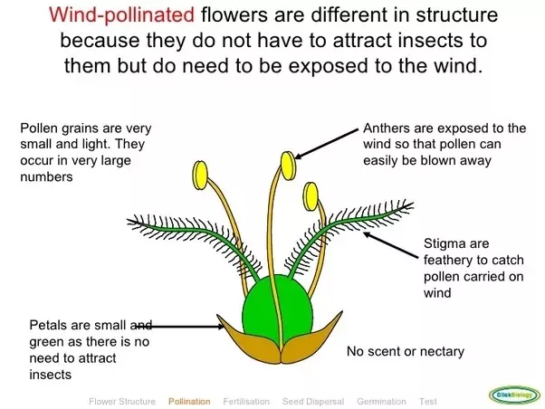
7.8 Reproduction KO
7. Types of Reproduction
Sexual reproduction – involves two parents, produces variation.
Asexual reproduction – one parent, identical offspring.
Plants
Pollination – pollen transferred to stigma
Fertilisation – pollen nucleus joins egg
Germination – seed begins to grow
Sexual reproduction in plants is how plants make seeds to grow new plants. It happens when pollen from the male part of one flower (called the anther) meets the egg inside the female part of another flower (called the ovary).
Pollination: Pollen is moved from one flower to another by the wind, insects like bees, or animals.
Fertilization: When the pollen reaches the ovary, it joins with the egg. This creates a seed.
Seed Formation: The seed grows inside the fruit, which protects it.
New Plant Growth: When the seed is planted in the soil, it can grow into a new plant.
🔴 Common Misconceptions
Plants do not reproduce sexually
Pollination and fertilisation are the same

Slide 5
7.8 Reproduction KO
Key Questions to Probe Understanding
What is the difference between puberty and adolescence?
How do male and female reproductive systems differ?
What happens during ovulation?
Where does fertilisation occur and why?
Why are sperm and eggs adapted differently?
Why might people choose to use contraception?
How is a foetus protected during pregnancy?
How does sexual reproduction differ from asexual reproduction?
What is the difference between pollination and fertilisation?
Why is variation important?
Key Word | Definition
DNA | Store of genetic information for all living things
Chromosome | A coiled structure of DNA found in the nucleus of cells made from many genes.
Gene | A small section of DNA that gives a characteristic.
Genome | The complete set of DNA found in an organism.
Genetic Engineering | Process which involves the artificial transfer of genetic information from one donor cell or organism to another.
Puberty | Time during which sexual maturity happens.
Fertilisation | The joining of male and female gametes
Pollination | The fertilisation of flowers by the transfer of pollen from one to another.
Germination | The process where seeds sprout and begin to grow.
Mitosis | A type of cell division which produces daughter cells identical to the parent.
Foetus | An unborn baby.
Embryo | An organism in the early stages of development.

