Slide 1
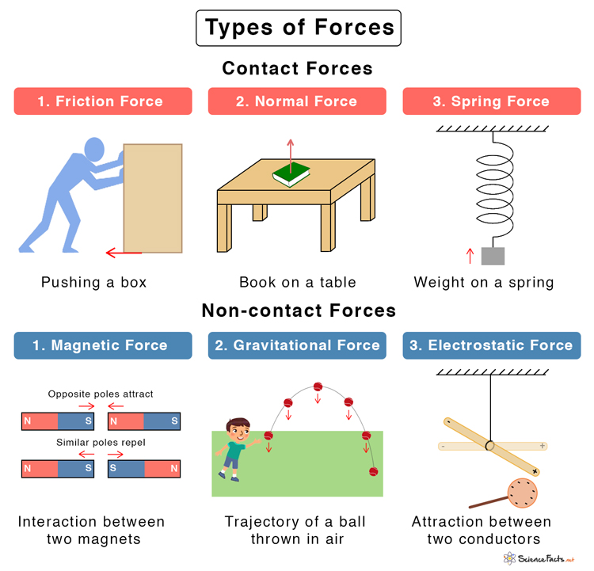
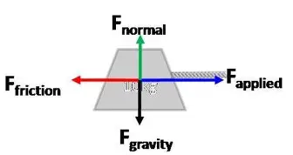
7.7 Forces KO
1. Contact and Non-contact Forces
A force is a push or a pull.
Forces can change speed, direction, shape, or start/stop motion.
Contact forces require touching (e.g. friction, air resistance).
Non-contact forces act at a distance (e.g. gravity, magnetism).
Objects often have more than one force acting on them.
2. Describing Forces (Force Diagrams)
Forces are shown using arrows.
Arrow direction shows direction of force.
Arrow length shows size (magnitude) of force.
Arrows start on the object.
Forces always act in pairs (action–reaction).
🔴 Common Misconceptions – Forces
Forces are only pushes – pupils may forget that forces can also be pulls.
Objects need a force to keep moving – pupils often think motion always needs a force.
Non-contact forces need touching – pupils may think gravity or magnetism require contact.

Slide 2


7.7 Forces KO
3. Resultant Forces
Resultant force is the overall force on an object.
Balanced forces → no change in motion.
Unbalanced forces → speed or direction changes.
Resultant force can be found by adding or subtracting forces.
If resultant force = 0 N, forces are balanced.
4. Friction
Friction is a force that opposes motion.
Acts between surfaces that are touching.
Friction slows objects down.
Rough surfaces create more friction than smooth surfaces.
Friction can be useful (e.g. walking, braking).
🔴 Common Misconceptions – Forces
Balanced forces mean no forces – pupils may think balanced means no forces are acting.
If an object is stationary, forces are unbalanced – pupils confuse rest with imbalance.
Forces must be equal to stop motion – pupils may ignore direction when calculating resultants.

Slide 3
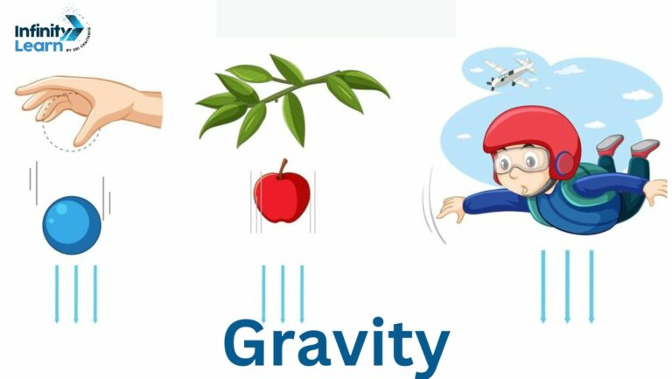
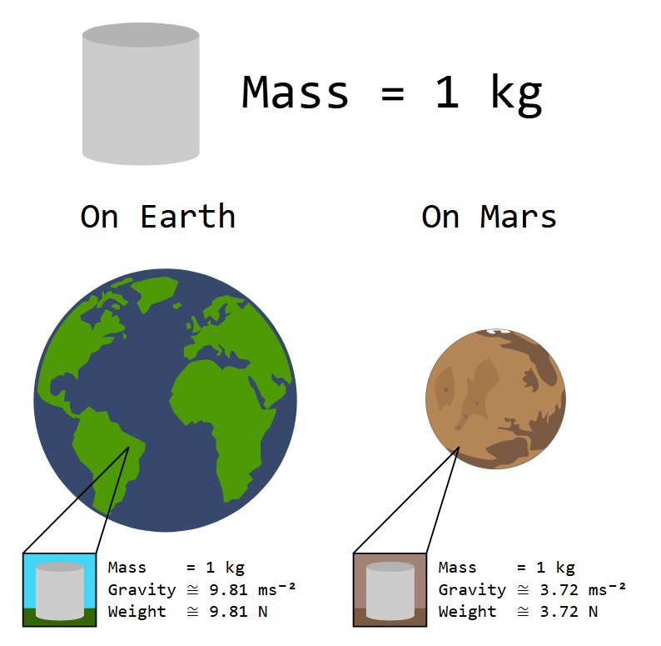
7.7 Forces KO
6. Mass and Weight
Mass is the amount of matter (kg).
Mass stays the same everywhere.
Weight is the force caused by gravity (N).
Weight depends on gravity.
Weight = mass × gravitational field strength.
5. Gravity
Gravity is a non-contact force of attraction.
It pulls objects towards the centre of a planet.
Gravity depends on the mass of the planet.
Gravity is different on different planets.
On Earth, gravity pulls objects downwards.
🔴 Common Misconceptions
Mass and weight are the same – pupils often use the terms interchangeably.
Weight is measured in kilograms – pupils confuse units.
Mass changes on different planets – pupils confuse gravity with matter.

Slide 4
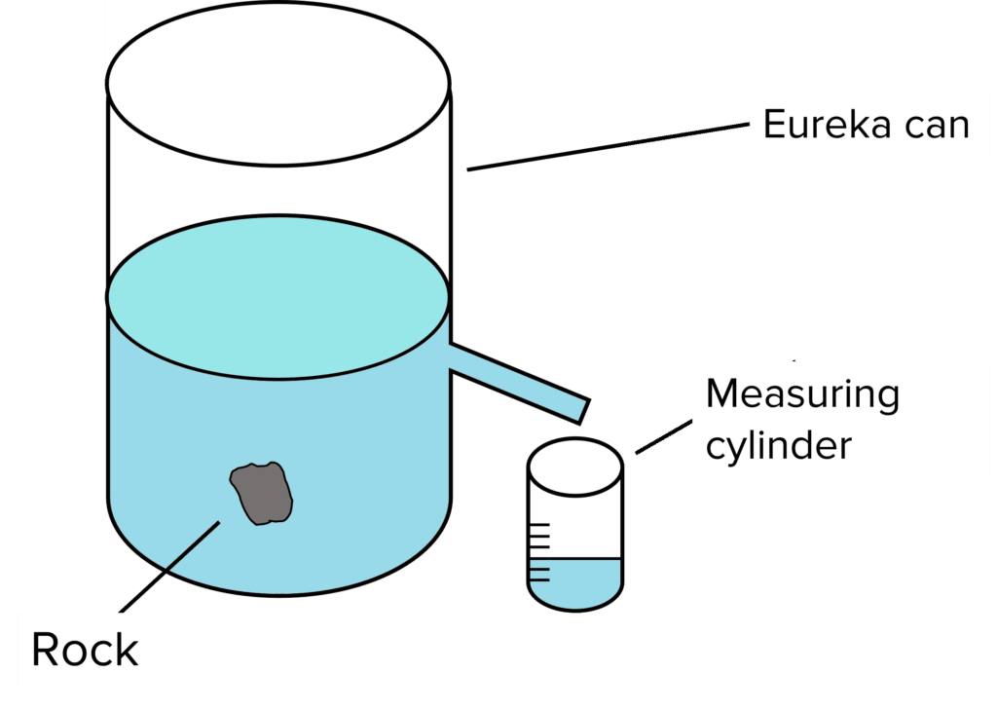
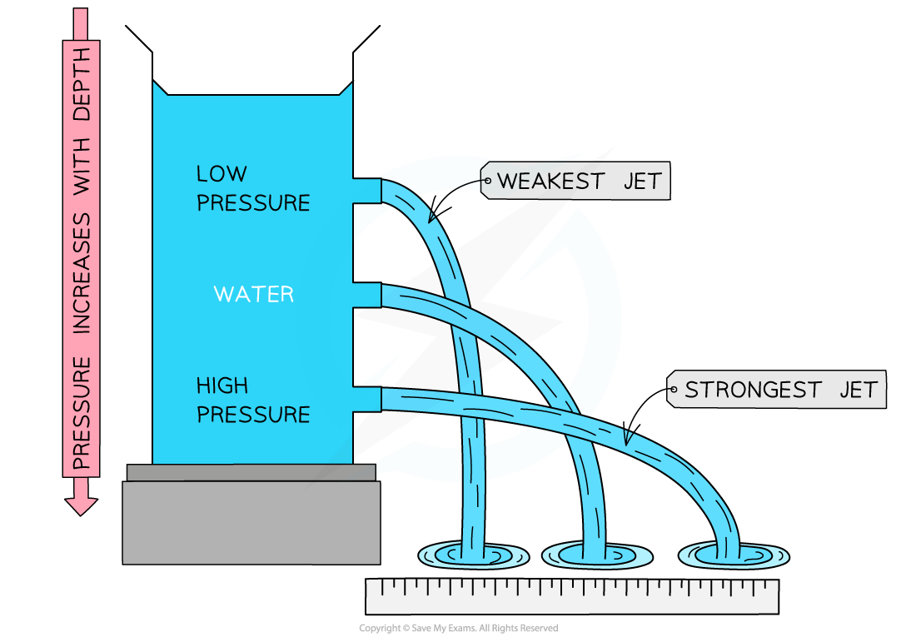
7.7 – Forces | Knowledge Needed
.
7.7 Forces KO
8. Pressure in Fluids
Pressure is force spread over an area.
Pressure in fluids is caused by the weight of the fluid above.
Pressure increases with depth.
Deeper water exerts greater pressure.
Dams are thicker at the bottom to withstand higher pressure.
7. Sinking and Floating
Density = mass ÷ volume.
Objects float if they are less dense than the fluid.
Objects sink if they are more dense than the fluid.
Shape can affect whether an object floats.
🔴 Common Misconceptions
Heavy objects always sink – pupils ignore density.
Floating means no gravity – pupils may think gravity stops acting.
Shape does not affect floating – pupils may overlook volume and displacement

Slide 5
7.7 Forces KO
What is a force and what can forces do to an object?
What is the difference between a contact force and a non-contact force? Give one example of each.
How do you draw a force (free-body) diagram correctly?
What is meant by balanced and unbalanced forces?
What happens to an object when the resultant force acting on it is zero?
How do you calculate the resultant force when forces act in the same or opposite directions?
What is friction and how does it affect the motion of an object?
What is gravity and why is it different on different planets?
What is the difference between mass and weight? Include units and the equation for weight.
Why does pressure in a liquid increase with depth, and why are dams built thicker at the bottom?
Force – a push or a pull
Contact force – force that needs touching
Non-contact force – force that acts at a distance
Gravity – force that pulls objects towards a planet
Friction – force that opposes motion
Air resistance – friction between air and objects
Water resistance – friction between water and objects
Force diagram – diagram showing forces with arrows
Arrow – shows direction and size of a force
Resultant force – overall force on an object
Balanced forces – forces equal; no change in motion
Unbalanced forces – forces not equal; motion changes
Mass – amount of matter (kg)
Weight – force caused by gravity (N)
Weight equation – weight = mass × gravity
Density – mass ÷ volume
Sink – object is more dense than the fluid
Float – object is less dense than the fluid
Pressure – force spread over an area
Depth – how deep something is below the surface

