Slide 1
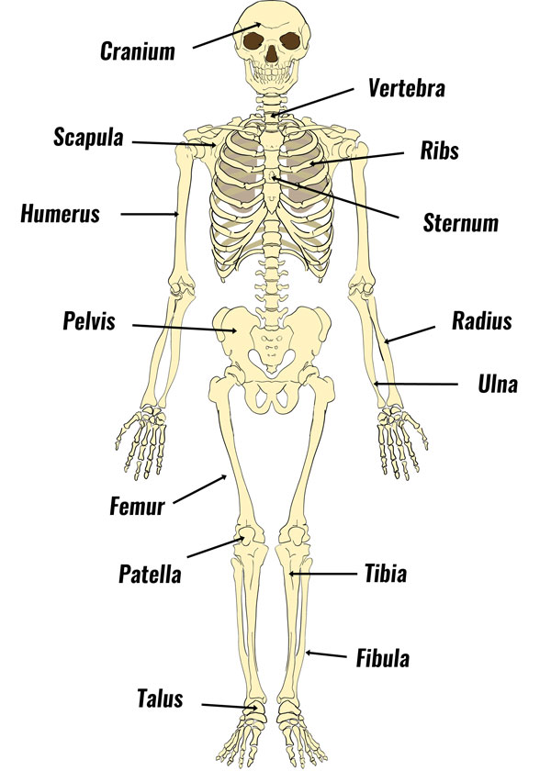
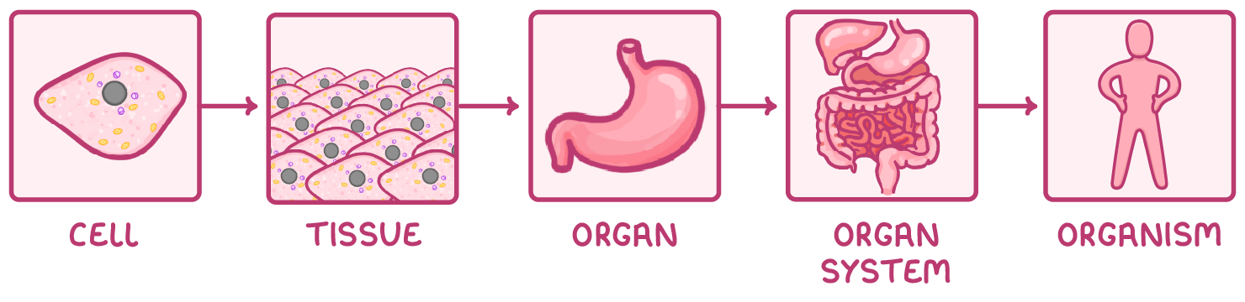
7.6 The Human Boday KO
1. Cells, Tissues & Organs
Cell: the smallest unit of life (e.g. muscle cell, nerve cell).
Tissue: a group of similar cells working together (e.g. muscle tissue).
Organ: a group of different tissues working together to perform a function (e.g. heart).
Organ system: a group of organs working together (e.g. digestive system).
Why tissues differ in organs
Different tissues are specialised for different jobs (e.g. muscle tissue contracts, nervous tissue sends signals).
2. Skeleton
Functions of the skeleton
Supports the body
Protects organs (e.g. skull protects brain)
Allows movement
Produces blood cells
Stores minerals
Different bones
Skull – protection
Rib cage – protects heart and lungs
Spine – support and flexibility
Limbs – movement
🔴 Common Misconceptions
Cells and tissues are the same
Organs are made of only one tissue
🔴 Common Misconceptions
Skeleton is only for protection
Bones do not change or grow

Slide 2
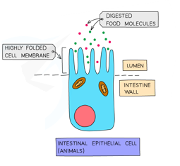
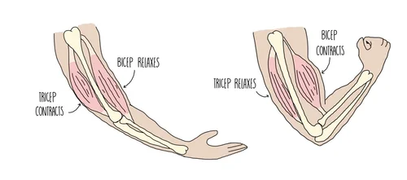
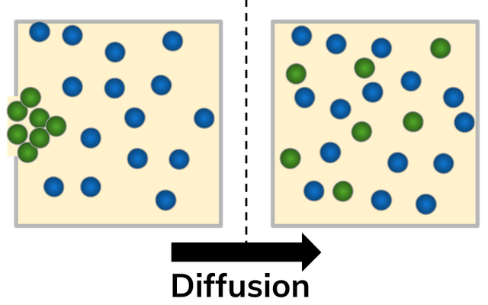
7.6 The Human Body KO
3. Muscles
Muscles contract to cause movement.
Muscles are attached to bones by tendons.
Muscles work in antagonistic pairs.
Antagonistic pairs
One muscle contracts while the other relaxes.
Example: biceps and triceps in the arm.
4. Diffusion
Diffusion: movement of particles from a high concentration to a low concentration.
Occurs in liquids and gases.
Does not require energy.
Increasing rate of diffusion
Higher temperature
Larger surface area
Steeper concentration gradient
🔴 Common Misconceptions
Muscles push bones
Both muscles contract at the same time
🔴 Common Misconceptions
Diffusion needs energy
Diffusion only happens in gases

Slide 3
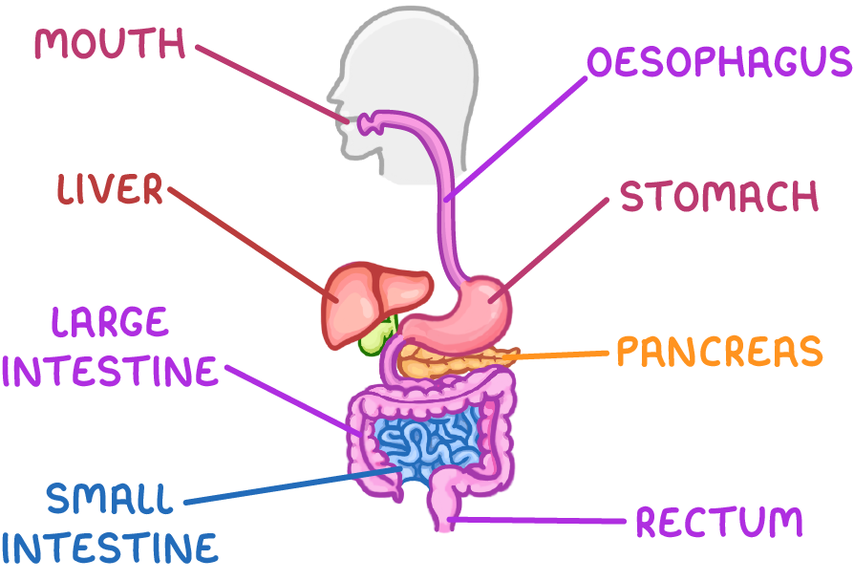
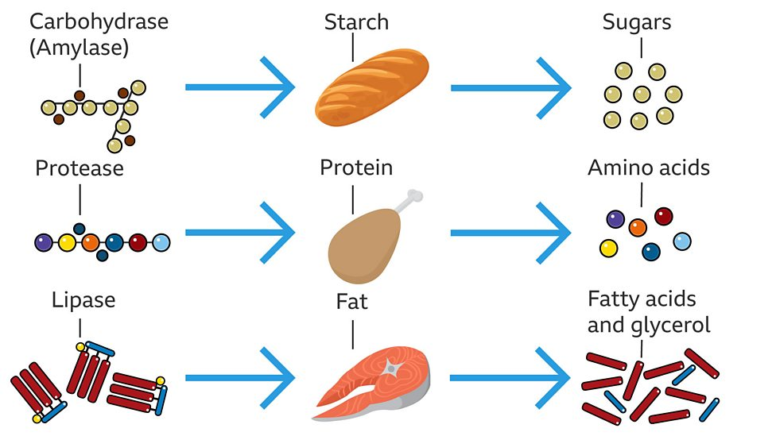
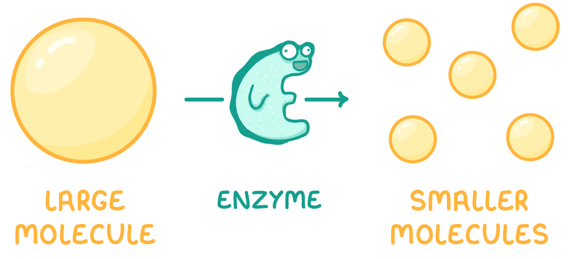
7.6 The Human Body KO
5. Digestion
Digestive system organs
Mouth – chewing and saliva
Oesophagus – moves food
Stomach – acid and enzymes
Small intestine – digestion and absorption
Large intestine – water absorption
Importance
Breaks food into soluble substances
Allows nutrients to be absorbed into the blood
Physical digestion: breaking food into smaller pieces
Chemical digestion: enzymes break molecules down
🔴 Common Misconceptions
Digestion only happens in the stomach
Food enters the blood in the stomach
🔴 Common Misconceptions
Enzymes are alive
Enzymes get used up
6. Enzymes
Enzymes are biological catalysts.
Speed up chemical reactions.
Not used up during reactions.
Examples
Amylase – starch → sugars
Protease – proteins → amino acids
Lipase – fats → fatty acids and glycerol

Slide 4
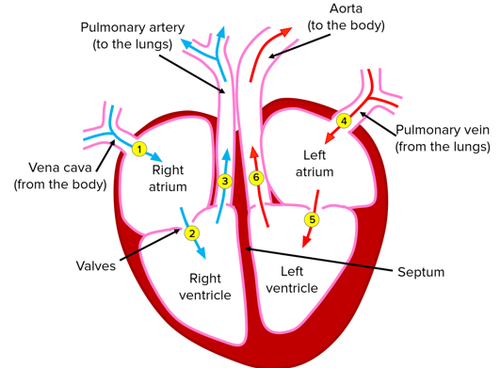
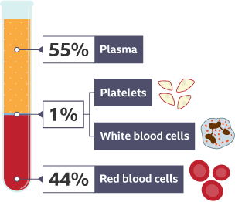
7.6 The Human Body KO
7. Circulation (Blood)
Functions of blood
Transport oxygen, nutrients, hormones
Remove waste (e.g. carbon dioxide)
Protect against disease
Regulate temperature
Blood components
Red blood cells – oxygen
White blood cells – defence
Platelets – clotting
Plasma – liquid transport
8. Circulation (Heart)
Heart structures
Atria (top chambers)
Ventricles (bottom chambers)
Valves – prevent backflow
Blood route
Body → heart → lungs → heart → body
Adaptations
Thick muscular walls
Valves
Separate sides
Double circulatory system
Blood passes through the heart twice per cycle.
🔴 Common Misconceptions
Blood only carries oxygen
Plasma is just water
🔴 Common Misconceptions
Heart pumps once per cycle
Oxygenated and deoxygenated blood mix

Slide 5
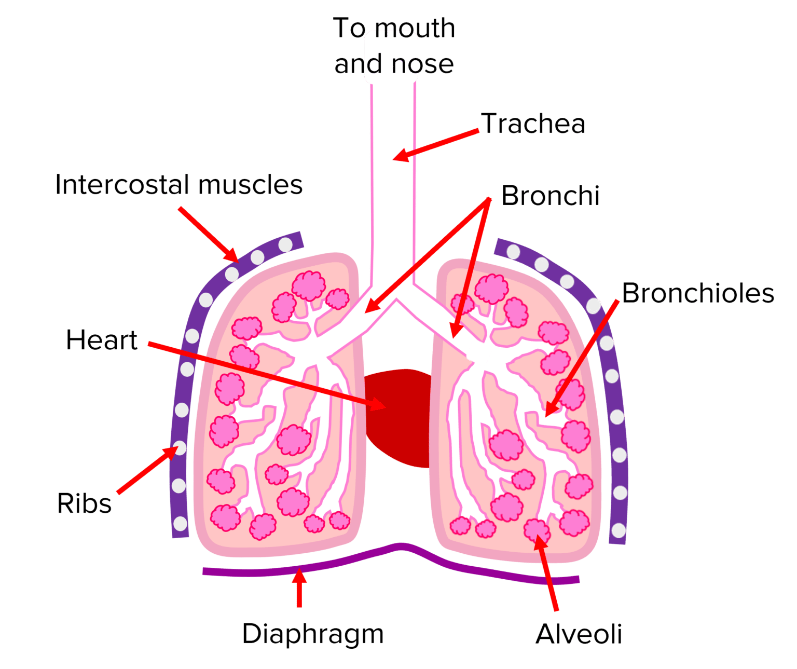
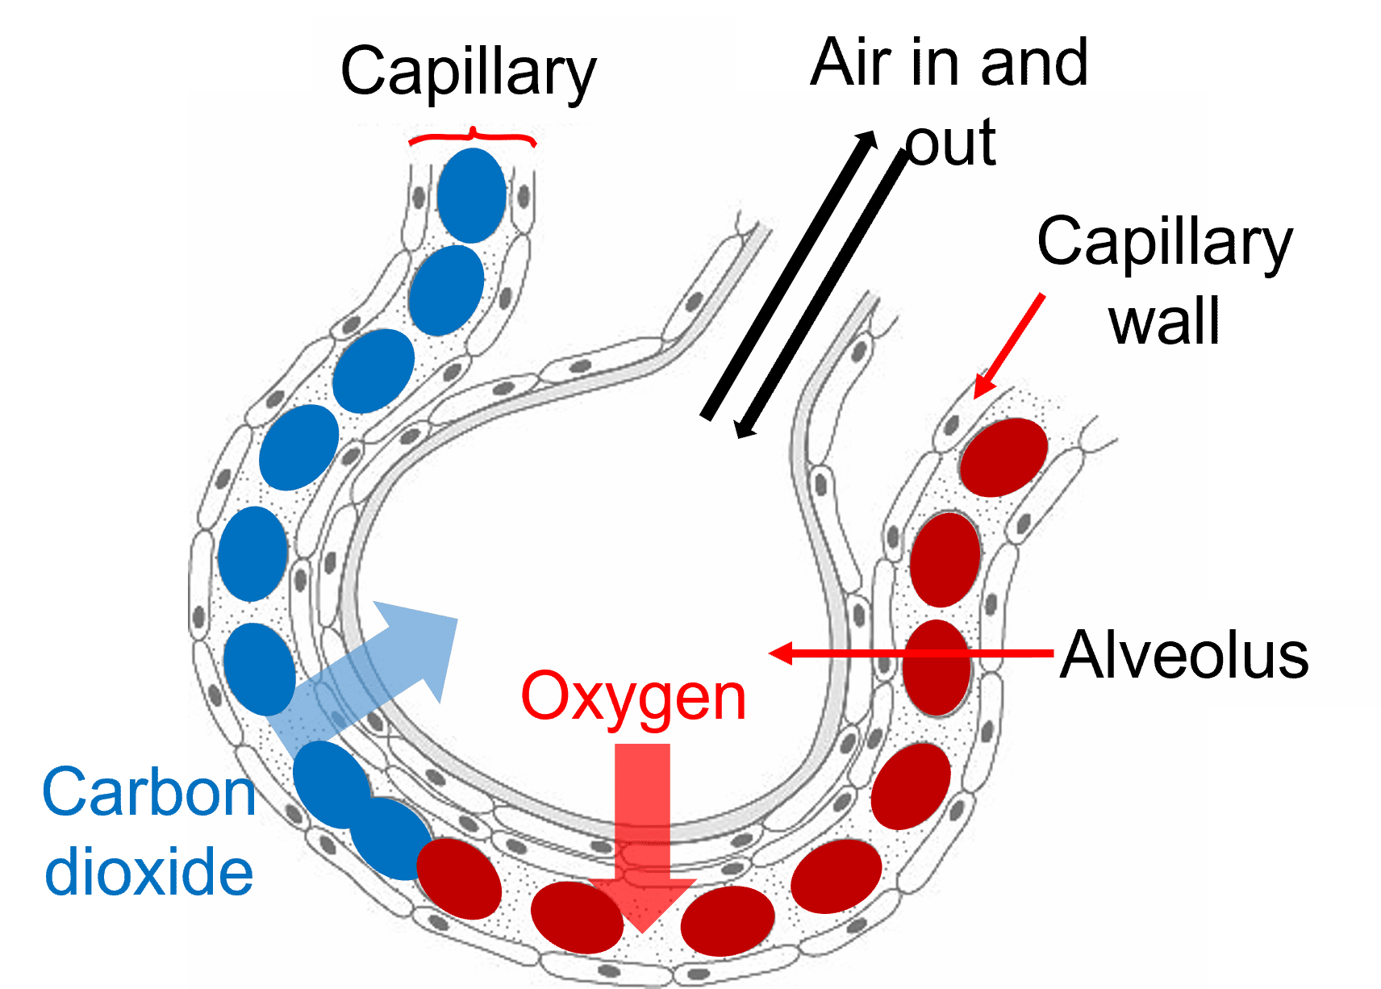
7.6 The Human Body KO
9. Lungs & Gas Exchange
Structures
Trachea
Bronchi
Bronchioles
Alveoli
Gas exchange
Oxygen diffuses into blood
Carbon dioxide diffuses out
Adaptations
Large surface area
Thin walls
Good blood supply
Moist surface
🔴 Common Misconceptions
Lungs are hollow sacs
Breathing and respiration are the same

Slide 6
7.6 The Human Body KO
Key Questions to Probe Understanding
What is the difference between a cell, tissue, and organ?
Why do muscles work in antagonistic pairs?
How does diffusion help gas exchange in the lungs?
Why are enzymes important for digestion?
What makes the heart efficient at pumping blood?
Why is the human circulatory system described as “double”?
How are the lungs adapted for efficient gas exchange?
Key words:
Cell – smallest living unit
Tissue – group of similar cells
Organ – group of tissues working together
Organ system – group of organs
Skeleton – supports and protects the body
Bone – hard structure
Muscle – contracts to cause movement
Tendon – joins muscle to bone
Antagonistic pair – muscles working opposite
Contract – shorten and tighten
Relax – lengthen and loosen
Diffusion – movement from high to low concentration
Digestion – breaking food down
Enzyme – biological catalyst
Absorption – nutrients into blood
Small intestine – site of absorption
Blood – transports substances
Heart – pumps blood
Alveoli – air sacs in lungs
Oxygen – needed for respiration
Carbon dioxide – waste ga

