Slide 1

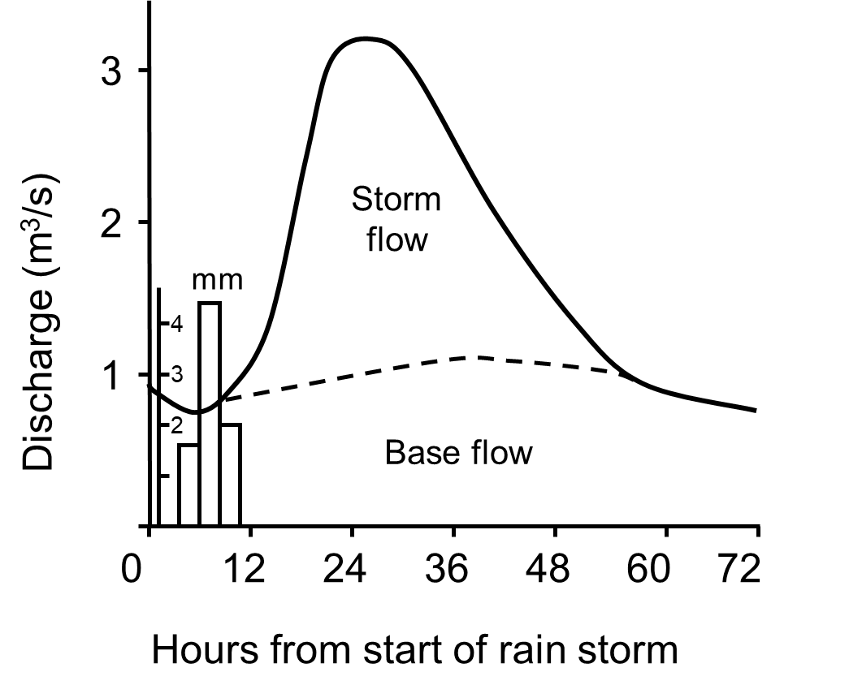
Big question: Is flood management worth the cost?
Year 9: Topic One - Urbanisation
Knowledge Organiser
Key idea 1: What makes extreme weather? Extreme weather:
Weather that is unusually severe or unexpected and falls outside normal patterns for a location.
Example: The UK experienced a heatwave in July 2022, reaching 40°C, the hottest temperature on record.
Explanation: Weather becomes extreme when it is unusually intense, happens more often than expected, or causes serious impacts such as flooding, drought, or heat-related deaths.
Types of extreme weather in the UK
Heatwaves – long periods of unusually hot weather (e.g. July 2022).
Flooding – caused by heavy rainfall and saturated ground (e.g. Storm Desmond, 2015).
Snow and ice – freezing temperatures cause disruption (e.g. “Beast from the East”, 2018).
Storms and strong winds – cause property damage and power cuts (e.g. Storm Eunice, 2022).
Droughts – long dry periods leading to water shortages.
How do we define ‘extreme’?
Weather is considered extreme based on three key factors:
Intensity – how strong or severe the weather is (e.g. heavy rainfall or record heat).
Frequency – how often it happens compared to the past.
Impact – how much damage or disruption it causes to people, property, and the environment.
Data interpretation – UK trends (2000–2020)
Trend: Both rainfall and highest temperatures in the UK have increased overall.
Example: Rainfall peaked around 1,300 mm in 2012 and 2020; the hottest day reached 39°C in 2019.
Anomaly: Rainfall dropped to 800 mm in 2008, showing some variation.
Explanation:
Climate change warms the atmosphere, which holds more moisture. This leads to heavier rainfall and more intense heatwaves, meaning the UK is experiencing more extreme weather.
Key idea 2: Why do rivers flood?
River flooding: When a river overflows its banks and water spreads over the surrounding land.
Example: Storm Desmond (2015) caused severe flooding in Cumbria and Lancashire, damaging homes, roads, and bridges.
Explanation: Flooding happens when too much rainfall or runoff enters a river channel faster than it can flow away.
Physical causes of flooding (natural)
Heavy rainfall – intense or prolonged rain saturates the soil, leading to more surface runoff.
Relief (steep slopes) – water runs off quickly, increasing river discharge.
Impermeable rock – prevents water soaking into the ground.
Snowmelt – rapid melting adds large volumes of water to rivers.
Confluence – where rivers join, increasing the amount of water in one channel.
Human causes of flooding
Urbanisation – concrete and tarmac stop water soaking in, increasing surface runoff.
Deforestation – trees no longer intercept rainfall, so more water reaches rivers quickly.
Agriculture – compacted soil from machinery reduces infiltration.
Poor river management – lack of flood defences or blocked drains increase flood risk.
Storm Desmond (2015) – Case Study
When: 4–6 December 2015
Where: North-west England (especially Cumbria and Lancashire)
Causes:
A powerful Atlantic storm brought record rainfall.
Mountains in Cumbria forced air to rise, cool, and condense, increasing rain.
Ground already saturated from earlier rainfall, so little infiltration occurred.
Impacts:
Over 5,000 homes flooded, and bridges destroyed.
Power cuts and road closures.
Estimated £500 million in damages.
Helpful revision - KS3 Geography - BBC Bitesize

Slide 2
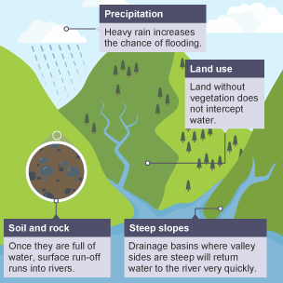
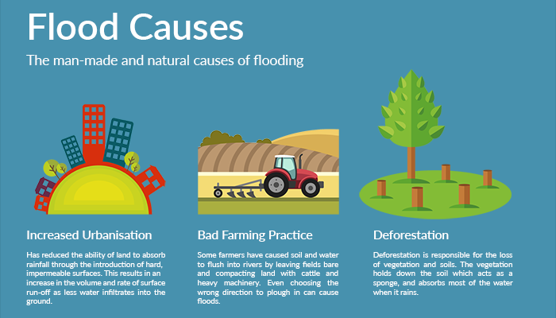
Big question: Is flood management worth the cost?
Year 9: Topic One - Urbanisation
Knowledge Organiser
Key idea 3: Why is the Northwest at high risk of flooding?
Flood risk: The likelihood that an area will experience flooding.
Example: The Northwest of England, especially Preston and Cumbria, often floods after heavy rainfall events such as Storm Desmond (2015) and Storm Ciara (2020).
Explanation: The Northwest is at high risk of flooding because of its wet climate, steep relief, impermeable rocks, and urban development on floodplains such as the River Ribble in Preston.
Physical Factor | Explanation | Example
Heavy rainfall | Moist air from the Irish Sea is pushed over the Pennines, causing orographic rainfall. When the ground is saturated, rain runs off into rivers. | Cumbria receives some of the highest annual rainfall in the UK.
Steep relief | The Pennine Hills cause rainwater to flow downhill quickly, increasing surface runoff and shortening lag time. | Water reaches the Ribble quickly, raising flood peaks downstream.
Impermeable rock | Rocks such as clay and millstone grit stop water soaking in, increasing runoff. | Common in parts of the Ribble’s drainage basin.
Large drainage basin | The River Ribble collects water from many tributaries, so heavy rainfall across the basin greatly increases river discharge. | Rivers such as the Hodder and Calder flow into the Ribble.
Human Factor | Explanation | Example
Urbanisation | Concrete and tarmac in Preston prevent infiltration. Rainwater quickly flows into drains and rivers. | Flooding in Walton-le-Dale and Penwortham during heavy rain.
Building on floodplains | Construction reduces natural flood storage and raises river levels. | Housing near the Ribble floodplain worsens flood impacts.
Deforestation | Fewer trees in the Ribble Valley means less interception and root absorption, so more runoff reaches rivers. | Farmland replaces woodland upstream of Preston.
Helpful revision - KS3 Geography - BBC Bitesize

Slide 3
Big question: Is flood management worth the cost?
Year 9: Topic One - Urbanisation
Knowledge Organiser
Key idea 4: How can rivers be managed?
River management:
Actions taken to control river flow and reduce flood risk to people, property, and the environment.
Example: Along the River Ribble in Preston, a mix of hard and soft engineering is used to prevent flooding in areas such as Broadgate and Penwortham.
Explanation: A combination of structural (hard) and natural (soft) engineering helps protect built-up areas while supporting the environment.
Type | Definition | Examples | Advantages | Disadvantages
Hard Engineering | Man-made structures built to control the river and reduce flood risk. Often expensive but provide strong, immediate protection. | • Flood walls – concrete barriers along the riverbank. • Embankments – raised riverbanks to increase capacity. • Dams and reservoirs – store water to control discharge. • Flood barriers – block tidal surges. | • Provides instant, reliable protection for people and property. • Protects urban areas like Preston from tidal and river flooding. • Can control river flow effectively. | • Very expensive to build and maintain. • Can cause flooding downstream. • Visually unattractive and may damage habitats. • Not always sustainable long-term.
Soft Engineering | Works with natural processes to reduce flood risk in a sustainable way. Cheaper and more environmentally friendly. | • Floodplain zoning – limits building on high-risk land. • Afforestation – planting trees to intercept rainfall. • Wetlands and reedbeds – store excess water. • River restoration (re-meandering) – slows down river flow naturally. | • Cheaper and more sustainable than hard engineering. • Improves wildlife habitats and biodiversity. • Reduces downstream flood risk naturally. • Improves water quality and recreation. | • Takes longer to take effect. • May not protect densely populated areas immediately. • Requires space (not suitable everywhere). • Effectiveness can depend on weather and maintenance.
Helpful revision - KS3 Geography - BBC Bitesize

Slide 4
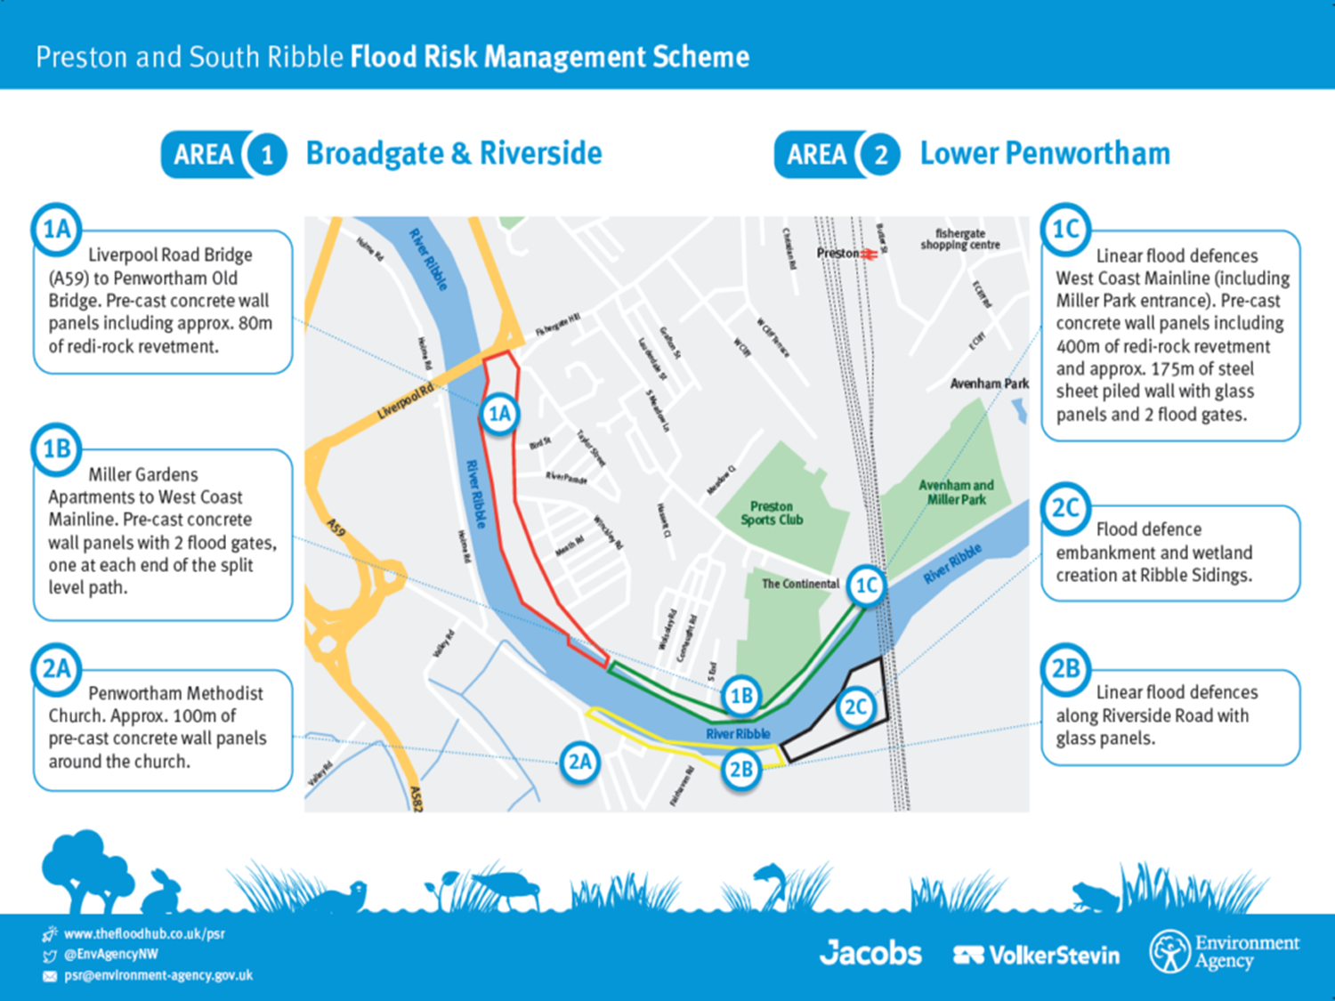
Big question: Is flood management worth the cost?
Year 9: Topic One - Urbanisation
Knowledge Organiser
Key idea 5: How is the River Ribble being managed?
River management in Preston:
The Preston and South Ribble Flood Risk Management Scheme aims to protect people, homes, and infrastructure from flooding caused by the River Ribble and tidal surges from the Irish Sea.
Example: New flood walls and embankments have been built between Liverpool Road Bridge and Penwortham Old Bridge to hold back high river levels.
Explanation: The scheme combines hard and soft engineering to protect urban areas while improving the environment and community safety.
Background: The River Ribble
Length: ~121 km (75 miles) from the Yorkshire Dales to the Irish Sea.
Tidal limit: Near Fishwick Bottoms, about 11 miles inland — meaning tides affect Preston.
Flood history: Repeated floods (1980, 1995, 2000, 2012, 2015, 2020, 2025) have caused serious damage to Broadgate, Penwortham, and Avenham Park.
Reason for management: To protect over 4,700 homes and businesses, parks, and main roads from repeated flooding.
1. What makes weather extreme?
2. Why do rivers flood?
3. Why is the Northwest at high risk of flooding?
4. How can rivers be managed?
5. How is the Ribble being managed?
6. How are decisions made about which areas to protect?
7. What are the potential problems with river management?
8. Is river management worth the cost?
Helpful revision - KS3 Geography - BBC Bitesize

Slide 5
Big question: Is flood management worth the cost?
Year 9: Topic One - Urbanisation
Knowledge Organiser
Key idea 6: How are decisions made about which areas to protect?
Decision making:
When money and resources are limited, organisations such as the Environment Agency must decide which areas receive flood defences first.
Example: Along the River Ribble, the agency must choose between protecting Preston, Longridge, or Ribchester.
Explanation: To make this fair, they use a cost–benefit analysis, which compares the cost of building defences with the benefits gained, such as the number of people protected and the value of land or property saved.
What is Cost–Benefit Analysis?
A method used to decide where flood defences should be built by weighing the cost of the scheme against the social, economic, and environmental benefits.
It helps ensure value for money and fair use of resources.
Key idea 7: What are the potential problems with river management?
River management problems:
Flood management schemes aim to protect people and property from flooding, but they can also create new social, economic, and environmental challenges.
Example: Along the River Ribble in Preston, flood walls and embankments protect homes near Broadgate and Penwortham — but may increase flood risk further downstream.
Explanation: River management often benefits some groups while disadvantaging others, leading to “winners and losers.”
Category | Positive Impacts (Winners) | Negative Impacts (Losers)
Social (People) | • People in protected areas feel safer and more confident living near rivers.• Reduces stress and disruption caused by repeated flooding.• Improves community spaces such as parks and riverside paths. | • Communities downstream may face a higher flood risk due to faster river flow.• Construction noise and disruption affect local residents.• Some people may be relocated if defences are built on residential land.
Economic (Money & Jobs) | • Prevents costly damage to homes, businesses, and infrastructure.• Helps protect jobs and transport links in cities.• Can reduce insurance costs and boost investor confidence. | • Schemes are very expensive to build and maintain (e.g. £49 million in Preston).• Taxpayers fund the projects, which may limit other services (e.g. schools, healthcare).• Property values may drop in unprotected or downstream areas.
Environmental (Nature) | • Wetlands, reedbeds and re-meandering projects create habitats and improve biodiversity.• Soft engineering improves water quality and supports wildlife.• Increases environmental awareness and education opportunities. | • Hard engineering (e.g. flood walls, embankments) can damage habitats and spoil the landscape.• Alters river flow, affecting fish migration and plants.• Construction causes short-term pollution and soil erosion.
Factor | Meaning | Example along the Ribble
Cost | How much money is needed to build the scheme. | Preston’s defences cost about £10 million.
People protected | How many residents or businesses are made safer. | 25,000 people protected in Preston; fewer in Ribchester.
Value for money | The benefit gained for every £1 spent. | Preston offers the greatest overall value because more people are protected.
Political importance | Large urban areas often prioritised as flooding impacts more voters and infrastructure. | Preston chosen before smaller towns due to population and economic value.
Helpful revision - KS3 Geography - BBC Bitesize

Slide 6
Big question: Is flood management worth the cost?
Year 9: Topic One - Urbanisation
Knowledge Organiser
# | Key Word | Definition | Example in a Sentence
1 | Extreme Weather | Unusually severe or unexpected weather conditions. | The 2019 heatwave was an example of extreme weather in the UK.
2 | Flooding | When water overflows onto normally dry land. | Heavy rainfall caused severe flooding along the River Ribble.
3 | Precipitation | Any form of water that falls from the atmosphere, such as rain, snow, or hail. | High precipitation levels in winter increase flood risk in Lancashire.
4 | Climate Change | Long-term changes in temperature and rainfall patterns. | Climate change is causing more frequent and intense storms in the UK.
5 | Discharge | The volume of water flowing in a river per second. | River discharge rises sharply after periods of heavy rainfall.
6 | Hydrograph | A graph showing how a river’s flow changes after rainfall. | The hydrograph for Storm Desmond showed a steep rising limb.
7 | Lag Time | The time between peak rainfall and peak discharge. | Short lag times increase the risk of flash flooding.
8 | Surface Runoff | Water that flows over the land rather than soaking into the ground. | Urban areas produce more surface runoff because of impermeable surfaces.
9 | Drainage Basin | The area of land drained by a river and its tributaries. | The River Ribble’s drainage basin covers parts of Lancashire and Yorkshire.
10 | Tributary | A smaller river that flows into a larger one. | The River Hodder is a tributary of the River Ribble.
11 | Floodplain | Flat land next to a river that naturally floods. | Many houses in Preston are built on the River Ribble’s floodplain.
12 | Hard Engineering | Man-made structures built to control natural processes like flooding. | Flood walls and embankments are examples of hard engineering.
13 | Soft Engineering | Natural or sustainable methods used to manage the environment. | Wetland creation is a form of soft engineering that reduces flood risk.
14 | Embankment | A raised riverbank made of earth or concrete to prevent flooding. | New embankments were built along Broadgate to protect homes.
15 | Flood Defence Scheme | A planned set of measures to protect an area from flooding. | The Preston and South Ribble Flood Risk Management Scheme protects 4,700 homes.
16 | Cost–Benefit Analysis | A method of comparing the costs of a project with its expected benefits. | The Environment Agency used cost–benefit analysis to decide which area to protect first.
17 | Erosion | The wearing away of rock or soil by water, wind, or ice. | River erosion can make channels deeper and change their shape.
18 | Deposition | When a river drops material it was carrying, usually when flow slows down. | Deposition along the floodplain can form levees.
19 | Sustainability | Managing resources in a way that meets current and future needs. | Soft engineering is often more sustainable than building large dams.
20 | Winners and Losers | Groups who benefit or suffer as a result of a decision or project. | River management creates winners and losers depending on where flood defences are built.
Helpful revision - KS3 Geography - BBC Bitesize

