Slide 1

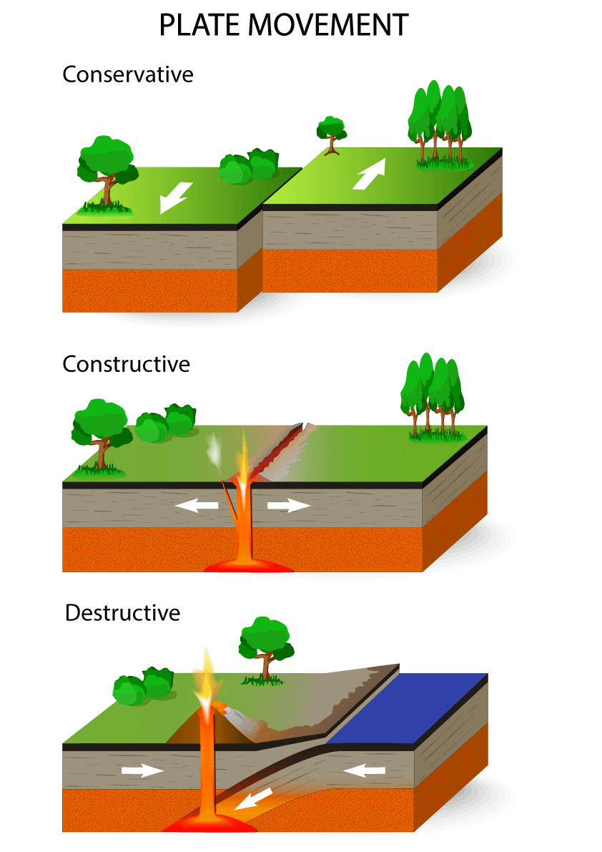
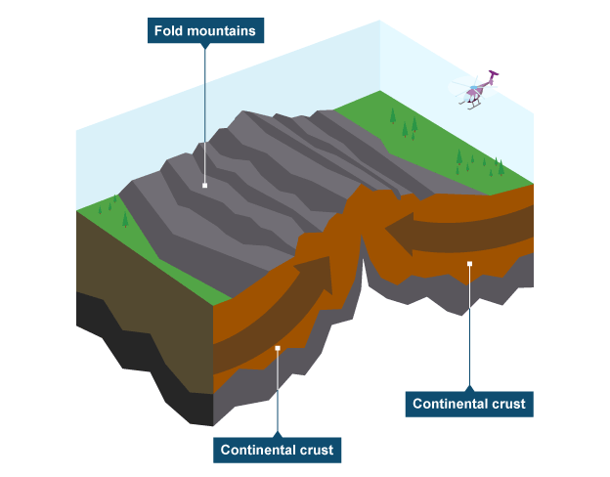
Big question: How hazardous are volcanic eruptions?
Year 8: Topic One – Tectonic Hazards
Knowledge Organiser
Key idea 1: What is a natural hazard?
Natural hazards are extreme natural events that can cause harm to people and property.
Hazard risk increases when more people live in hazardous areas or when they are poorly prepared.
It also increases when a hazard is frequent or intense. The three main types of hazard are geological (e.g. earthquakes, volcanoes), atmospheric (e.g. storms) and hydrological (e.g. floods).
Hazard risk is affected by population density, wealth, urbanisation, and how well people can predict and prepare for events.
Key idea 2: What happens at different plate boundaries?
The Earth’s crust is divided into large pieces called tectonic plates, which float on the mantle.
At constructive boundaries, plates move apart and magma rises to create new crust, such as the Mid-Atlantic Ridge.
At destructive boundaries, plates collide and one subducts beneath the other, forming volcanoes and earthquakes.
At conservative boundaries, plates slide past each other, causing earthquakes but no volcanoes.
At collision boundaries, two continental plates meet to form fold mountains.
Key idea 3: How do volcanoes differ physically?
There are three main types of volcano: Shield, Composite, and Supervolcanoes.
Shield volcanoes have gentle slopes and erupt runny basaltic lava, creating wide volcanoes that erupt frequently but less violently (e.g. Mauna Loa, Hawaii).
Composite volcanoes have steep sides made from alternating layers of ash and lava. Their thick andesitic lava traps gas, causing explosive eruptions (e.g. Mount Etna, Italy).
Supervolcanoes are massive depressions called calderas that can eject thousands of cubic kilometres of material. Their eruptions have global effects on climate and can cause widespread destruction (e.g. Yellowstone, USA).
Key idea 4: Why was Mount Nyiragongo more hazardous than Eyjaffjallajokull?
Mount Nyiragongo (DR Congo, 2002) erupted in a low-income country where people were less prepared. The fast-flowing basaltic lava destroyed homes in Goma and killed around 147 people. There was limited monitoring and poor infrastructure, so evacuation was difficult.
In contrast, Eyjafjallajökull (Iceland, 2010) occurred in a high-income country with strong preparation and monitoring. Although no one died, ash clouds disrupted global flights, showing how even a moderate eruption can have worldwide impacts.
Helpful revision - KS3 Geography - BBC Bitesize

Slide 2
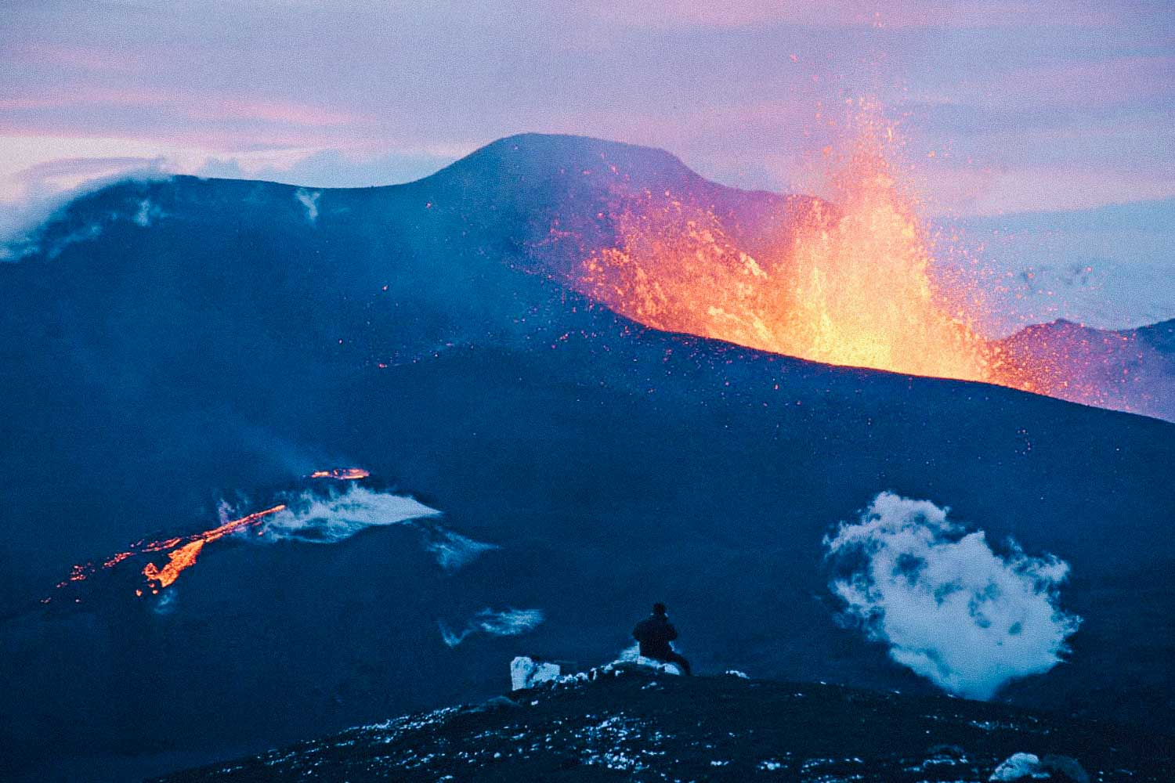
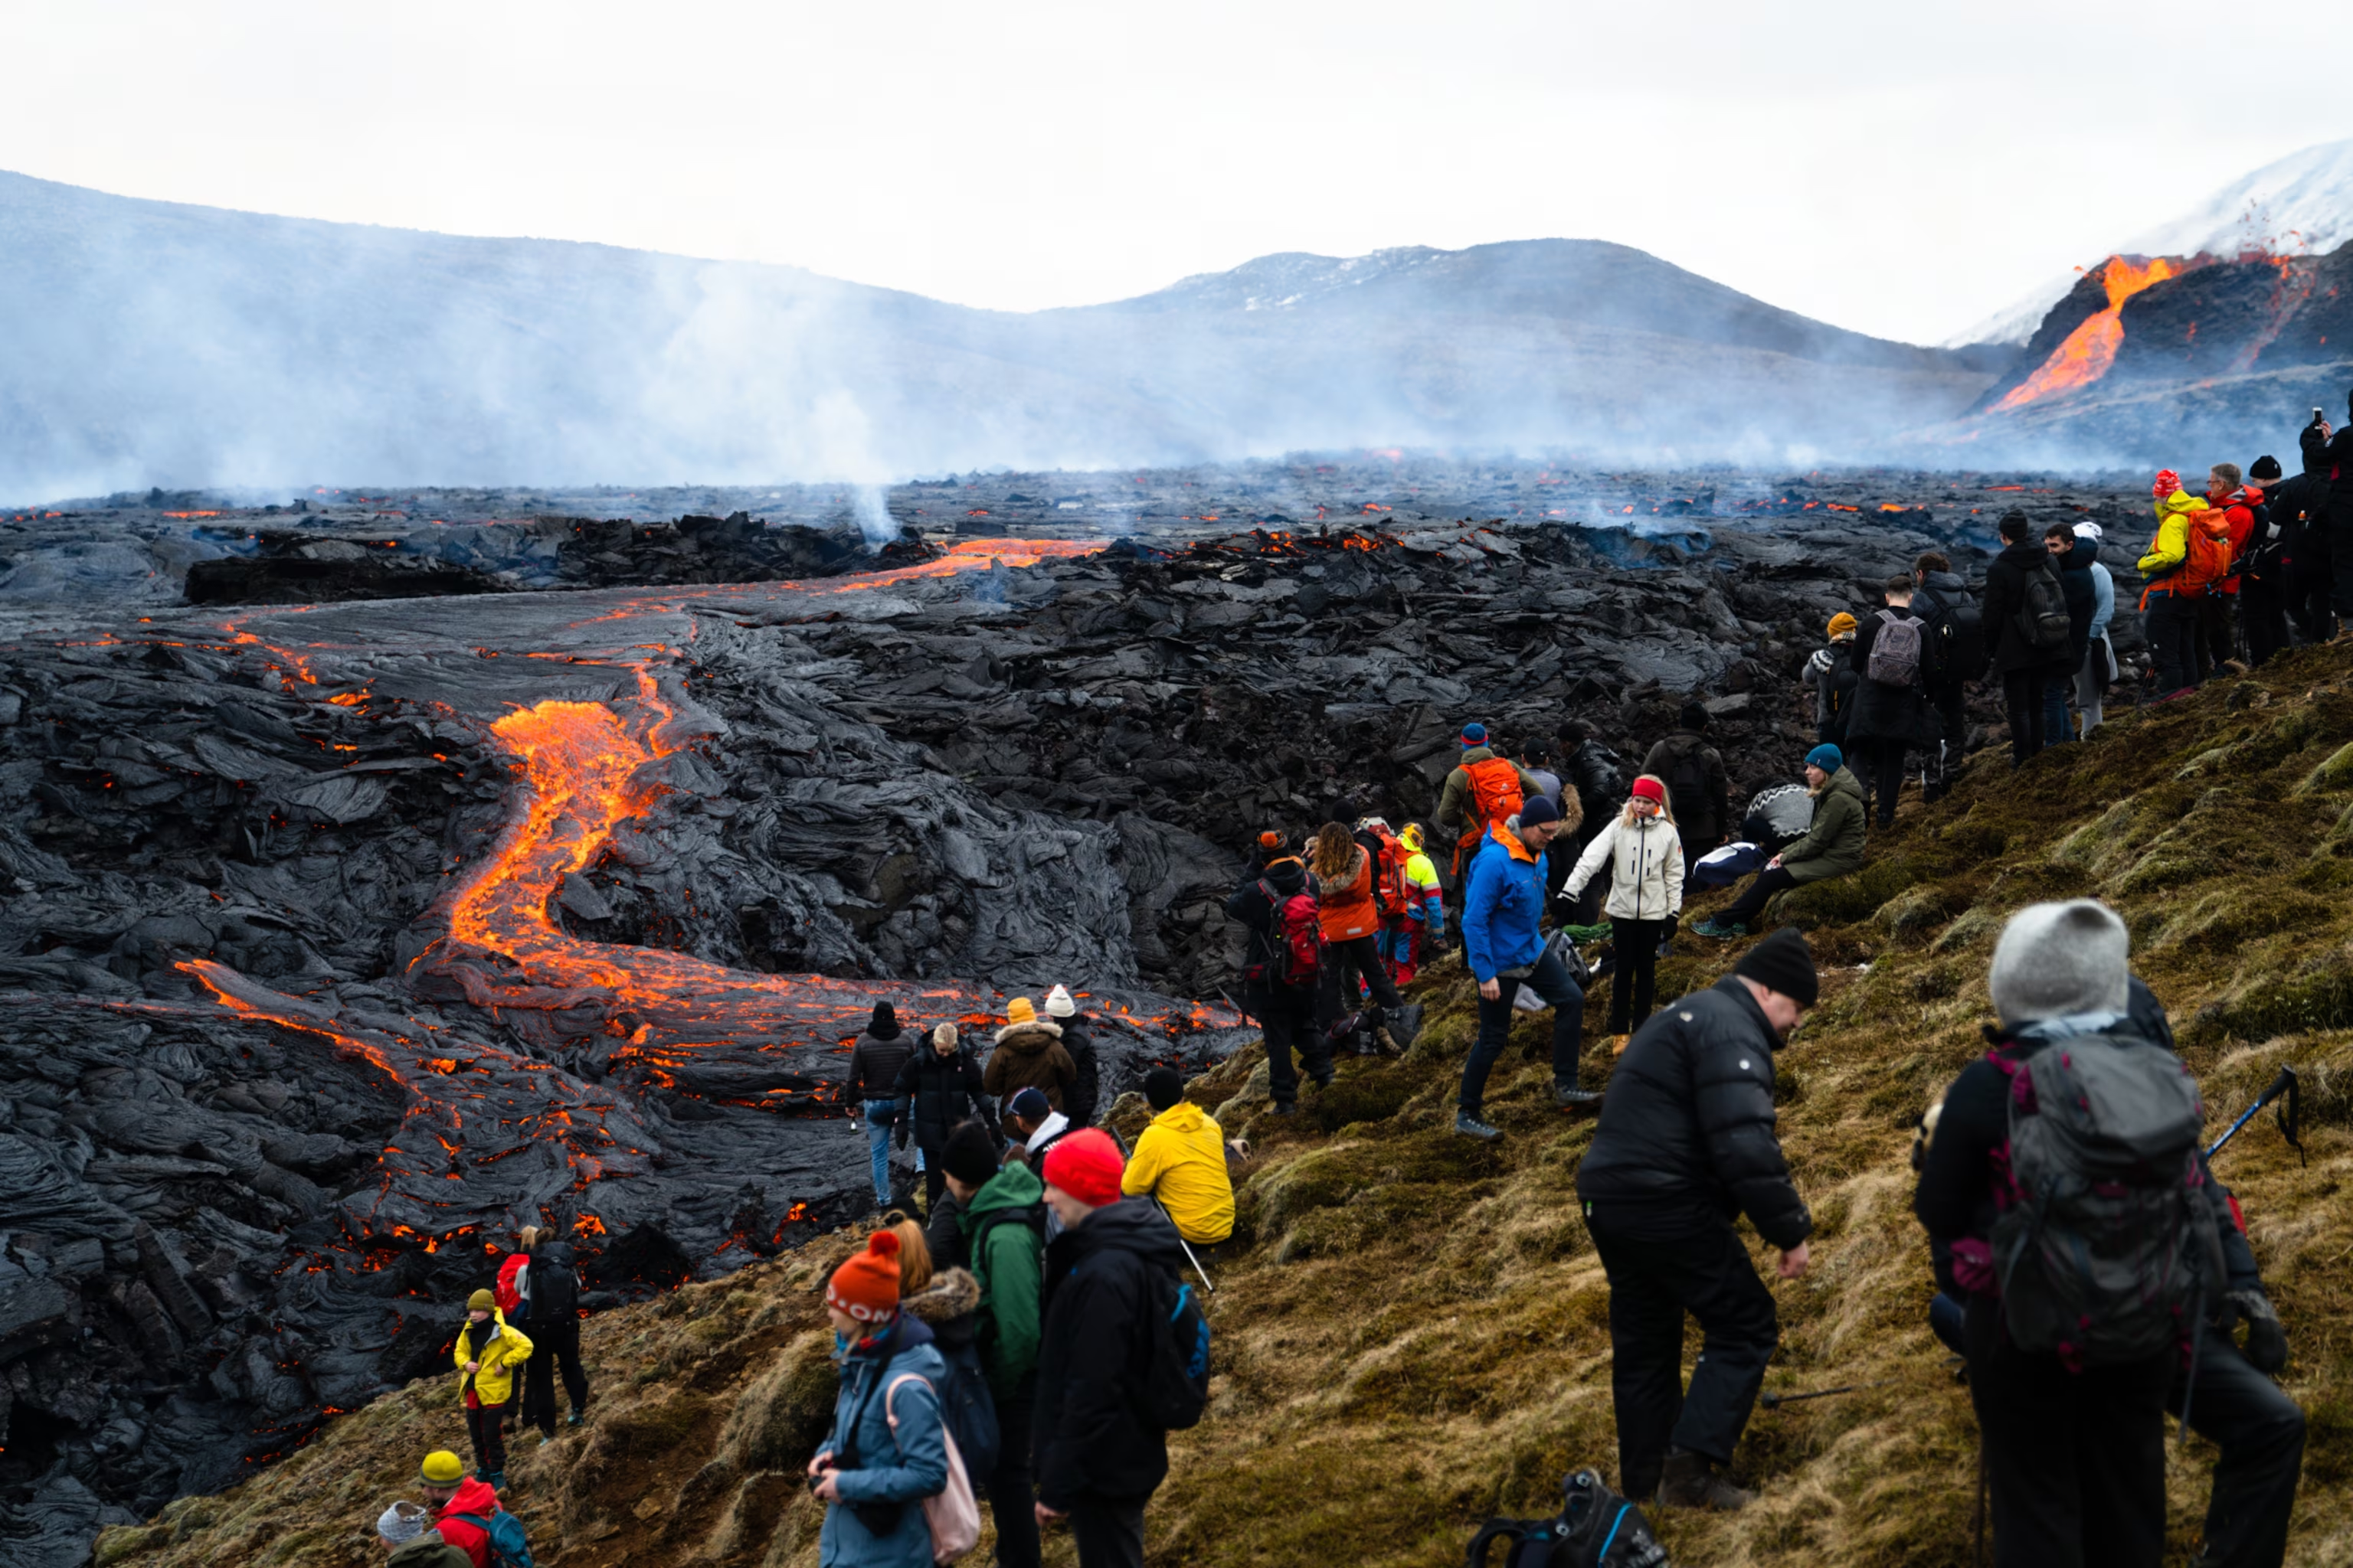
Big question: How hazardous are volcanic eruptions?
Year 8: Topic One – Tectonic Hazards
Knowledge Organiser
Key idea 5: How can volcanic hazards be managed?
Volcanic hazards can be managed through prediction, preparation and response.
Scientists monitor warning signs such as earthquakes, gas emissions and temperature changes.
Preparedness includes evacuation routes, emergency drills and public education.
Response includes rescuing people, delivering aid and rebuilding damaged areas.
Long-term management includes improving infrastructure, land-use planning and international aid.
High-income countries usually have stronger prediction systems and faster recovery than low-income countries.
Key idea 6: How has migration shaped our school community?
Better monitoring and communication could have saved lives. Installing more seismometers and improving emergency warnings would have helped people evacuate sooner.
Education programmes and safe shelters could reduce risk in future eruptions.
International aid helped rebuild Goma, but stronger roads, hospitals and power supplies are needed for long-term resilience.
Key idea 6: How can volcanoes bring advantages?
Volcanoes can bring economic and environmental benefits.
Lava and ash create fertile soils for farming.
Volcanic rocks supply valuable minerals and geothermal energy can generate electricity.
Volcanic landscapes attract tourists, creating jobs and income for local communities.
Countries such as Iceland and Italy benefit from geothermal energy, agriculture and tourism.
Although risky, people continue to live near volcanoes because of these opportunities.
Helpful revision - KS3 Geography - BBC Bitesize

