Slide 1
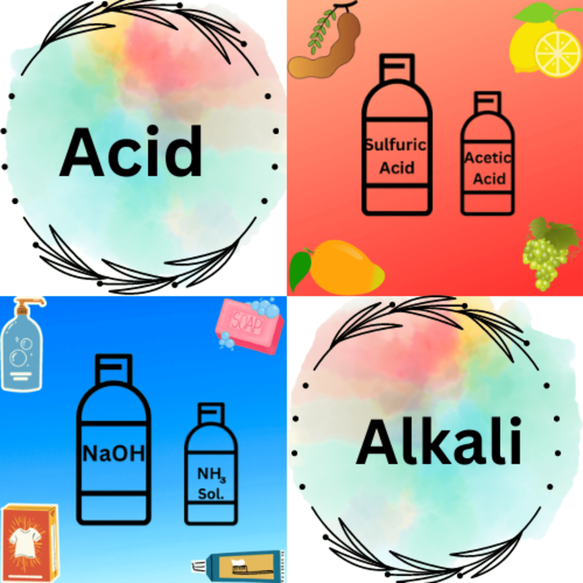
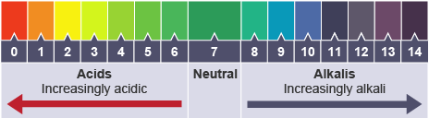

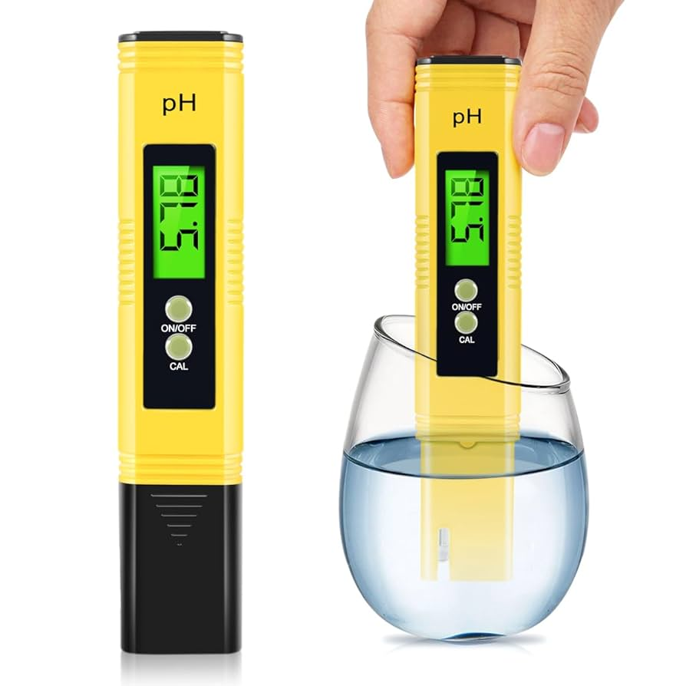
7.4 Acids and Alkali KO
1. Acids, Bases, and Alkalis
Acid: pH below 7, produces H⁺ ions in solution.
Alkali: soluble base, pH above 7, produces OH⁻ ions in solution.
Base: a substance that neutralises an acid.
Common examples: hydrochloric acid (HCl), sulfuric acid (H₂SO₄), sodium hydroxide (NaOH).
2. pH Scale & Indicators
pH scale: 0–14 (0 = strong acid, 7 = neutral, 14 = strong alkali).
Universal indicator: shows a range of colours to indicate pH.
Other indicators: litmus (red in acid, blue in alkali), methyl orange, phenolphthalein.
pH probe/data logger: more accurate than colour indicators.
🔴 Common Misconceptions
All bases are alkalis – pupils may not realise that only soluble bases are alkalis.
Acids are always dangerous – not all acids are corrosive; some are weak and safe in everyday products (e.g., citric acid in fruit).
3.pH scale is only about colour – students may forget it’s numerical (0–14) and linked to H⁺/OH⁻ concentration.

Slide 2
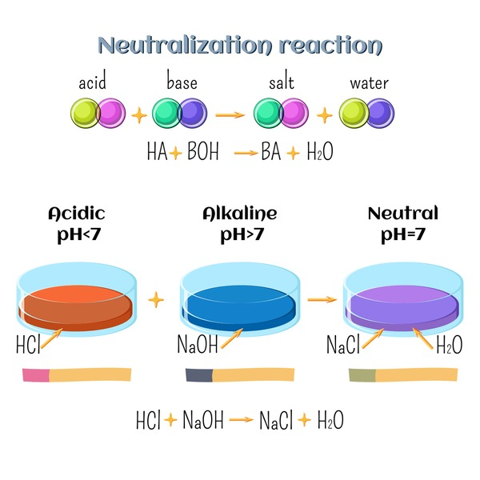
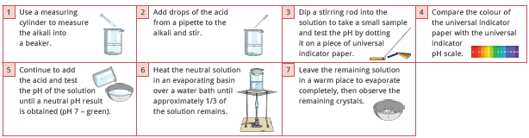
7.4 Acids and Alkali KO
3. Neutralisation
Definition: Acid + Base → Salt + Water.
Examples:
  HCl + NaOH → NaCl + H₂O
  H₂SO₄ + CuO → CuSO₄ + H₂O
Neutralisation moves pH closer to 7.
4. Making Copper Sulfate (Salt Preparation)
Steps:
  Add excess copper oxide to sulfuric acid.
  Filter to remove unreacted solid.
  Evaporate and leave to cool → crystals form.
Key words: excess, filtration, crystallisation.
Misconception
Neutralisation always gives pH 7 – pupils may think the end point is always exactly 7, forgetting that it depends on strengths of acid/base.
Neutralisation produces gas – some may confuse with other reactions (e.g., acid + carbonate → CO₂).
Indicators always give the same colour change – they may think all indicators behave like litmus.

Slide 3
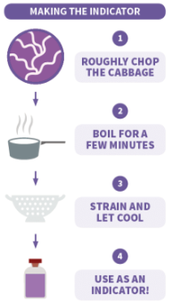
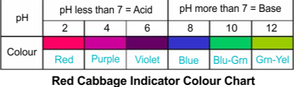
7.4 Acids and Alkali KO
5. Red Cabbage Indicator (Practical Link)
Natural indicator changes colour with pH.
Useful for showing acids and alkalis in a simple way
Misconception
“Strong” = “concentrated” – pupils often mix up strength (ionisation ability) with concentration (amount of solute).
Copper oxide dissolves in water – some may expect it to dissolve instead of needing acid to make copper sulfate

Slide 4
7.4 Acids and Alkali KO
❓ Key Questions to Probe Understanding
What is the difference between a base and an alkali?
How do acids and alkalis differ in terms of ions produced?
What does a pH of 3 tell you about a solution compared to a pH of 6?
Why is universal indicator more useful than litmus?
What happens to the pH when an acid reacts with an alkali?
Write a balanced equation for the neutralisation of HCl with NaOH.
Why is “excess” copper oxide added when preparing copper sulfate?
What do we mean by “filtration” and “crystallisation” in salt preparation?
Why might a pH probe be better than an indicator?
Give examples of acids and alkalis you might encounter at home.
Keyword | Definition
Acid | Substance with a pH below 7 that produces H⁺ ions in solution.
Base | Substance that neutralises an acid.
Alkali | A soluble base that produces OH⁻ ions in solution.
pH Scale | Scale from 0 (strong acid) to 14 (strong alkali), with 7 as neutral.
Indicator | A substance that changes colour to show whether a solution is acidic, neutral, or alkaline.
Universal Indicator | Shows a full range of colours to indicate pH.
Litmus | Indicator that is red in acid and blue in alkali.
Methyl Orange | Indicator that is red in acid and yellow in alkali.
Phenolphthalein | Indicator that is colourless in acid and pink in alkali.
Neutralisation | Reaction between an acid and a base producing salt and water.
Salt | Compound formed when the hydrogen in an acid is replaced by a metal or ammonium ion.
Copper Sulfate | A salt made from sulfuric acid and copper oxide.
Filtration | Method used to separate an insoluble solid from a liquid.
Crystallisation | Process of forming solid crystals from a solution.
pH Probe/Data Logger | Electronic device used to measure pH accurately.

