Slide 1
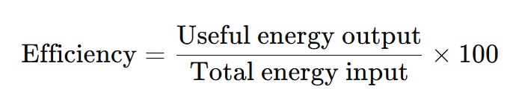
7.Energy KO
Energy Store | Description
Kinetic | Moving objects have energy in their kinetic store.
Gravitational | Objects gain energy in their gravitational potential store when they are lifted above ground.
Elastic | Objects have energy in their elastic potential store if they are stretched or compressed.
Electrostatic | Objects with charge (like electrons and protons) interacting with one another have energy in their electrostatic store.
Magnetic | Magnets interacting with each other have energy in their magnetic store.
Chemical | Objects with energy in their chemical store can release energy in chemical reactions.
Nuclear | Atomic nuclei release energy from their nuclear store during nuclear reactions.
Thermal | All objects have energy in their thermal store; the hotter the object, the more energy it has in this store.
Example 1 – Light Bulb
Total input energy = 100 J
Useful output energy (light) = 20 J
Wasted energy (heat) = 80 J
Efficiency = (20 J ÷ 100 J) × 100 = 20%
Example 2 – Electric Motor
Total input energy = 500 J
Useful output energy (kinetic) = 400 J
Wasted energy (heat + sound) = 100 J
Efficiency = (400 J ÷ 500 J) × 100 = 80%
Ways to Increase Efficiency
- Reduce wasted energy → insulation, lubrication, streamlining
- Use more efficient appliances (e.g. LED bulbs, modern motors)
- Recover waste energy (e.g. regenerative braking)
⚠️ Common Misconceptions
Efficiency over 100% is possible –miscalculate or assume you can get “more out than in.”
Cost of electricity depends only on power rating – forgetting time and cost per kWh
Equation | Cost = Energy used (kWh) × Cost per kWh
Values | Energy used = Power × time = 2 kW × 0.5 h, Cost per kWh = 30p
Calculation | Energy used = 1 kWh, Cost = 1 × 30p
Answer | 30
Units | pence (p)
Calculating the Cost of Electricity
Equation
Cost = Energy used (kWh) × Cost per kWh
Example Calculation

Slide 2

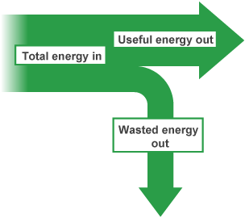
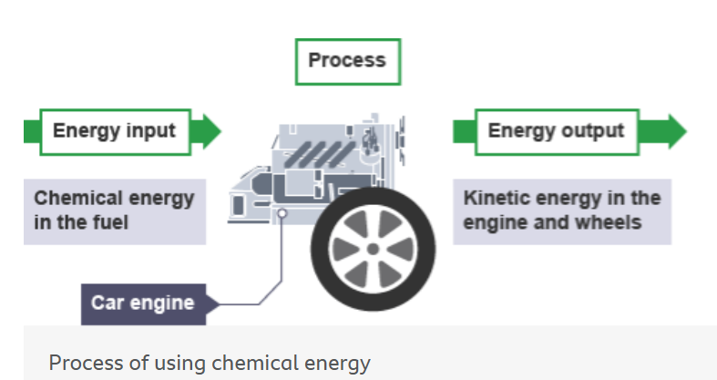
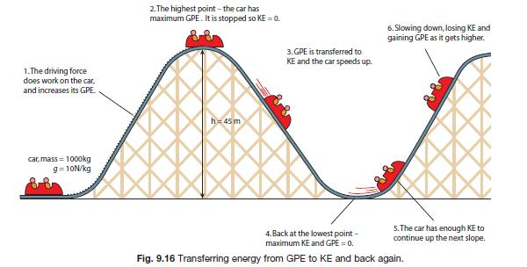
7.Energy KO
Energy Dissipation
This is where energy is ‘wasted’ by being transferred out to the surroundings. Energy becomes stored in less useful ways.
Sankey diagrams summarise all the energy transfers taking place in a process.
The thicker the line or arrow, the greater the amount of energy involved.
General Energy Transfer Rule
Energy is transferred from one store to another by a process.
Example:
Input store → Chemical energy
Process → Engine
Output store → Kinetic energy
Energy Stores in a Roller Coaster 🎢
At the top of the track → lots of gravitational potential energy (GPE).
As the coaster goes downhill → GPE is transferred into kinetic energy (movement).
At the bottom → kinetic energy is greatest, GPE is lowest.
As the coaster goes up again → kinetic transfers back into GPE.
Some energy is always lost to the surroundings as heat (friction) and sound.
⚠️ Common Misconceptions
Energy is “used up” – pupils often think energy disappears, rather than being transferred or dissipated into less useful stores.
All input energy is useful – forgetting about wasted energy (heat/sound).
Sankey diagram arrows are random – not understanding thickness shows amount of energy.

Slide 3
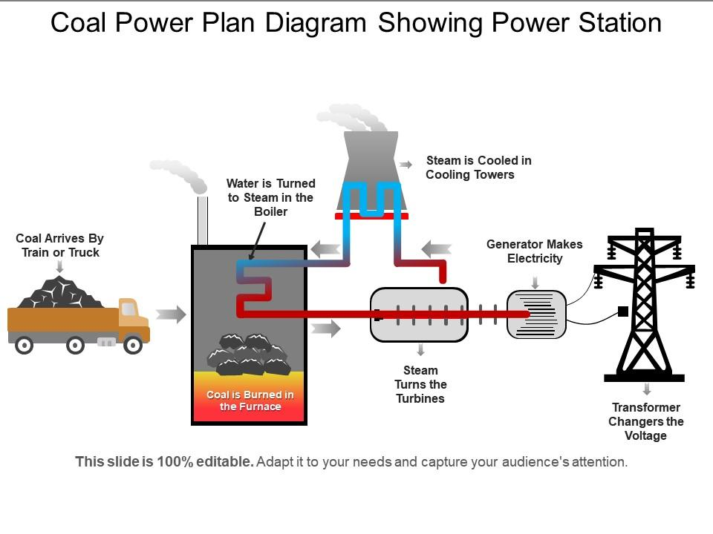









7.Energy KO
Non-renewable energy resource | These will run out. It is a finite reserve. It cannot be replenished.
Renewable energy resource | These will never run out. It is an infinite reserve. It can be replenished.
Power station | Generates electricity | Fuel burnt releasing thermal energy | Water boils into steam | Steam turns turbine | Turbine turns generator | Generator induces voltage
Energy resource | How it works
Fossil Fuels (coal, oil and gas) | Burnt to release thermal energy used to turn water into steam to turn turbines
Nuclear | Nuclear fission process
Biofuel | Plant matter burnt to release thermal energy
Tides | Every day tides rise and fall, so generation of electricity can be predicted
Waves | Up and down motion turns turbines
Hydroelectric | Falling water spins a turbine
Wind | Movement causes turbine to spin which turns a generator
Solar | Directly heats objects in solar panels or sunlight captured in photovoltaic cells
Geothermal | Hot rocks under the ground heats water to produce steam to turn turbine
⚠️ Misconceptions – Renewable & Non-Renewable Energy
Renewable energy never runs out instantly – pupils may think it can’t be affected by conditions (e.g. solar panels always work, wind always blows).
Renewable means no environmental impact – pupils sometimes assume renewables don’t cause pollution (ignoring manufacture, land use, noise, or habitat disruption).
Non-renewable fuels will last forever – pupils may not realise coal, oil, and gas supplies are finite.
Burning fossil fuels only releases useful energy – forgetting that waste heat and pollution are also produced.
Nuclear energy is renewable – pupils often confuse “low carbon” with renewable.

Slide 4
7.Energy KO
❓ Key Questions for Pupils
What does the law of conservation of energy tell us about energy transfers?
In a light bulb, why is most of the energy “wasted”?
How do Sankey diagrams help us understand efficiency?
How is energy transferred in a roller coaster as it moves up and down the track?
What does “dissipation” mean, and why is this energy less useful?
How can we increase efficiency in machines and appliances?
How do we calculate the cost of electricity used in a home appliance?
Why can efficiency never be more than 100%?
Energy Calculations Efficiency (Light Bulb)
A bulb takes in 120 J of energy and gives out 30 J as light.
- Calculate the efficiency of the bulb.
Sankey Diagram – Energy Transfer
A heater takes in 200 J of energy. It transfers 150 J usefully as heat and 50 J is wasted as sound.
- Draw or describe a Sankey diagram for this process.
- Calculate the efficiency of the heater.
Cost of Electricity
A 2 kW heater is left on for 3 hours. The cost of electricity is 25p per kWh.
- Calculate the energy used in kWh.
- Calculate the total cost of running the heater.

