Slide 1
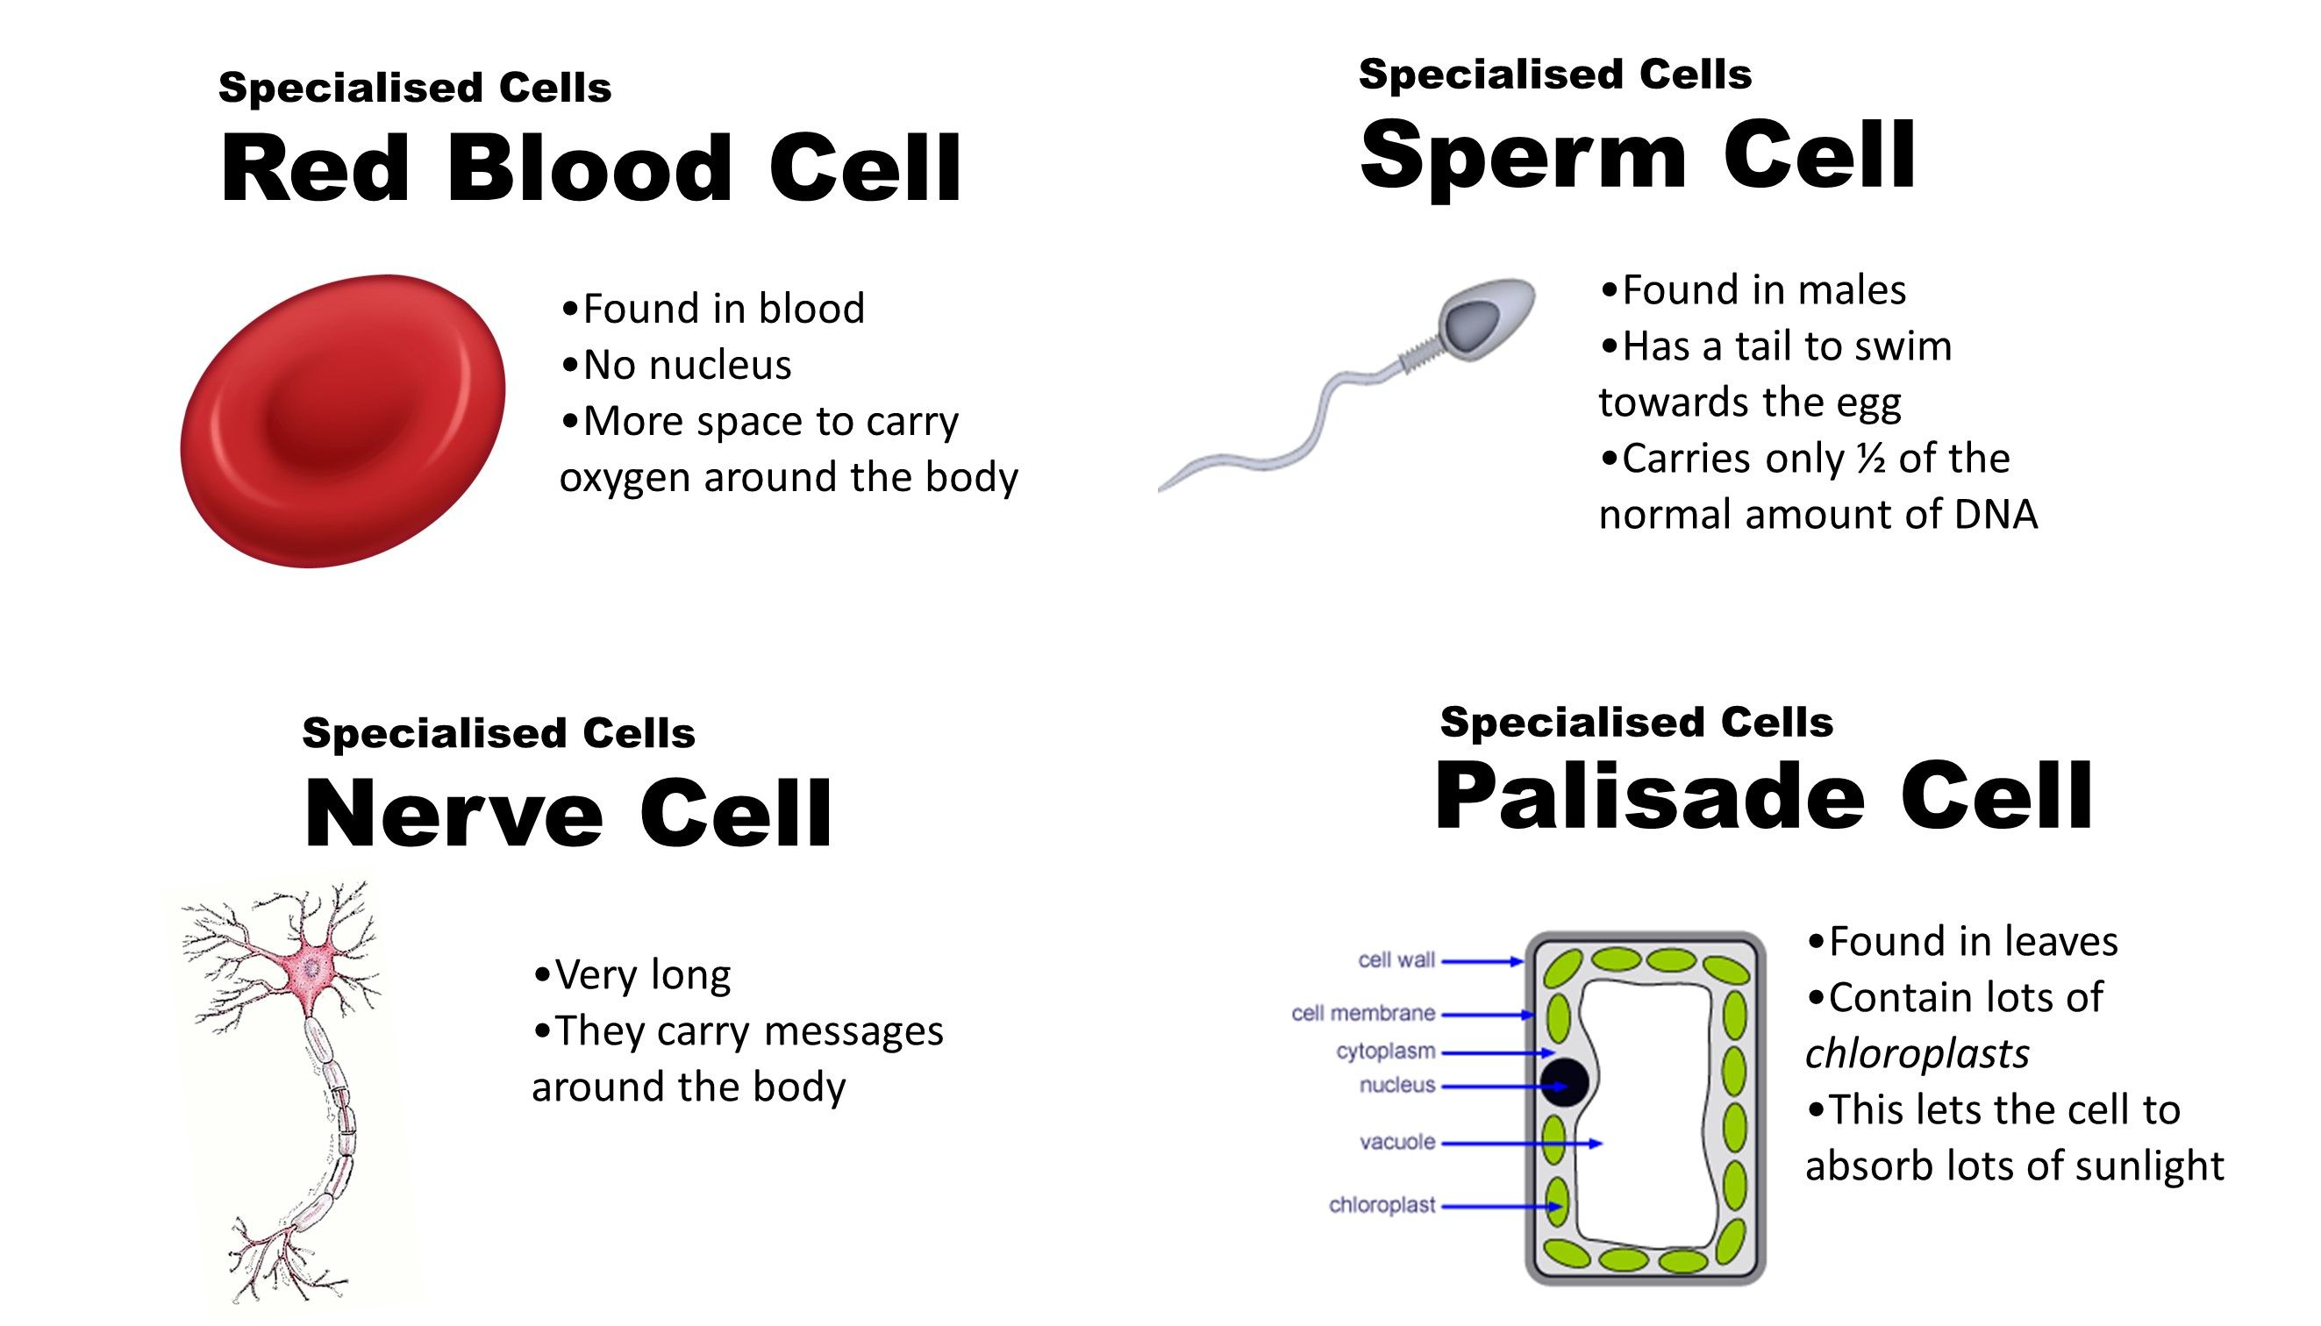
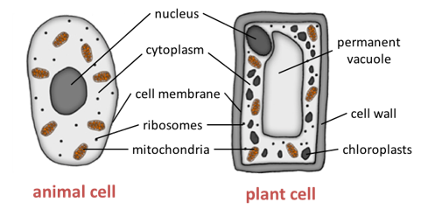
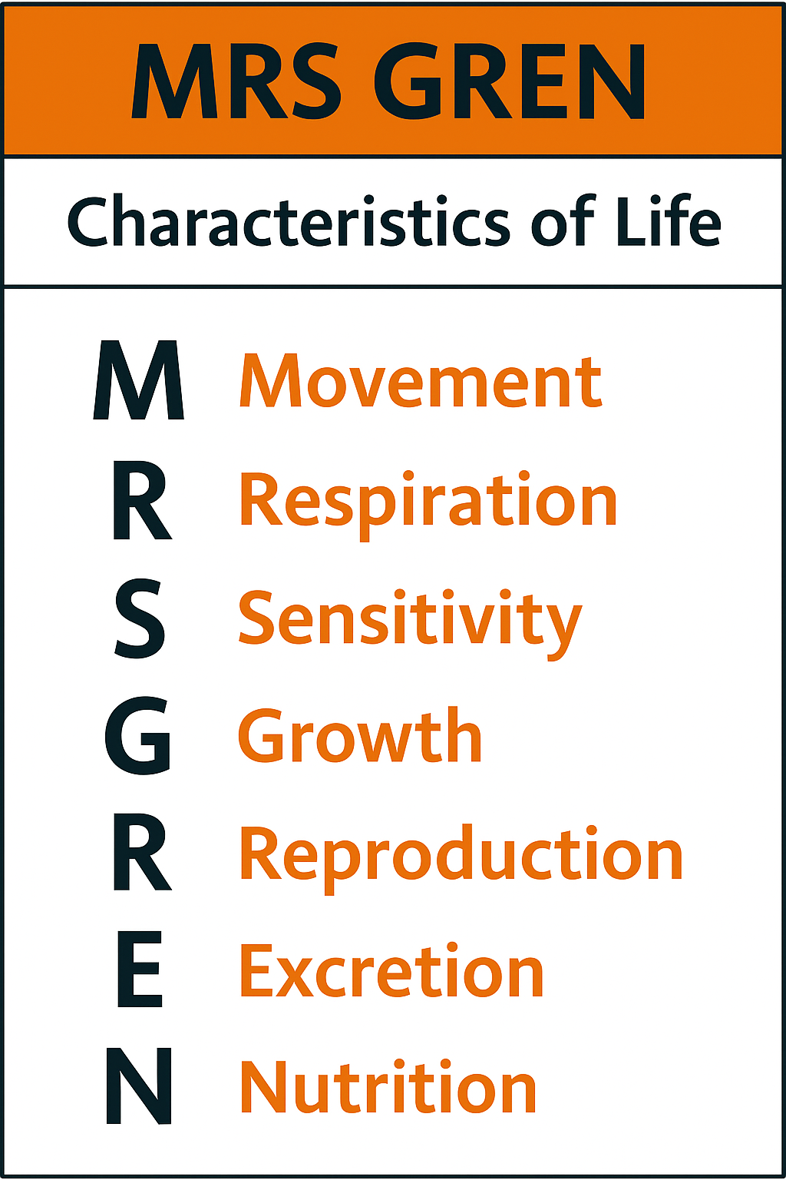
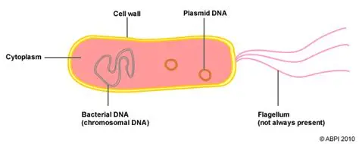
7.2 Cells KO
Organelle | Description
Nucleus​ | Controls the cell​
Cell membrane​ | Controls movement in and out of cell​
Cytoplasm​ | Where chemical reactions happen​
Mitochondria​ | Respiration​
Chloroplast​ | Photosynthesis​
Cell wall​ | Strengthens the cell​
Vacuole​ | Filled with cell sap​
Plant vs animal cells
Bacteria cell
Misconception: Cell Types
Believing all cells have a nucleus (not true for prokaryotes like bacteria).
Confusing plant cell walls with cell membranes.
Thinking chloroplasts are found in all plant cells (not true, e.g. root cells).

Slide 2
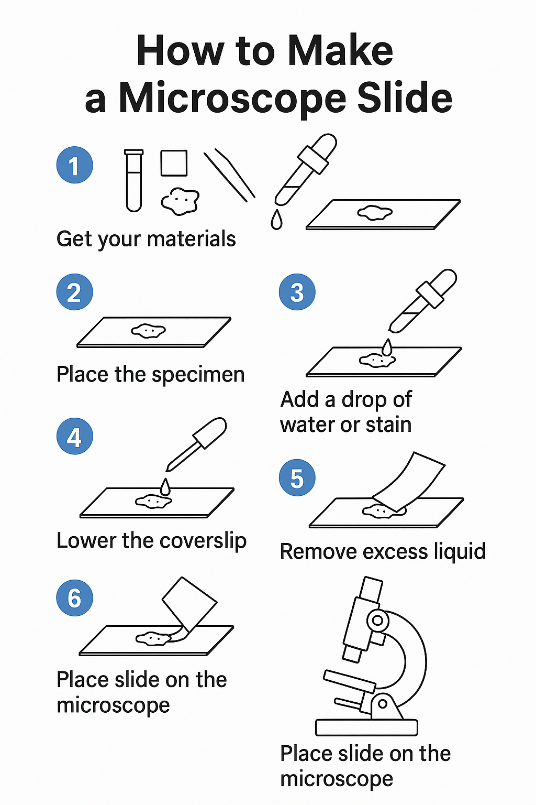
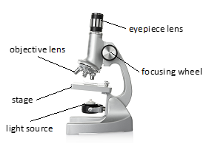
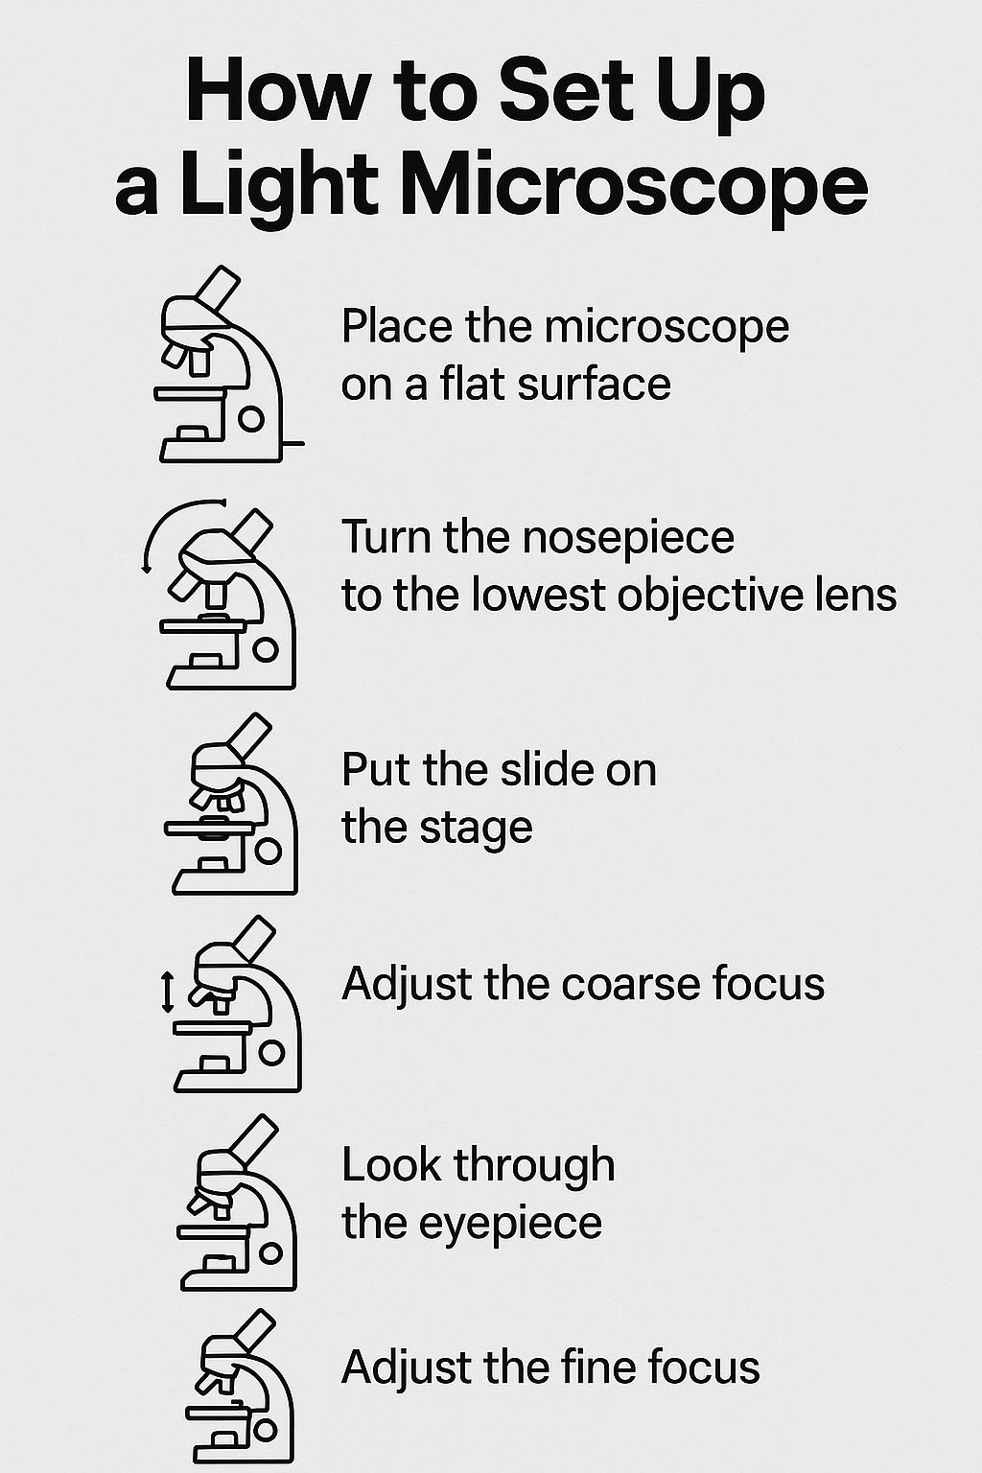
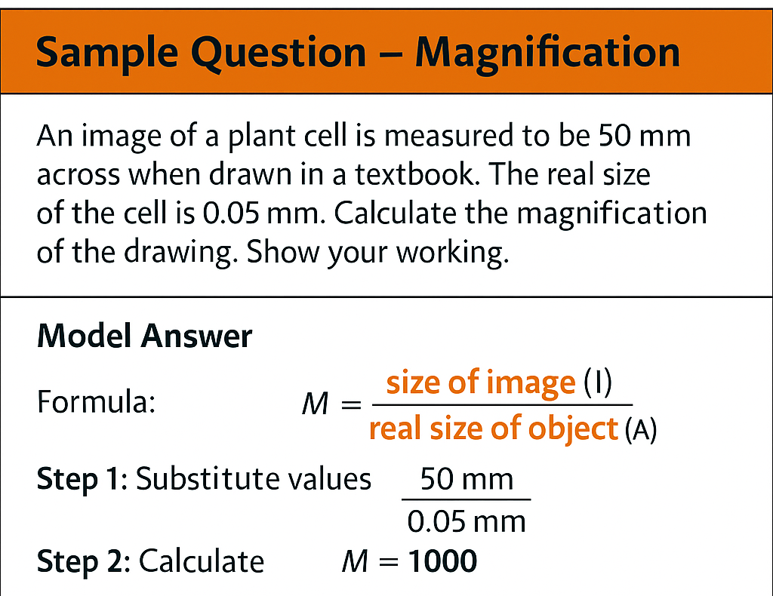
7.2 Cells KO
Misconception : Microscopes
Believing electron microscopes work the same way as light microscopes.
Struggling with magnification formula (mixing up image size and actual size).

Slide 3

7.2 Cells KO
1. MRS GREN
What does the word respiration mean in science?
How is excretion different from going to the toilet?
Key Vocabulary
MRS GREN – Movement, Respiration, Sensitivity, Growth, Reproduction, Excretion, Nutrition
Eukaryotic cell – cell with a nucleus and organelles (animal/plant)
Prokaryotic cell – cell without a nucleus (bacteria)
Nucleus, Cytoplasm, Cell membrane, Mitochondria
Chloroplast, Cell wall, Vacuole
Specialised cell, Magnification, Light microscope, Electron microscope
2.Cell Structure
How are animal and plant cells the same?
How are animal and plant cells different?
What is the main difference between a bacterial cell and an animal cell?
3.Organelles
What job does the mitochondria do in the cell?
Why don’t root cells have chloroplasts?
How is the vacuole in a plant cell different from one in an animal cell?
4.Microscopy
What is the magnification formula?
Why do electron microscopes show more detail than light microscopes?
A picture of a cell is 40 mm wide. The real cell is 0.04 mm wide. What is the magnification?
Misconception : MRS GREN
Thinking respiration = breathing (rather than a chemical reaction releasing energy).
Forgetting excretion is about removing waste products of chemical reactions

