Slide 1
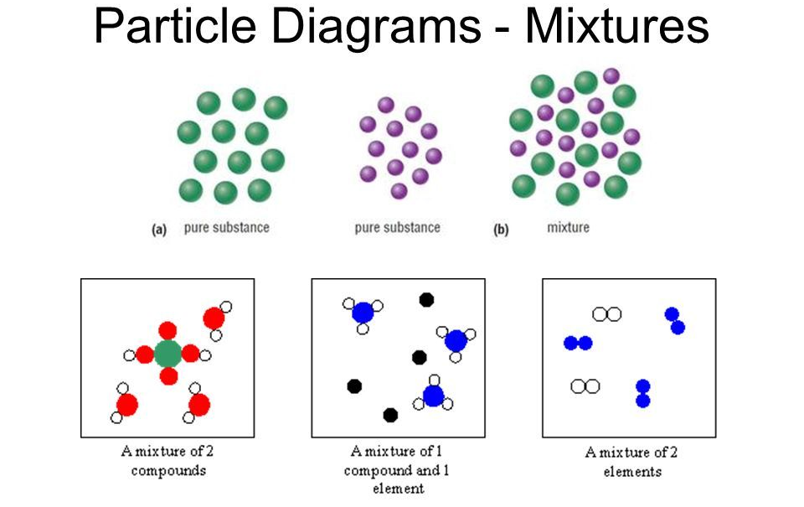
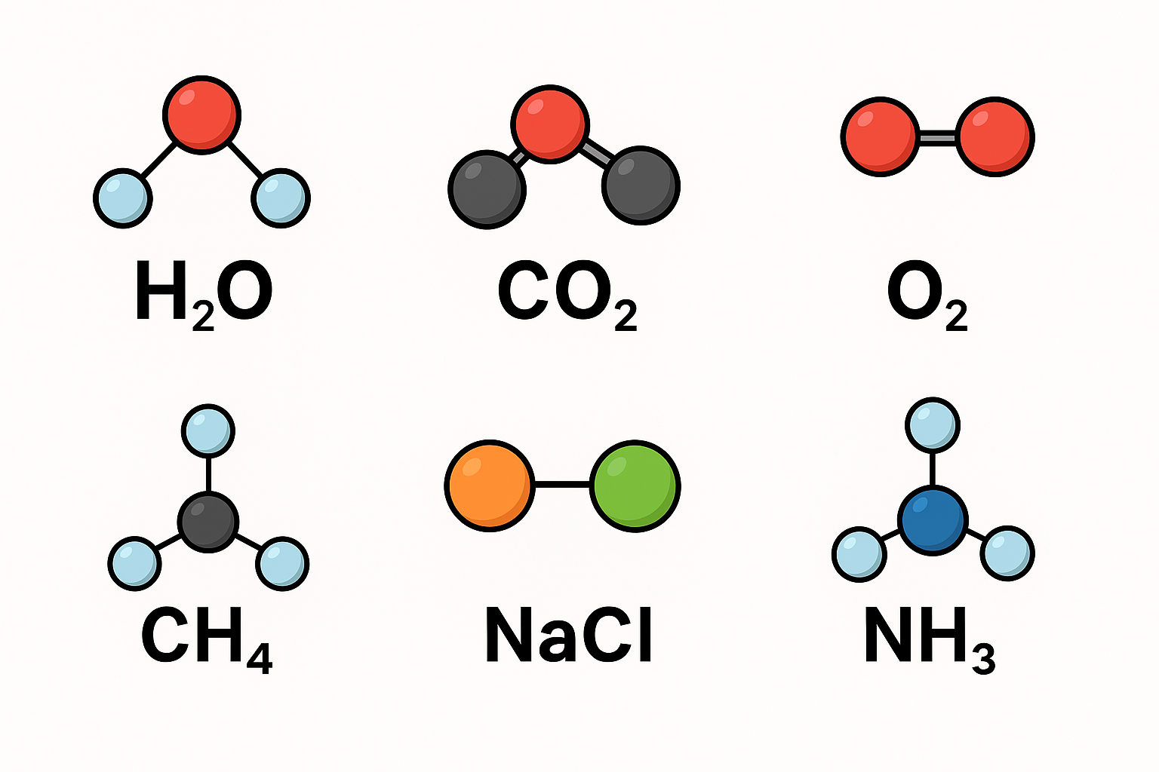
7.2 Particles KO
Atoms & Elements
  Definition of an atom (smallest particle of an element).
  Definition of element (made of only one type of atom).
  Use of the periodic table to identify elements.
2. Elements, Compounds & Mixtures
  Element: one type of atom only.
  Compound: chemically joined atoms (fixed ratio, new properties).
  Mixture: not chemically joined, easy to separate, keeps original properties.
  Particle diagrams to show differences
3. Chemical Formula
  Rules for interpreting formulae (capital/lowercase letters = different elements).
  Count number of elements & total atoms in a formula (e.g. H₂O, CO₂).
Misconception : Atoms & Elements
Thinking atoms can be seen with a normal microscope.
Mixing up compounds and mixtures (thinking they are the same).
Believing mixtures can’t be separated
Chemical Formula
Forgetting that a capital letter means a new element.
Miscounting atoms in a formula (e.g. H₂O has 3 atoms, not 2).

Slide 2
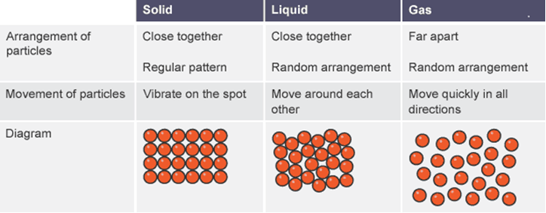
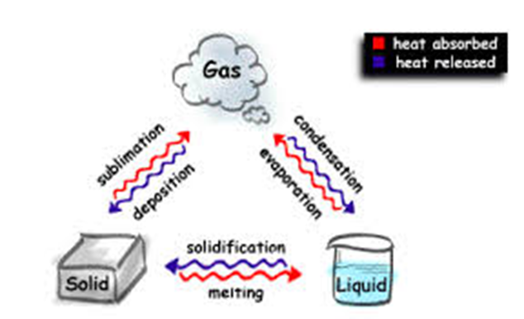
7.2 Particles KO
5. Changes of State
  Melting, boiling, evaporation, condensation, freezing, sublimation.
  Particle explanation for each (energy, movement, spacing).
  Use melting/boiling points to predict state at given temperature.
4. States of Matter
  Solids: fixed shape, particles in rows, vibrate.
  Liquids: take shape of container, particles slide past each other.
  Gases: fill container, particles move randomly, spread apart.
  Diagrams of particle arrangement.
Misconception: States of Matter
Thinking particles in solids don’t move at all (they vibrate).
Believing gases have no particles in them (“empty space”).
Changes of State
Confusing boiling and evaporation (boiling = all particles, evaporation = surface only).
Thinking temperature changes during a change of state (it stays constant).

Slide 3
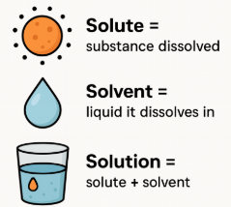
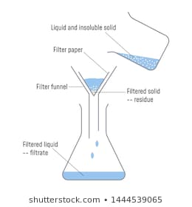
7.2 Particles KO
5. Particles in Solution
  Solute = substance dissolved.
  Solvent = liquid it dissolves in.
  Solution = solute + solvent.
  Effect of temperature on solubility.
  6.Filtration
  When it is used (insoluble solid + liquid).
  Steps: filter paper → insoluble solid stays as residue → liquid passes as filtrate.
  Explanation of how it separates mixtures.
Particles in Solution
Thinking the solute disappears completely when it dissolves.
Believing hot water always dissolves the same amount as cold water.
Filtration
Believing filtration can separate dissolved substances (it only separates insoluble solids).

Slide 4
7.2 Particles KO
Keyword | Definition
Atom | The smallest particle of an element that still has its properties.
Element | A pure substance made of only one type of atom.
Compound | A substance made when two or more different elements are joined together chemically.
Mixture | Two or more substances together but not chemically joined (can be separated easily).
Symbol | A one- or two-letter code that represents an element (e.g. O for oxygen, Na for sodium).
Formula | A way of showing the elements and number of atoms in a substance (e.g. H₂O).
Molecule | Two or more atoms joined together by bonds (can be the same element or different ones).
Solute | The substance that dissolves (e.g. sugar).
Solvent | The liquid that does the dissolving (e.g. water).
Solution | The mixture made when a solute dissolves in a solvent.
Soluble | Able to dissolve.
Insoluble | Not able to dissolve.
Filtration | A method to separate an insoluble solid from a liquid.
Residue | The solid left behind in the filter paper.
Filtrate | The liquid that passes through the filter paper.
Melting | Changing from solid to liquid.
Boiling | Changing from liquid to gas (throughout the liquid).
Evaporation | Changing from liquid to gas (only at the surface).
Condensation | Changing from gas to liquid.
Freezing | Changing from liquid to solid.
Sublimation | Changing directly from solid to gas (and back again).
Key questions:
Atoms & Elements
What is an atom?
What is an element?
How can the periodic table help us?
Elements, Compounds & Mixtures
What is the difference between an element, a compound, and a mixture?
Can mixtures be separated? How?
Chemical Formula
What does a capital letter in a formula show?
How many atoms are in CO₂?
States of Matter
How are particles arranged in a solid, liquid, and gas?
Why do gases fill a container but solids do not?
Changes of State
What is the difference between boiling and evaporation?
Does the temperature change during melting? Why not?
Particles in Solution
What is a solute, solvent, and solution?
How does temperature affect solubility?
Filtration
What does residue mean?
What does filtrate mean?
What type of mixture can filtration separate?

