Slide 1
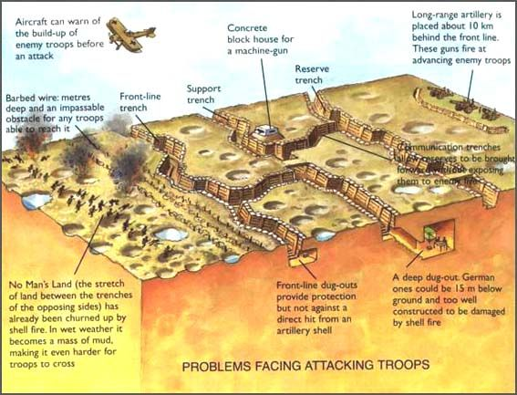
Key Vocabulary
Enquiry Question: - What was the experience of men and women from across the British Empire in the First World War?
1.Trench fever: caused by body lice and included flu-like symptoms including high
temperature.
2. Trench foot: caused by soldiers standing in mud/waterlogged trenches.
3. Shell-shock: caused by stressful conditions of war and symptoms included tiredness,
nightmares, headaches and uncontrollable shacking.
4. Machine guns: Fired 500 rounds a minutes. Pierced organs and fracture bones.
5. Artillery: Bombardments were continuous, Artillery fire caused half of all causalities.
6. Shrapnel: Caused maximum damage exploded mid-air above enemy. Killed/injured.
7. Chlorine Gas: Led to death by suffocation. 1915, gas masks given to all British soldiers.
8. Mustard Gas: Odourless gas, worked in 12 hours. Caused blisters, burn the skin easily.
9. No Man’s Land: Land between Allied and German trenches in WW1.
10.Trenches: Long, narrow ditches dug during the First World War.
11..Gangrene: When a body decomposes due to a loss of bloody supply
12. Casualty Clearing Station : Main medical establishment immediately behind the front line.
13. Munitions: - bombs bullets and explosives.
14. Conscription : In January 1916, Parliament passed the first conscription laws (compulsory enrollment)
15. Pals Battalion : Soldiers raised in the same locality with the promise they would serve with their friends.
16. WAAC : Women's Auxiliary Army Corps.
Duration: 141 days, from July 1 to November 18, 1916. Total advance 7 miles
British: 420,000 casualties. French: 200,000 casualties. German Casualties: l 450,000 killed and wounded.
First Day Casualties: British: 57,470 casualties. British Fatalities: 19,240.

