Slide 1
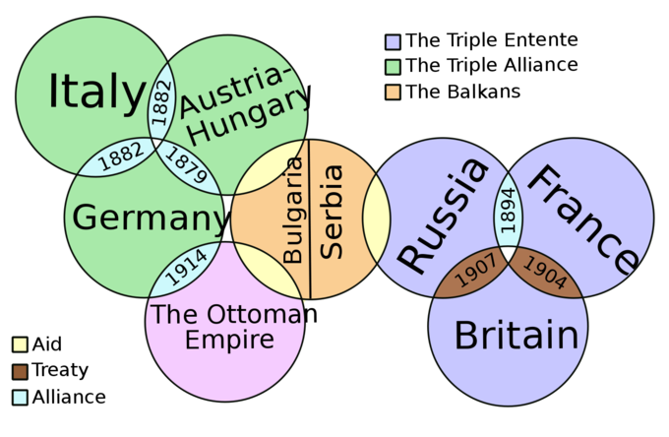
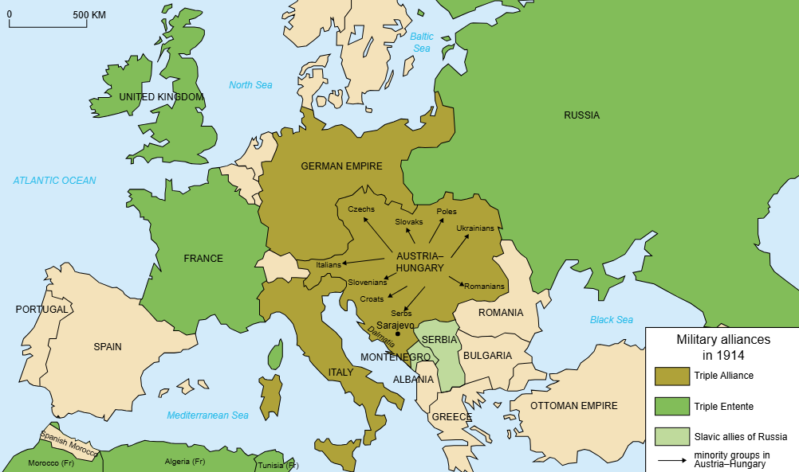
Key Vocabulary
Key Vocabulary
Enquiry Question: - Did a single bullet lead to the Great War?
9. Dreadnought: the largest and most powerful battleship during World War I that was invented by the British
empire: a group of countries or regions that are controlled by one ruler or one government
10. Imperialism: when a nation takes over another nation to rule them and take their natural resources
11.militarism: building up and maintaining a strong, well equipped military in order to defend, gain power, or achieve goals
12. Mobilize: bringing together military forces to prepare for war
13. Nationalism: feeling loyal and proud of your nation and believing your nation is better and more important than other nations
14. Schlieffen Plan: Germany's plan for fighting a two front war with Russia and France where Germany would invade France through Belgium in a surprise attack; beat them quickly; and move to the Russian front before the Russians could mobilize their army.
1.Alliances: agreements between nations to work together for a common goal or to defend each other in the event of war
2.Alliance system: when several nations form alliances with several other nations
annexed: to add an area or region to a country, state, or city
3.Archduke Franz Ferdinand: the heir to Austria-Hungary's throne whose assassination sparked WW I
4.Arms Race: a situation in which countries that are enemies each try to build or collect weapons faster than the other can
5.Assassination: Killing a famous or important person usually for political reasons
6.Black Hand: the Serbian terrorist group that planned and carried out the assassination of Archduke Franz Ferdinand
7.Boer War of 1899: a war between the British and the Dutch in Southern Africa
8. Colony: an area under the control of a mother country, whose purpose is to provide resources to help the mother country
The Big Picture

