Slide 1
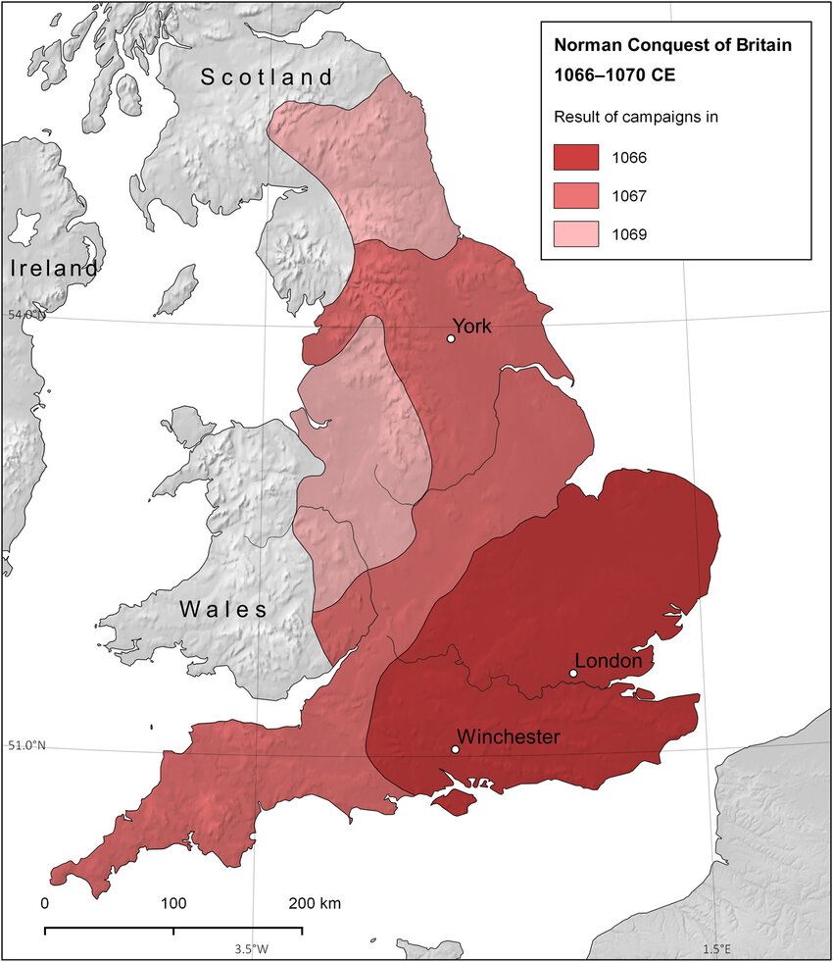
Key Vocabulary
Enquiry Question: - How effectively did the Normans conquer England?
1.ECONOMY: Things to do with money in a society.
2.DOOMSDAY BOOK: - Book produced in 1086 to gather tax and landownership information
3.HARRYING: - Destruction of land and property
4. ANGLO-SAXON: A people that invaded England from Germany in the 400s AD.
5.VIKING: Raiders and invaders from Scandinavia from 800AD to 1100AD.
6. FYRD: - Saxon peasant soldier poorly armed and trained.
7. HUSCARL: - Professional Saxon soldier well equipped and trained.
8. Hauberk: - Commonly called chain-mail armour for Norman Knights
9. NORMAN: A people that lived in Northern France (Normandy) and invaded England in 1066
10. MEDIEVAL: Things to do with the Middle Ages (1000AD-1500AD
11. Motte + Bailey CASTLE: place where rulers/lords would live in with their soldiers.
The Big Picture
These are the key events, big themes and substantive knowledge which should be considered when teaching the Norman Conquest
Jan 1066
Death of King Edward
Succession Crisis
1067-71
Anglo Saxon
Resistance
1086
The Domesday
Book
Anglo Saxon England
Oct 1065
The Embassy to Normandy
Oct 1066
The Norman Invasion
Battle of Hastings
1071-1100
The Normanisation of England
.
12. KNIGHT: A professional soldier that was given land by a lord to rule
3. MONARCH: The king/queen of a country.
14. HEIR: Someone who will inherit your lands and titles after you die.
15..FEUDAL SYSTEM: A social hierarchy established by William the Conqueror in England.
16. HOMAGE: - Process of swearing an oath in return for land.
17. POPE: The head of the Christian church.
18.MONASTERIES: A place where monks (men who dedicate their lives to God) live as a community with rules.
19. NOBILITY: People belonging to an upper class in society with a high social rank.
20. PEASANT: A labourer (often in farming) that is of low social class.
21. REBELLION: An uprising by people in a country against their rulers.
These primary sources are some of the useful source to utilise
The Anglo Saxon Chronicle, written between 890-1100
The Bayeux Tapestry, produced after the Norman Conquest
The Domesday Book, produced in 1086

