Slide 1
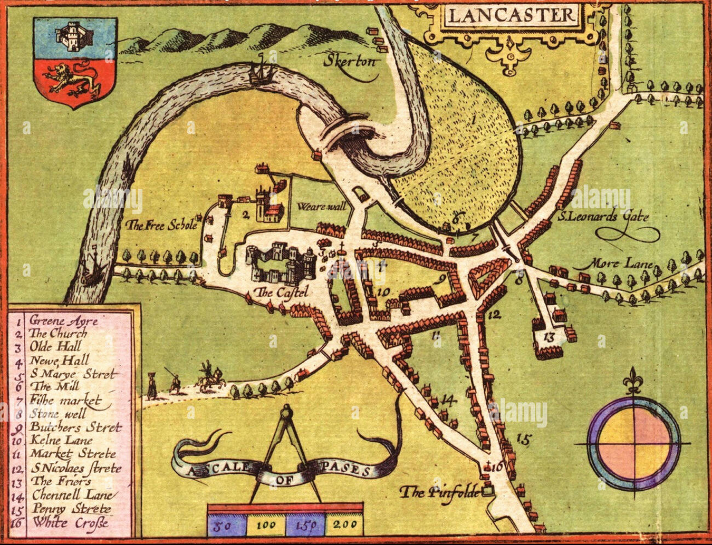
Y7 What was it like to live in the Middle Ages?
Feudal System | A way of organising society where the king gave land to nobles, who gave land to knights, and peasants worked the land.
Monastery | A community where monks lived, prayed, and worked, often providing medicine, education, and shelter.
Tithe | A tax where people gave one-tenth of their earnings to the Church.
Pope | The head of the Catholic Church, seen as God’s representative on Earth.
Crusade | A religious war fought by Christians to capture the Holy Land from Muslims.
Guild | An organisation of craftsmen or merchants who controlled trade in towns.
Villein | A peasant who worked on the lord’s land and had few rights.
Trial by Ordeal | A medieval method of deciding guilt by using dangerous tests, such as holding hot iron.
Magna Carta | A document signed in 1215 limiting the king’s power and giving some rights to nobles.
Heretic | A person accused of going against the teachings of the Church.
Black Death | A plague (bubonic and pneumonic) that killed millions in Europe in the 14th century.
Buboes | Painful swellings caused by the bubonic plague.
Revolt | A violent uprising against authority, such as the Peasants’ Revolt in 1381.
Four Humours | A medical theory that illness was caused by an imbalance of blood, phlegm, black bile, and yellow bile.
The Big Picture​
1215 – Trial by ordeal abolished; Magna Carta signed (limits king’s power).
1066 - Battle of Hastings; William the Conqueror becomes king and introduces the feudal system
1096 – Start of the First Crusade.
1381 – The Peasants’ Revolt led by Wat Tyler.
1450s – Printing press invented in Europe (new ideas spread more widely).
1070 - Building of major monasteries begins under the Normans (e.g. Durham Cathedral).
1170 – Murder of Archbishop Thomas Becket in Canterbury Cathedral (shows Church power)
1347 – The Black Death arrives in Europe (reaches England in 1348).
Noblewoman | A woman from the upper classes who could manage estates but still had fewer rights than men.
Knight | A warrior who served his lord in battle in return for land or rewards.
Peasant | A poor farmer who worked the land; most people in medieval England were peasants.
Manor | The land and village controlled by a lord, where peasants lived and worked.
Pilgrimage | A religious journey to a holy place, often to show devotion or seek healing.

