Slide 1
History
Fulwood History Department
Year 9 Knowledge
Organisers

Slide 2


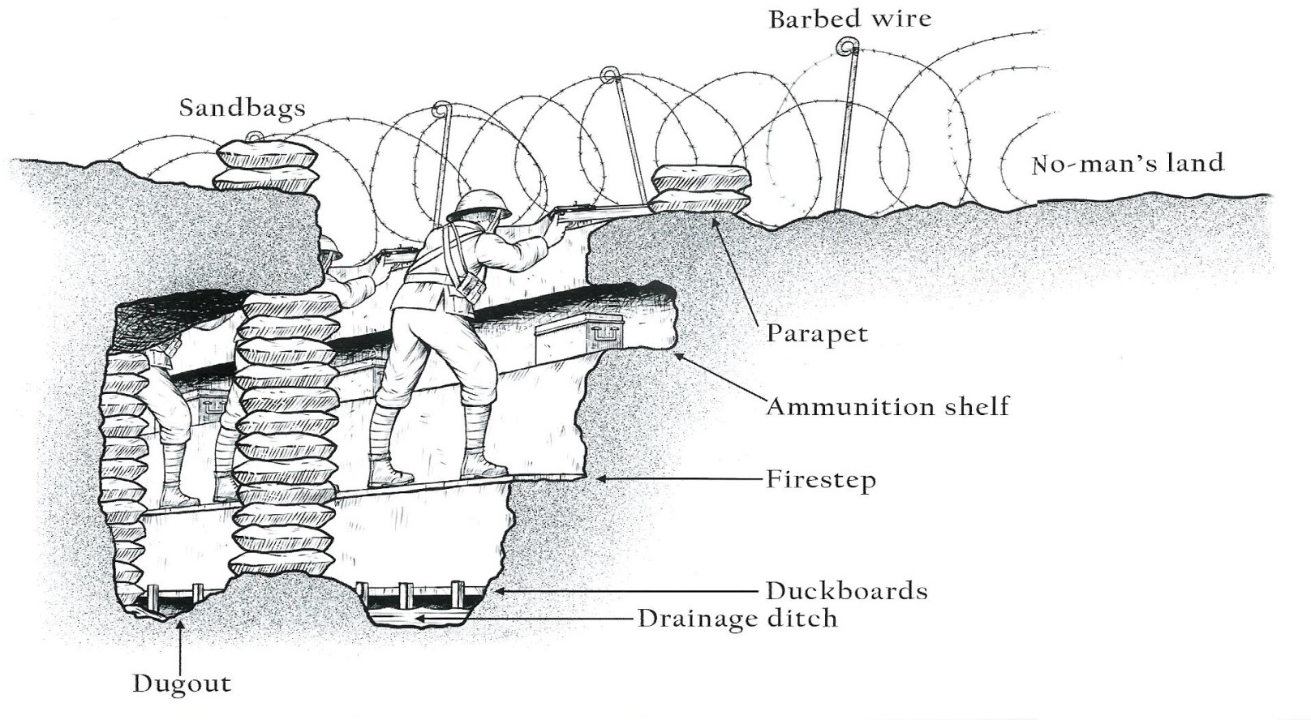
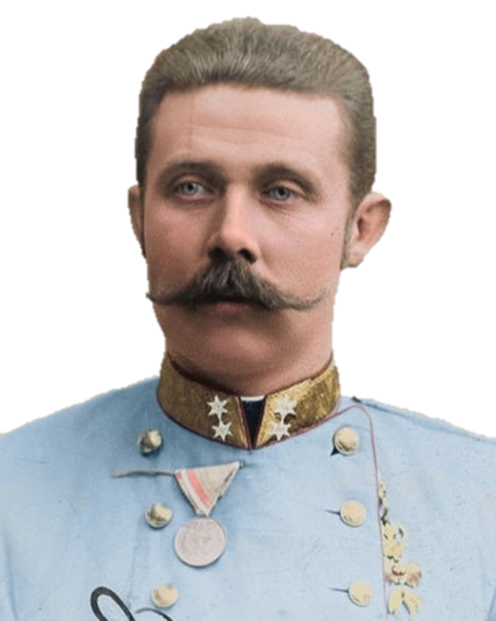
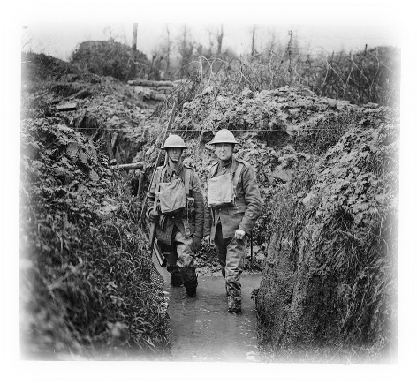
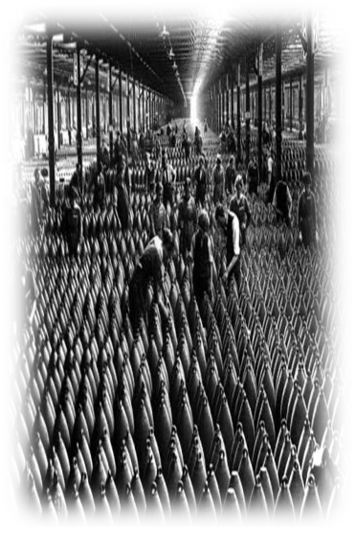
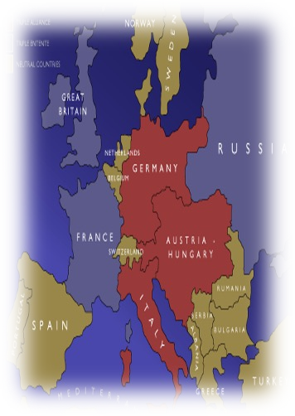
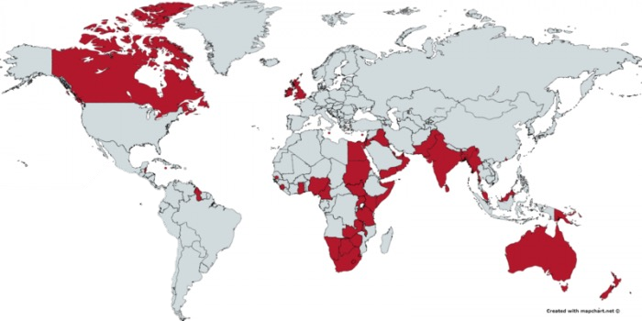
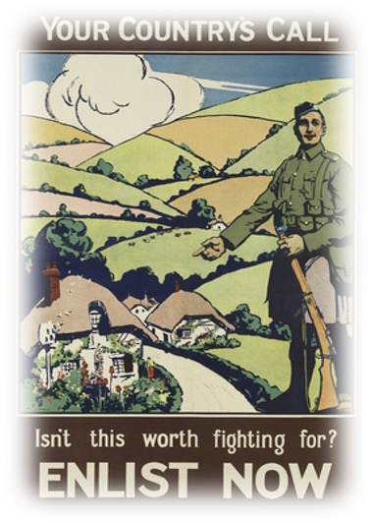
WORLD WAR ONE
Why did men go to war?
GUILT
The government used propaganda to try and guilt people into fighting. Posters appeared saying ‘your chums are fighting, why aren’t you.’
PRIDE
A lot of people wanted to fight because they wanted to prove their country was the best. They also felt strongly enough to protect it from an invasion.
FAMILIES
Many men wanted to
protect their women and children at home, and prove that they were capable of looking after others.
Knowledge organiser
Timeline
Ye a r 9
Events of the first world war
1914: The Assassination of Archduke Franz Ferdinand sparks the start of the war.
August 1914: Britain officially joins the war, claiming that it would only last 4 months.
OCtober 1914: The first battle of Ypres starts, killing many British and Belgian soldiers.
DeCember 1914: The first Zeppelins were seen over the English coast – they would be devastating to areas of Britain.
Ma/ 1915: The Lusitania sinks, killing American citizens and finally causing America to join the war effort.
1915: Italy switch sides, they begin to fight with Britain, France and Russia.
April 1915: The Zeppelins begin attacking Britain, they target coastal cities and London.
1916: David Lloyd George becomes Prime Minister of Britain, his war cabinet met every day which was highly praised.
November 1916: The Battle of Verdun begins, killing 540,000 French and 430,000 German men.
November 1916: The Battle of the Somme begins, which saw the highest number of casualties of any battle
1918: The armistice is signed finally drawing a close to the war, this was signed on the 11th November, at 11am.
1919: The Treaty of Versailles is signed, finally declaring official peace in Europe.
What were the trenches like?
BARBED WIRE
Problems in the trenches
Trench Foot: this was a condition caused because soldiers feet were constantly in the water. It led to infections and in some cases amputations were needed to treat it.
Shell Shock: This was a mental health issue that caused multiple physical reactions such as shaking and ticks which meant that they could not go over the top.
Trench Fever: This was spread by lice, and led to flu like symptoms such as headaches, coughing and fatigue.
Risks of being gassed or shot were also a big problem in the trenches.
SANDBAGS
NO MANS LAND
PARAPET
AMUNITION SHELF
FIRESTEP
DUCK BOARDS
DRAINAGE DITCH
DUGOUT
What was the short term cause of the war?
Europe was on the Brink of war, and all it took was one event to spark it off. In 1914, the Austrian Prince and his wife Sophie, were travelling through Serbia. A terrorist organisation – The Black Hand Gang- had plotted to murder them in response to Austria taking over Serbian land. After a failed attempt in the morning, Gavrilo Princip finally got his opportunity when he walked out of a sandwich shop, he shot Sophie first, and then killed Franz Ferdinand. This then caused the different European countries to declare war on each other in a domino effect.
WHAT WERE THE LONG TERM CAUSES OF THE FIRST WORLD WAR?
MILITARISM
People took great pride in their armies and navies. To make sure that theirs was the best, they spent more money on having bigger military forces. No one wanted the smallest army so countries got caught up in an ‘arms race’
ALLIANCES
As each country began to feel threatened, they
looked for friends to back them up in war –known as
allies. Europe split into two
alliances: Britain, France and Russia formed the Triple Entente; Germany, Austria-Hungary and Italy formed the Triple Alliance.
IMPERIALISM
Everyone wanted a large Empire, and so the race to
NATIONALISM
At the beginning of the 20th century, people started to take great pride in their
gain other nations, particularly in Africa, led to tension and fierce rivalries among European countries. They began to see each other as a threat to their overseas possessions, and the only way to remove the threat was to go to war with them.
countries. This is called ‘nationalism’ – thinking that your nation is better than
others. Unfortunately, for many leaders of Europe, the best way to prove they were the best was to have a war with their rivals.

Slide 3




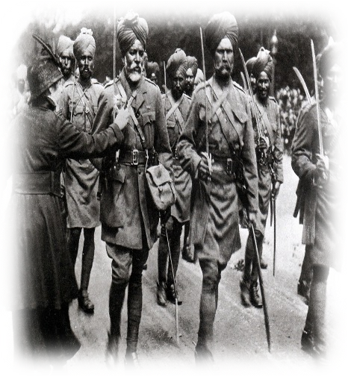
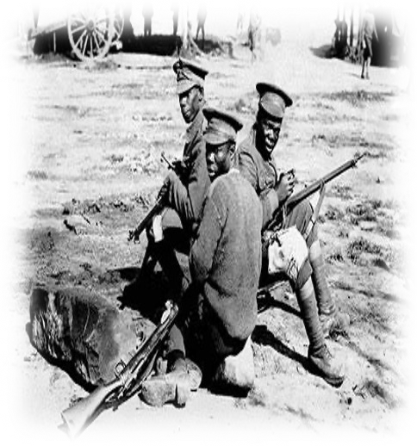
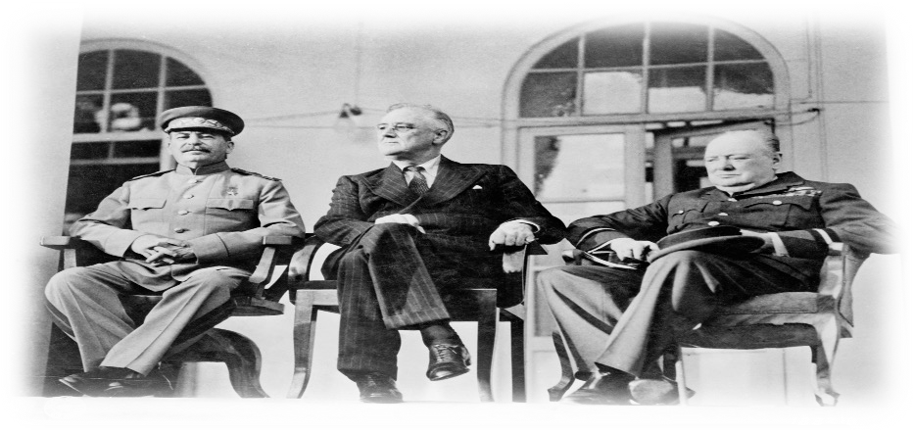
WORLD WAR ONE
Life at home during the war
Knowledge organiser
The Germans flew huge inflatable air ships called Zeppelins over the eastern part of Britain. By the end
of the war, 50
Zeppelins had dropped over 5000 bombs,
killing 557 people and injuring1300.
There was a food shortage in Britain because German submarines and ships were sinking supply ships coming into England. This brought about rationing, to limit the amount of things people could buy.
Women were able to do men’s jobs. Before long there were lots of female bus drivers, chimney sweeps and steel makers. In 1915 a Women's Land Army formed to farm the land.
At the start of the war, the government brought in a new law: The Defence of the Realm Act (DORA) which allowed them to do whatever they felt was necessary to win the war.
Around 70 million men around the world fought in World War One. Over 8 million men fought from
Britain and its
Empire, and 1 million of these were killed. 2 million were injured.
Ye a r 9
Who do we blame for the battle of the Somme?
Interpretation A: General Haig is the Butcher of the Somme
The extraordinary number of deaths under Haig’s command at both the Somme and Passchendaele undermine any argument that his performance deserves praise. If the best argument for praise of Haig is that he did the best he could under difficult circumstances - was merely following orders to advance - then his ‘performance’ must be judged within these confines: the structuralist interpretation. Few objectives of his strategies ever came to fruition. His tactics were rigid, poorly thought out, unenlightened and overly reliant upon traditional methods of warfare. His rigid belief in the importance of cavalry and traditional infantry formation destroyed the morale of his troops and prolonged the slaughter.
Soldiers of the empire
What did the big three want at the end of the war?
Armistice was signed on the 11th November 1918, but lasting peace was
still needed. The Treaty of Versailles was eventually signed in 1919, without the input of Germany. David Lloyd George (Britain) wanted to keep Germany weak but also wanted to avoid humiliating them. Wanted to end the German threat to the British Empire and reduce their navy so it was not in competition with theirs. Woodrow Wilson (USA) wanted to prevent Germany from becoming aggressive again but didn’t think it should be published too harshly. He wanted individual countries to have their own right over themselves: ‘self determination Around 1.4 million French Men had been killed in the war and huge areas of France had been destroyed. George Clemenceau (France) wanted Germany to pay for this. He wanted to weaken Germany’s armed forces so they could never attack France again, and he wanted revenge.
Interpretation B: General Haig is not the Butcher of the Somme
Haig’s goal at the Somme – as stipulated by the British government - was to relieve the French at Verdun. This was achieved. The British government
ordered that Haig had to go on the Offensive at the Somme in 1916; the German’s were in French territory and the French lines were on the cusp of
collapse at Verdun. Haig therefore had no choice but to attack. It is highly unlikely that any British General could have minimised the casualty rate,
given the British imperative to attack, the highly effective defensive trench
formations and the limited availability of attacking weapons. New weapons such as tanks and aircrafts had not proved their worth; those that were already established had to play the main role in impact and were not available in large numbers.
Source A: ‘Two and a half million soldiers from the Empire fought in the First World War. They made a vital contribution to the British war effort and to eventual victory. More than a quarter of a million men made the ultimate sacrifice…Before the war, people had referred to the colonies as “dependent” – but during the war, Britain became dependent on them! Without them, without the “soldiers of Empire”, the British could not have won.’
K E Y T E R M S
KEY TERM | DEFINITION | KEY TERM | DEFINITION
Armistice | The ceasefire that ended the First World War on 11th November 1914. | Trench Foot | A foot disease common among First World War troops who stood in cold and wet conditions for long periods of time.
Rationing | Officially limiting the amount of items such as food allowed to each person during the wat time. | Censorship | Limiting access to information, ideas or books in order to prevent knowledge.
Court Martial | A military court for trying soldiers accused of breaking the rules. | Pals Battalion | A groups of friends or co workers who enlisted to fight in the First World War together.
Shell Shock | A nervous condition suffered by some soldiers exposed to the noise and chaos of battle. | Propaganda | False or misleading information used to spread a certain point of view.
The treaty of Versailles
This was eventually agreed in 1919, but Germany were not allowed to take part in the discussions, instead they had to accept everything that was put to them in the treaty. Territory was taken from Germany, depriving it of valuable industrial income. Germany had to accept responsibility for starting the war, leading to feelings of humiliation and anger. This was the War Guilt Clause, which left many Germans feeling humiliated. Germany had to pay reparations of £6.6 billion, which would ensure that the economy would not recover. Germany’s armed forces were severely reduced. For example, there was no air force, a maximum 100,000 soldiers and a reduced navy.

Slide 4

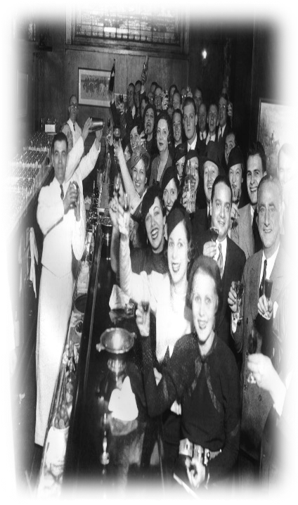
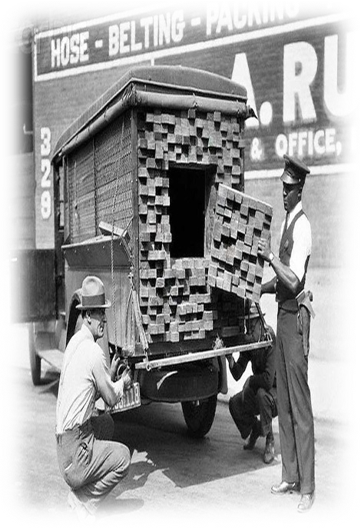
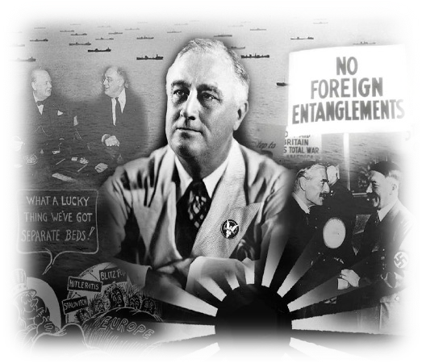
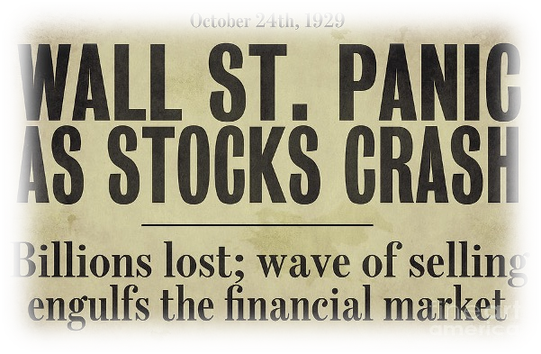





THE INTERWAR YEARS
What was life like in Europe after the war?
FRANCE
Knowledge organiser
GERMANY
BRITAIN
Germany suffered thorough Hyperinflation, meaning their money was worth nothing. One egg cost £80 million Reichsmarks
France had to try and rebuild, it had lost most of its farmlands in the East, and many of its men had been killed in the war.
Rationing was in place for
Ye a r 9
What happened after ww1?
1919: The Treaty of Versailles is signed, ending World War One and imposing heavy reparations on Germany.
1920: The American Policy of Isolation begins, distancing them from the politics of the rest of the world.
1920: Prohibition starts in America, banning the sale of alcohol across all states
1923: The Great Kanto Earthquake hits Japan, in particular Tokyo, ending their roaring 20s early.
1924: Lenin dies, leaving Joseph Stalin as ruler of Russia. This then begins his policy of industrialisation in 5-10 years.
1925: The Locarno Pacts are signed in efforts to stabilise relationships with Germany.
1929: The Wall Street Crash plunges America into severe economic depression, dragging the rest of the world with it.
1931: The Spanish Monarchy is overthrown and the republic is born, a temporary government is set up in the mean time. .
1933: Hitler becomes chancellor of Germany. By March, he passes the enabling act giving himself additional powers.
1936: The Spanish Civil War begins, Francisco Franco leads troops against the Republican government.
1938: Britain and France sign the Munich Pact with Germany to give permission for them to invade the Sudetenland.
1939: Britain and France declare war on Germany in response to Hitler’s continued aggression in Eastern Europe.
much of the 20s, with food shortages continuing. It was also trying to ensure India remained in its Empire.
Timeline
The treaty of Versailles
This was eventually agreed in 1919, but Germany were not allowed to take part in the discussions, instead they had to accept everything that was put to them in the treaty. Territory was taken from Germany, depriving it of valuable industrial income. Germany had to accept responsibility for starting the war, leading to feelings of humiliation and anger. This was the War Guilt Clause, which left many Germans feeling humiliated. Germany had to pay reparations of £6.6 billion, which would ensure that the economy would not recover. Germany’s armed forces were severely reduced. For example, there was no air force, a maximum 100,000 soldiers and a reduced navy.
America’s isolation
After WW1, many American people
decided they did not want to get involved in another global war that they deemed ‘Europe’s problem’. They did not want their troops to fight a war that they didn’t see as their problem as such. America wanted to become self sufficient so they would not have to rely on other countries for essentials to keep their country running.
The Wall Street Crash
In 1929, the American Stock Market collapsed, leading to a global financial disaster. America were plunged into economic disaster which then in turn dragged the rest of the world with it. All big economies suffered severely because of this.
What was prohibition?
Alongside the events of the Roaring 20s, the American government decided that they needed to try and prevent violent and unruly behaviour brought on by alcohol consumption. Many people actually wanted this to be brought in!
Speakeasies and bootlegging
Although many wanted prohibition, this actually just increased the desire for underground bars, called speakeasies. Bootleggers also began secretly transporting the alcohol across the Mexican or Canadian border so that people could still access the alcohol they wanted.
What were the roaring 20s like?
FASHION
In America, the ‘flappers’ became a real craze. Women had recently got more rights and so were becoming more ‘free’ following the first world war. They wore short skirts, danced on their own and smoked. The clothes were iconic and very against societal norms.
ECONOMIES
As each country began to
WOMEN
Younger entering
MUSIC
This was the era of Jazz music. The music was African American and caused uproar with many white Americans. It also took an a more unfiltered and raw approach to once taboo topics like sex and race. This music was played frequently in the hidden ‘speakeasies.
feel threatened, they looked for friends to back them up in war –known as allies. Europe split into two alliances: Britain, France and Russia formed the Triple Entente; Germany, Austria-Hungary and Italy formed the Triple Alliance.
women were
a revolutionary
period. They gained many new rights, dressing how they wanted, voting in elections, and involving themselves in politics. The male dominated word was coming to an end. The Flappers were the ‘new woman’

Slide 5

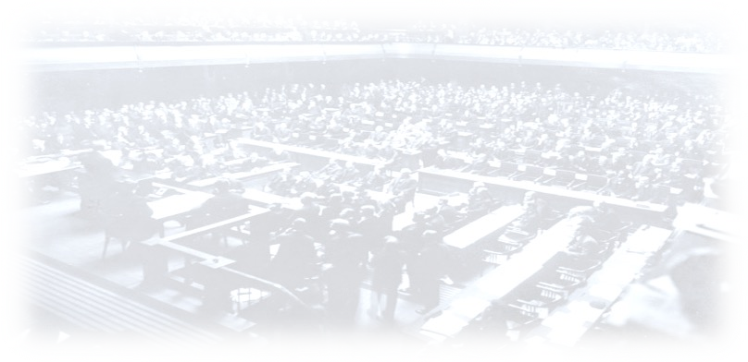

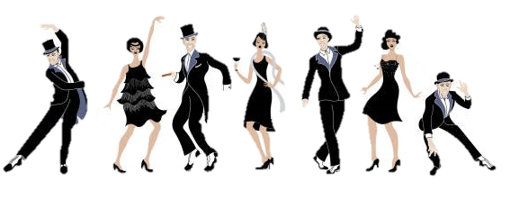
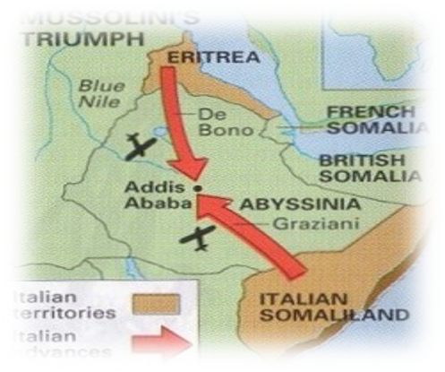
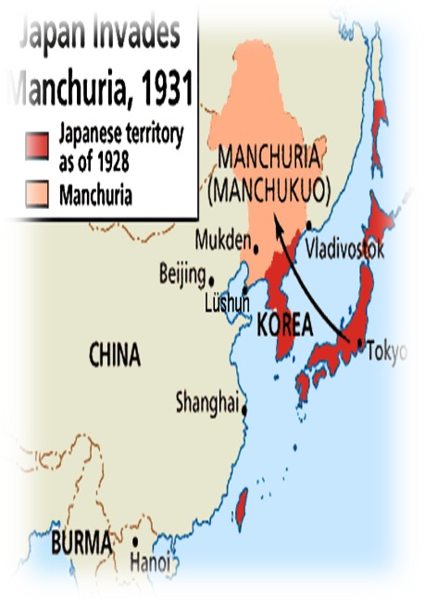
THE INTERWAR YEARS
What happened during the Spanish civil war?
In the end, Franco
Knowledge organiser
Germany had successfully proved that it was capable of fighting in a large scale conflict and winning. Its army and weaponry were up to standard, and the threat of large scale war heightened.
The Spanish Civil War started in 1936, and saw right wing nationalists (like the Nazis) led by General Franco, fight against the left wing republicans.
The USSR
Hitler however, used this war as an opportunity to test out his armed forces, joining the side of Franco to ensure another Fascist dictator was put into power in Europe.
won the war and ruled until he died at the age of 75. This was a turning point in European politics in the 1930s, as now there were three powers, all of whom were dictators.
Ye a r 9
supported the Republican forces, however the British and French did not want to get involved in case it escalated to a full scale world war.
Roaring 20s in Britain
Post WW1 in Britain was also a time for significant change and development.
Power to the People
In 1918, all British men and some women got the power to vote in
general elections. In 1924, Britain's first labour government were
elected. The Labour Party
Bright young things
For young, wealthy people, the 1920s was a good time. There was new Jazz music, clubs, more alcohol, new fashion. Men wore makeup and colourful clothes; women could go out without a chaperone.
Soviet Threat to the League of Nations
Russia had been taken over by a communist government in 1918, and their radical ideas meant that the Western governments did not trust them. Communism was a relatively new concept and they believed it would threaten the way of life for many other Capitalist countries. The USSR were eventually allowed to join in 1935, but tensions were high because of it.
Italian threat to the league of nations
Italy had a fascist government, with Benito Mussolini in charge. Italy already owned land in Northern Africa, and so it was an obvious choice to invade Abyssinia. It was rich in natural resources, and provided an opportunity to start an Empire. In 1934, Mussolini ordered the attack to begin, and the League of Nations found it very difficult to get involved with Italy’s movements. Italy succeeded in 1936.
represented working-class people.
Not everyone experienced the Roaring 20sA
Peace time was hard for people, thousands had been sent home from the British armed forces who had to come to terms with life changing injuries, or the mental toll the war had taken. Many people from the Empire had been brought to Britain, chose to stay. However, in the summer of 1919 violent race riots broke out against this.
Most people in Britain did not have much time or money to spare during this period. By 1926, the British economy was struggling again. There was more unemployment and people found life vert hard.
The League of Nations was set up after the war to ensure that there would be lasting global peace. This was stipulated in the Treaty of Versailles, and all countries agreed to join.
Once the organisation had been set up America decided not to join even though it had been their idea. Germany were also prevented from joining.
Initially, the plan had been to allow all countries to have a say in things going on globally, however without America it never really worked the way it should do. Germany also felt like they were being unnecessarily punished.
K E Y T E R M S
KEY TERM | DEFINITION | KEY TERM | DEFINITION
Fascist | An anti-democratic system of government developed by Mussolini in Italy and Hitler in Germany | Bootlegging | These were the people who snuck alcohol in during the Prohibition
Flapper | A middle or upper-class woman who cur her hair shorter and wore shorter dresses; flappers smoked and drank openly | Reparations | Money paid by a country that has lost a war, for the damage and injuries it has caused.
Isolationism | Choosing to not be involved in world politics or trade | Socialist | Someone who believes in public ownership rather than privately owned business
Speakeasies | These were underground clubs or bars in America, they had a secret password to enter. | Communist | A political theory created by Karl Marx, all property is publicly owned and each person works and is paid on their abilities.
Japanese threat to the league of nations
Japan had been suffering as a result of the
1929 Wall Street Crash; their only natural resource was silk and so they needed additional resources to boost their economy. In 1931, Japan orchestrated the Mukden incident, where they rigged a Japanese railway with dynamite and blew it up. They then blamed the Chinese foe this so they had a reason to invade Manchuria. The invasion
lasted over 5 months and led to them occupying Manchuria against the wishes of China. The League of Nations opposed this but they did not do anything to intervene against Japanese aggression – the closest country who could intervene was Russia, but they were still not a part of the League.

Slide 6

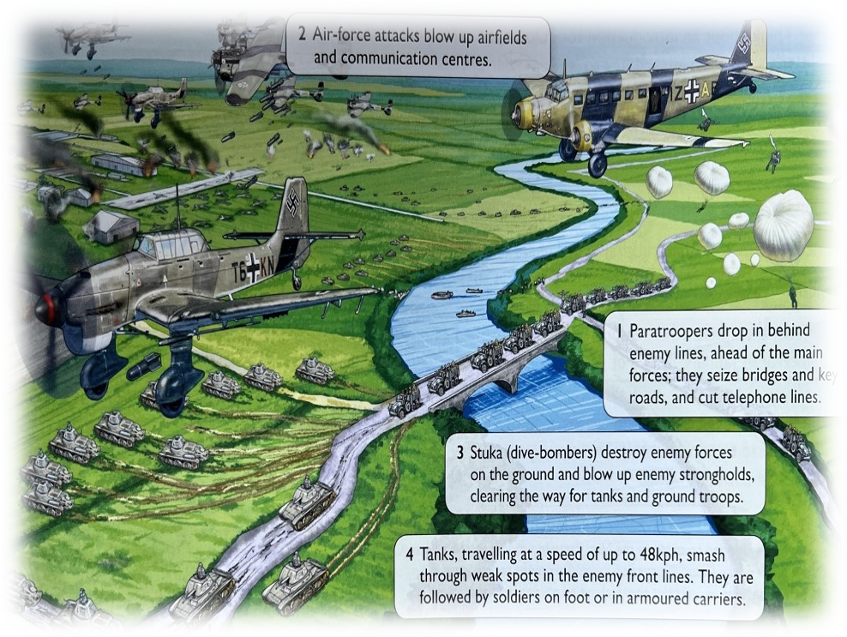

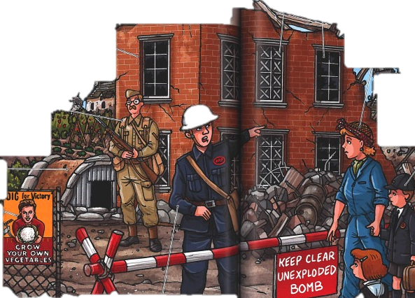







WORLD WAR TWO
What was the evacuation process like?
With the situation on the home front, the Government made the decision to evacuate 1 million women and children from the cities to protect them from the war in the skies.
For four days in September 1939 the Government took over Britain's transport systems for 4 days to evacuate the cities and send them to villages in the countryside.
On a leaflet sent out to people around the country it said: “The scheme is entirely a voluntary one, but clearly the children will be much safer and happier away from the big cities where the dangers will be greatest.”
The home front
Knowledge organiser
Timeline
Ye a r 9
Events of the first world war
1939: Hitler invades Poland on the 1st September. Britain and France declare war on Germany two days later.
10th Ma/ 1940: Germany begin to use Blitzkrieg to take land in Europe.
26th Ma/ 1940: Operation Dynamo, or the Dunkirk Rescue is launched to evacuate British and French troops from France.
Jul/ 1940: The Battle of Britain begins, with the Germans eventually loosing due to the new radar technology. .
June 1941: Hitler attacks Russia in Operation Barbarossa. They are now fighting a war on two fronts.
DeCember 1941: Japan launches its attack on Pearl Harbour in America. This brings the USA into the war officially.
November 1942: Germany reaches Stalingrad in Russia. However the Russian people fight back and win.
June 1944: the D-Day landings begin in France, with British, French and American troops launching an attack to liberate them.
April 1945: Russia reaches Berlin. Hitler commits suicide rather than be captured by the Russian soldiers..
Ma/ 1945: Germany unconditionally surrenders. They put no contingencies in place as they have nothing left to fight with.
August 1945: The Atom bomb is dropped on Hiroshima and Nagasaki, effectively ending the war between USA and Japan.
OCtober 1945: The United Nations is set up, promoting peace across the world to prevent any further war.
What was the German tactic of blitzkrieg?
Late in 1940, the German began to bomb key cities in the UK, including London. For one 11 week period, London was bombed every single night except one. 30,000 civilians had been killed and 87,000 seriously injured.
By May 1940, the government urged all men ages between
17 and 65 who weren’t in the army to join what became known as the Home Guard. They worked part time to prepare their area for attack.
The Germans tried to cut off supplies of food and other goods by sinking the ships that brought the supplies to Britain.
The government issued millions of gas masks to civilians as a precaution against gas bombs.
People put up thick black out curtains to prevent any glimmer of light from escaping.
Germany invaded Poland on the 1st September 1939 using a new method of warfare called Blitzkrieg, meaning Lightening War. Blitzkrieg involved fast-moving columns of tanks supported by infantry soldiers and dive-bomber attacks. By the end of September, the Polish armed forces had been defeated. Britain and France had promised to protect Poland, but were too far away to stop the invasion. As a result, there was very little fighting for about six months after Poland was defeated. Instead, Britain crossed the channel to help its allies, France and Belgium, set up defensive positions along their borders
Causes of world war two
The League was
The Treaty was seen as severe. It damaged
Germany economically, made her weak and hurt German
pride. Hitler would use this bitterness and anger as fuel for his speeches and
to justify for his foreign policy.
Fuelled by his anger at Versailles and helped to power by depression.
Hitler’s foreign
policy would eventually push Europe to war. He started with rebuilding the small, weak
German army.
created on the idea of Collective Security: Countries standing together against aggression. In 1935, the League failed to stop to Mussolini’s attack on Abyssinia. The League was not taken seriously after this event.
The Rhineland was on the border with France. Under the Treaty of Versailles,
Germany was
forbidden from putting troops there. Hitler took a gamble and marched his army into this army.
Austria and
As Hitler grew stronger he wanted more. Europe feared war over the Sudetenland. After talks in
Munich, Germany, the Sudetenland was given to Hitler. In return, he promised this was his last territorial
demand.
The NSNAP was a surprising agreement between Hitler and Stalin. It opened the way for Hitler to invade Poland without fear of Soviet attack. The Nazi invasion of Poland was the trigger for WW2
The Wall Street Crash marked the start of a Global Depression. This helped dictators come to power and other countries were too weak to stand against them.
Germany had been banned from joining together. Hitler (Austrian) believed the two countries should be united. He ignored Versailles and arranged a vote. The Austrians voted to join Germany.

Slide 7

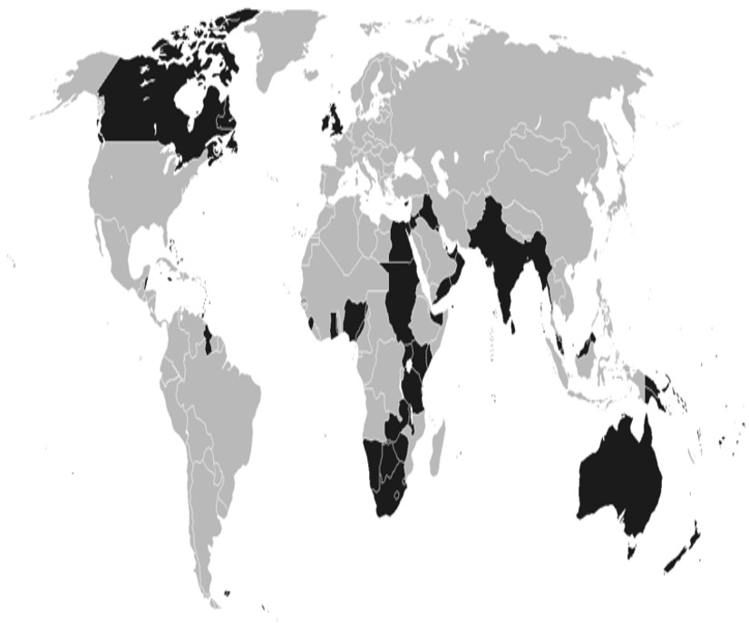



WORLD WAR TWO
CANADA
Just over 1 million Canadians fought against Italy and Germany in Europe and Japan in the Pacific region. Canadian troops played a key role in the D-Day landings of 1944. Canadian sailors fought to protect ships carrying vital supplies across the Atlantic Ocean. In total, more than 45,000 Canadians lost their lives, and 55,000 were wounded.
Contributions from the empire
WEST AFRICA
British colonies in West Africa (Gambia, Sierra Leone, Ghana and Nigeria) served as military bases. Thousands of people from British East Africa (Kenya, Uganda) joined the armed forces, as well as 60,000 from northern and Southern Rhodesia. Many served as support troops in military hospitals, airfields and naval bases.
INDIA
Two and a half million Indians fought in the War – the largest volunteer army in History. They fought in Europe, as well as in Sudan against the Italians, in Libya against the Germans and in Burma against the Japanese. Around 90,000 people lost their lives while serving with the Indian forces. Indian soldiers, sailors and aircrew received over 4000 medals – Including 31 Victoria Crosses, Britain's highest bravery medal.
Knowledge organiser
Turning points in the warÅ
Ye a r 9
By 1941, Hitler and the Germans had spread through much of Europe, occupying France, Belgium, Poland and Greece. In June of 1941, Germany begins to invade Russia in an attack known as ‘Operation Barbarossa’.
By the end of 1940, nearly half a million British and French troops had been trapped between France and Belgium. Britain organised a rescue mission, using commercial fishing ships they rowed the channel and rescued 340,000 troops.
WEST INDIES
About 16,000 West Indians volunteered to serve. Around 6000 served with he RAF as ground staff, fighter pilots, bomb aimers and machine-gunners. Around 90 West Indians won medals for bravery or leadership skills, including Ulric Cross. He flew over 80 bombing missions, 20 of them over Germany. His plane landed 7 times without its wheels because they had been shot away or would not lower.
By August 1940, the RAF was only days away from defeat. However brand new radar technology meant that the British could detect German planes. In the Battle of Britain Germany lost 60 fighter planes to Britain's 25, so Hitler abandoned his plans.
America had remained a neutral party in the war, until Japan joined on the side of Germany and attacked Pearl Harbour in Hawaii. The attack destroyed 20 American ships and 300 aircraft, forcing America to join the war.
NEW ZEALAND
Around 160,000 New Zealanders (about 9% of the population) fought on Britain's side in many of the key campaigns in Europe and the Pacific region. Around 12,000 New Zealanders died.
CONSEQUENCES OF WORLD WAR TWO
HEALTH AND MEDICINE
NUCLEAR WAR
UNITED NATIONS
Britain, USSR and the USA realised they needed to do something to prevent war happening again. They set up the United Nations, where all countries could join with the purpose being to promote peace. By 2011, 193 countries were members.
Codenamed Operation Overlord, the D-Day Landings began on the beaches of France to liberate them from German rule. By late 1944 all of Northern France had been liberated, and by the following Spring the allies had defeated the Germans.
K E Y T E R M S
KEY TERM | DEFINITION |  | KEY TERM | DEFINITION
Home Front | The civilian population and activities of a nation whose armed forces are engaged in War abroad. |  | Turning Point | This is a moment where the war changes direction. Germany were winning, then a number of events turned that away.
Appeasement | The act of making sure peace is reached peacefully. |  | Cold War | A war with no actual fighting, but with increasing tensions in other ways.
Blitzkrieg | The German tactic of ‘lightening war’, hitting targets at random and doing so quickly. |  | Nuclear Bomb | A bomb that splits the atom, it detonates above ground and causes more damage than the average bomb.
Evacuation | Removing the children and pregnant women from cities at risk from the Blitz. |  | United Nations | An organisation set up after the war to prevent any more war in Europe.
Doctors and surgeons worked hard to develop new medicines to help injured soldiers. Penicillin prevented infection, plastic surgery corrected injuries to the face, and posters were created to encourage people to be more hygienic.
Japan refused to stop fighting at the end of the war, and so America resorted to using its nuclear weapons. On the 6th August 1945 the first bomb was dropped on Hiroshima, and the second on the 9th in Nagasaki with 240,000 civilians being
killed.
Tensions in Europe since the end of the warÅ
During the Second World War, the USA and the USSR fought together to
defeat Nazi Germany. As the war came to a close however, the differences between America and Russia became clear. At the end of the war, Germany was split into four different sections, Eastern Germany was given to Russia, and Western Germany was split between France, Britain and America. By 1948, Western Germany was merged into a single zone, putting the East and the West against each other. This angered the USSR because they weren’t told about this, and so tensions increased. This was made worse when NATO, the North Atlantic Treaty Organisation was set up which included 12 of the biggest Western powers and again excluded Russia. To retaliate against this, Russia set up its own military alliance including the Eastern European Communist States. Tensions continued to rise between America and the USSR and it concluded in a ‘Cold War’, which means it is a war with no actual fighting.

Slide 8


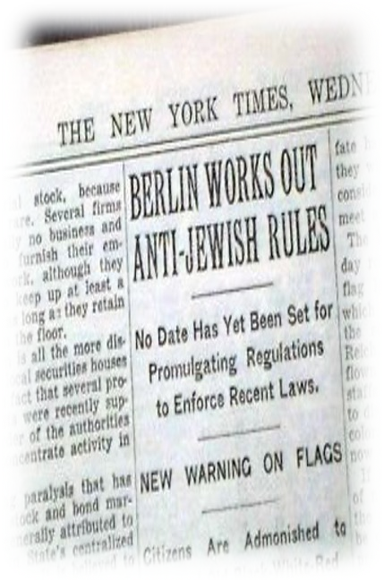
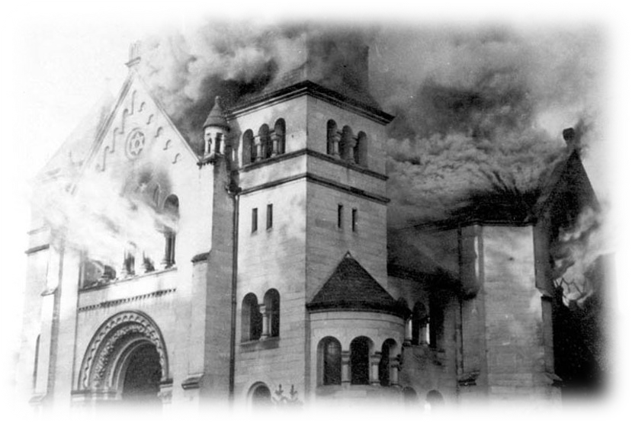
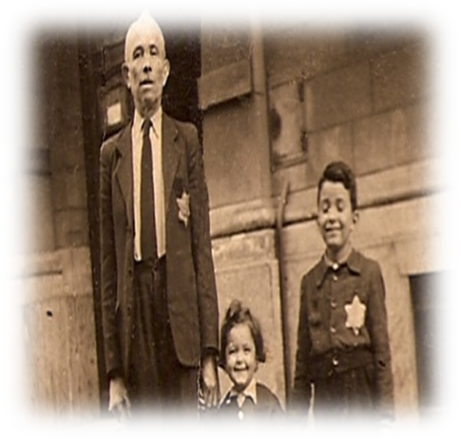



THE HOLOCAUST
Hitler’s rise to power
In February 1933, the Reichstag burned down. It was suggested that a Communist did this, however this would be the event that started Hitler’s rise to dictator.
Knowledge organiser
In January 1933, Hitler becomes Chancellor of
Germany, meaning he is the second most powerful man in the country. He had antisemitic policies he could now put in place.
March 1933 the Enabling Act is passed. This meant that Hitler could now pass laws without the rest of the Government. The president dies, and Hitler is made Fuhrer.
Timeline
Ye a r 9
Events of the first world war
1933: The Nazis came to power in Germany, with Hitler being appointed Chancellor..
1935: The Nuremberg Laws reduced Jews to second class citizens. They were stopped from working certain jobs.
1936: The Berlin Olympics began, and the Nazis used it as a platform to show how good they were.
1937: There was an escalation of anti-Jewish propaganda. Concentration camps were starting to be used for Jewish people.
1938: Kristallnacht begins, with attacks against Jewish businesses, at least 91 Jews died and 267 synagogues were destroyed. .
1939: The Second World War begins, and the SS had to develop plans to move Jewish people in Poland.
1940: German forces march across Europe and begin to limit the rights of Jews here too, concentration camps created specifically for Jewish people for the first time.
1941: The Final Solution was agreed, meaning that methods of mass murder of the Jewish Population began.
1942: More Jews were murdered in 1942 than in any other year of the Holocaust, mainly in the newly built extermination camps.
1944: Germany was loosing the war, and so it marched the Jewish populations from camps in Poland back into Germany.
1945: Germany lose the war, and the concentration camps are liberated. People finally learn the horrors of the Holocaust.
1946: The Nuremberg Trials begin, with 18 Senior Nazi Officials being executed for their crimes in the war
WHAT WERE THE NUREMBERG LAWS
On the 15th September 1935, the Nazis introduced the Nuremberg Race Laws. These took away the civil rights of all Jewish people in Germany.
This law was based on family lineage to determine who was Jewish and who was not. People with three or four Jewish grandparents were considered Jewish.
If you were classed as a Jew, you could no longer class yourself as a German
Citizen, they could not vote, and could not work for the government.
Another section of the Law banned the
marriage between Jewish people and non Jewish people.
Identifying Jewish People in Germany
What happened during Kristallnacht?
On the 9th November 1938, Kristallnacht – meaning Night of Broken Glass – began. Nazis in Germany burned down synagogues, vandalized Jewish homes, schools and businesses, and killed around 100 Jews.
30,000 Jewish men were arrested and sent to Concentration Camps.
The event was done in retaliation to a Polish Jew killing the German diplomat in Paris. The Germans used this as the
excuse to begin more violent attacks on the Jewish population, and many now claim this was the first event in
the Holocaust.
The Nazis held the German Jews responsible for the damage done, and they were made to clean the streets on
their hands and knees and pay a fine for the vandalism of their own shops.
Part of the Nuremberg Laws made it clear that all Jewish people must wear the Star of David on their clothes so they can be identified.
This meant that German owned shops could refuse to serve Jewish people, and it
made it easier for the SS soldiers to identify who should be adhering to the
new laws.
Timeline of Jewish Treatment in Germany
1938
Jews were
1933
The SA organised
a boycott of Jewish shops and businesses.
Jewish Civil Servants, lawyers and teachers were sacked.
Science lessons were introduced teaching that Jews were subhuman.
1936
The Berlin
Olympics begin, and the Germans remove all visible signs of Jewish persecution.
However, persecution continued in all other areas of Germany.
1939
The Nasi’s who
had been encouraging Jews to emigrate from 1933 onwards, now started ‘forced’
emigration. 150,000 Jews
were deported but they had to
pay a large tax before they left.
1934
Jewish shops
were marked with a yellow star Jews had to sit on separate seats on the busses and trains.
1935
The Nuremberg
Laws stripped Jews of all their rights within
German society.
Jews were also banned from joining the army.
ordered to register all wealth and property.
They could no
longer practice as doctors and lawyers
Jews were forced to change their
first names: men to Israel, women as Sarah
1938
Kristallnacht (The
Night of Broken Glass). The SS organised attacks on Jewish homes, business and synagogues.
1939
In March, there
were mass arrests. 30,000 Jews were sent to concentration camps.

Slide 9
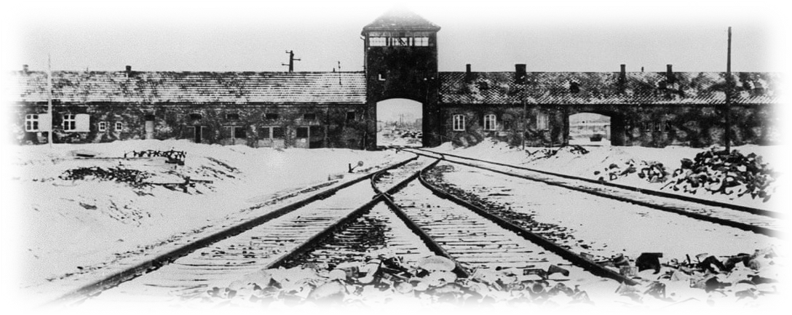
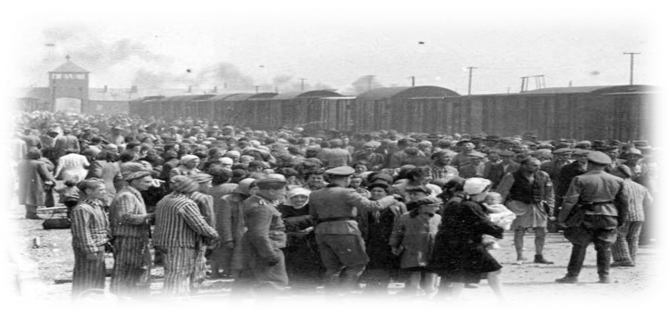



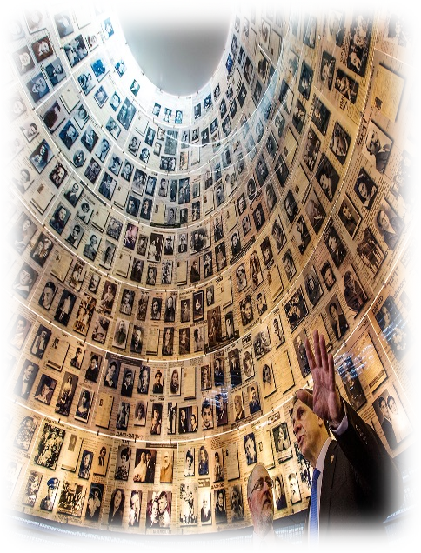
THE HOLOCAUST
The final solution
There is no official documentation that tells us when Hitler decided to enact the Final Solution, we just know that it happened. The Final Solution was the decision to exterminate 11 million Jewish people living in Germany and the countries they occupied in 1942.
In 1941, there were already cases of mass murder occurring in Concentration camps. At Auschwitz in 1941, 575 sick and disabled prisoners were sent to their deaths at a euthanasia centre.
The success of these previous mass exterminations encouraged the Final Solution to become more widespread, with the eventual result of this being the creation of gas chambers across many concentration camps, and the eventual deaths of 6 million Jewish people.
Auschwitz Birkenau
Knowledge organiser
Development of concentration camps
Ye a r 9
The first concentration camps were set up as detention centers for enemies of the German state. These could have been political prisoners such as communists, or people who actively went against the Nazi leadership.
Later during Nazi rule, these ‘detention centres’ expanded to include Jehovah’s Witnesses, homosexuals, Roma Gypsies and ‘a-socials’ (these were people who were deemed undesirable to the German population)
In 1940, Auschwitz I was built in Poland, to house the mass numbers of Jewish people who had been deported here from Germany in the 1930s. To begin with, it remained a labour camp, forcing people to work and build a new camp – Auschwitz II Birkenau – to increase the capacity of people here.
However, when the final solution began Birkenau became a death camp, specifically for the mass extermination of the Jewish populations.
Throughout the existence of the camp, the authorities treated Jews with utter contempt. Many Jews fell victim to starvation, cold hard labour,
constant harassment and abuse, and various experimentations and extermination operations. It is estimated that around 1.1 million Jews
were murdered in Birkenau before it was liberated in 1945.
In March 1938, Germany brought Austria back into
German control. At this point, thousands of Jewish people were arrested and sent to different concentration camps around
Germany.
After the Kristallnacht, more Jewish people were sent into concentration camps, and instead of being there for short periods of time, they were now there for months if not years of their lives.
Liberating the concentration camps
LIBERATION
DEATH MARCHES
NUREMBERG TRIALS
Between 1945-1939, leading Nazis were put on trial publicly. The trials were held by a mix of the four main powers, and in the end all but three of the men on trial were found guilty. These men were then executed by hanging. Since then, there have been trials held for Nazis found since.
Remembering the holocaust
People in concentration camps were subject to forced labour, they had very little food and were forced to work incredibly hard manual labour, and those who were doing this were often worked to death.
K E Y T E R M S
KEY TERM | DEFINITION |  | KEY TERM | DEFINITION
Kristallnacht | This was when the Nazis burned down synagogues, and broke into shops. |  | Liberation | The action of setting someone free from imprisonment.
Concentration camp | A detention centre for anyone the Nazis didn’t like, they were difficult places to be in. |  | Antisemitism | The strong dislike or cruel and unfair treatment of Jewish people.
Final Solution | This was the decision made by Hitler and the Nazis to kill all the Jews across Europe. |  | Persecution | The unfair or cruel treatment of someone over a long period of time because of the race, religion or political beliefs.
Extermination | The killing of a whole group of people. |  | Holocaust | The commonly known name for the Nazi’s attempt to wipe out the Jewish race.
Soviet troops reached the border of Poland, and so instead of standing their ground the Germans marched the healthiest of the Jews back into central Germany so they could continue to maintain the concentration camps. The women, children and sick were left to die in the remaining camps.
The first camp to be liberated was Majdanek in 1944. The Germans demolished the gas chambers to hide evidence of their crimes. Those soldiers who helped to liberate the camps were shocked by what they had seen.
The Holocaust is remembered every year on Holocaust memorial Day on the 27th April. Around the world people pay their respects to the lives lost.
We are still lucky enough to have stories from survivors of the holocaust, who give us many good first hand accounts of what happened.
We also have the remains of the concentration camps that have been turned into museums to teach people about the horrors of the event.

Slide 10


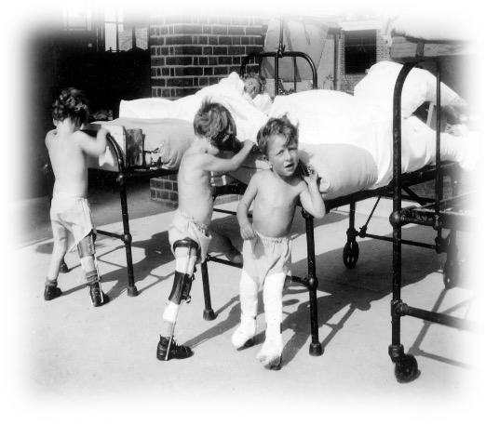

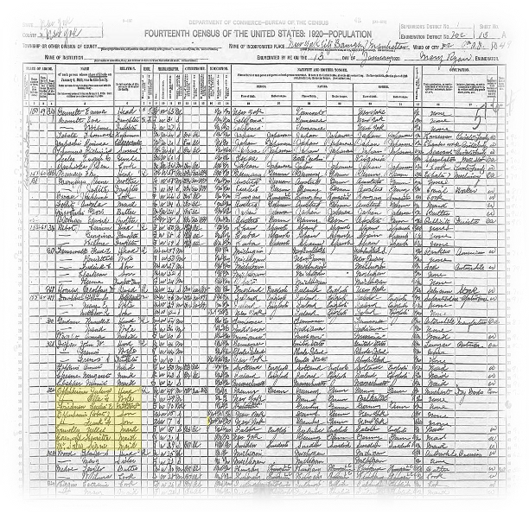
100 YEARS IN BRITAIN
Attitudes towards disability in the early 20th century
Knowledge organiser
‘DISABILITY MAKES THE HUMAN RACE WEAK’
People did not want to spend taxes on helping the disabled. People judged people by
whether they could work.
‘THESE PEOPLE NEED OUR HELP’
Working to help others in need is central to many religions. Most people in Britain were Christians and so this
was central to their beliefs.
Ye a r 9
100 YEARS OF British History
1901: Queen Victoria dies, marking the end of an era.
1905: The Aliens Act was passed which restricted migration into Britain
1919: returning Servicemen from WW1 from the Empire were not welcomed back, with the Seaport Riots taking place to protest.
1928: Equal Rights Act was passed, giving women the same voting rights as men
1950s: The first migrants from the Empire Windrush came to help rebuild Britain after the second world war
1958: The Notting Hill Race Riots broke out.
1965: Race Relegations Act made it illegal to discriminate against anyone based on their ethnicity
1970: The Equal Pay Act is passed making it illegal to pay women less than men for the same job.
1988: The Lockerbie Bomb – a plane from London to New York explodes killing all on board
2001: September 11th the 9/11 attacks on New York take place on the US, hitting the World Trade Centres and the Pentagon
2013: the Marriages Act is passed in Britain allowing same sex couples to legally marry.
2017: Manchester Arena Bombings took place at the end of the Arianna Grande concert
2020: England loose to Italy in the Euro finals, and racist attacks against footballers take place.
‘DISABILITY MAKES BRITAIN WEAK’
In 1899 Britain fought an imperial war. 35% of those who volunteered to serve were found to be unfit. This worried people as they thought it made Britain less secure.
Timeline
Source A: Sue Bush on Polio
‘My parents lived in very poor housing and they had two other children and they were told that I would never be accepted into a mainstream school,…there was this school in Sussex that took disabled children of every type, physically disabled that is, so at the end of the day my parent’s didn’t really have a choice, so at the age of three, I was sent and spent my childhood there until I was seventeen. I can remember lying there in the bed at night thinking ‘This is actually so awful I wish I could die.’ There was the A classes which stood for Academic and then there was the C classes which stood for Commercial…where you learnt things like shorthand, typing, bookkeeping…and this is the one I took real exception to at the time and still do, is the B classes which stood for Backwards. Really? I remember our headteacher announcing to a bunch of visitors ‘these are our backwards children: they’re not very able,’ he just announced that in front of a whole class of children to strangers…you know, my one friend was in there and she was upset for days.
Women in the 20th century
Soldiers after the war
Doctors had never seen so many injuries
before, and so they found new and experimental ways to treat people.
Many injured men could not return to their jobs following the war.
The government set up the Kings National Roll Scheme to support newly
disabled soldiers, however not enough businesses signed up to it.
The mental patients union
In 1918, a law was passed saying that education had to be provided for disabled Children, but the law did not require all children to be taught together.
Their education was specifically around low-skilled jobs, and they rarely had the same opportunities as other children.
Women gained the right to vote in 1928, but equality was still not reached. In 1931, the first woman was elected to become an MP.
In 1941, a woman named Lillian Bailey joined the Women's Auxiliary Air Force and trained as an aircraft instrument
repairer in York
Why is it hard to find some people in historical sources?
In order to write about particular people who were not powerful in government, we have to find them in sources that survive. It was government officials who decided how to collect the information on groups of people, for example the NHS did not collect statistical data about peoples ethnicity until the 1990s. This means that we can see how women’s life expectancy changed, but not how their ethnicity impacted this. Similarly, the category ‘Gypsy or Traveler’ was not used in the UK census until 2011. As a result, a historian of the twentieth century using the government records could not identify it an individual came from this group.
How can we know about people when there are no records of them?
If Historians want to look at data to find out about the ethnicity
of the person from the past, they would find this difficult to do. Historians therefore have to draw conclusions about people based on those few individuals who are recorded. Proferssor Olivette Otele argues that the few black people who do appear in written records give us clues about others. Those individuals are exceptional as they were written about, but they also lived and worked with other people. Olivette says that we can suggest what other black people’s lives were like by studying the lives of the few black people who do appear in records.
Margaret Thatcher became the first female Prime Minister in 1979, and she changed the face of politics for the whole country.

Slide 11


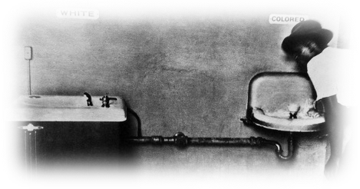
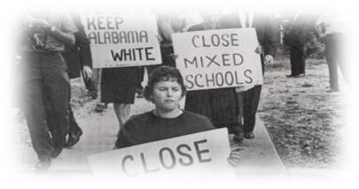
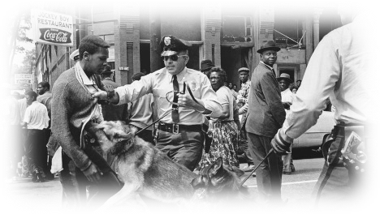
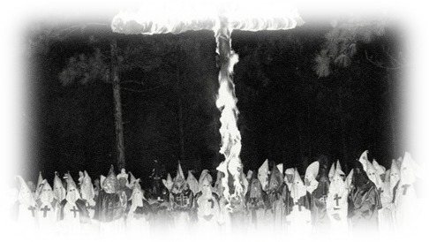
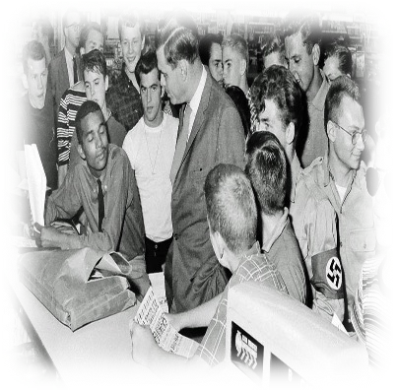
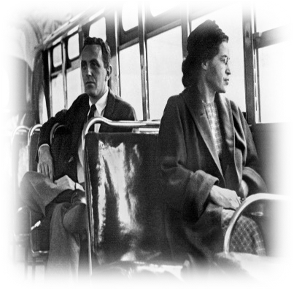
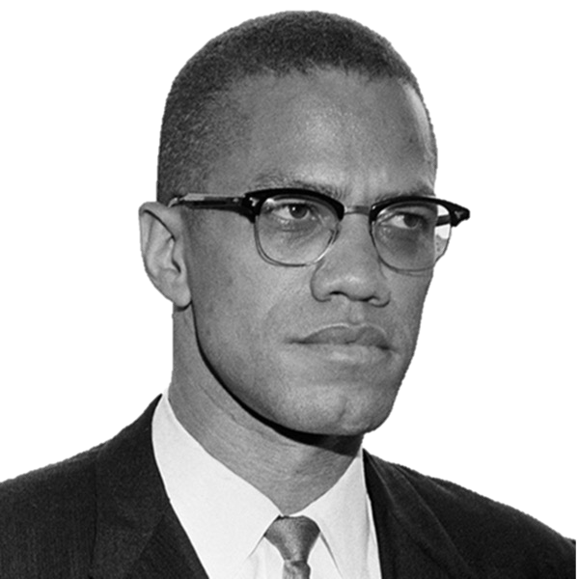
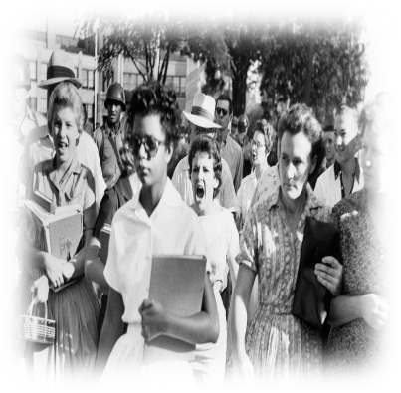
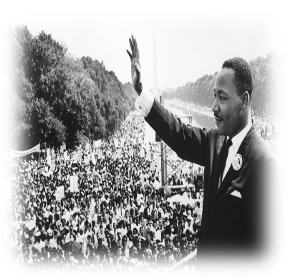
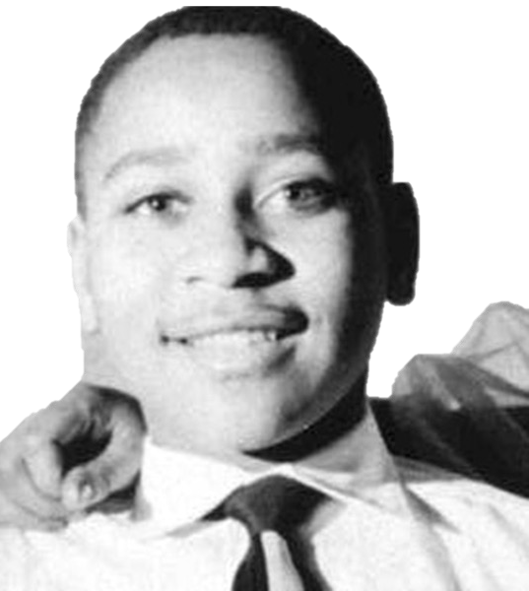
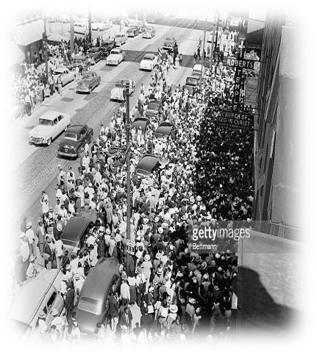
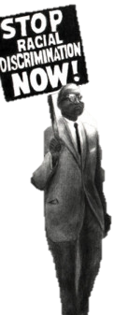
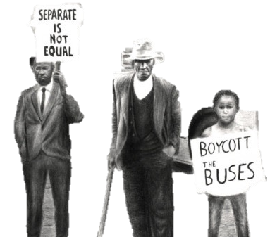
CIVIL RIGHTS MOVEMENT
Jim Crow laws and the KKK
KKK:
This was a group of racist Americans who
NRA:
Around the time the KKK was branded a terrorist organisation, the NRA formed, which prevented African Americans having the right to own a gun.
Knowledge organiser
Jim Crow
These were laws that kept people of colour separate
Slavery Timeline
Ye a r 8
from the white Americans.
campaigned against the rights of African Americans, and actively lynched them.
What happened during the British empire?
1865: Jim Crow Laws are formally introduced in America, with the
guise of keeping races ‘Separate but Equal’.
1865: The formation of the KKK is formed as an illegal organisation to keep the Jim Crow laws operational.
1955: Emmett Till is brutally murdered in Mississippi for allegedly flirting with a white woman.
DeCember 1955: Rosa Parks refuses to give up her seat to a white man on the bus.
1963: 250,000 people take part in the March on Washington for Jobs and Freedom. Martin Luther King makes his ‘I Have a Dream’ Speech.
19963:The Bristol Bys Boycott in England
1964: President Lyndon B. Johnson signs the Civil Rights Act preventing discrimination on any protected characteristic.
1965: Malcom X is murdered
1968: Martin Luther King is assassinated
1970: The Mangrove Nine trial are the first time that a judge in court admitted that there is evidence of racial hatred in the police force
1981: The Hill Cross Fires leave 13 dead, the fire department blame the victims, however there was evidence to suggest it was a racist attack.
2020: George Floyd is murdered by police in America, sparking the Black Lives Matter movement world wide.
They claimed it would keep them ‘separate but equal.’
WHAT DID THE JIM CROW LAWS LOOK LIKE IN REALITY?
How were civil rights achieved?
Integration:
In 1957, nine African American students attempted to integrate Central High School in Alabama. This caused
outrage and protests from the white community.
However, it was effective as it led to an end to the
Violent Methods:
Malcom X orchestrated several violent protests in order to achieve Civil Rights. These included the Harlem Race Riots.
However, they were largely ineffective as it
encouraged more people to be against them.
Marches:
1963 saw the largest Civil Rights March in Washington. 250,000 people marched to protest the Jim Crow Laws. This was highly effective as it has been credited as one of the main reasons the Civil Rights Act was passed in 1964. Martin Luther King made his speech here.
Sit Ins:
segregated schools.
Boycotts:
The sit ins started in 1960, when four African
Americans went and sat in a white only restaurant.
They were refused service, so they refused to leave.
This was very effective as
it forced an end to segregated restaurants.
In 1955, Rosa Parks refused to move on the bus for a white man. She was arrested and fined. This sparked the boycott of busses in Alabama, which was highly effective as it ended segregated buses and caused them to go out of business.
Who was Emmett till?
Emmett Till was a 14-year-old boy from Chicago- a state with less strict Jim Crow laws. In 1955, he visited his cousins in Virginia, one of the strictest Jim Crow states. He was dared by his cousins to go and ask a white woman in a shop out on a date. Till went into the shop, and on his way out said, ‘bye baby.’ A few days later, the woman's husband and friend came to his uncle's house, kidnapped Till and brutally murdered him. He was shot in the head, his eye gouged out, and then drowned in the river.
What happened next?
The police in Virginia wanted to bury the body quickly, but Till’s mother refused, as she wanted her son buried in Chicago. When his body returned, she was horrified at the state of him, and so she sent photos to the local newspapers. Emmett Till’s murder received national front-page status, and a trial was set for his murders. However, the Jury were all white, and after deliberating for less than an hour they were found not guilty. This horrified many in America and was the spark that lit the Civil Rights Movement.
Assassination of Malcom X and Martin Luther King
There was still a lot of resentment in America towards the Civil Rights Movement. The two leading figures, Malcom X and Martin Luther King, were assassinated in the 1960s, proving that there was still a long was to go for achieving an end to racism in the United States.

Slide 12
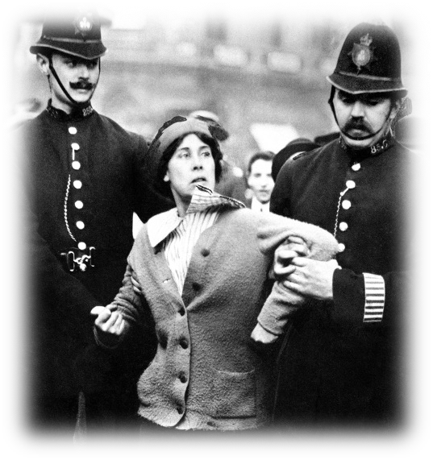




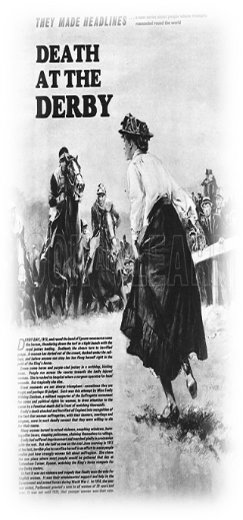
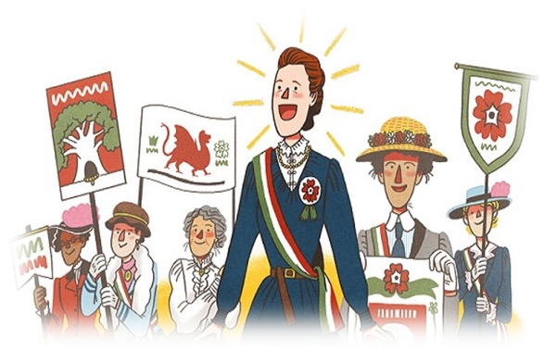
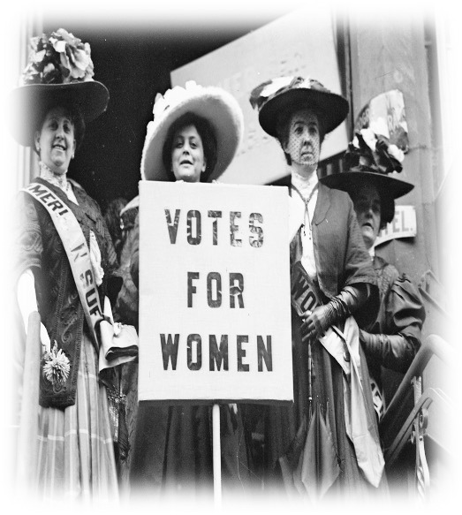
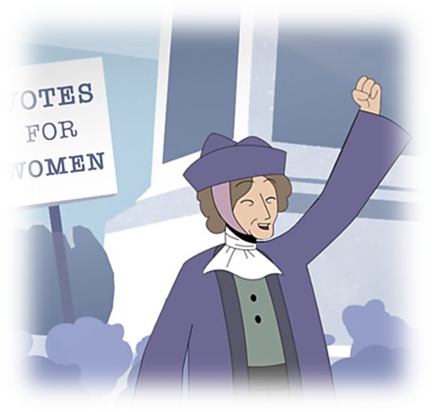
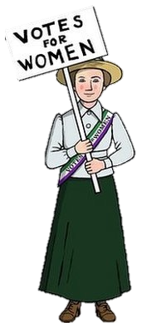
POVERTY, SUFFRAGE
AND THE TITANIC
What methods were used to get womenAs’ rights?
The Suffragists wanted to act within the law, and believed that any action that did break the law would not help their movement, They instead organised marches, wrote letters and tried to gain support through political persuasion.
This however, did not work. They instead started a campaign of violence and disorder to get the vote. They disrupted political meetings to try and get politicians to pay attemtion.
Hunger strikes were used in prisons when they were arrested for their actions. They refused to eat in an attempt to martyr themselves, however they prison guards often forced the women to eat.
Women also handcuffed themselves to important buildings, and burned down the houses of politicians when they were not at home. Historians today argue whether these methods helped or hindered the women’s rights movement.
Planting bombs and smashing windows on private property were more extreme ways to disrupt the general public, and make sure they were paying attention to their movement.
Knowledge organiser
Ye a r 9
Suffragettes
The Suffragettes were a much smaller organisation, with around 2,000 members. They believed the only way the vote would be achieved was through violence and militant actions. They refused to let men join their movement, and received a lot of attention from the media because their actions were so shocking. These tactics, although more extreme, have been argued to be the main reason women got the right to vote.
Emmeline Pankhurst
She led the WSPU from October 1903.. She took a more militant action, smashing windows, committing arson and going on hunger strike.
She was arrested numerous times and had to be force fed by prison officers because of her prolonged hunger strike.
EMILY DAVIDSON
She joined the WSPU in 1906, and three years later left her job as a teacher to join the suffragette movement. She was arrested a number of times for setting fire to post boxes.
In 1913, she attempts to pin the Suffragette flag on the Kings horse during a race, she is knocked over and trampled on and subsequently died.
Millicent Fawcett
Suffragists
The Suffragists were a peaceful branch of the women's rights movement. They did not take part in the more violent methods used by the Suffragettes. This was the only national organization, with large numbers from across the UK joining, they even allowed men to join! A lot of these campaigns however were ignored. They simply weren’t noticeable at a time when there was a war brewing and poverty on the rise. Overall, they believed that the vote would be achieved peacefully, and that violence would not be the answer.
She was a leading Suffragist and led the NUWSS from 1897-1919. She played a key role in getting women to vote, and was dedicated to using constitutional methods, rather than militancy which she claimed was counter productive.
Results of the movement?
In 1908, Henry Asquith saif he intended to give women the right to vote if he was prime minister. He became Prime Minister from 1908-1916, but he went back on his word and never gave it to them. This sparked Black Friday, when the WSPU marched in protest. It was violent and hundreds were badly hurt. The start of WW1 in 1914 paused the Suffrage Movement though.
K E Y T E R M S
KEY TERM | DEFINITION | KEY TERM | DEFINITION
NUWSS | The National Union of Women's Suffrage Societies, it was a peaceful organisation. | Suffragette | A campaigner for Women’s suffrage willing to undertake militant actions to break the law.
WSPU | Women’s Social and Political Union was formed when Emmeline Pankhurst, this was the more violent of the groups. | Suffragist | A campaigner for women’s suffrage who believes in constitutional methods.
Constitutional | A peaceful, legal way of campaigning, often recognising ‘political’ methods. | Pacifist | An individual who disagrees with war on principle, they are not violent at all.
Suffrage | The right to vote in political elections. | Militant | Aggressive and violent behaviour in pursuit of a political cause.
In 1928. women were finally given the right to vote with no conditions. They were allowed to vote if they were over the age of 21, and this was also given to all men no matter whet class they were in, or whether or not they owned a house.

Slide 13
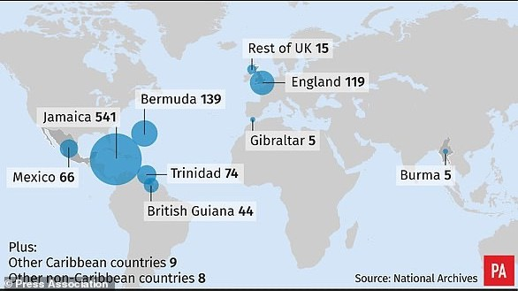






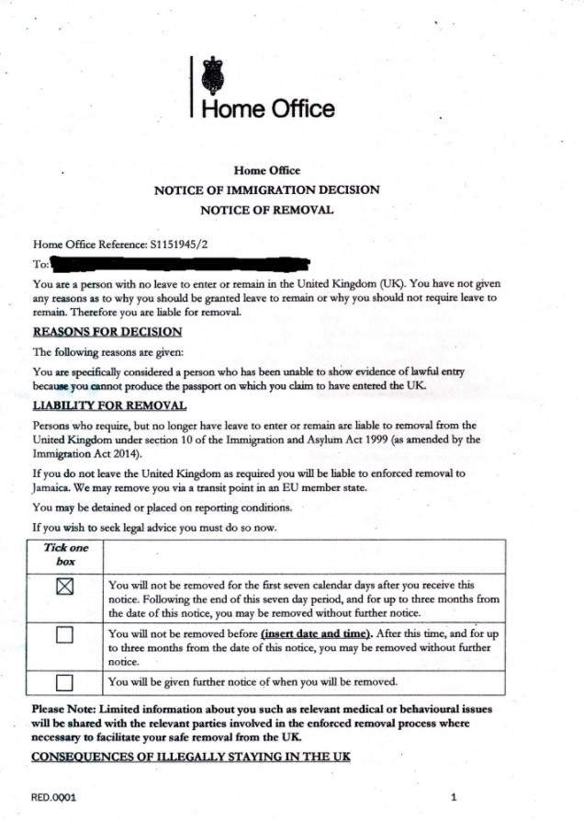





CIVIL RIGHTS MOVEMENT
The civil rights protests in England
Knowledge organiser
Paul Stephenson organised the boycott, and in 1963 Ian Patay announced there would be no more discrimination in employing bus crews. In 1965 the Race and Equality Act was passed in Britain.
The Mangrove Nine were a group of British black activists who were arrested for protesting against the Police. They had shut down a key restaurant used by minority groups to access help.
The New Cross Fire started in 1981 and led to the death of 13 Black Britons. Police officers at the scene of the crime claimed to begin with that it was started by a Neo-Fascist group known for Arson attacks.
Ye a r 8
In August 1970 this turned into a riot, and led to 19 arrests. However it was the first time in a court that a judge acknowledged racism within the Police.
Despite this, the Police began to blame the victims for the fire. This led to protests, and in
2002 the
victims were cleared of all responsibility.
Where did the Windrush generation come from?
The Bristol Bus Boycott in 1963 arose from the refusal of the Bristol Omnibus
Company to employ black
or Asian bus crew in the city.
What was the Windrush Scandal?
Stories from the Windrush scandal
Why did people to Britain?
People, especially the young, left the Caribbean for a range of reasons, attracted by job vacancies in the UK but also seeking new opportunities for a different life. Many felt as though they were ‘coming home’ to join an imperial family who they felt like they belonged in. But when they arrived, they were categorised as ‘coloured colonial labour’ and often stereotyped as inferior to British workers. In fact, most of the men who came from the Caribbean had previously worked in skilled professions or possessed excellent employment credentials. However, many found their access to jobs restricted to only those who the local population considered ‘undesirable’ including street cleaning and general labour, or those that demanded anti- social hours such as working night shift.
From 2013 the Windrush
generation started receiving letters claiming that they had no right to be in the UK. Some were treated as illegal immigrants. Some lost jobs, homes, benefits and access to the NHS. This was the very same NHS that in 1948 welcomed them because they did the jobs that others were not willing to do. To amplify this insult, legal citizens
Paulette Wilson - 61 Worked as a kitchen worker in the House of Commons, made homeless, detained and threatened with removal to Jamaica after being in England for 50 years.
Michael Braithwaite
- 66
He was sacked as a special needs teaching assistant after 56 years in the UK.
Albert Thompson
He was denied NHS cancer treatment and told it would cost him
£54,000 after four decades paying taxes.
were placed in immigration
detention centres and some deported. Those abroad on holiday were refused back into the only country they had ever known.
What is the black lives matter movement?
This was the movement set up to ensure that people of colour continued to have Civil Rights. The movement came to a forefront during 2020 after the murder of George Floyd by white police officers. This had an impact worldwide.
Colson was an English slave trader in the 17th century. He received a statue in 1895 to commemorate his philanthropic works, but it is estimated that he sold around 100,000 people into slavery. When George Floyd was murdered in America and the Black Lives Matter Protests began, the people of Bristol took to the streets and pulled down the statue. They did not want there to be a commemorative monument to someone who was involved in so much pain.
K E Y T E R M S
KEY TERM | DEFINITION | KEY TERM | DEFINITION
Civil Rights | The rights of citizens to political and social freedom. | Lynching | To kill someone for an offence without a legal trial, this is usually in the form of hanging.
Boycott | To stop using something as a form of protest, for example not using the busses. | Institutionalised racism | This is a form of racism that is embedded in the laws and regulations of a country. This in the modern day is normally with the police.
Protest | To express an objection to something or someone, usually in the form of marches. | Scandal | An action or event which is regarded as morally or legally wrong, causing public outrage.
Integration | The process of merging two things together. | Assassination | The process of killing someone, this is normally done secretly.

