Slide 1
History
Fulwood History Department
Year 8 Knowledge
Organisers

Slide 2
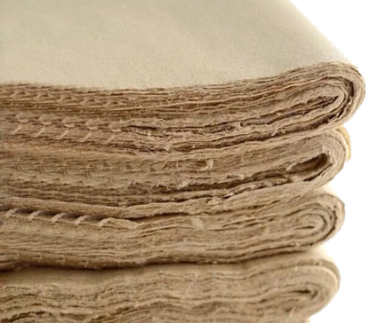
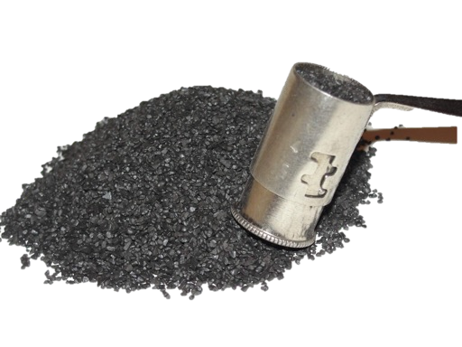
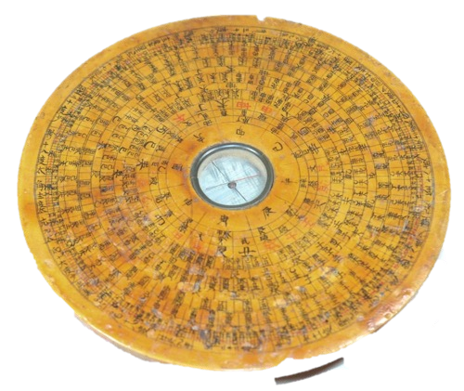
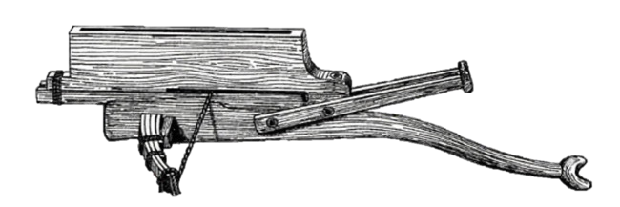

THE SILK ROADS
Life in medieval Baghdad
Knowledge organiser
Advances in architecture saw huge domed Mosques and bridges built. Visitors who travelled the Silk Roads were impressed with what they saw. It was known as the ‘round city.’
At the centre of the city was the ‘House of Wisdom’ which was a centre for learning. Baghdad prided itself on having an excellent educational programme, and literacy was highly valued.
They developed hospitals to help the sick, and the city was home to many different religious groups. They had excellent standards of living with rubbish being collected and public bath houses being built.
The road of faith
Ye a r 7
Alexander the Great conquered Persia and further East, and he brought with him his own faith – those of the Ancient Greek Gods. As he conquered along the West of the Silk Roads, he set up temples to the different
Gods. This however, threatened the Buddhists who had previously been very good at spreading their religion throughout Asia. Now they had to compete with the new
Greek religion and their impressive temples.
What inventions came from china?
P A P E R
It came from China in 105AD and was
made from tree bark and hemp.
B L A C K P O W D E R
This was gun powder and was developed in 1000 AD
C O M P A S S
It was created in 206 AD and helped people travel at sea by knowing directions.
C R O S S B O W
Created in 500 BC and changed how warfare happened.
The Buddhist faith was very simple in practise, they focussed on the route to peace through a personal, spiritual journey. When they were faced with the threat from the Greeks, they built their own temples to rival theirs. They set up statues of Buddha and encouraged people to live worship their faith together with music and dancing, rather than to do so privately.
Who was Genghis khan?
I N T E R P R E T A T I O N A :
Genghis Khan deserves to be remembered as
nothing more than a cruel despot who raised mountains of human skulls. He destroyed whole empires and felt that brutality was a good way to keep people under control. He was proud of his slaughtering and believed terror should be helpful in getting enemies to join his side.
There are multiple accounts of Khan’s men ripping babies from pregnant women, using prisoners as human shields to fill moats so soldiers could cross. | Khan’s actions were typical of the time; his tactics were common with all medieval armies.
Kidnapping of women was banned under Mongol law | Women were put in charge of domestic affairs and could divorce their husbands
Many of Khan’s key advisers were women | Ten percentage of the world’s population lost their lives due to his legacy. The conquests of Khan’s descendants is estimated to have resulted in the deaths of forty million people
At the siege of Caffa, victims of the plague were catapulted over the city walls leading to the Black Death spreading to Europe in the 14th century | Many of the descriptions of Mongol atrocities were written over a century after they were alleged to have taken place.
The Jewish Faith had been spreading into Asia and the Middle East via the Silk Roads, much like Buddhism. However, some Rabbi’s were actually against this! The Rabbi’s did not like everyone who adopted the Jewish faith, and compared converts to ‘annoying scabs that itch.’
I N T E R P R E T A T I O N B
Genghis Khan’s cruelty has been exaggerated. He was a genuine phenomenon who was responsible for exporting technology, science and culture
around the globe. He was tolerant of different religions and passed many laws granting them their freedom.
The Prophet Muhammad was a trader along the Silk Roads, and often listened to other traders talk of their religions such as Christianity. In the year 610 AD,
Muhammad began to have revelations from God, and in the years after his death, they would be written down to
form the Qur’an.
K E Y T E R M S
KEY TERM | DEFINITION | KEY TERM | DEFINITION
Silk Roads | The route through Asia and Northern Africa that people took to trade on. | Empire | A country in control over other countries. They are more powerful and own those areas of land
Inventions | Something that has been made and never been seen or heard of before | Barbarian | Someone who is uncivilised. They are violent, rude and not a nice person
Trade | When you buy and sell different items to make money | Interpretation | A historians opinion developed over time through careful research on a particular topic
Merchant | Someone who trades items to make money | Religion | Someone’s belief system, who they worship and how they think about life.
The spread of Christianity was not welcomed by many along the Silk Roads. The Sasanian empire, of which their faith was Zoroastrianism (a religion that taught that the world was split into good and bad, light and darkness, order and chaos), had a large number of Christian converts.

Slide 3


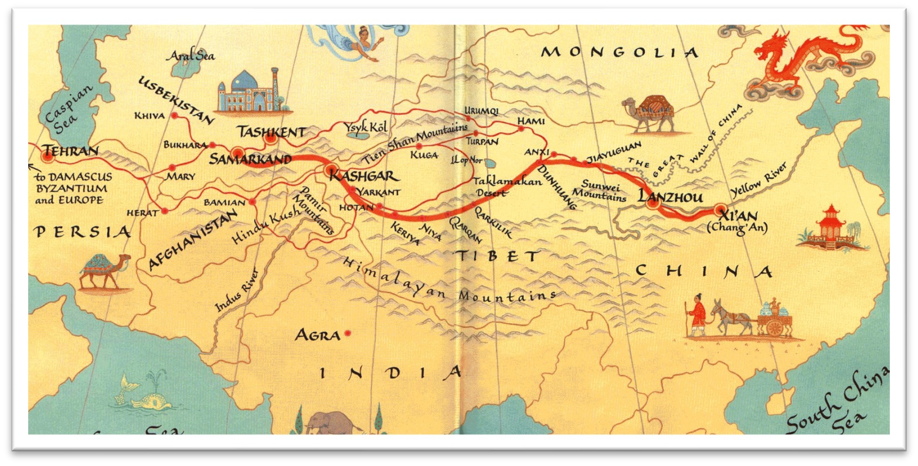


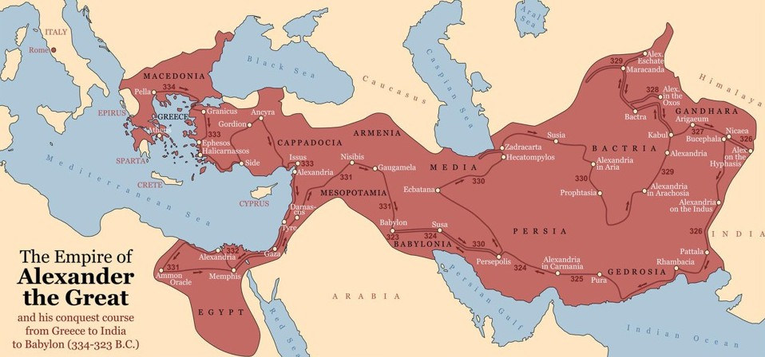


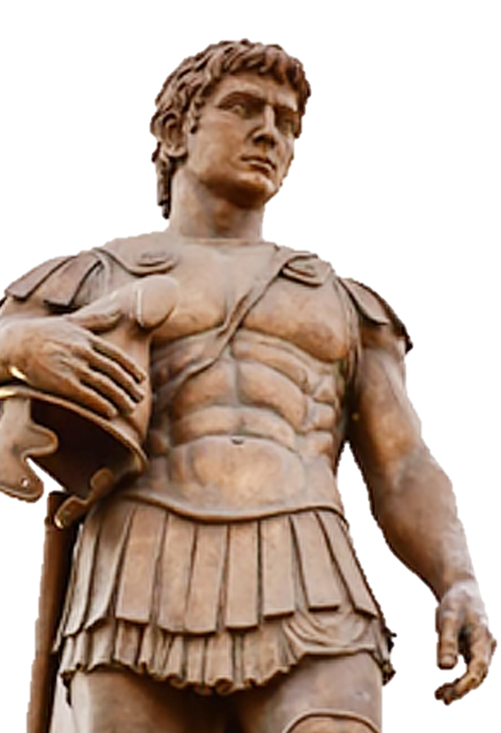

THE SILK ROADS
Why did the silk roads develop
When the advisors came back, the Emperor was fascinated and so began to open trade routes with them, allowing all sorts of goods to move locally in Asia.
Knowledge organiser
China had kept its borders closed for years, meaning no one was allowed in or out. That was until the Han Dynasty sent advisors out to countries on its borders
With Alexander the Great uniting countries West of China, the Silk Roads grew, and soon goods were being transported from China all the way to Europe.
Silk Roads timeline
Ye a r 7
Development of the silk roads
737 BC: Tea leaves are discovered and brewed for the first ime.
00 BC: The crossbow and Abacus are invented in China, it evolutionises warfare and mathematics.
36 BC: Alexander the Great is crowned King of Macedonia nd begins his Empire
130 BC: China officially opens the Silk Roads and begins trading with the West
105 AD: Paper is made in China
220 AD: The compass is invented in China.
00 AD: Porcelain is created in China
50 AD: The first type of printer is invented, with keys used for ach different letter
1000 AD: Black powder is invented in China. This was originally used for fireworks but was later used in the creation of guns.
1206 AD: The Mongol Empire started with Genghis Khan. This began the fall of the countries along the Silk Roads.
1453 AD: The Silk Roads are closed. The Mongol Empire and the ending of a lor od countries power meant that they were no longer safe to travel along.
Where were the silk roads?
2
t
5
r
3
a
6
6
e
What moved along the silk roads?
S I L K
This material was made in China and highly sought after in Asia and Europe.
H E R B S A N D J E W E L S
Spices and tea, as well as Jade were moves along the Silk Roads
How did Alexander the Great impact the development of the Silk Roads?
S O U R C E A : F R O M H I S T O R I A N P E T E R
F R A N K O P A N
Eventually the tables were turned when
Alexander the Great, widely thought to be the most brilliant general of all time,
conquered Persian forces in Egypt before crushing a massive army sent to stop him at
Gaugamela in what is now Iraq. After his victory, he began an extraordinary march into
the heart of Asia, taking city after city,
building new towns, roads and fortresses along the way to protect his gains. Alexander knew it was important to treat the local populations well: ‘it is their loyalty,’ he told his men, ‘that will make our Empire permanent and stable.’ And so he made himself master of the heart of the world, overseeing a realm that fanned out in all direction before he died
at the age of just 32 in 323 BC.
Who was Alexander the Great
R E L I G I O N
Buddhism, Hinduism and the Islamic faith all spread by the Silk Roads.
Alexander the Great was the King of Macedonia in 359 BC.
S O U R C E B : F R O M H I S T O R I A N P E T E R F R A N K O P A N
Alexander’s advance helped deepen the connections linking East with West. Goods, people and ideas – about religion, literature and Education – that were already flowing in each direction began to do so even more rapidly. Rulers in India even started to issue orders in several languages, including Greek and
Aramaic, so that they could be understood by people of all backgrounds and cultures. Soon, merchants, travellers, holy men and teachers began to throng along the Silk Roads.
He built up an empire first by securing Greece, and then moving into the Asia and the
Middle East.
He took over Egypt, Syria and Persia, and was prepared to take over India.
A N I M A L S
Animals such as horses were traded by western countries in exchange for these luxury items from the East.
He had one of the greatest empires in History at this point

Slide 4


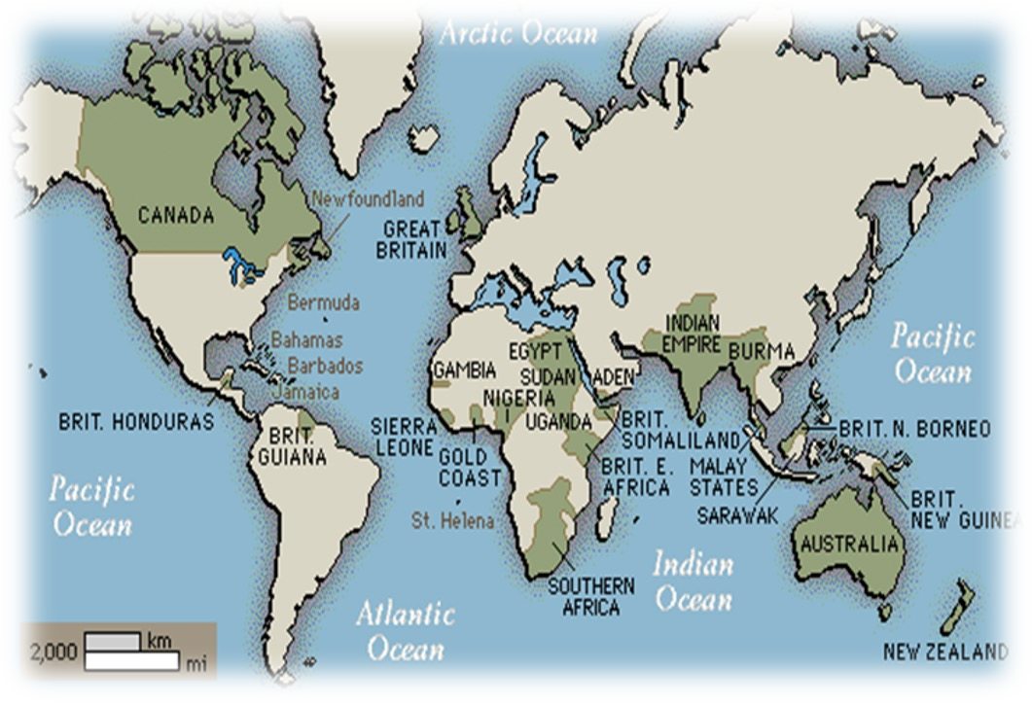
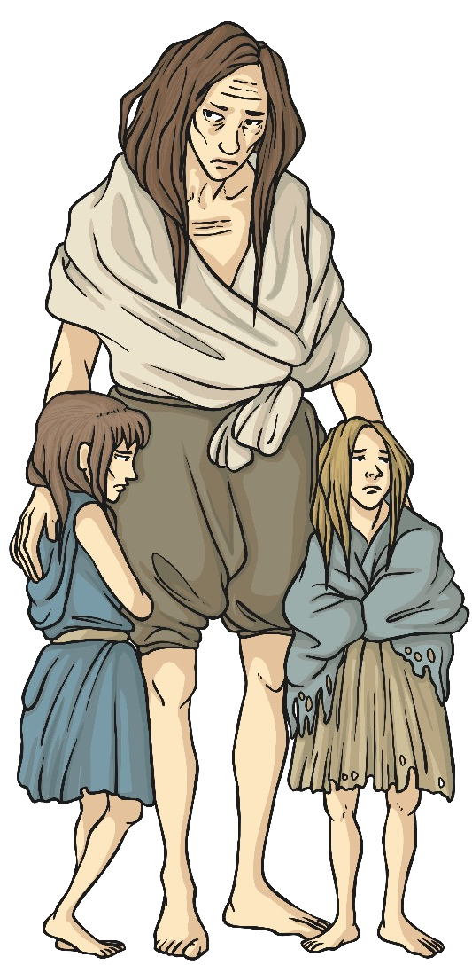
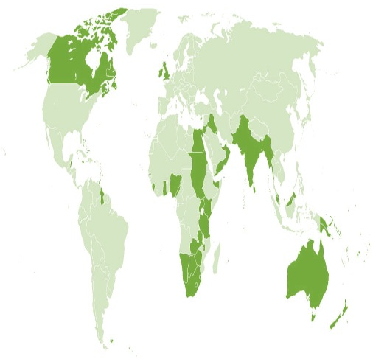
THE BRITISH EMPIRE
Why did Britain want an empire?
Social:
Knowledge organiser
Religion:
Economic:
Colonies offered cheap natural resources, and it would secure a large market to sell the goods she made.
Ye a r 8
Britain wanted to spread the Christian faith to other countries, with the aim of civilising them.
Britain wanted to civilise the native people of the different countries, and they believed they were morally superior.
Stuarts Timeline
What happened during the British empire?
1600: Elizabeth grants a charter to the East India Company, which
begins establishing trading posts in India.
1607: James I creates the first colony in Virginia, America, called Jamestown.
1655: Oliver Cromwell wrests control of Jamaica from Spain. English settlers bring in vast numbers of enslaved Africans to work the sugar estates on the Island.
1661: The first permanent British settlement on the African Continent is established in the Gambia River.
1759: Britain captures Quebec during the French Indian War, ending Frances power in North America. .
1775-83: The American Revolution takes place. The American colonists win the war, and Britain recognises them as an independent colony.
1788: The British Empire gains new settlements in Australia.
1807: Britain abolishes the slave trade, making it illegal to capture anyone else and sell them for profit.
1845: Ireland experience the Potato Famine, further worsening relations between England and Ireland.
1919: Mahatma Gandhi becomes a leader of the Indian National Congress.
1947: India is divided into India and Pakistan.
1997: The last significant English colony is returned to Chinese sovereignty, ending the British Empire.
Why was there an influx of migrants to Britain?
South Asians Came from the Indian sub- continent and Sri Lanka from the 1940s onwards
Other Commonwealth Migrants Today, there are many of them living in Britain, including 400,000 Australians
East African Asians Came from Kenya in 1968 and Uganda between 18th September and 7th November 1972
Irish
Came to Britain at the time of the Irish Famine in the middle of the 19th century
West Africans
Came with the Romans but more of us came from the 16th century onwards
African Caribbean
Came to Britain after the Second World
War from places like Jamaica
Migration to Britain in recent historyÅ
There has also been a pattern of European migration into Britain
(unrelated to the Empire). Particularly Eastern Europe – by 1901 there were 82,844 Eastern Europeans living in Europe. These were fleeing political unrest and instability in their home nations and were attracted by many of the same pull factors as colonial migrants (a safe environment, work and lack of persecution)
What happened with the Irish Potato Famine?
A large number of potatoes can be grown on
a small amount of land. Over half the population of Ireland in the middle of the 19th century depended on their potato crop for survival. It is a simple crop to grow and was very filling. Potatoes however, do not keep long. A good crop one year cannot be kept for the next year. If the crop failed, people did not have enough money to buy other food. In the 1840s, the worst happened and the crop failed. When they came to harvest the potatoes in 1845, all they got was black gooey mess. There was a 50 % loss in the number of potatoes harvested successfully in that year. This resulted in lots of people being very hungry and starving to death.
What were the consequences of the Irish Potato Famine?
Death was a serious consequence of the famine, reports said: ‘The husband dies by the side of the wide and she doesn’t even realise he has died.’
Key facts about the British Empire
The British Empire was the greatest empire the world has ever seen, and for more than a century Britain was the foremost global power, ruling over a quarter of the world’s area and population.
Key Facts:
One million people in Ireland are estimated to have died of starvation, epidemic and disease.
People lost their businesses as farmers and tradesmen, as they could not grow or sell their goods anymore.
This led to economic
depression.
Lasted during 1497 – 1997.
Over 450 million people (more than a quarter of the world's population AT THAT TIME).
36,000,000 square miles of territory (more than a quarter of the world's area).
The years 1815 to 1914 are referred to as
Britain's imperial century.
2 Million Irish people emigrated from 1845-55,
and a million emigrated to other areas of the Empire.
The Irish language therefore began to die out.
There was widespread feelings that the British government were not doing enough, and so rebellion and unrest began.

Slide 5









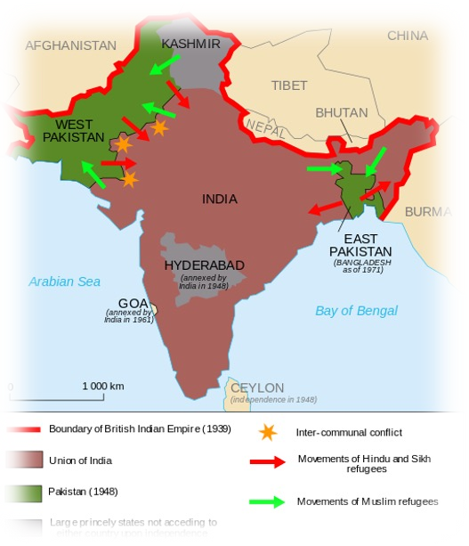




THE BRITISH EMPIRE
The steps to the partition of India and Pakistan
Knowledge organiser
The Amritsar
Massacre in 1919 led to the deaths of 1,200 Indians who had been peacefully protesting. The British opened fire on unarmed people.
The Muslim League was created by
Muslims who were scared that an independent India would mean they were a minority, so they campaigned a partition and the creation of Pakistan.
Ye a r 8
The British Raj ran India, they introduced
Western style
education and transport. But they also ran the economy for Britain, not India.
Indian National Congress was formed by educated Indians who disliked British Rule, they wanted independence from Britain and a united India.
Gandhi believed in Satyagreaha – non violent protest- and so he
led many peaceful campaigns to gain India its
independence.
British control of India
Britain controlled India since 1622. The East India Company (run by the British) used India as a base to trade with the rest of Asia. During their time in India, the British had to put down several rebellions – the worst one being the Sepoy Rebellion of 1857 Queen Victoria became Empress of India in May 1876 in an attempt to dispel any future rebellions. India played a large role in providing Britain with soldiers. These soldiers were used in protecting the British Empire
What was the new model army?
During the Partition, millions of Hindus, Muslims and Sikhs left their homes to move to either India or Pakistan. This mass movement of refugees was accompanied by terrible violence between the two faiths and hundreds of thousands of people were killed, either on the journey or on the border, between India and Pakistan.
After the Partition, India lost a large part of the fertile land that it had previously owned in the Punjab region, to Pakistan. This meant that India did not have as much farmland to grow its crops, for its people. This caused there to be a shortage of food in the country initially.
After the partition, both India and Pakistan claimed that they should have full control of the Kashmir region. The Kashmir region (on the border of I/P) was split between the two countries, during the partition. Pakistan and India have fought three wars, to gain full control over the region, in 1947, 1965 and 1999.
Interpretations on the British empire
Consequences of the British Empire
Improved agriculture: Britain improved these conditions and the Colonies still benefit even today. | Religion: People might argue that the Spread of Christianity prevented people following their own faiths such as Hinduism, Buddhism and Islam
Culture: British customs were seen to be forced on the people while their own local customs were ignored. | Clean water and sanitation: Britain improved these important conditions in the Colonies.
Native people such as the Aborigines of Australia had their land taken by The British. 80% of the Aboriginal population were wiped out in 150 years. | Soldiers: The colonies provided soldiers to fight for Britain examples being World War 1 and World War 2 to defeat evil.
English Language: The English language is almost universal and spoken throughout the world, which makes for good communication between nations. | Things belonging to the native people were stolen and brought back to Britain. For example a lot of aborigines’ art work was taken as well diamonds taken from India.
Criminals who committed petty crimes (like stealing cheese) were transported to far away places like America and Australia. They had to leave their family behind and some never saw them again. | Friendship: Many of the former colonies though now independent choose to belong to The British Commonwealth a force for friendship between nations.
Interpretation B: ‘Inglorious Empire: What the British did to India’, by the Indian author and diplomat Shashi Tharoor, published in 2018.
Interpretation A: ‘Empire: How Britain Made the World’ by the British historian Niall Ferguson, published in 2003.
“The Empire blew rebels from cannons, massacred unarmed protesters, entrenched longstanding racism, and caused millions to die from starvation. British imperialism justified itself as an educated dictatorship for the benefit of the governed. However, every supposed imperial 'gift' - from the railways to the rule of law - was designed for Britain's interests alone.”
“The Empire provided much good for its colonies, including a model of parliamentary-style government; the British understanding of the rule of law; trading links; investment from other European businesses; co-operation and friendship in the form of team sports; and schools set up by Christian missionaries.”
K E Y T E R M S
KEY TERM | DEFINITION | KEY TERM | DEFINITION
Imperialism | A policy of extending a countries power and influence over foreign countries to make them part of their empire. | Famine | An extreme lack of food, this normally lasts for a long time and leads to death and migration.
Trade | The selling and swapping of goods like cotton or food. | Migration | The movement of people to a new area of country in order to find work or better living conditions.
Empire | A group of colonies controlled by one powerful country. | Partition | The separation of land to create new countries.
Colony | A country or region under the control or influence of a more powerful country. | Commonwealth | An independent country which used to be a part of the British Empire.

Slide 6

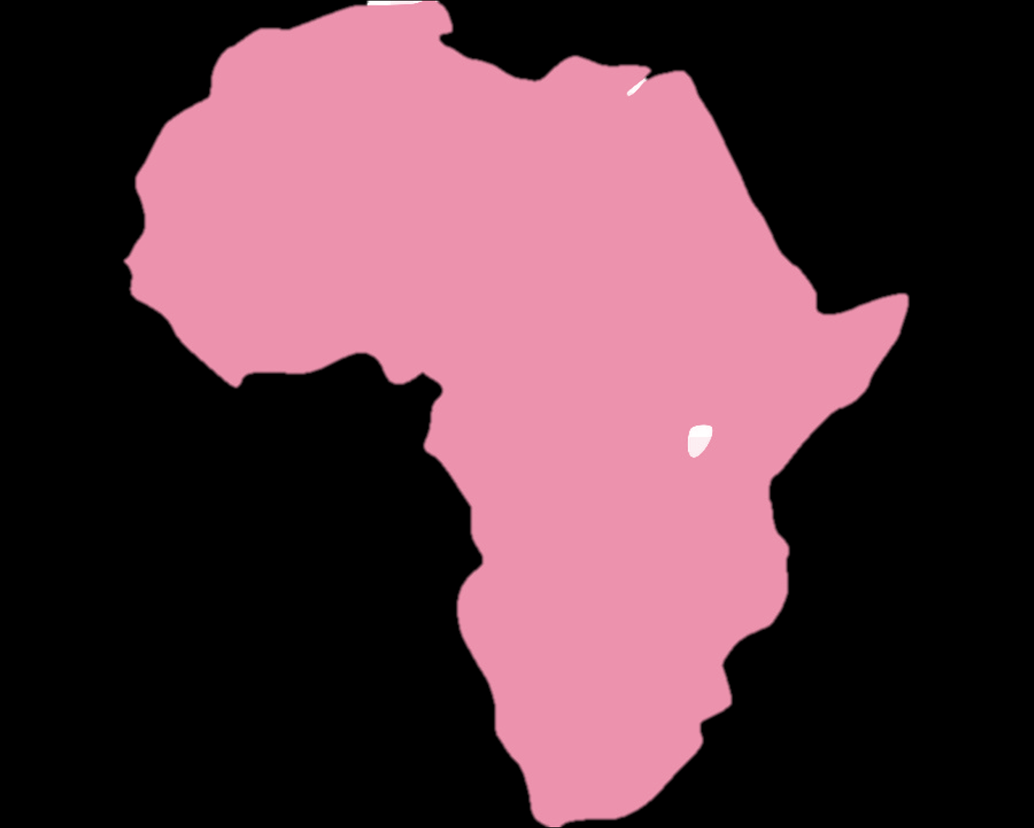


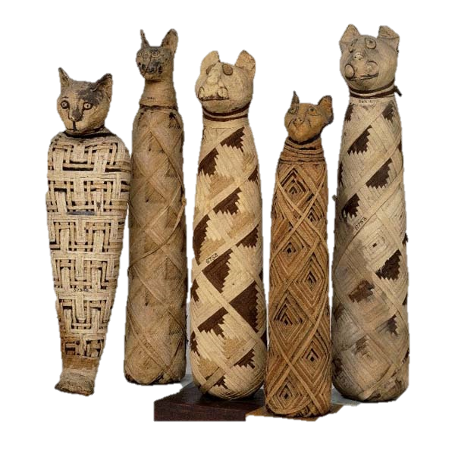
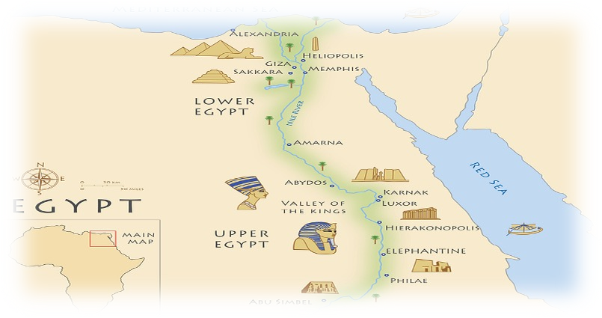
AFRICAN KINGDOMS
Where were the African kingdoms?
Knowledge organiser
MALI:
EGYPT:
❑
❑
❑
C. 1240-1645
Famous for its wealth Traded in gold, salt and spices.
Mansa Musa – richest man ever!
Islam
❑
c. 3150 BC when Narmer unified Upper and Lower Egypt.
Ruled by Pharaohs
Developed Egypt into one of the greatest civilisations, with impressive architecture still existing today.
They followed their own religion with multiple deities.
Key events Timeline
Ye a r 8
Key dates in African history
5000 BC: People begin to farm along the river Nile as it is fertile land and easy to produce crops.
3150 BC: Narmer unites Upper and Lower Egypt, and becomes one of the first Pharaohs.
2500 BC: Construction of the Great Pyramid of Giza is completed, making it one of the Ancient wonders of the world
525 BC: The Persians conquer Ancient Egypt, which marks the beginning of the end for Egypt.
332 BC: Alexander the Great conquers Egypt, bringing it into his Greek empire
900 AD: The kingdom of Benin is created, and the first Oba is crowned ruler of the country.
1230 AD: The Mali Empire is formed.
1325 AD: Mansa Musa makes his pilgrimage to Mecca. On his journey he bankrupts Egypt as he spends so much money.
1390 AD: The Kingdom of the Kongo is formed.
1460 AD: Songhay Empire is formed
1482 AD: Portugal arrive to begin trading with the Kingdom of the Kongo.
1500s: The Transatlantic Slave Trade begins, impacting on all future development of Africa.
1610 AD: The end of the Mali Empire.
Historical misconceptions
❑
❑
❑
❑
❑
SONGHAY:
❑
❑
c. 1460s – 1591
Replaced the Mali empire
Diverse empire with people from different
backgrounds
Controlled much of he Sub-Saharan trade
❑
❑
KINGDOM OF THE KONGO:
❑
❑
❑
Emerged in the late 14thc Ruled by the Manikongo Dominated trading routes trading in copperware, metal, raffia cloth and pottery.
Portuguese arrived to trade in 1482/3
BENIN:
c. 900s when the Edo people settled into the rainforests of West Africa
Ruled by Oba’s (chiefs) including Eware the Great
Developed Benin City into a city comparable to those in
Europe
Rich source of art including the Benin Bronzes
❑
❑
❑
❑
❑
HISTORICAL OPINIONS ON AFRICA
Interpretation A: Hugh Trevor Roper, 1963
“Perhaps, in the future, there will be some
African history to teach. But at the present there is none, or very little: there is only the history of
the Europeans in Africa. The rest is largely darkness and barbarous tribes in irrelevant corners of the globe”
Pre-colonial history of Africa has been neglected by historians over time. Pre-colonial Africa is normally the period before 1800, before the Europeans began to colonise Africa. One of the legacies of the Transatlantic Slave Trade Is misconceptions about Africa – lots of people believe Africa was not developed or societies were not complex or wealthy.
Ancient Egypt
Interpretation B:
Ignorant, superstitious, and barbaric, African art was assessed as “primitive” and inferior compared to European “high” art; African political organizations were regarded as mere “tribal” associations; and African medicine men were “witch doctors.”
Ancient Egypt lasted around 3000 years, and its Empire spread from Syria to Sudan.
In the beginning, Egypt was a series of cities spread across the River Nile, but eventually they united into what we know as Ancient Egypt.
Pharaoh was the name given to the leader of the country, and were considered the protectors of the people.

Slide 7








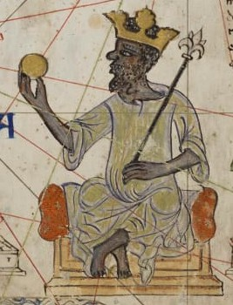
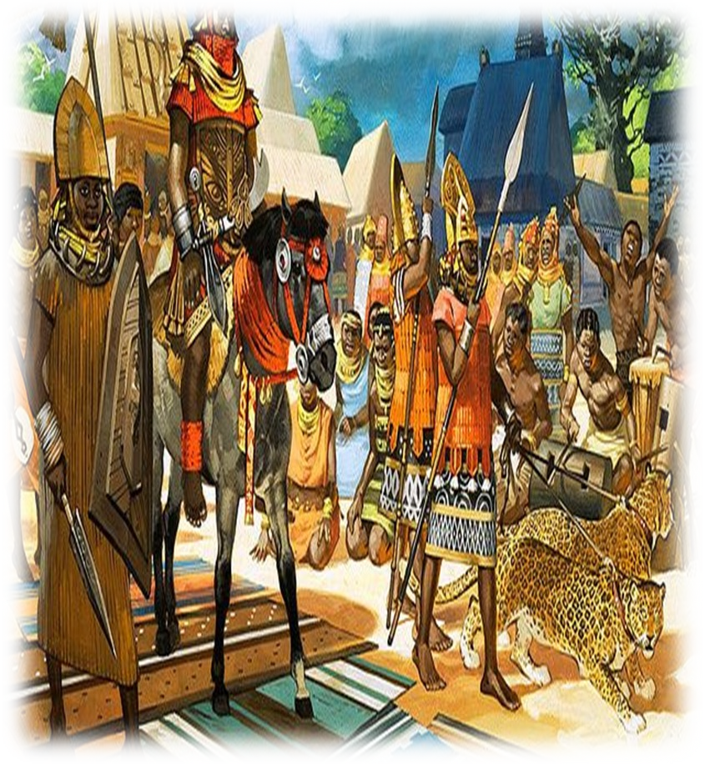
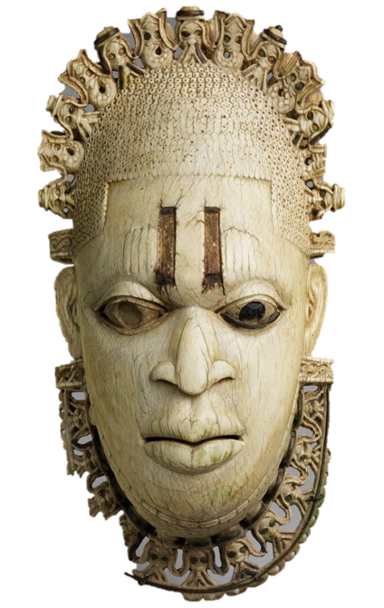
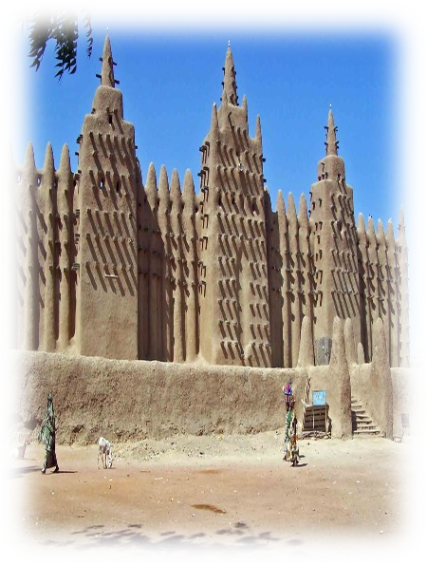
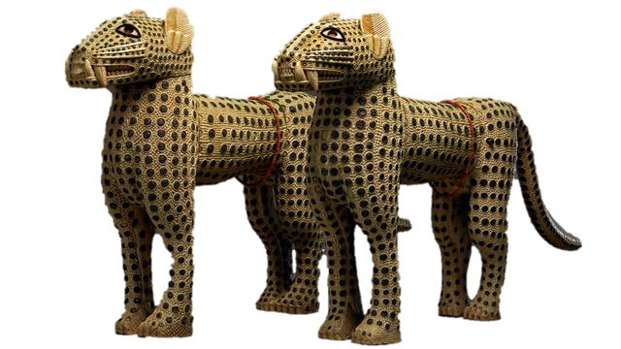
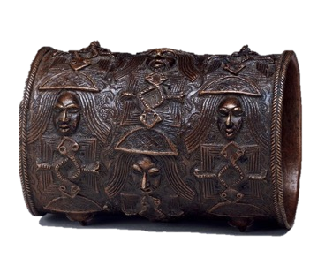
AFRICAN KINGDOMS
Egyptian Civilisation
Knowledge organiser
The Pharaoh was responsible for the countries wealth. Most of the hard work that kept the country running smoothly was carried out by merchants, craft workers, labourers and slaves.
Egyptian towns were built in a grid-like pattern, with mud walls being built around the outside and channels being built in the middle of the streets to remove waste.
Hieroglyphs were used as the language of the Ancient Egyptians.
There were
around 1,000 symbols all having different meanings. They knew a lot about
broken bones and surgery.
The Pyramids were massive four sided tombs, built for the Pharaohs of the Old Kingdom. The summit of each pyramid was probably capped in Gold.
Ye a r 8
The Pharaohs were considered to be holding the spirit of a God inside them, and so they were worshipped by the people as God Kings
Who was Mansa Musa
Mansa Musa was the Muslim King of Mali, and is known to have been one of the richest men in History, with his net worth estimated to have been
£400 billion. As is traditional for his faith, he embarked on a pilgrimage to Mecca, and took with him 60,000 men, and spent so much money in the countries that he passed through that he ended up bankrupting Egypt! Musa also made sure to build schools, libraries and employed scholars from Mecca to ensure the lasting legacy of his kingdom wasn’t just wealth but was with learning and education.
What happened to the kingdom of Benin?
Benin was under threat from Britain. The British wanted to gain control of Benin so they could get rich by selling its palm oil and rubber. The Oba tried to stop all contact with Britain, but the British insisted on their right to trade. In 1897 a group of British officials tried to visit Benin. They were sent away because the Oba was busy with a religious ceremony, but they decided to visit anyway. As they approached the borders of Benin, a group of warriors drove them back and several British men were killed. This attack made the British furious. They sent over a thousand soldiers to invade Benin. Benin City was burnt to the ground and the kingdom of Benin became part of the British Empire.
What were the Benin Bronzes?
The Mali Empire
The Mali Empire started in 1235 and ended in the 17th century; it was formed through a conflict between the Susu Kingdom and the Manlike people. We know about the Mali Empire from their tax records and from the pledges they took from other countries who joined their empire. The Mali Empire had a big focus on education, as they believed that if the people were educated that their empire would succeed. The more people who were educated, the more they would work, and therefore they could be taxed more.
Ida, the first Queen Mother of Benin. Her son was crowned Oba of Benin in the 15th century. This is a Bronze statue
Factors making an Ancient civilisation
❑ Being next to a river, this was for water sources for growing crops and to drink.
❑ Having trade with other countries
❑ Having their own language so communication was easy
❑ Having skilled craftsmen to build
different things such as the Pyramids.
❑ Farming systems to ensure crops will grows to feed the people.
❑ A social structure such as a government
Leopards carved from ivory. They were a symbol of power in Benin and used to represent their Obas.
K E Y T E R M S
KEY TERM | DEFINITION | KEY TERM | DEFINITION
EMPIRE | A group of colonies controlled by one powerful country. | MANSA | The name for a king in Mali
PRE-COLONIAL | This is a time period before a country became part of an Empire | OBA | The name for a king in Benin
MISCONCEPTIONS | This is something we all consider to be true, but actually is wrong | INFERENCE | This is something we can learn or work out from a given text
PHARAOH | The name for a ruler in Ancient Egyptian. | CIVILISATION | This is any society that has a structure to it. This could include culture, class or politics
This is a bangle made out of brass. These would have been worn by lower ranking officials in the palaces of the Obas, or at official events.

Slide 8



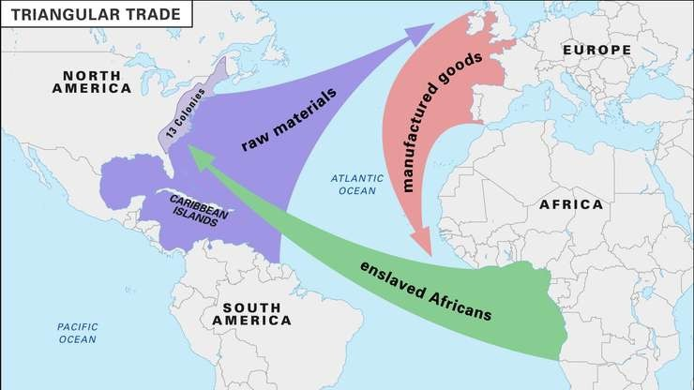
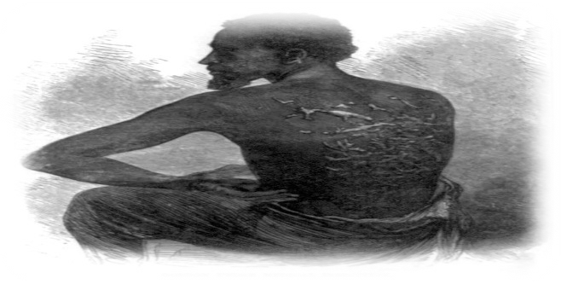
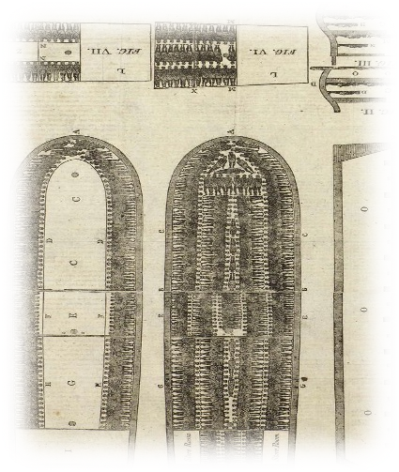
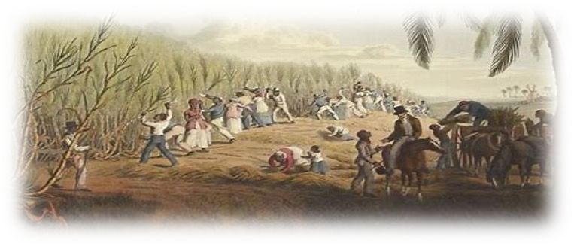
TRANSATLANTIC SLAVERY
Why did the slave trade last so long?
Empire:
Knowledge organiser
Money:
Morally:
People believed that the African people were inferior to white people, and so they didn’t see anything wrong with what they were doing.
The traders were making so much money from the salve of enslaved people, that it would have been too profitable to end.
Britain took enslaved people from its own colonies in Africa, and so they believed that it was their right to do so.
Slavery Timeline
Ye a r 8
What happened during the British empire?
1502: First enslaved African people arrive in the New World in
the forced service of the conquistadors.
1619: The first Africans in English America are brought to Jamestown, Virginia.
1641: colonial plantations in the Caribbean begin exporting sugar. British traders also begin capturing and shipping enslaved people.
1700: The largest numbers of enslaved Africans are taken to the Americas during this period.
1780: The peak of the slave trade is reached. On average, some 78,000 enslaved people are brought to America every year.
1789: Olaudah Equiano publishes the first significant work on an enslaved persons life. The Book is The Interesting Narrative of the Life of Olaudah Equiano.
1807: The British abolishes the slave trade with its colonies, effectively banning new slaves being transported in the middle passage..
1808: America bans the importation of slaves into the country
1833: Britain passes the Slavery Abolition Act, freeing 800,000 slaves in its colonies
1861- 65: The American Civil War is fought between those who want to increase slavery to new states and those that want it abolished.
1863: Abraham Lincoln passes the Emancipation Proclamation, which declares all enslaved people are now free in America.
How did the slave trade work?
What was it like on the middle passage?
SOURCE A:
There was enough food, but not
RAW MATERIALS
These are goods such as coffee, sugar and tobacco that are grown on plantations in
America and the Caribbean. These are produced by Slaves to maximise
profits.
MANUFACTURED GOODS
These are goods such as guns, cloth and alcohol. These were sold to
Africans in exchange for slaves. The
traders also kidnapped people
for slavery.
always of good quality. Daily
rations might include yam, biscuits, rice, beans and occasionally meat,
but the way it was served-one bucket among ten-meant that there were quarrels and infection. Water was part of daily rations but could be in short supply and unpleasant to drink.’
SOURCE B:
Temperatures on some journeys could reach 32 degrees and many suffered from seasickness and
THE MIDDLE PASSAGE
This was the journey between Africa and America, where traders transported slaves. The conditions
were horrendous, with cramped spaces, little food and high death rates.
heatstroke. Some died of dysentery…others died of harsh treatment and poor food…those who did survive the journey were taken, after landing, to a camp to be fattened up and cleaned.’
What was life like on the plantations?
Once enslaved people had been sold off at auction, they were sent to do a variety of different jobs in different countries, but their lives were always hard. On huge farms called plantations, they were forced to plant, look after and harvest crops that would sell for lots of money in Europe. Sugar was frown in the West Indies, cotton was grown in North America, Tobacco was grown in North and South America, and coffee was grown in South America.
’A slave would be expected to work for most of his or her life. Some worked in the Plantations owner’s house as a cleaner, cook or servant, but most worked out in the fields as farm worked. Three
and four year olds would work in Punishments for slaves who break my
What was the transatlantic slave trade?
Slavery has been around for years, with the Ancient Egyptians using them to build the pyramids to Spanish settlers using native Americans to work for them.
‘trash gangs’ (weeders) or
^{as} laws
water can carriers.
^{Between the} For any rebellions: rebels nailed to the
The transatlantic slave trade made slavery profitable. At the height of the slave trade, in the 1700s, an estimated six million Africans were taken across the Atlantic ocean to work as slaves. Over 50,000 voyages, lasting between 40 and 70 days, were made in 300 years.
^{ages of nine and twelve, they} ground then burnt; fire applied starting at would start to work in the fields the feet, gradually moving up to the head. with the adults. As they got older, For continued running away: removal of
slaves would often do
^{less} hand, foot or testicle with an axe.
exhausting jobs, such gardening,
^{as} For running away: neck ring or iron muzzle
^{horse-and-carriage} Failing to do duties properly: lashed for
driving, cleaning and nursing.’
every year of the slaves life.

Slide 9
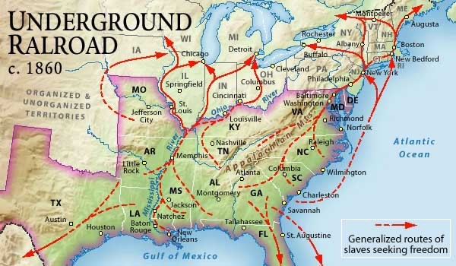




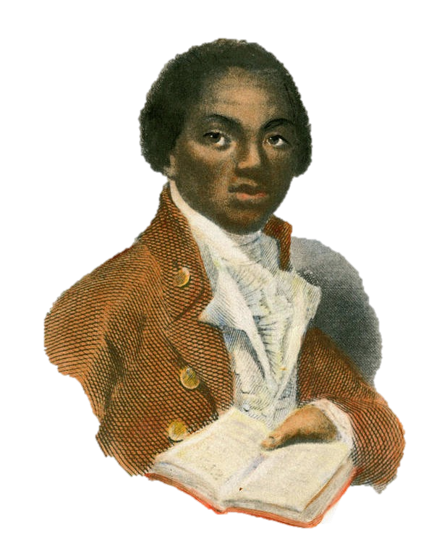
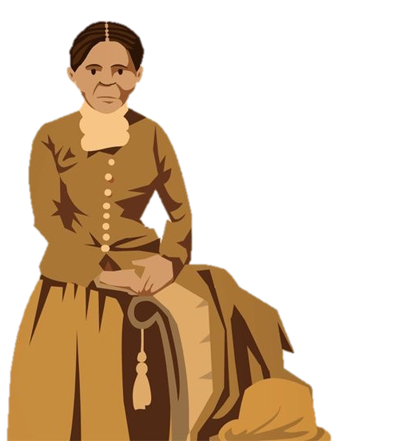
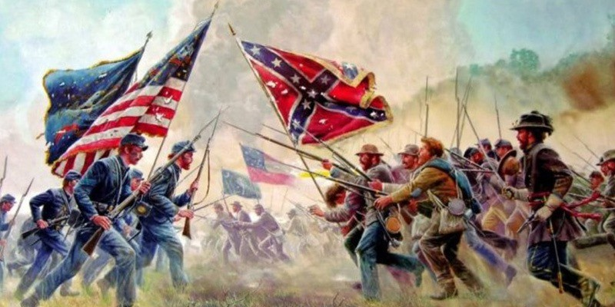
TRANSATLANTIC SLAVERY
What happened in Nat turners rebellion?
There were many rebellions across North America and the Caribbean, some more successful that the others. Some rebellions were passive, choosing not to be violent; but others were violent, with Nat Turner being one of the bloodiest.
Knowledge organiser
Ye a r 8
Virginia was one of the large Slave states. By 1860, there were 550,000 enslaved people working on plantations. Nat Turners rebellion took place in Southampton County in 1831.
Nat Turner had been born into Slavery, but his mother had been captured in Africa. He had therefore been taught to hate slavery. He had been taught to read and write by a fellow slave.
The aim of the rebellion was to free enslaved people. They went from house to house killing the slave owners. In the end they murdered 55-
65 slave owners
and was the bloodiest rebellion.
The rebellion failed within a few days, but Turner survived.
When he was caught he was executed for his part in the plot as
well as 56 slaves. Nearly 200 slaves were killed by white mobs for revenge.
The local government issued new laws banning the education of both enslaved and freed slaves and restricted them meeting. At the churches for enslaved people, white people attended to monitor them.
What was the underground railroad
If a slave ran away from their owner,
they were very likely to be recaptured unless they had help. The Underground
railroad helped slaves escape by creating a secret network of safe houses
to provide escaped slaves with help to
get away from their owners. Songs were sung on the plantations that told slaves where these safe houses were.
Who was Harriet Tubman?
Why was slavery abolished in Britain?
L E G A L I T Y A N D
P O L I T I C S
The Society for the Abolition of the Slave Trade was set up in 1787. Its aim was to campaign for the end of the slave trade and for the slaves of Africa to live free and independent lives. It became more and more popular By 1792, Parliament had been presented with 519 petitions against slavery. These showed over 390,000 signatures. This showed public opinion was turning against the slave trade.
The slave trade and plantations
became less profitable. Prices and costs went up and down as war interrupted trade.
K E Y I N D I V I D U A L S
Many people write about the horrors of the slave trade and convinced many of the need to ban it, for example, Hannah More. She wrote poems and books.
B E L I E F S A N D I D E A S
From the day she was born, Tubman worked in cotton fields with her family. One of her first jobs was carrying water. When she was older, she then moved to working on the plantation with her family. She saw a slave run for freedom and got the courage to do the same. One night, she crept out and fled to the forest. She travelled for weeks to avoid capture, and eventually she reached Pennsylvania, a state where there was no slavery.
She tried to settle, but she couldn’t, so
she decided to go back. She went back to her plantation, collected her family and led them to freedom. Harriet Tubman went back time and time again to free slaves, and it is now suggested that she led 70 slaves to freedom.
Anti-slavery religious groups such as Quakers thought that slavery was a sin against God. Slave Rebellions slowly changed attitudes. There were
William Wilberforce campaigned tirelessly against the Slave Trade. He tried and failed numerous times but did not give up. Thomas Clarkson was tasked with collecting evidence to support the abolition of the slave trade, He interviewed sailors, published pamphlets and making speeches at public meetings. From 1787-1795, Josiah Wedgwood worked with the abolitionists. He designed the emblem which was used on hat pins, brooches, buttons and seals.
rebellions in many British and Danish colonies,
including Guyana. Slavery slowly became legally unacceptable. Granville Sharp used low courts to try and give slaves their freedom. He fought many court cases including the Zong Ship.
K E Y T E R M S
KEY TERM | DEFINITION | KEY TERM | DEFINITION
Transatlantic | This involves going across the Atlantic ocean either by plane or by boat. | Rebellion | The act of armed resistance against a government or a leader.
Slave | A person who is forced to work for and obey another, and is considered their property. | Emancipation | This is the act of being set free from legal, social or political restrictions.
Plantation | A farm which grows coffee, sugar or tobacco. | Manufactured | This is a product created using large scale machinery, and involved raw materials
Middle Passage | The journey across the Atlantic Ocean that carried enslaved people as cargo. | Passive | This is when something is non - violent
Why was slavery abolished in America?
Slavery was abolished in America in 1865, 58 years after Britain.
Slavery was so important to the Southern economy in America that there was severe opposition to granting freedom to enslaved people.
Abraham Lincoln, the President of the US, wanted to prevent slavery from spreading into the Western States of America, but the South disagreed.
The American Civil War began in 1861, but Lincoln won and abolished slavery across the whole of America because of it.

Slide 10


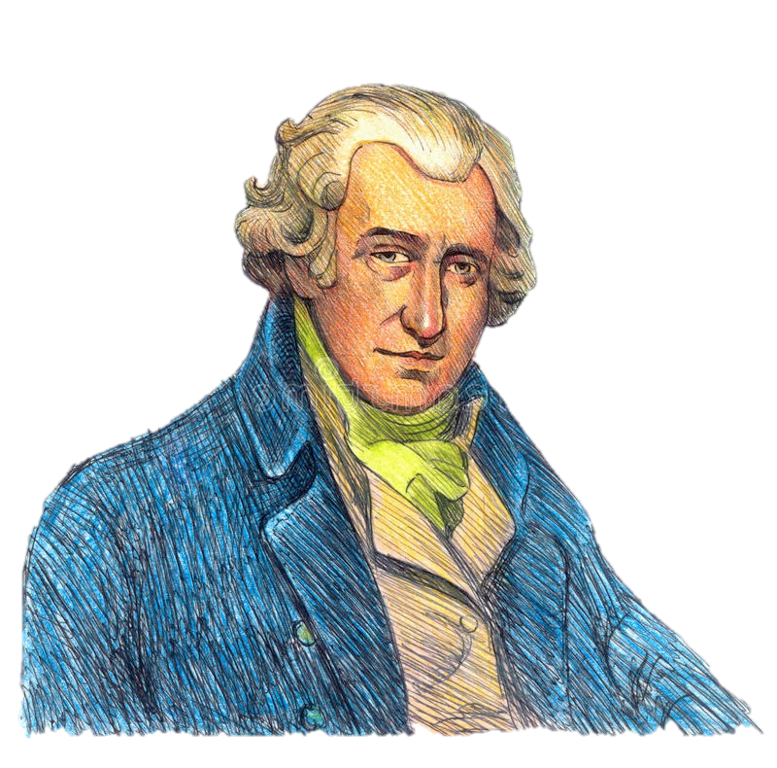
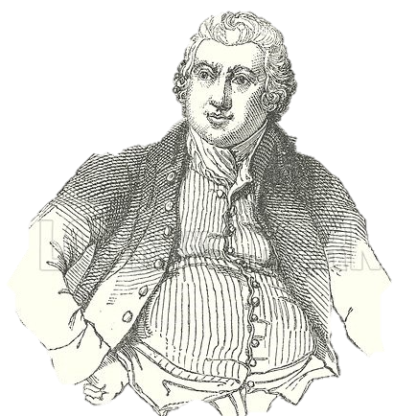
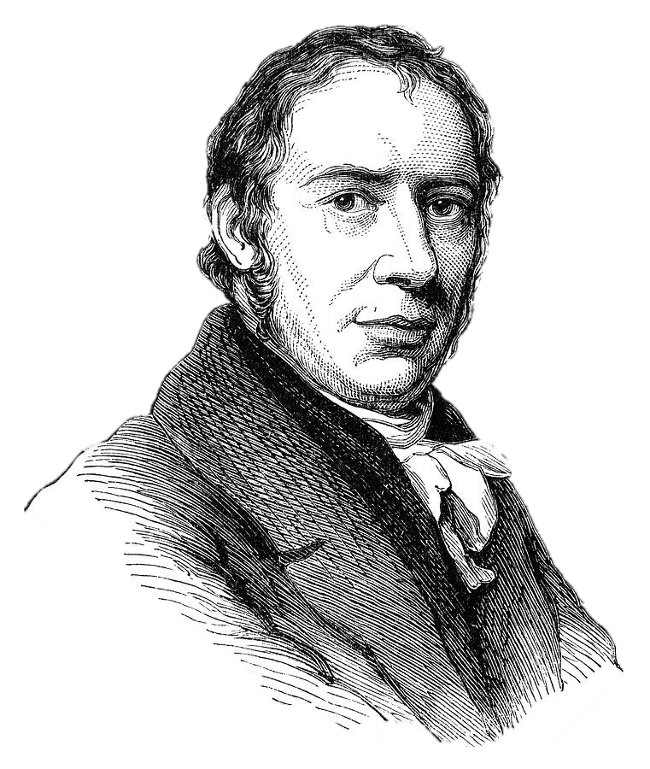
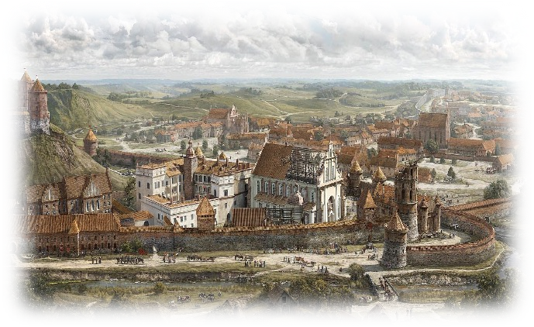
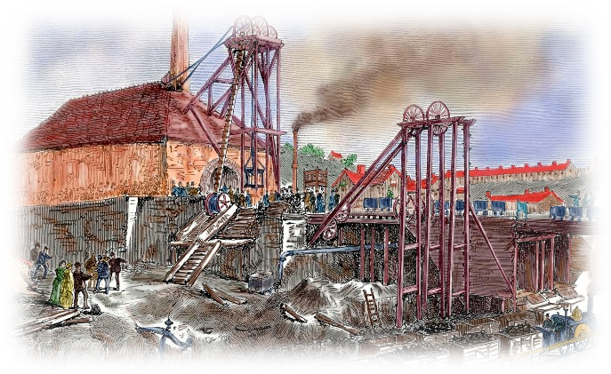
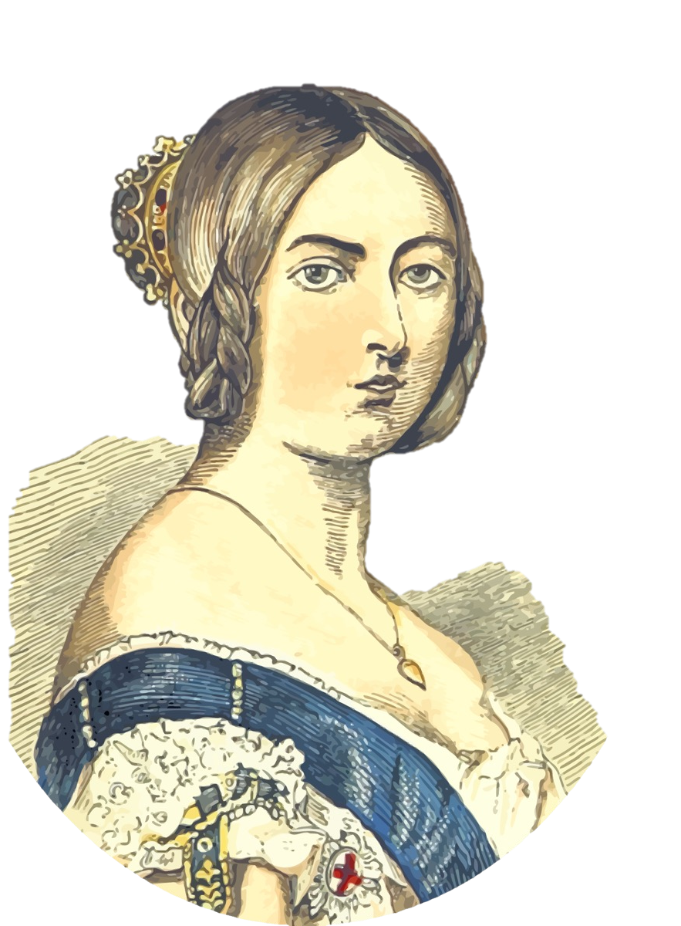
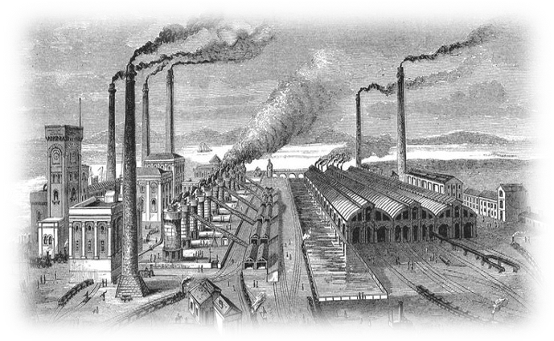
INDUSTRIAL REVOLUTION
How did the industrial revolution change England?
Knowledge organiser
Jim Crow
These were laws that kept people of colour separate from the white Americans. They claimed it would keep them ‘separate but equal.’
KKK:
This was a group of racist Americans who campaigned against the rights of African Americans, and actively lynched them.
NRA:
Around the time the KKK was branded a terrorist organisation, the NRA formed, which prevented African Americans having the right to own a gun.
Timeline
Ye a r 8
WHAT HAPPENED DURING THE INDUSCTIAL REVOLUTION?
1764: James Watt creates the Spinning Jenny.
1769: James Watt then creates the first Steam Engine using ideas from Newcomen.
1775: Arkwright develops mills which use one machine to develop yarn.
1811-1813: Luddites begin to oppose industrialisation, attacking the mills which are putting smaller business out of work.
1833: Michael Sadler writes a report on the conditions people were working in, and it shocks the general public.
1837: Queen Victoria becomes ruler of England
1851: The Great Exhibition opens at the Crystal Palace in Hyde Park.
1859: Charles Darwin's’ on the Origin of the Species is published, revolutionising how we see human development.
1879: Thomas Edison created the lightbulb, which would eventually replace the old gas lights.
1880: Education becomes compulsory for children under 10, which meant that literacy rates were rising in England.
1897: The Women's Suffrage campaign starts, to try and achieve equal rights for women.
1901: Queen Victoria dies, and his succeeded by Edward VIII leading into the new century.
What inventions were made in the industrial period?
James Watt:
1781 James Watt created the first steam engine that allowed for the development of factories. This steam engine was used to turn a wheel, which then in turn powered the new mills.
Arkwright:
In 1775, Arkwright developed the mills which meant that new machinery could be developed to speed up the process of creating manufactured goods.
Trevithick: Richard Trevithick developed the first trainline in Britain, which sped up the process of moving goods across the country. This was then used alongside the
canals.
How did the industrial revolution change towns?
17TH CENTURY TOWN:
In the 17th century, towns and cities were starting to grow. They still however, had plenty of farmland, independent businesses and smaller populations. Many people were involved in hand making materials such as cloth, and transport was predominantly on foot or horse and cart.
19TH CENTURY TOWN:
In the 19th century, towns had become much more industrial. Factories had taken over much of the farmlands around cities, independent businesses had been replaced with large scale manufacturing, and the countryside had been carved up to create railway lines and canals. Towns had become overcrowded, with people themselves working long hours and suffering serious health problems.
Positive consequences of the industrial revolution
There were more people, and as a result we had a better understanding of medicine, healthcare and science. The factories produced food, clothing and shoes to make sure this growing population was cared for.
The growing population was well fed, and so the new inventions like the Seed Drill meant that farmers could produce more crops to feed them. New ideas on breeding animals also helped.
Britain’s Empire grew. During this time, The Empire contained 450 million people living in 56 colonies all across the world. Cheap goods were imported from these countries to increase the profits of manufactured goods in Britain.
Entrepreneurs increased, with people willing to take more risks. They bought raw materials like cotton and sold them at profit. John Cadbury is an excellent example of someone who imported sugar for his chocolate business.
Who was queen Victoria?
Queen Victoria was the ruler of the United Kingdom for 63 years, and the love of her life was her husband Prince Albert. Victoria’s reign saw the most change of any previous monarch: by the time she died, more children than ever were in school, the Industrial Revolution had reached its peak, and the British Empire had expanded to its biggest yet. Prince Albert himself was a massive advocate for the inventions, and he created an event ‘the Great Exhibition’ to show off all the inventions made during the 19th century.
There was an increase in inventors, who created new machines such as the steam train, electric generators, light bulbs and the telephone. Britain became a world leader in science and technology.
Britain increased its supplies of coal and iron which was a valuable raw material. By 1850, Britain produced half of the world’s iron and two thirds of the worlds coal.
Britain was referred to as
the workshop of the world.

Slide 11






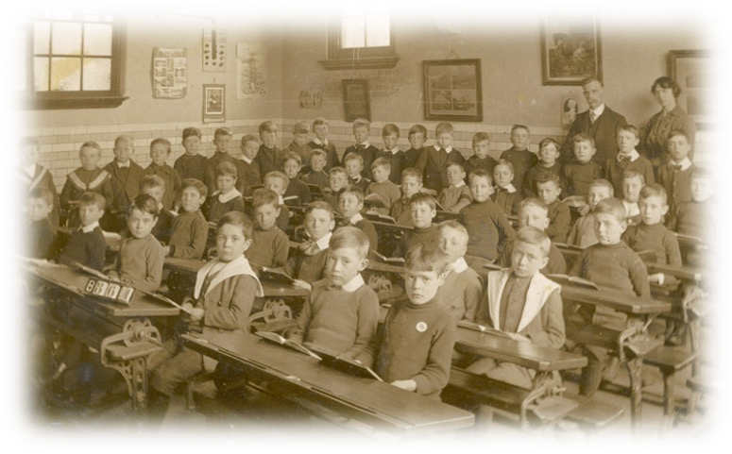
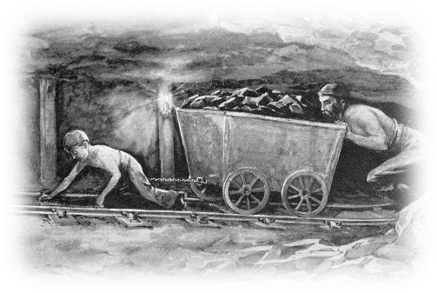
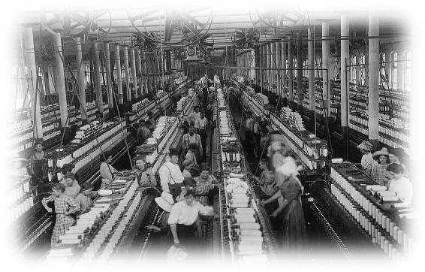
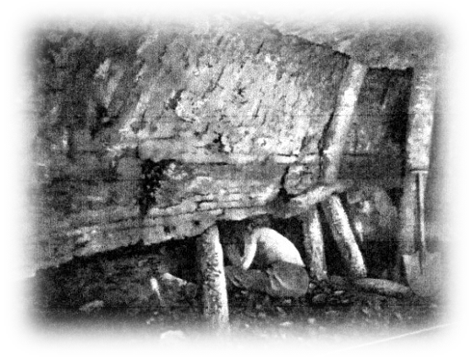
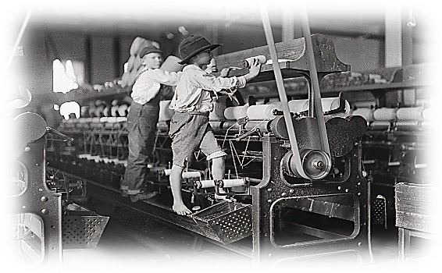
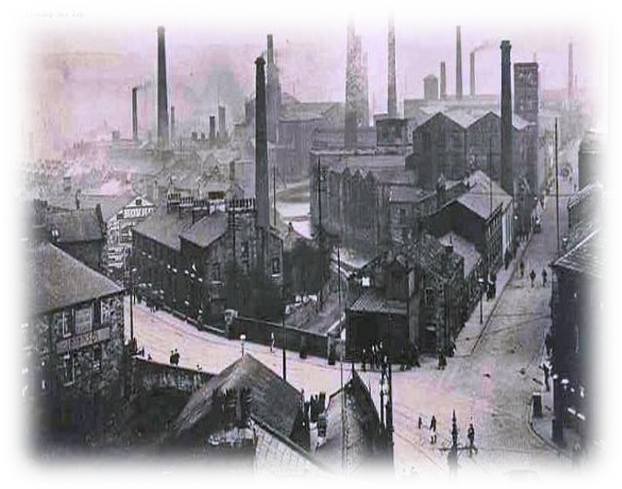
INDUSTRIAL REVOLUTION
Working conditions in the industrial revolution
Knowledge organiser
Wages were incredibly low because competition for jobs was extremely high.
The more
people migrating into towns, the more people needed work, and so the money was
low as people were
desperate.
Child Labour was high as there were no laws preventing children from working, and nothing that stopped them from doing dangerous jobs, Children were often doing the more dangerous work as they were smaller.
In addition to all the long hours and hard manual labour, if jobs, employers also used to punish people if they were seen to be working too slow, or not doing as they had been asked to do.
Dangerous conditions in the factories were a big problem. The factories were often over crowded, and people ended up with serious health conditions from them such as breathing difficulties from taking in the cotton.
Working in the mines had a similar effect, with many miners ending up with deformities and not being able to stand up straight. There were also frequent cave ins and gas leaks that led to explosions.
Ye a r 8
Loong hours: Throughout the Industrial Revolution, workers shifts
averaged 12- 16 hours a day,
with few breaks and rarely a day off.
What was the problem with education?
In the early 1800s, there were no government run schools, and there were no laws that said children must go to work. Instead, most children worked in factories for 15 hours a day. The Factory Act in 1833 said that any child working in a factory should get two hours a day of basic education.It wasn’t until 1870 the government acted and created the Elementary Education Act, making sure that every child between the ages of 5 and 12 had to go to school.
What were Victorian schools like?
What were conditions like in the mines?
What were conditions like in the factories?
Hours were between 12-14 a day, with extra time required during busy periods.
Wages were typically 75p a week, but women and children were much less, around 15p.
There were problems of ventilation as mines got deeper. This meant that oxygen was limited, and other gasses such as methane and carbon monoxide were more common. This led to explosions that caused the deaths of miners.
Children as young as 4 years old sat all day in the dark opening the doors for the trucks to pass through.
Wages were so low, that there were stories of pregnant women giving birth down in the pit one day, and being back at work the next!
If a man joined a trade union to fight for his rights, he was sacked not only by his mining company, but not allowed to work for any of them.
Accidents frequently
happened, with children being
forced dangerous, machinery.
to crawl into unguarded
Students would have had some PE known as Drill, History and Geography, and basic numeracy. Their lessons would also have been silent, with children sat in rows facing a blackboard. Teachers were tough and so were punishments, leaving school without permission, swearing and answering back were all punishable offences.
Cotton thread had to be spun in damp, warm conditions.. Going straight out into the cold night air led to many cases of Pneumonia. The dusty air also led to lung disease.
What about Colne?
Colne developed as a town because of the Industrial Revolution. The North of England had the perfect climate for cotton to be spun into thread. If it was too hot or cold, the thread would become brittle and snap.
K E Y T E R M S
KEY TERM | DEFINITION | KEY TERM | DEFINITION
Domestic System | The system where people worked in factories in their homes or small workshops. | Factory system | The system where people worked in factories to produce goods in large numbers.
Canal | A long, narrow, man made channel of water used to transport materials quicker across the UK. | Industrial Revolution | A dramatic change in the way things were made, when factories replaced faming as the main form of business.
Domestic System | The system where people worked in their homes or small workshops rather than factories. | Pauper Apprentice | An orphan who worked in a factory in return for food and a bed.
Entrepreneur | A business person who takes risks, often with their own money, for profit. | Trade Union | An organisation of workers in a trade formed to protect their rights and working conditions.
For Nelson and Colne then, this meant that many factories and mills popped up to spin the cotton into thread, and then into clothing. Cotton was imported into the area from the plantations in America, and then using the canals and trainlines, brought across into Colne and Nelson.

