Slide 1

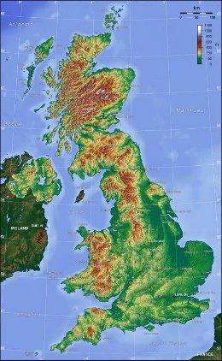
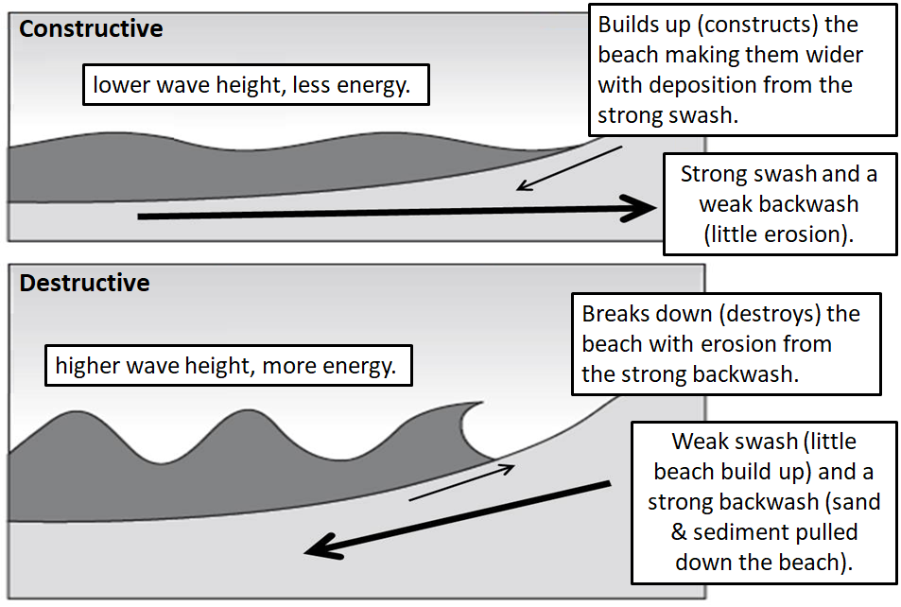
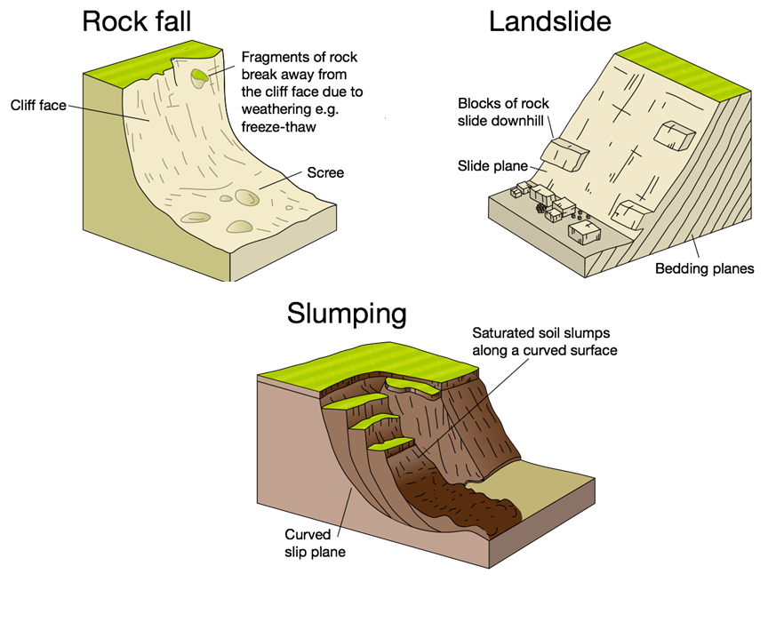
Year 11 – Paper One: Section C
Physical Landscapes in the UK - Coasts
Knowledge Organiser
Landscapes of the UK
UK has wide variety of rock types (geology)
UK’s main upland areas are formed from hard rock such as granite and slate, and they are found in Grampian Mountains (Scotland), Lake District (England), Snowdonia (Wales).
UK’s main lowland areas are formed by softer rocks such as chalk and clay, and they are found in East Anglia (known as The Fens - lowest place in the UK)
UK has extensive river system – most river source’s begin in the mountains/hills and flow out to the sea.
  River Thames - deepest river in Britain
  River Severn - longest river at 220 miles
Erosional Processes
Hydraulic action: the force of water entering cracks in the rock causes air to become trapped, causing the rock to break apart.
Attrition: rocks carried by the sea knock into each other, becoming smaller, smoother and rounder.
Abrasion: rocks scrape and grind along a rock platform, making it smoother.
Weathering rocks breaking down or crumbling in situ (where they are).
Mechanical weathering does not involve a chemical change in the rock e.g. freeze-thaw.
Chemical weathering does involve a chemical change in the rock e.g. carbonation.
Mass movement is the shift (falling) of large amounts of material down a slope, due to the influence of gravity and other forces. ​
Waves
Helpful revision: https://www.bbc.co.uk/bitesize/topics/zs3ptyc

Slide 2
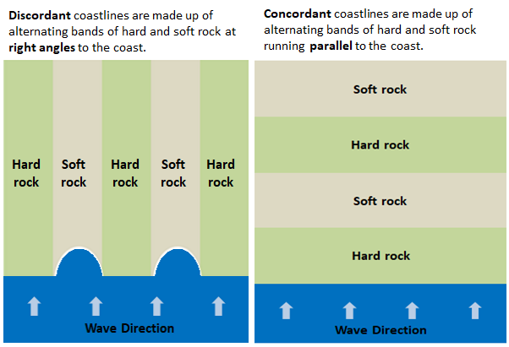
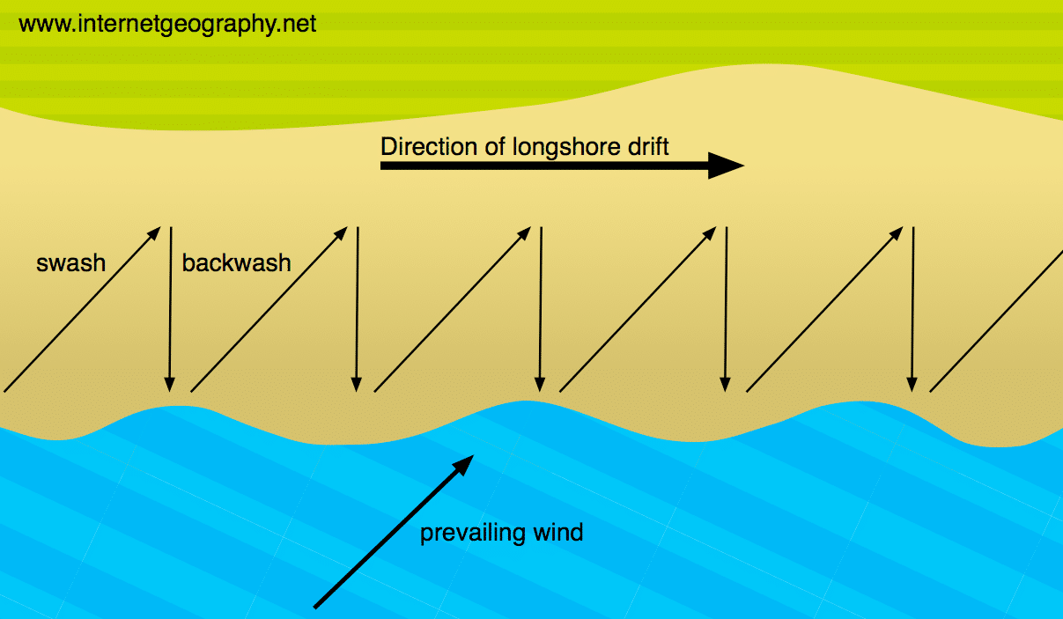
Transportation
Traction: large boulders are rolled along the sea bed
Saltation: pebble-sized particles are bounced along the sea bed
Suspension: small particles like silt and clay are carried along in the water
Solution: soluble materials e.g. limestone are dissolved and carried along in the water.
Longshore drift is the transportation of sediment along the coast.
Waves follow the direction of the prevailing wind
The waves hit the coast at an angle
The swash carries material up the beach in the same direction as the waves
The backwash carries material down the beach at a right angle back towards the sea
Over time, material zig zags along the coast
Deposition happens when:
Water carrying sediment loses energy and slows down
Waves enter an area of shallow water
Coasts build up when material deposited is greater than the rate of erosion.
How does geology affect the coast?
Headlands and bays
Headland is a cliff that juts out to the sea – surrounded by water on three sides. A bay is a curved section of the coast –often with headlands on either side.
Formation of headlands and bays:
1. Waves approach a discordant coastline, where there are bands of hard and soft rock at right-angles to the coastline.
2. The less resistant rock is more easily eroded by the wave action than the resistant rock.
3. The bands of less resistant rock retreat backwards, further than the resistant rock on either side.
4. This creates bays that are set back, with headlands on either side.
5. Material eroded from the headlands is deposited in the bays due to the sea getting shallower here and the waves losing energy.
Discordant coastlines are made up of alternating bands of hard and soft rock at right angles to the coast. Concordant coastlines are made up of alternating bands of hard and soft rock running parallel to the coast.

Slide 3
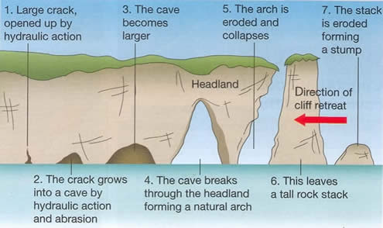
What coastal features are formed by erosion at Swanage?
The south coast of Swanage has a concordant coastline. The east coast of Swanage has a discordant coastline – there are alternating bands of hard chalk/limestone and soft clay/sand, forming an irregular coastline with several coastal landforms.
Headlands and bays: There are bands of alternating hard and soft rock. Chalk (resistant rock) to the north at Ballard Point, creating a headland. Followed by soft clay and sands to the south of this, creating Swanage Bay. Limestone (resistant rock) to the south of this at Durlston Head, another headland. Waves erode the clay faster than the limestone and chalk, creating Swanage Bay with headlands on either side – Ballard Point to the north and Durlston Head to the south.
Old Harry Stack: Located off Ballard Point headland. The headland is made out of hard chalk.
Erosion by wave refraction concentrating their force on the headland, has led to the formation of Old Harry – stacks made of hard chalk -whilst deposition occurs in Swanage bay to the south of it.
‘Old Harry’s Wife’ was a chalk stack to the east of Old Harry, which has now eroded into a stump
What coastal features are formed by deposition at Swanage?
Wave refraction: This is when waves bend to mirror the shape of the coastline, where the coastline is an irregular shape, e.g. where there is a headland and a bay. When the waves bend on entering a bay, the energy is spread out over a wider distance, leading to a drop in energy, and so deposition happens.
Beaches: Beaches are formed by constructive waves depositing material. Sandy beaches are mainly found in sheltered bays, where low-energy waves build up the beach due to wave refraction. Pebble beaches are usually found where cliffs are being eroded. The high energy waves wash away the fine sand and leave behind the large pebbles.
Sand dunes: A sand dune is a mound or hill of sand found at the back of a beach.
Sand is deposited around an obstacle (e.g. driftwood) by the wind, forming embryo dunes.
These develop and grow over time. Dune slacks (small pools) can form in hollows between dunes.
Swanage Bay: Swanage bay is found along the eastern coast of Swanage, where the discordant coastline is. The rock in the bay is a mixture of soft clays and sand, which erode easily. Either side of the bay are headlands. The headland to the north is called Ballard Point, and this is made of hard chalk. The headland to the south is called Durlston Head, and this is made of hard limestone. Because waves have eroded the soft rock of the bay more easily, the coastline here has retreated, creating the bay that is set further back from the headlands. The shape of the bay is curved, so wave refraction causes sand to be deposited here, creating a beach with sand made from particles of limestone and chalk.

Slide 4
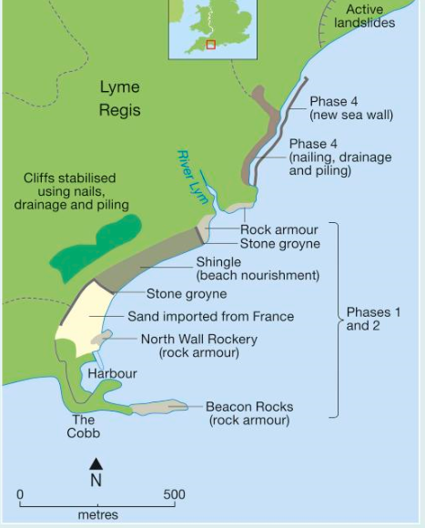
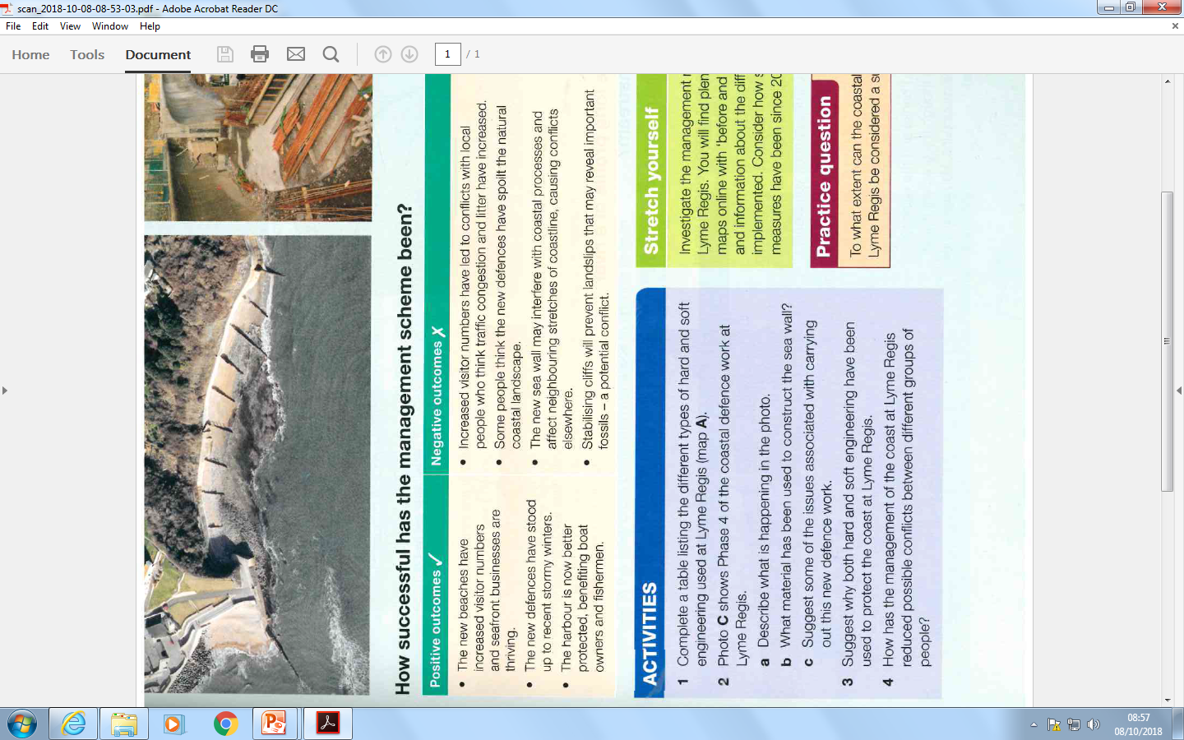
To what extent are hard and soft engineering beneficial when protecting the coast?
Hard Engineering: ​
Soft engineering:
Sea walls | A wall, which is curved at the top, made out of a hard material like concrete that reflects waves back to sea.
Rock armour | Boulders piled up along the coast that force waves to break.
Gabions | Wall of wire cages filled with rocks, usually found at the foot of cliffs.
Groynes | Wooden or stone fences built out to sea from the coast. Traps sediment being transported by longshore drift.
Beach nourishment and reprofiling | Pumping sand and shingle from elsewhere (e.g. from the seabed) or from lower down the beach to a existing beach to make it higher or wider.
Dune regeneration | Creating or restoring sand dunes by planting vegetation such as Marram grass. This stabilises the dunes and helps trap sand to build them up.
Managed retreat | Controlled flooding of low-lying coastal areas – the “do nothing” approach.
How does coastal management work in Lyme Regis?
Reasons for management
It has a population of 4000 people which can go up to 16,000 in summer due to people staying in summer homes
It has a huge tourist industry which needs to be protected
Most of the town is built on unstable cliffs which are eroding rapidly due to strong waves.

