Slide 1

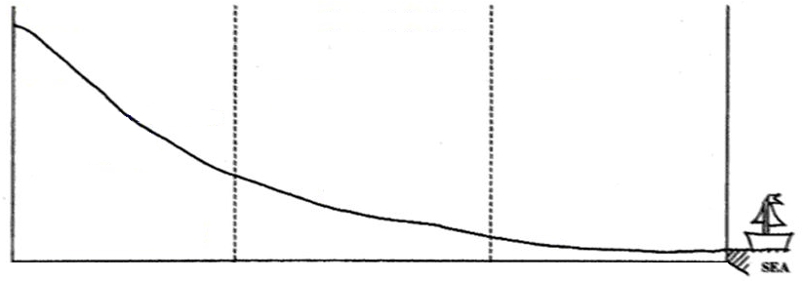
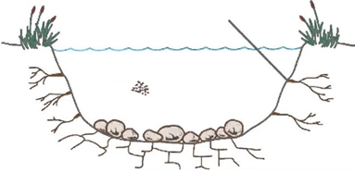
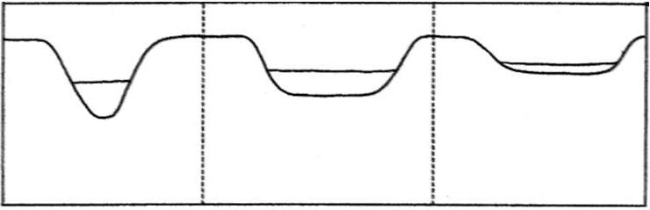
Year 10 – Paper One: Section C
Physical Landscapes in the UK - Rivers
Knowledge Organiser
Changing long profile and cross profile of a river
The long profile of a river shows how the gradient of the land changes from the source to the mouth of a river.
Fluvial processes: Erosion - where rocks are worn away and the land changes shape.
Types of erosion:
hydraulic action - The force of the river against the banks can cause air to be trapped in cracks and crevices. The pressure weakens the banks and gradually wears it away.
abrasion - Rocks carried along by the river wear down the river bed and banks.
attrition - Rocks carried by the river smash together and break into smaller, smoother and rounder particles.
solution - Soluble particles are dissolved into the river.
Vertical erosion deepens the river, forming a v-shaped valley/channel. High turbulence carries material which wears away the river bed, especially in the upper course.
Lateral erosion widens the river valley/channel, especially in the middle/lower course.
source
upper
middle
lower
decreasing gradient
mouth
hydraulic action
The cross profile of the river shows the cross-section of the river and the river valley.
attrition
solution
upper
middle
lower
abrasion
Helpful revision: https://www.bbc.co.uk/bitesize/topics/zpypgdm

Slide 2
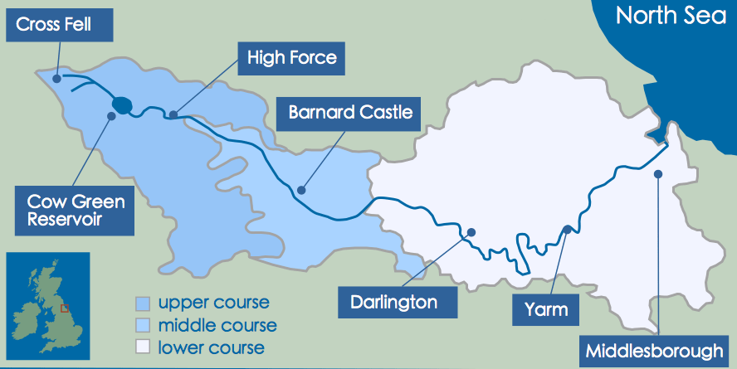
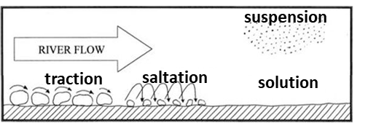
Fluvial processes: Transportation - where eroded material is carried by the river downstream.
traction - Boulders and pebbles roll along the river bed.
saltation - Material carried by the river bounces along the river bed.
suspension - Rocks carried along by the river wear down the river bed and banks.
solution - Soluble material is dissolved and carried by the river water.
Example of UK River Valley: The River Tees
The River Tees is located in the north of England. It flows 137 km (85 miles) east from its source in the Pennines to its mouth on the North Sea coast (Tees estuary) at Red Car.
Upper course landforms
The source of the River Tees is Cross Fell in the Pennines.
The River Tees flows over hard, impermeable rocks in its upper course. Vertical erosion has formed classic V-shaped valleys. The image below shows interlocking spurs close to Cauldron Snout.
The UK’s largest waterfall, High Force, is located in the upper course of the River Tees and drops 22m. An area of hard rock, called Whin Sill (or Whinstone), is located above a layer of soft rocks (sandstone and shale), and together they create the waterfall. An impressive 700m gorge has formed in front of the falls.
Middle course landforms
As the River Tees reaches its middle course, lateral erosion overtakes vertical erosion, evidenced by winding meanders. Here the gradient becomes more moderate and the valley widens. lateral erosion and deposition. The meander near Yarm encloses the town.
Lower course landforms
Meanders in the lower course are much larger. Oxbow lakes have formed in some areas. Evidence of past flooding can be seen in the naturally formed levees.
Greater deposition creates features such as floodplains & levees near Darlington. Mudflats form due to deposition at the river’s estuary. Some areas of the estuary are designated SSSI’s (Site of Special Scientific Interest) but there is also plenty of industry at the mouth of the river.
Fluvial processes: Deposition - where transported material is dropped when the river loses energy, such as when it enters the sea.
Rivers deposit eroded material as they lose speed (velocity) when:
the river becomes shallower;
the discharge (volume of water) is reduced;
the amount of transported material increases;
the river reaches the mouth.

Slide 3
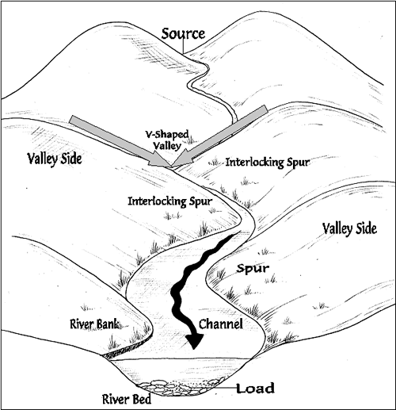
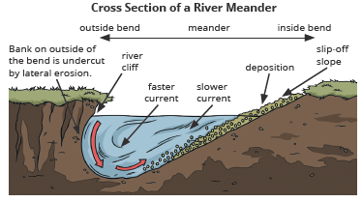
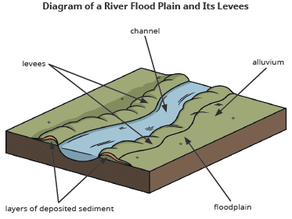
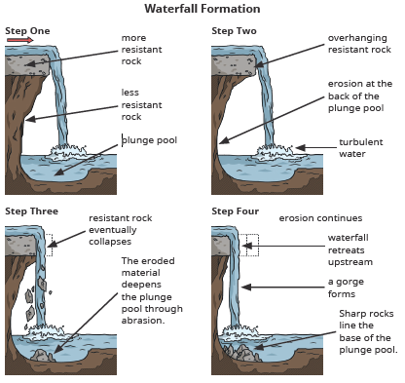
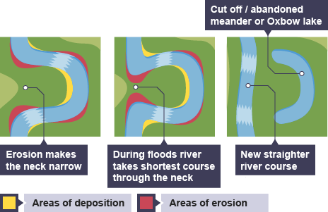
Upper course landforms
Interlocking spurs form where vertical erosion creates steep-sided V-shaped valleys. The river winds and bends; avoiding areas of hard rock creating interlocking spurs.
Waterfalls form where a layer of hard rock overlays a layer of soft rock. The soft rock erodes at a faster rate than the hard rock. This leads to the hard rock overhanging the soft rock. Eventually the hard rock overhang becomes too heavy and collapses causing the river to retreat upstream.
Middle course landforms
Meanders form in the middle and lower course where lateral erosion causes the river to widen. As a river goes around a bend, most of the water is pushed towards the outside. This causes increased speed and therefore increased erosion. The water on the inside bend of the river is much shallower and slower. As a result, material is deposited (forming a slip-off slope).
Ox-bow lakes form where meanders have become so enlarged that the river breaks through the narrow ‘neck’. The river will flow along this new route as it is the shortest course. Deposition will eventually completely cut the old meander loop off from the river channel creating an ox-bow lake.
Lower course landforms
Floodplains are the wide valley floor on either side of the river in the lower course. When the river floods and overflows its levees the water loses energy once it hits the land. This sudden loss of energy leads to deposition of river sediment on the land close to the river channel.
Levees form in the lower course of a river along the river banks due to repeated flooding. As water overflows the main channel, it loses energy, depositing material creating natural embankments.
Estuaries are located in the tidal zone at the mouth of a river where the river meets the sea. The water level in the estuary rises and falls with the tide. During high tide, large areas of valley floor will be flooded. As the tide falls, material will be deposited, creating mudflats which will be exposed during low tide.

Slide 4
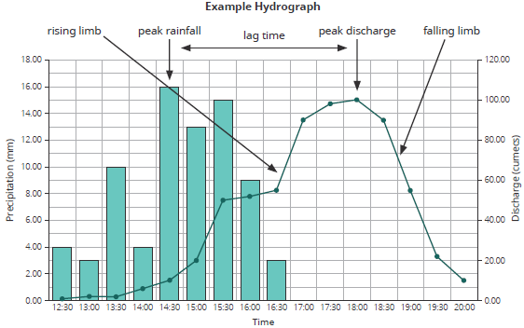
The use of hydrographs to show the relationship between precipitation and discharge
hydrograph - A graph which shows the rainfall (bar graph) and river discharge (line graph) of a river over a period of time.
discharge - The volume of water which passes a given point in the river over a set amount of time. It is measured in cubic measures per second (cumecs).
Peak discharge - the point on a flood hydrograph when river discharge is at its greatest.
lag time - The time between the peak rainfall and the peak discharge.
rising limb - The part of a hydrograph which shows the increase in discharge as rain enters the river channel. A steep rising limb indicates an increased flood risk as water quickly enters the channel. The lag time occurs because most rain water does not land in the river and has to travel to the river overland (surface runoff) or slowly underground (after infiltration). The lag time can be sped up by steep slopes, saturated ground and impermeable surfaces.
falling limb - The part of a hydrograph which shows the decrease in discharge as the river returns to its usual level.
How physical and human factors affect the flood risk
Precipitation - The amount and duration of precipitation can affect flood risk.
Heavy precipitation will cause flooding as there is too much water to infiltrate into the ground causing water to run over the land (increased surface runoff).
Prolonged precipitation will cause the soil to become saturated preventing further infiltration. Precipitation will therefore run over the land (increased surface runoff).
If surface runoff is increased the discharge of the river will increase, increasing the likelihood of a flood.
Geology
Impermeable rocks (e.g. marble and granite) and clay soils do not allow precipitation to infiltrate; increasing surface runoff. If surface runoff is increased the discharge of the river will increase, increasing the likelihood of a flood. Permeable rocks allow precipitation to infiltrate through to the water table and decreases surface runoff rates.
Relief
Steep slopes will cause surface runoff to enter the river more quickly, less water will infiltrate and as a result more water will end up in the river. If the discharge of the river is increased, increasing the likelihood of a flood.
Land Use
Buildings and roads are often impermeable (e.g. concrete and tarmac) and can increase the likelihood of a flood in two ways:
less water will infiltrate and more water will end up in the river;
drains are designed to remove rainwater quickly from urban areas (reducing the lag time). This rainwater is normally directed towards rivers, increasing river discharge.
Trees help to reduce the discharge of a river in two ways:
trees intercept rainwater which can then evaporate;
trees can soak up groundwater.
If trees are cut down, more water will end up in the river.

Slide 5
The costs and benefits of management strategies
Hard engineering strategies
Dams and reservoirs
Reservoirs (artificial lakes) are formed behind a dam (a wall across a river) usually in the upper course.
Pros - reservoirs store water and provide a reliable water source. Hydroelectric power (HEP) can be generated. Flood risk is reduced.
Cons -they are expensive to build. Settlements and habitats are often flooded. Alters the river course downstream as land no longer floods, resulting in less fertile land as silt is no longer deposited. Eroded material is trapped behind the dam, which alters river processes and landforms downstream.
Channel straightening
Rivers are artificially straightened.
Pros - the flood risk is reduced as water is transported away from the area quickly.
Cons - water is carried downstream quicker. As a result, flooding and erosion is more likely downstream.
Embankments
Raised walls along the river banks.
Pros - flooding will be less frequent as the river channel can hold more water.
Cons - if the river floods severely, flood waters will be trapped on the floodplain. Can be expensive.
Flood relief channels
Water is diverted from areas that are being protected.
Pros - water can be controlled by opening and closing flood gates.
Cons - they are expensive to build. Water is carried downstream quicker, which means that flooding and erosion is more likely downstream.
Soft engineering strategies
Flood Warnings and Preparations
The Environment Agency alert the public with apps, radio and TV broadcasts.
Pros - These reduce the impact of flooding by giving people time to prepare (e.g. evacuate and protect their homes/belongings).
Cons - Flooding can still occur. Some people might not be alerted.
Flood Plain Zoning
Building is restricted in parts of the flood plain to reduce the impact of a flood. Hard surfaces would increase the likelihood of a flood.
Pros - The impact of flooding is reduced. Floodplain retains its natural function.
Cons - The development/economic growth of an area could be restricted. This offers limited help to areas already built on.
Planting Trees
Trees intercept precipitation, increasing the lag time and reducing discharge.
Pros - This is a cheap management strategy. Soil erosion is reduced. Habitat creation increases biodiversity of the area.
Cons - Less farmland is available.
River Restoration
Making the river more natural and allowing natural river processes to happen.
Pros - This reduces flood risk downstream. Increases wildlife through habitat creation.
Cons - Local flood risk is increased.

Slide 6
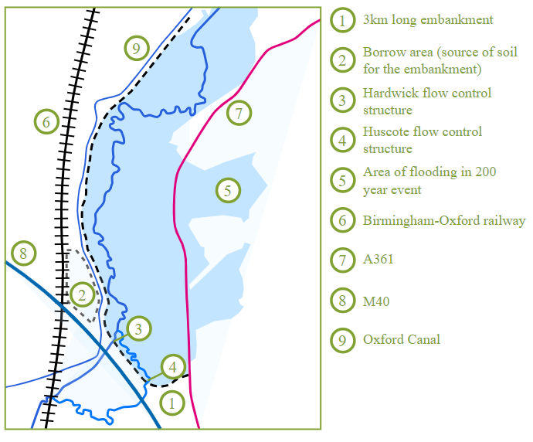
Example: Banbury Flood Management Scheme
Banbury flood management scheme
Banbury is a historic market town located in Oxfordshire, England. It is situated on the banks of the River Cherwell (a tributary of the River Thames), near the north-eastern edge of the Cotswolds. Banbury is approximately 64 miles (103 kilometres) northwest of London and 22 miles (35 kilometres) north of oxford, the county town of Oxfordshire.
Why was the Banbury flood management scheme required?
Banbury has been affected by flooding of the River Cherwell numerous times. The 1998 flood led to the closure of the railway station and caused £12.5 million in damage. There was further flooding in 2007.
What is the Banbury flood management strategy?
In 2012, an innovative project was completed to construct a flood storage reservoir north of the town at an investment of £18.5 million.
The scheme involved building a 3km long and 4.5m high embankment, paralleling the M40 motorway, to form a 3 million cubic meters storage basin.
The purpose of the reservoir is to regulate the flow of surplus rainwater into the river, using specially engineered outlets to discharge the water slowly. When heavy rainfall occurs, the surplus water accumulates in the storage reservoir.
This water is then gradually released into the River Cherwell over the following days, mitigating any sudden influx that could potentially escalate the town’s flood risk.
The key features of the scheme included:
Raising the A361
Constructing new pumping stations to transfer water
Controlling the flow of the River Cherwell through the Hardwick and Huscote flow control structure
A biodiversity Action Plan (BAP) habitat with ponds, trees and hedgerows
Constructing 4.5m high embankments using soil taken from the borrow area, which is now a small reservoir used for storing water that would otherwise have caused the River Cherwell to flood.

