Slide 1

KS4 Geography - Paper Two: Section A
Urban issues and challenges - Rio De Janeiro (NEE City)
Why is urban growth happening?
Urbanisation - the proportion of the world's population who live in cities - is also growing.
It is the result of the natural increase of a population (births minus deaths) plus migration.
Urban growth is the increase in the area covered by cities.
Urbanisation has taken place at different times and at different speeds in different parts of the world.
The greatest rate of urbanisation is shown in low income countries (LICs) and newly emerging economies (NEEs).
Urbanisation is slowing in high income countries (HICs) where counter-urbanisation is taking place.
The proportion of people living in towns and cities varies in different parts of the world.
In most of the world's richer countries over 60% of the population live in cities.
In south and south east Asia around half the population live in towns and cities.
About 50% of Africa's population live in urban areas. Urbanisation in Africa is expected to rise faster than in any other continent.
Why do cities grow?
More than half the world's population now live in urban areas, and cities all over the world are continuing to grow. There are two main reasons why cities are getting bigger.
Natural increase - Where the birth rate is higher than the death rate.
Rural-urban migration - The movement of people from the countryside into towns and cities.
Push-pull factors these are features of a place that make people want to move. Push factors are negative features of a place that make people want to leave, whilst pull factors are the positive features of a place that attract migrant in.
The emergence of megacities
Megacities are cities with a population of over 10 million.
In 1990 there were ten megacities - one in the USA, two in Japan, two in Central and South America, four in Asia and one in Africa.
By 2014 there were 28 megacities. In 2018 there were 33 megacities, 27 of which were in the less-developed world. Six were in China and five in India. By 2050 there may be as many as 50 megacities, many of which will be in LICs and NEEs, particularly in Asia and Africa.
Why is Rio De Janeiro important?
Located in the south east of Brazil, on the Atlantic coast.
Rio was the capital of Brazil until 1960, the capital is now Brasilia.
Rio is the second largest city in Brazil with 20.1 million people living in and around the city.
Regionally important - the big industries in the city are supported through the multiplier effect by businesses on the outskirts, attracting businesses and increasing the population. Rio’s population reaches 12.5mill if the population on the outskirts of the city is included.
Nationally important - Brazil’s
second most important industrial centre, contributes 5% to Brazil’s GDP. HQs of Petrobras (Brazil’s largest oil company) located there. Attracts highly qualified migrants from universities all over the country.
Helpful revision: https://www.internetgeography.net/aqa-gcse-geography/urban-issues-and-challenges/

Slide 2
KS4 Geography - Paper Two: Section A
Urban issues and challenges - Rio De Janeiro (NEE City)
Internationally important - iconic city with Christ the Redeemer statue and Copacabana Beach which attract approx. 1.6 million tourists every year, making it one of the most visited cities in the southern hemisphere. Global sporting events such as the World Cup (2014) and Olympics (2016) made the city internationally significant.
Why has Rio grown?
Migration - when people move from one area or country to another. 65% of Rio’s growth over the last 150 years has been due to migrants travelling to Rio from abroad (international migration) and from elsewhere in Brazil (internal migration) such as, migration from rural areas, such as Rhodonia, in the north where jobs outside farming are limited and there can be shortages of water (drought-stricken) as well as inadequate services.
Natural increase - caused by a high proportion of young people in the city, who are in their 20s and 30s. Many people who migrate to the city are young (of child bearing age - 18-35yrs), leading to a higher birth rate and low death rate. Better quality services in the city, such as healthcare and social services, have resulted in a healthier population (low death rate) and also a reduction in infant mortality.
How has urban growth created opportunities in Rio?
Rapid urban growth of Rio has created social and economic opportunities in the city. Levels of investment are higher compared with more rural parts of Brazil. This is due to Rio being a major industrial centre and trading port.
Access to services: healthcare - Access to free healthcare throughout the city and better access to hospitals, doctors’ surgeries and pharmacies, than in other parts of Brazil. 3 public hospitals and 6 private ones. Most hospitals are located in the wealthier south and west zones of the city. Healthcare is available for poorer people living in favelas. Santa Marta favela has a population of 8,000 and is 13km away from its nearest hospital. Health cover has increased from 4% to 70% foe people in some slum areas. Medical professionals ‘Family heath teams’ go into the favela to treat patients and test people for different diseases. This led to early detection of illnesses increasing life expectancy.
Access to services: education - The standard of education is high in Rio compared with rural areas of Brazil. Rio has over 1000 primary schools, 400 secondary schools and six universities. 90% of children aged 10 can read and write. Many migrants move to Rio to improve the education opportunities for their children. There are schools in the favelas. School attendance has traditionally been poor, several non-governmental organisations such as 'Schools for Tomorrow' are working with communities to improve education provision. The government provides grants to help children remain in school and supports extracurricular activities such as volleyball and football. In 2001 the Estáscio de Sá university opened in Roçinha favela.
Access to resources: water supply – Rio has the largest water treatment works in the world, and people living in the city have a much greater chance of having a fresh water supply than people in rural areas of the country. Around 80 per cent of Rio's water comes from the Guandu River. Since 1998 seven new treatment plants and 300 km of new water pipes have been built meaning about 96% of the city area has safe piped water, but only about 88% of houses connected.
Resources: energy – about 99% of the city’s residence have direct access to electricity. New power lines have been installed and the construction of the Simplicio Hydro-Electric Complex (2013) has increased Rio’s supply of energy by 30%. Two nuclear reactors have been constructed and a third is due to start operating in 2023. Though a community energy programme over 150 solar panels have been fitted to the roofs of many building in Santa Marta Slum, providing affordable energy.
Helpful revision: https://www.internetgeography.net/topics/urban-growth-in-rio-de-janeiro-brazil/

Slide 3
KS4 Geography - Paper Two: Section A
Urban issues and challenges - Rio De Janeiro (NEE City)
Economic opportunities for growth
Economic development has brought improvements to Rio's roads, transport, services and environment. Growing economic prosperity has attracted large companies to Rio from other parts of Brazil and South America, as well as from abroad. These developments have created a range of new economic opportunities in the formal economy.
How have industrial areas stimulated economic development?
The main industrial areas are concentrated in the North and Centro Zones of Rio, where they benefit from proximity to the port. Rio is the third busiest port in Brazil, exporting raw materials including coffee, sugar and oil. Oil refining and shipbuilding employ many local people, providing secure incomes and stimulating economic development. These industries attract investment and encourage supply chain industries to set up in the area, boosting the economy and creating employment opportunities.
Rio has one of the most diverse ranges of industries in any Brazilian city. It has a rapidly expanding service and quaternary sector as well as established traditional manufacturing industries, such as engineering, printing and publishing, pharmaceuticals and food processing.
How has urban growth created challenges in Rio?
Slums: Locally known as ‘guetos', Rio's slums are usually older abandoned industrial or residential buildings. Most of these buildings have been illegally sub-divided, often with many people living in a single room. Dangerously overcrowded, they typically have inadequate services like bathrooms, kitchens or proper ventilation and lighting. They are often owned by landlords who charge high rents. Whilst many buildings have been demolished, some still stand.
Squatter settlements: Squatter settlements are unplanned uses of land by homeless people, and they may be improved over time. Favelas are the most common type of squatter settlement in Rio. There are around 1000 favelas across the city, housing about 24% of Rio's population. Rocinha is a favela that emerged in the 1920’s. It is located on a hillside in the south of the city. The population of Rocinha is probably around 225,000.
Challenges of living in Favelas:
Houses are poorly constructed on steep hillsides. In 2010, heavy rainfall caused a landslide, killing 224 people when houses were swept away.
12% of favelas do not have access to running water so they tap into the city water mains usually located at the bottom of the steep hillside.
Over 30% have no electricity, so they illegally connect to electricity pylons.
Around 50% have no sewage connections so sewage flows into open sewer drains which run through the streets.
Unemployment rates are as high as 20%. Much employment is poorly paid with irregular jobs in the informal sector. Average income may be less that £75 a month.
High murder rate of 20 per 1000 people in many favelas. Drug gangs dominate many favelas. Many people that live in the favelas do not trust the police due to corruption and violence.
Waste builds up in the street, increasing the risk of disease spreading amongst the people living within the favelas
Helpful revision: https://www.internetgeography.net/topics/urban-growth-in-rio-de-janeiro-brazil/

Slide 4
KS4 Geography - Paper Two: Section A
Urban issues and challenges - Rio De Janeiro (NEE City)
Challenges in providing access to healthcare: There are only 3 public hospitals in the city which are free for emergencies, however, they are overcrowded and face infrastructure problems. In 2013 Only 55% of people living in the city had access to a family health clinic. Factors causing this are a lack of medical facilities in the favelas, medical facilities being many miles away in the wealthier areas, difficulties of getting to medical help due to distance and no road network to travel there easily.
Challenges in providing access to education: Despite education is compulsory in Brazil for children aged 6-14, about 25% of the poorest children do not attend school regularly. Most of these live in the favelas. Only half of children complete their education after the age of 14. Factors causing this are a shortage of schools in some parts of the city and children often have to travel long distances, which is time consuming and expensive. Poverty in families means children have to work to help support their families, lack of computers and resources as well as poor internet connection has also impacted education.
Challenges in reducing crime:
Crime is a major problem in Rio. Drugs, robbery, violent crime and vandalism are all major challenges for the police. Street crime (mugging) is a problem in the tourist areas. One of the most significant problems in favelas is associated with powerful criminal gangs operating drug trafficking in many of the favelas.
There is little trust in the policing within Rio to keep people safe, so often the gangs go unchallenged by local people.
Challenges in reducing unemployment:
Brazil’s economy was hit by a deep recession in 2015 and this led to an increase in unemployment in Rio. Between 2017 and 2020 unemployment rate in Rio averaged around 15%. There are huge differences in unemployment across rich and poor areas in Rio, leading to inequalities in earnings. Around one-third of workers in Rio are in the informal sector completing jobs such as car washing, recycling and street vending. This work is not guaranteed and is poorly paid.
How has urban growth created challenges for Rio’s infrastructure?
Challenges in providing a reliable water supply
The Guandu treatment plant supplies 92% of Rio's fresh water, however, around 12% of the city's population does not have access to clean running water. Over one-third of water is lost through leaky pipes, fraud and illegal access. Rio frequently experiences water shortages, mainly due to problems with infrastructure as pipes are poorly maintained and leakages result in water being cut off, sometimes for several days. Providing access to water in the favelas is difficult due to many residents not having legal proof of ownership and so water is not supplied to individual households. Instead, water is supplied to a central area for residents to access.
Challenges in providing sanitation systems
Sanitation systems involve the capture (toilets), transfer and treatment or disposal of human waste and wastewater. In Rio about 35% of the city's sewage is transferred in open sewers and dumped into Guanabara Bay. The city's infrastructure pipes and sewage treatment works cannot cope with the volume of waste. As with water supply, many favelas are not connected to the city's sewage system.
In the North Zone favela of Pica-Pau, most homes lack piped water and sanitation.
In Rocinha favela, open sewers transfer raw sewage into the sea.
Lack of adequate sanitation and piped water can lead to the spread of waterborne diseases such as cholera.
Helpful revision: https://www.internetgeography.net/topics/urban-growth-in-rio-de-janeiro-brazil/

Slide 5
KS4 Geography - Paper Two: Section A
Urban issues and challenges - Rio De Janeiro (NEE City)
Challenges in providing energy
In Rio, about 99% of all homes have access to electricity. However, the infrastructure lacks resilience, with illegal connections and overloading of the system often resulting in power cuts. In favelas, the illegal tapping of electricity is common. Demand for energy in Rio is high and rising rapidly, due to the city's growing population and expanding industrial sector. To address the challenges, power supply to the city has been increased and the new Simplicío hydro-electric complex has increased Rio's electricity provision by 30%.
Challenges in managing waste disposal
Each year Rio produces 3.5 million tons of waste, of which less than 2% is recycled. Most of the city's waste ends up in the recently opened Seropedica landfill site. Landfill gas produced here is used to generate electricity or is converted to fuel for waste collection vehicles. Waste collection varies hugely across the city and is particularly infrequent in the favelas where narrow, steep streets make access difficult. Waste litters the streets and much of it enters rivers flowing into Guanabara Bay, causing algal blooms, contamination and floating debris.
Challenges in managing water pollution
Guanabara Bay is highly polluted, causing a major threat to wildlife. There is a danger that pollution could affect Copacabana beach, which would have an impact on tourism and the local economy. There are several sources of Rio's water pollution:
Many of the rivers flowing into the bay are heavily polluted with sewage and waste.
Over 50 tonnes of industrial waste is discharged each day.
Oil spills and other ship discharges contaminate the bay.
Challenges in managing traffic congestion and air pollution
Rio is the most congested city in South America. Traffic congestion increases stress and levels of air pollution. It also wastes time for commuters and costs businesses huge amounts of money in delays. Rio's mountainous coastal location restricts the options for road building, causing congestion on the city's main routes.
Car ownership has increased by 40 per cent in recent years.
Air pollution is estimated to cause 5000 deaths per year.
Heavy traffic and exhaust fumes combine with industrial pollutants to create a brown smog which hangs over the city.
Helpful revision: https://www.internetgeography.net/topics/urban-growth-in-rio-de-janeiro-brazil/

Slide 6
KS4 Geography: Paper Two: : Section A – Urban issues and challenges
How has planning improved quality of life for the urban poor in Rio?
What is quality of life?
Quality of life describes the extent to which a person is comfortable, healthy and able to enjoy life.
How are favelas being improved?
Until 1980 the authorities in Rio did not acknowledge the existence of favelas. These areas were not shown on any maps. In the mid-1980s city planners felt that something needed to be done for the city's poorest citizens. Rather than destroy the favelas and squeeze their large populations into public housing, the city decided to upgrade them and provide essential services. After Rio was awarded the 2016 Olympics there was a move to destroy favelas in areas where Olympic facilities were being built.
The Favela Bairro Project
The Favela Bairro Project (1995-2009) was a US$1 billion 'slum to neighbourhood’ project
that aimed to integrate Rio's favelas into the fabric of the city and address issues of land ownership, infrastructure and service provision. The scheme involved over 250000 residents in 73 communities.
Social
Daycare and after-school care, enabling adults to seek secure employment
Improving adult literacy to increase employment opportunities and incomes
Medical services for drug addiction, alcoholism and victims of domestic violence
Environmental
Replacement of wooden buildings with brick, making them permanent and less likely to be damaged by the weather
Removal of houses from dangerous steep slopes
Infrastructure improvements (water, sanitation and electricity)
Widening and paving of streets to allow access for waste collection and emergency services
Economic
Inhabitants can apply to own their properties legally, encouraging them to improve their housing (self-help)
Access to credit to allow people to buy materials to improve their home.
How successful has the Favela Bairro Project been?
The city authorities worked closely with local communities to make the project successful. By 2005 around 100 favelas had been improved. Residents had been granted land ownership, roads had been paved and new childcare centres opened. Training was available in hygiene, computing and community development. The quality of life, mobility and employment prospects of the inhabitants improved considerably. A 3.5km cable car, public transport, system in Complexo do Alemao, improved mobility across the favela.
Despite the successes, there have been a number of issues:
Training for employment has had limited success, as many residents lacked the appropriate literacy skills - basic literacy was not addressed.
Credit schemes were not widely available to help residents afford to improve their homes.
Some of the new infrastructure improvements were costly and were not maintained.
New elevated pavements have caused rainwater to flood homes.
Rents have risen in some of the improved favelas.
Helpful revision: https://www.internetgeography.net/topics/urban-growth-in-rio-de-janeiro-brazil/

Slide 7
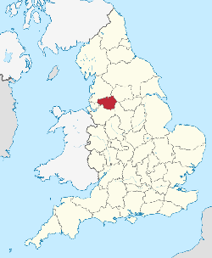
KS4 Geography - Paper Two: Section A
Urban issues and challenges – Manchester (HIC City)
Location Manchester is located in the northwest of England. It is roughly 160 miles northwest of London and is close to other major cities such as Liverpool and Birmingham. Several rivers flow through the city, including the River Mersey, which connects Manchester and Liverpool.
Global importance of Manchester:
Manchester was the world’s first industrial city, during the early 1900s, was the leading producer of cotton and textiles.
It was also the birthplace of the computer and in Manchester scientists first split the atom, discoveries which changed societies all over the world.
Manchester University still leads in many areas of scientific research and it attracts students and researchers from all over the world. It is ranked as the 55th best university in the world.
Spinningfields is also home to international banks such as BNY Mellon and in 2019 Manchester exported £14.9bn worth of goods worldwide, equating to 18% of total GDP.
National importance of Manchester:
Home to the BBC at MediaCity, one of the country’s leading media outlets, and Granada, which makes programmes such as Coronation Street.
Manchester accounts for 10% of all employment in the UK - Manchester’s economy to be UK’s third fastest growing between 2024 and 2026.
Manchester is known as the music capital of the UK, not only is it home to a range of venues for music, such as the AO Arena, The Etihad and Old Trafford Cricket Ground, but many bands such as Oasis, originated in Manchester.
Spinningfields in Manchester is home to the city’s financial services. Banks such as RBS, HSBC and Barclays have their UK headquarters there.
National migration to Manchester:
Students from all over the country come to the four large universities in the city. During term times this increases the population in the south of the city in neighbourhoods such as Fallowfield. This part of the city has lots of bars and cafes which are supported by the student population, as well as a high proportion of rental houses.
International migration to Manchester:
Manchester is one of the most ethnically diverse cities in Europe with over 200 languages being spoke in the city. Parts of the city are particularly diverse e.g. Cheetham Hill as well as China Town in the centre and ‘The Curry Mile’ in south Manchester.
Helpful revision: https://www.internetgeography.net/topics/urban-growth-in-rio-de-janeiro-brazil/

Slide 8
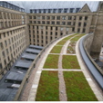
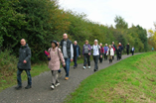
KS4 Geography - Paper Two: Section A
Urban issues and challenges – Manchester (HIC City)
Integrated transport systems: Involves the combining of different modes of transport to maximise ease and efficiency for the user in terms of time, cost, comfort, safety, accessibility and convenience - The Metrolink tram system is linked to bus stations, national train stations (Piccadilly and Victoria), park and Manchester Airport. One ticket can be used on the Metrolink and buses. However, journeys can be long and expensive.
Urban greening: Manchester’s Green and Blue Infrastructure Strategy sets out objectives:
To improve the parks and green spaces so that people use them e.g. Music festivals in Heaton Park.
To create green space in new building developments and add green space to current buildings e.g. grass roof on the Town Hall.
To improve access to green areas by making green corridors e.g. by turning an old railway line in Salford into a green walking route through the city (the Loopline).
Challenges in Manchester
Deprivation - the damaging lack of benefits considered to be basic necessities in a society.
Parts of the city suffer deprivation with 2.7% of the population of Manchester on benefits, compared to just 1.8% in the UK as a whole, showing that people are poorer and may be unlikely to afford a ‘normal’ standard of living. Inner city areas, particularly in north Manchester (e.g. Miles Platting) suffer more from deprivation compared to wealthy wards in south Manchester (e.g. Didsbury West).
Inequalities in housing - High proportion of people in poor quality and small housing in MP, high proportions of people in social housing. House prices in DW are very high.
Inequalities in education - MP 45% of GCSE pupils achieved acceptable level of attainment, compared to 83% in DW, probably due to poor attendance at school and poor aspirations due to high unemployment.
Inequalities in health - Life expectancy is lower in MP (71.5 years) compared to DW (79.2 years), because of issues such as obesity and poor health choices e.g. smoking and alcohol consumption. Coronary heart disease is a big problem in MP.
Inequalities in employment - 12% of people in MP are on credit due to unemployment, compared to 2% in DW. High levels of unemployment due to poor outcomes in education.
Waste disposal - as in all parts of the country residents in Manchester have a number of different household bins in order to help them to recycle.
Although initially people used them, the rates of recycling has stagnated (not improved), despite us generating more waste. Therefore, the city is using more and more landfill to cope with its waste.
Dereliction - There are many parts of Manchester that have been left abandoned leading to buildings becoming derelict, attracting vandalism. This is mainly an issue in inner city areas such as Mayfield train station, which was once a key transport hub for the city. IT is a large site that could be useful today.
Helpful revision: https://www.internetgeography.net/topics/urban-growth-in-rio-de-janeiro-brazil/

Slide 9
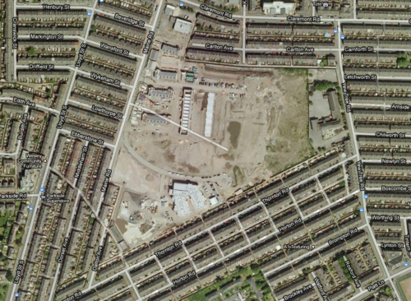
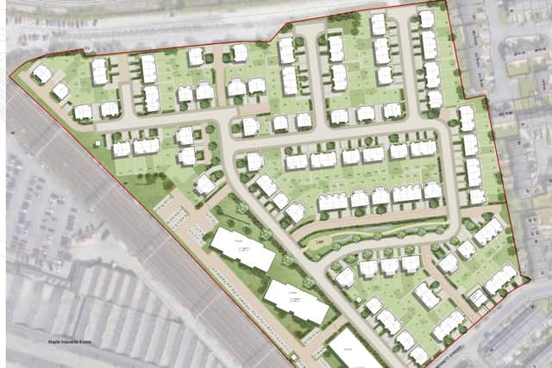
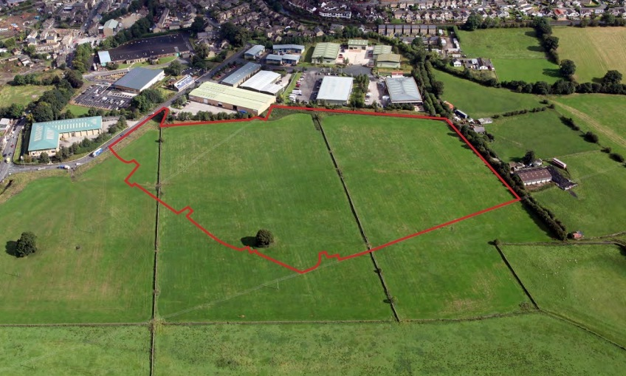
KS4 Geography - Paper Two: Section A
Urban issues and challenges – Manchester (HIC City)
Brownfield sites - Manchester City FC’s, stadium used to be at Maine Road in Moss Side before they got a new stadium in Ardwick. The stadium was demolished in 2003 and the Maine Road site was left empty for two years until the site was used to build 474 new houses on it.
Greenfield sites - Many greenfield sites in Salford are being used to build affordable new homes for the rising population. Peel Holdings, the developer, is being criticised for taking up green space rather than brownfield sites. There are also concerns amongst local people that Salford does not have enough services to support a rising population.
Urban Sprawl, the uncontrolled growth of towns and cities, encroaching on rural surroundings.
Conurbation, an extensive urban settlement that is formed when two or more cities, which were originally separate, grow together to form a continuous metropolitan region.
The conurbation of Greater Manchester was made because of the uncontrolled growth of the city and the satellite towns around it (Bury, Bolton, Salford etc.)
This means there is little green space within the urban area.
Stanley Green Retail Park in the rural-urban fringe south of Manchester.
A bypass has been built to cope with larger numbers of vehicles, however, local people have better services close by rather than having to travel into Manchester.
Commuter settlement, a settlement whose residents live there but work elsewhere, usually travelling into a city to get to work each day.
Ramsbottom is a commuter settlement, located about five miles north of Bury in Greater Manchester.
Desirable because of semi-rural setting in a conservation zone, so will remain ‘unspoilt’.
Good motorway network nearby to get to central Manchester.
House prices are rising sharply, pricing out local people.
Helpful revision: https://www.internetgeography.net/topics/urban-growth-in-rio-de-janeiro-brazil/

Slide 10
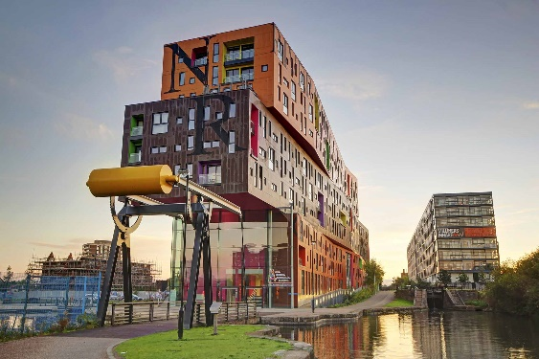
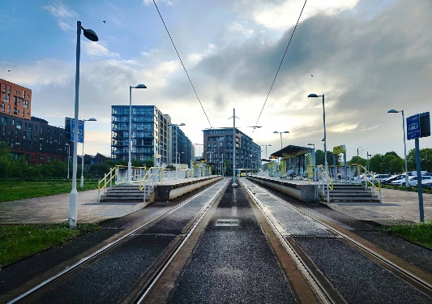
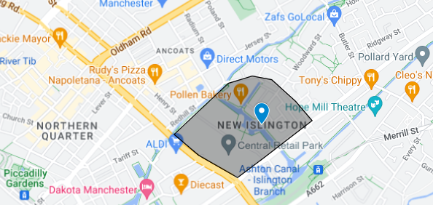
KS4 Geography - Paper Two: Section A
Urban issues and challenges – Manchester (HIC City)
Urban Regeneration in Manchester – History:
The Cardroom estate was built to replace the old slums of the Industrial Revolution. Named after part of a cotton mill, it was designed in a way that was supposed to solve urban problems; the estate was low-rise, with two-storey houses in a landscaped, ‘villagey’ cluster. It was pedestrianised, so children could play outside. For several years it all worked well. The first tenants were locals, and knew and looked out for each other. But, gradually, other forms of social interaction began to arrive. Drug dealers discovered the estate, with its central location and bushes and blind corners. The estate's layout was also a gift to burglars and joyriders. The Cardroom became a sink estate, people moved in with track records of anti-social behaviour and began to take the area down with them. It became an estate where people lock themselves in after dark, where the nearest shop is 15 minutes’ walk away, where the open spaces belonged to the joyrider. An estate where the police wouldn’t go and where taxis wouldn’t drop off.
This process of upgrading and bringing energy and money into an area that was deprived is known as regeneration.
Urban Regeneration in Manchester – New Islington
New Islington is a part of the northern side of the city centre. A regeneration project started following the 2002 Commonwealth Games, which began to regenerate this area and Hulme and Moss Side - mainly managed by Urban Splash. However, Manchester City has contributed over £10 million since 2005 to aid the area’s regeneration.
Over 1700 new houses were constructed in the area, some of the existing social housing have been improved, and local facilities have been rebuilt to help encourage people to stay. The canal running through the area was improved to provide open space and 300 trees were planted. There were 10 new shops, a doctors’ surgery, a football pitch and a children’s centre added as well as public transport improvements, including a new bus route and a New Islington Tram stop. However, in recent years, due to the demand for housing and the area becoming very popular with wealthier people, the house prices are incredibly high and very few were kept for social housing pricing poorer people out of the area.
Helpful revision: https://www.internetgeography.net/topics/urban-growth-in-rio-de-janeiro-brazil/

Slide 11
KS4 Geography - Paper Two: Section A
Urban issues and challenges – Sustainable City
Sustainable city - one in which there is minimal damage to the environment, the economic base is sound with resources allocated fairly and jobs secure, and there is a strong sense of community, with local people involved in decisions made. Sustainable urban living includes several aims including the use of renewable resources, energy efficiency, use of public transport, accessible resources and services. It aims to make the quality of life for residents in the future as good as it is now.
Freiburg, Germany: A sustainable city.
Water conservation – rainwater is retained and reused to reduce the amount of water taken from reservoirs. This is done by collecting rainwater by households, having green roofs that filter rainwater, and having pervious pavements that allow water to soak into the ground.
Energy Conservation – The city plans on being 100% powered by renewable energy by 2050. Freiburg is one of the sunniest cities in Germany and there are over 400 solar power installations in the city, including at the football stadium. Many homes have their own solar power generators, and they make so much energy that residents can sell energy back to the power company!
Waste recycling – Residents have different bins for different household waste, so that paper, glass and tins can be recycled (much the same as in the UK). Across Germany rates of recycling are high with 70% of their waste being recycled or reused, but in Frieburg the volume of recycling is higher than the national average. Freiburg reduced its annual waste disposal from 140,000 tons in 1988 to 50,000 tons in 2000. Biowaste (e.g. grass and food waste) and waste that is burned in the local incinerator is turned into energy.
Creating green space – 40% of the city is forested – 56% of this is conserved and the rest is used for timber, but most of this grows back within a year. Green space is maximised in the built environment with 44,000 trees in the parks and along the streets, as well as having ‘green’ tracks on the tram system and green roofs on buildings.
Sustainable transport strategy in Freiburg
Planning in the city prioritises public transport as well as walking and cycling over cars as the entire city centre is pedestrianised with 400km of cycle paths.
The city has an integrated system, so the trams, cycle paths, bus routes and trains all connect to one another.
Public transport is fast, reliable and regular (a tram arrives every 7 minutes). Public transport is also cheap - a monthly ticket for unlimited travel costs €47 (in its first year alone, the card is credited with increasing regional public transit trips by 26,400 while the number of car trips fell by 29,000).
Tickets for sporting events and concerts also class as public transport tickets.
In one district (Vauban) parking is limited to garages on the outskirts of the neighbourhood and each parking space costs 18,000 Euro
Helpful revision: https://www.internetgeography.net/topics/sustainable-urban-living-freiburg/

