Slide 1
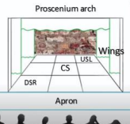
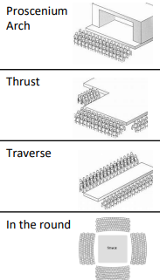

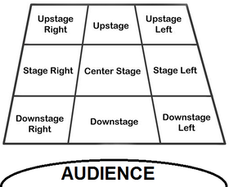
YEAR 8 AP1 PERFORMING KNOWLEDGE ORGANISER
1. Features of writing:
Setting: location
Characters: people
Plot: what happens
Conflict: characters having different objectives
Protagonist: leading character
Antagonist: character’s rival
Prequel: events that precede original work
Sequel: events that come after original work
Duologue: two actors in a scene
Dialogue: conversation/what they are saying
Monologue- a long speech by one actor in a play or film, or as part of a theatrical or broadcast programme.
Soliloquy- an act of speaking one's thoughts aloud when by oneself or regardless of any hearers, especially by a character in a play.
4🎭 Basic Drama Techniques
🔹 Freeze Frame / Still Image
Actors stop and hold a position like a photograph.
✅ Used to highlight an important moment or idea.
🔹 Thought Tracking
While in freeze frame, a character speaks their thoughts out loud.
✅ Helps the audience understand what the character is thinking or feeling.
🔹 Narration
A character or narrator explains what is happening on stage.
✅ Adds extra information, backstory or describes action.
🔹 Hot Seating
One actor sits in the "hot seat" as their character and answers questions from the group.
✅ Helps develop a deeper understanding of the character.
🔹 Role Play
Acting out a character in a made-up situation.
✅ Explores how characters might react and behave.
🔹 Improvisation
Making up dialogue and action on the spot without a script.
✅ Encourages creativity and quick thinking.
🔹 Slow Motion
Performing actions more slowly than normal.
✅ Emphasises an important moment or shows detail clearly.
🔹 Marking the Moment
Highlighting a key moment using techniques like freeze frame, lighting, sound, or gesture.
✅ Draws the audience’s attention to something significant.
5.Sound-
Diegetic: a sound from within the world of the play
Directional: where the sound comes from
Distortion: altering the sound
Underscore: music played in the background
6.
There are two main styles:
Naturalistic – performance which aims to replicate real life
Non-Naturalistic – performance which is experimental
The Terrible Fate of Humpty Dumpty
The victim of a deadly gang at his new school, Terry Dumpton is hounded to the end. Fear, pity, guilt and deceit divide the bullies, giving rise to discussions of moral issues, prejudices, the community and media subjects.
Acting skills
2. VOCAL-
Pace: speed
Pause: temporarily stopping
Tone: emotion
Volume: loud/quiet
Diction: clarity/ good enunciation
Projection: voice being heard
3. PHYSICAL-
Facial expression: use of eyes/eyebrows/mouth
Eye contact: looking into someone’s eyes
Posture: use of spine
Movement/stillness
Gesture: use of hands/head to communicate an idea
Proxemics: meaningful use of space
Levels: different heights e.g. led on floor, sat on chair, stood up
Gait: an actors walk

