Slide 1
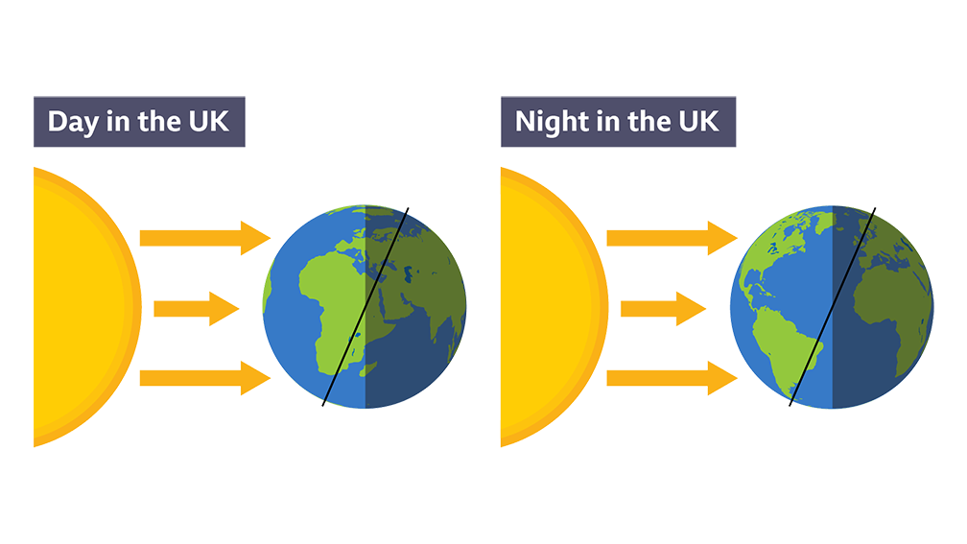
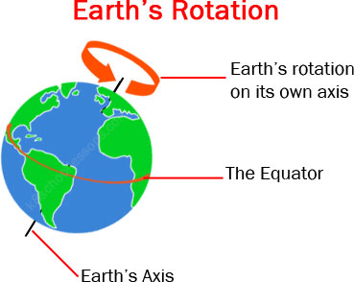
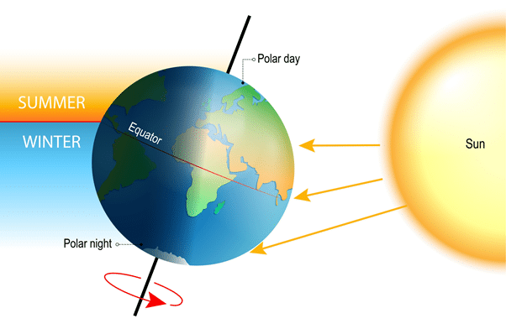
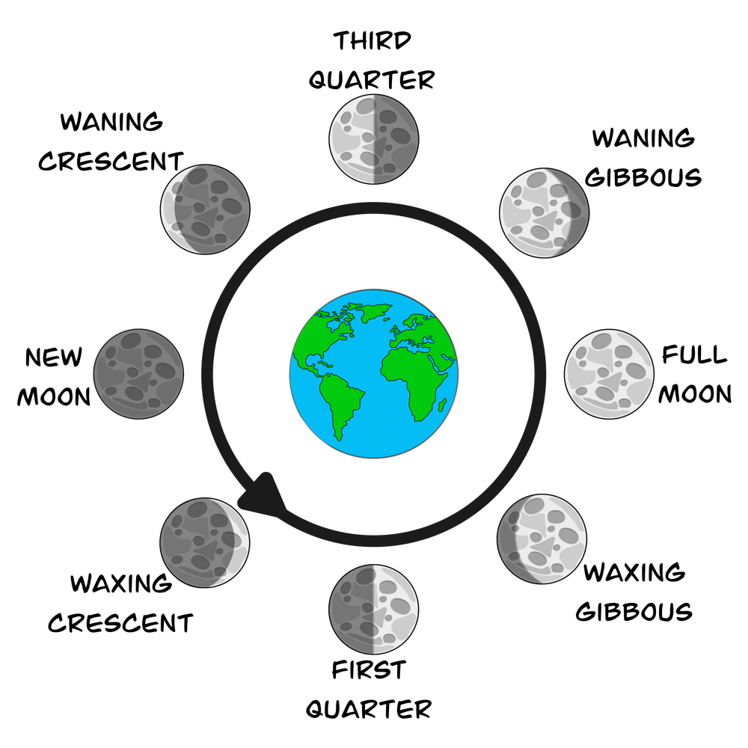
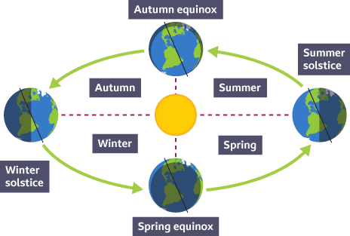
9.1 Astronomer KO
1. Day and Night
Caused by the Earth rotating on its axis every 24 hours.
3. Seasons
Caused by the tilt of the Earth’s axis.
In summer, the Sun’s rays are more direct, making days longer and warmer.
4. Moon Phases
The Moon orbits the Earth every 28 days.
Phases include: New Moon, First Quarter, Full Moon, Last Quarter.
2. Year
The Earth completes one orbit of the Sun every 365.25 days.

Slide 2
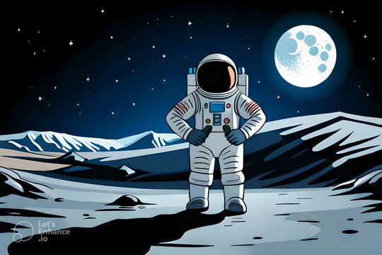
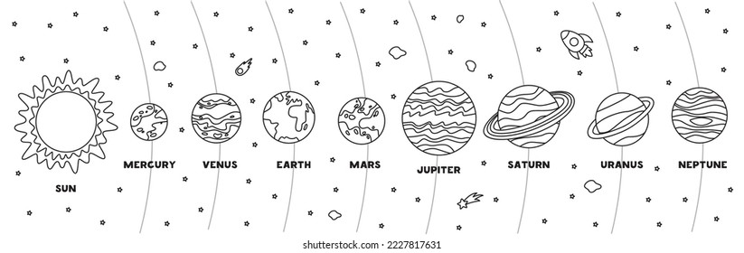
9.1 Astronomer KO
5. The Moon Landing
The first Moon landing was in 1969 (Apollo 11).
It demonstrated the potential of space exploration and inspired technological innovation.
6. Planets
Order: Mercury, Venus, Earth, Mars, Jupiter, Saturn, Uranus, Neptune
Inner planets are small and rocky; outer planets are large and gaseous.
7. Stars
Our star is the Sun.
Stars are huge balls of gas undergoing nuclear fusion.
Life cycle of a star includes: nebula → main sequence → red giant → white dwarf or supernova.
8. Galaxies
A galaxy is a large collection of stars.
We live in the Milky Way galaxy.
A constellation is a group of stars forming a pattern.

Slide 3
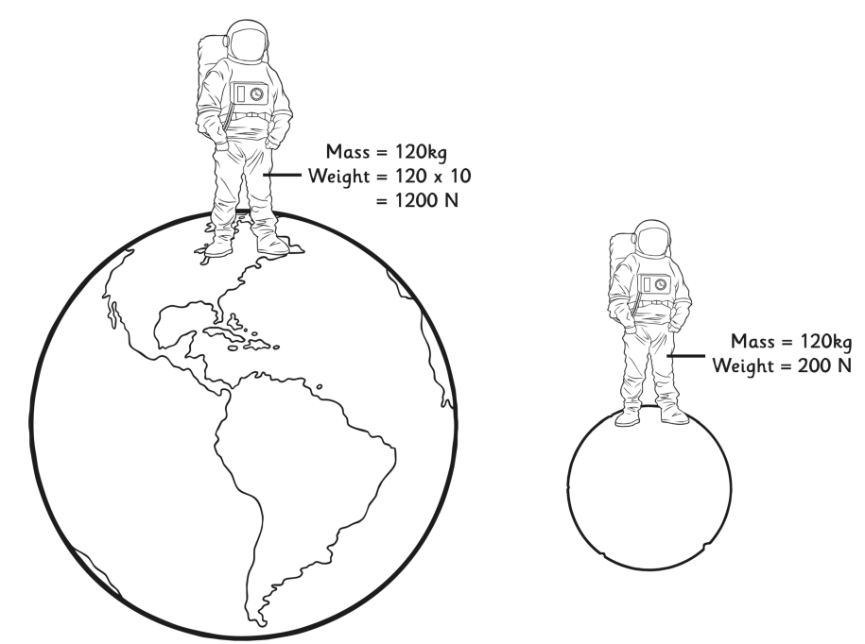
9.1 Astronomer KO
9. Gravity
A force that pulls objects towards each other.
The strength of gravity depends on mass and distance.
Gravity is weaker on the Moon than on Earth.
10. Mass and Weight
Mass: the amount of matter in an object (kg), stays the same.
Weight: the force of gravity on an object (N), changes with gravity.
Weight = Mass × Gravitational field strength
Example Question:
An astronaut has a mass of 60 kg. Calculate their weight on Earth, where the gravitational field strength is 9.8 N/kg.
Worked Example
Equation:
Weight = Mass × Gravitational field strength
Substitution:
Weight = 60 kg × 9.8 N/kg
Calculation:
Weight = 588
Unit:
Weight = 588 N

Slide 4
9.1 Astronomer KO
Day and Night
• What causes day and night?
• How long does it take for the Earth to complete one rotation?
• Why is it daytime in the UK when it's nighttime in Australia?
• What direction does the Earth rotate?
• How does Earth's rotation affect shadows during the day?
Moon Phases
• How long does it take the Moon to orbit the Earth?
• What are the four main phases of the Moon?
• What is a New Moon?
• Why does the Moon appear to change shape?
• What phase comes after a Full Moon?
Galaxies
• What is a galaxy?
• What galaxy do we live in?
• What is a constellation?
• How do stars appear to form patterns in the sky?
• Give an example of a constellation.
Year
• What causes a year?
• How long does it take Earth to orbit the Sun?
• Why do we have a leap year every 4 years?
• What does orbit mean?
• How is Earth’s orbit related to the seasons?
Planets
• What is the order of the planets from the Sun?
• Which planets are rocky and which are gaseous?
• Which planet is the hottest?
• What is the difference between inner and outer planets?
• Which planet is known as the “Red Planet”?
Gravity
• What is gravity?
• What two factors affect the strength of gravity?
• Is gravity stronger on the Moon or on Earth?
• What keeps the planets in orbit?
• How does gravity affect weight?
Seasons
• What causes the seasons on Earth?
• Why is it warmer in summer than in winter?
• How does the tilt of the Earth's axis affect sunlight?
• What is different about the Sun’s rays in winter?
• Why are days longer in summer?
Stars
• What is the name of our star?
• What process happens inside stars?
• What is the first stage in a star’s life cycle?
• What can a red giant become?
• What is nuclear fusion?
Mass and Weight
• What is mass and how is it measured?
• What is weight and how is it measured?
• What is the equation to calculate weight?
• If a person has a mass of 60 kg, what is their weight on Earth?
• Does your mass change on the Moon?

