Slide 1
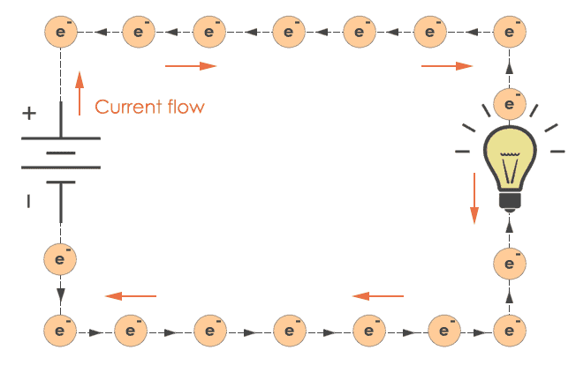
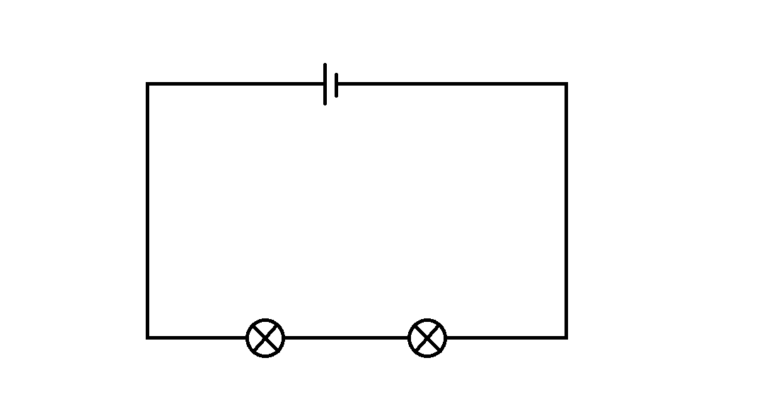
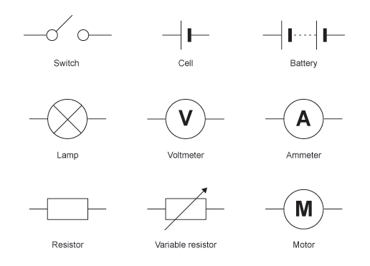
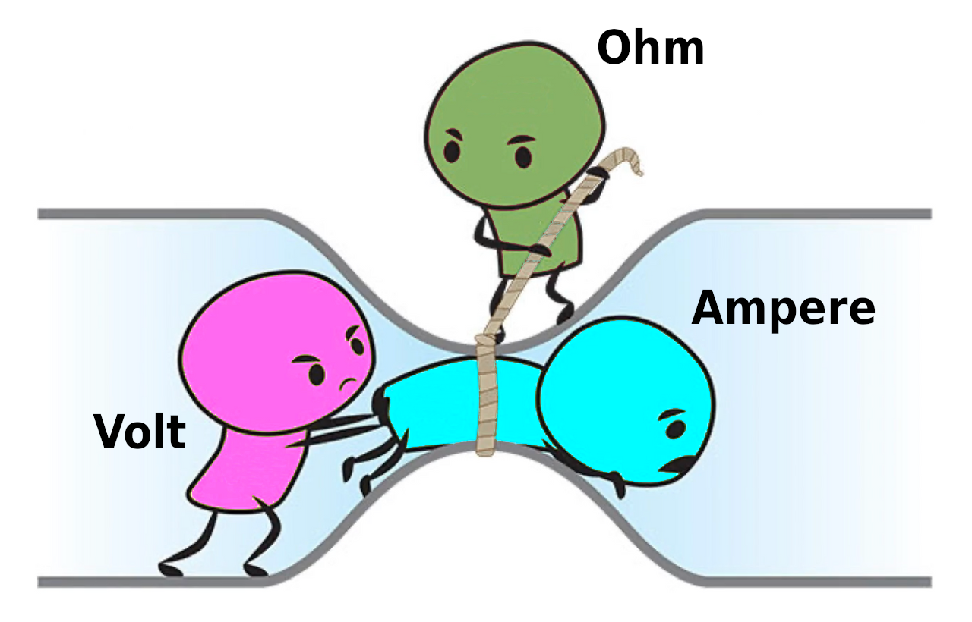
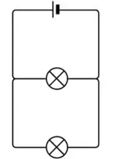
8.9 Electrician KO
1.
Electric Current | Current is the flow of electrons (charge) measured in amperes (A). It requires a complete circuit.
Voltage (Potential Difference) | Pushes the current around the circuit. Measured in volts (V). Higher voltage = more energy to components.
Resistance | Measured in ohms (Ω). Resistance slows down current. Higher resistance = lower current.
Series Circuits | Current is the same at all points. Voltage is shared. One break = no current.
Parallel Circuits | Current splits across branches. Voltage is the same across each branch. If one bulb breaks, others stay on.
3.
2.
4.
Misconception : Electricity is used up | Energy is transferred, but current stays the same in a series circuit.
Voltage and current are the same thing | Voltage pushes the current. They are different quantities.

Slide 2
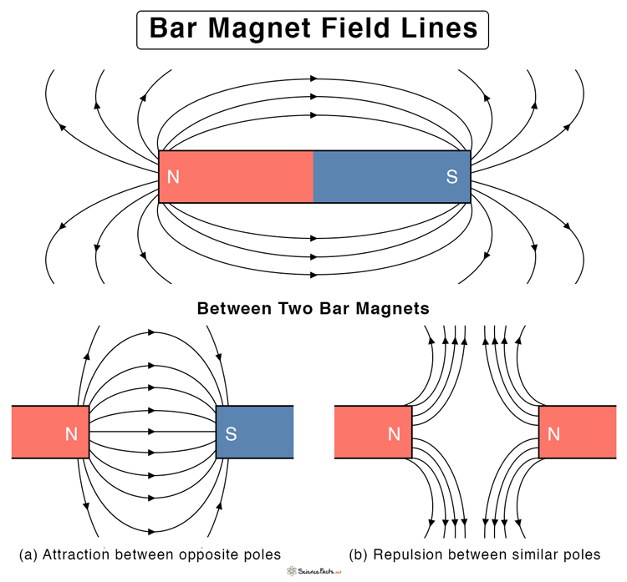
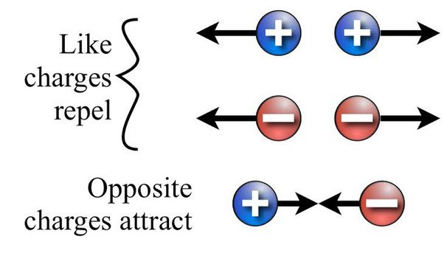
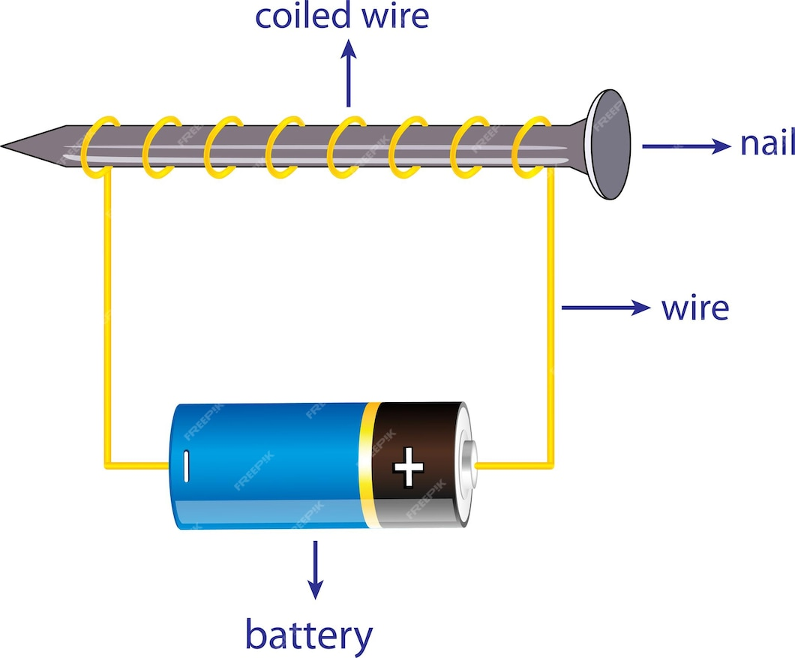
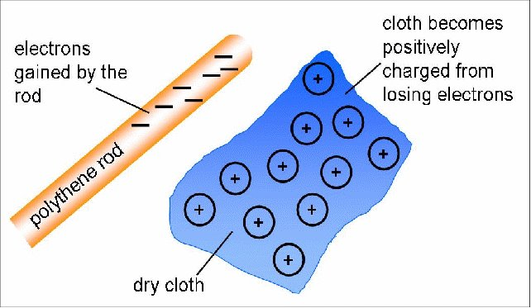
8.9 Electrician KO
Magnetic Fields | Magnetic field lines go north to south. Iron, nickel, cobalt = magnetic materials.
Electromagnets | A coil of wire with a current creates a magnetic field. Strength increases with more coils or higher current. Used in motors, bells, etc.
Static Electricity | Caused by friction. Electrons are transferred, creating a positive or negative charge. Like charges repel, opposites attract. The material which loses electrons becomes positively charged. ​ The material which gains electrons becomes negatively charged. ​ Opposite charges attract ​ ​ Like (the same) charges repel
6.
5.
7.
Misconception: Static shocks are from electricity in wires | Static electricity is due to friction and charge buildup, not power from circuits.

Slide 3
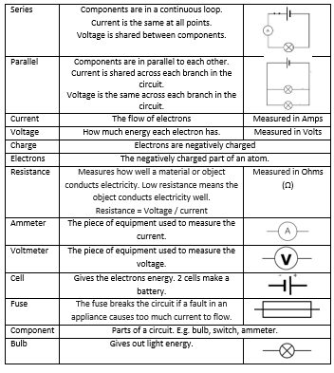
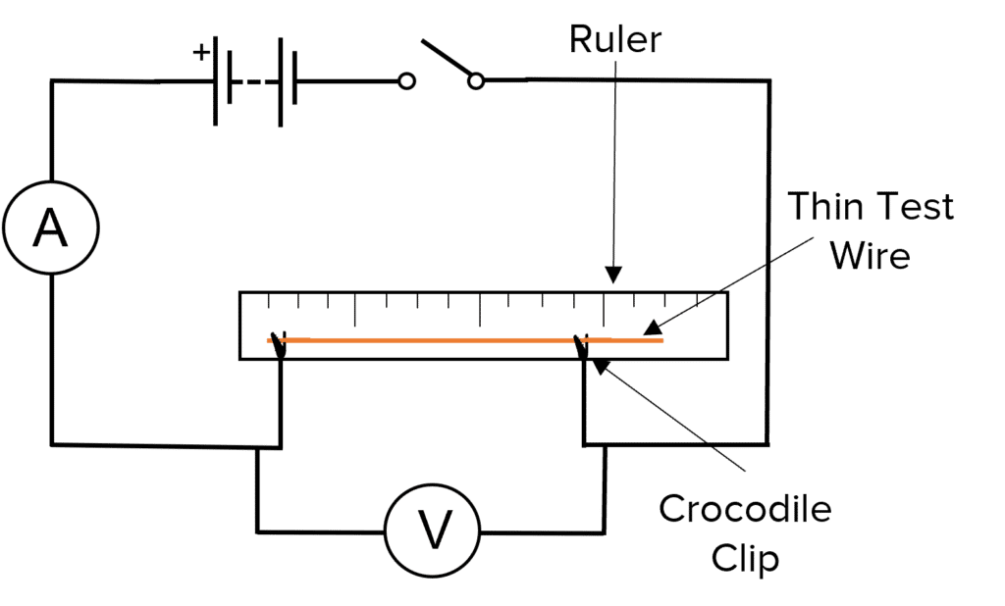
8.9 Electrician KO
8.
Resistance of a wire
Method:
Set up the circuit as shown in the diagram:
  Attach the wire to a meter ruler using tape.
  Connect the wire into the circuit using crocodile clips at both ends.
  Place an ammeter in series and a voltmeter in parallel across the wire.
Choose a length of wire to test (e.g. 20 cm). Move the crocodile clips to this position.
Close the switch to allow current to flow.
Record the readings on the ammeter (current, I) and the voltmeter (voltage, V).
Calculate the resistance using the formula:
R=V/I ​
Repeat the experiment for different lengths of wire (e.g. 30 cm, 40 cm, etc.).
Record results in a table and plot a graph of resistance against wire length.
Sample Calculation: Resistance
Equation:
R=V/I
Example:
Voltage (V) = 3.0 V
Current (I) = 0.60 A
Substitute into the equation:
R=3.00.60=5.0
ΩR = 3/0.6= 5.0
Answer:
Resistance = 5.0 Ω

Slide 4
8.9 Electrician KO
Key Questions Electrical circuits ( 1,2,3 and 4 )
What is the main difference in how components are connected in a series circuit compared to a parallel circuit?
In which type of circuit does the current stay the same through all components?
If one bulb breaks in a series circuit, what happens to the rest of the circuit?
Why are parallel circuits used in household lighting?
Which type of circuit allows components to work independently of each other?
True or False: In a series circuit, the more components you add, the dimmer the bulbs become.
Describe one advantage and one disadvantage of using a parallel circuit instead of a series circuit.
6.Magnetic Fields – Key Questions
What is a magnetic field?
How can you show the shape of a magnetic field around a magnet?
What do magnetic field lines always point from and to?
Where is the magnetic field strongest on a bar magnet?
What happens when two like poles are brought together?
What happens when two opposite poles are brought together?
What is a compass and how does it help us see magnetic fields?
Name three magnetic materials.
7.Electromagnets – Key Questions
What is an electromagnet?
How can you make an electromagnet stronger?
What happens to an electromagnet when the current is switched off?
What are the advantages of electromagnets over permanent magnets?
What are some uses of electromagnets in everyday life?
How does wrapping more coils of wire around the iron core affect the strength of an electromagnet?
What role does the iron core play in an electromagnet?
5.Static Electricity – Key Questions
What is static electricity?
How can an object become charged?
What happens when two insulators are rubbed together?
What type of charge do electrons carry?
What happens when two objects with the same charge are brought close together?
What happens when two objects with opposite charges are brought close together?

