Slide 1
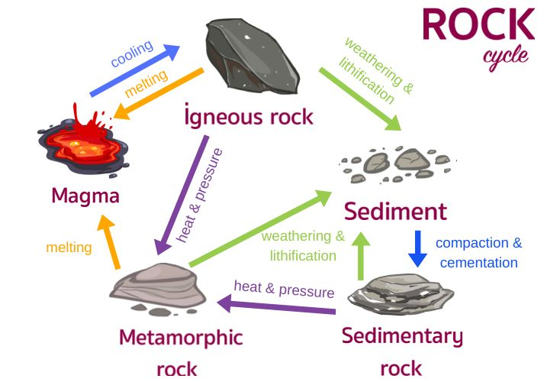
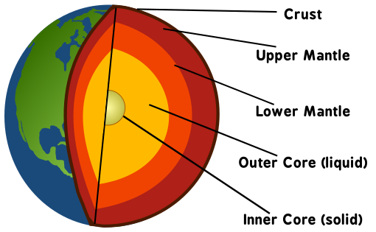
8.7 Geologist KO
1. Core Knowledge
3. Rock cycle
Topic | Key Knowledge
Rock or Mineral | A rock is a mixture of minerals. A mineral is a naturally occurring substance.
Sedimentary Rocks | Formed from layers of sediment, compacted and cemented over time.
Structure of the Earth | Crust, mantle, outer core, inner core; different compositions and properties.
Plate Tectonics | Movement caused by heat from the core, resulting in earthquakes and volcanoes.
Igneous Rocks | Formed when magma cools; can be intrusive or extrusive.
Metamorphic Rocks | Formed when heat and pressure change existing rocks.
Rock Cycle | Explains how rocks change from one type to another through various processes.
2. Structure of the Earth
Misconception: The Earth’s crust is one solid piece (it's broken into plates)

Slide 2
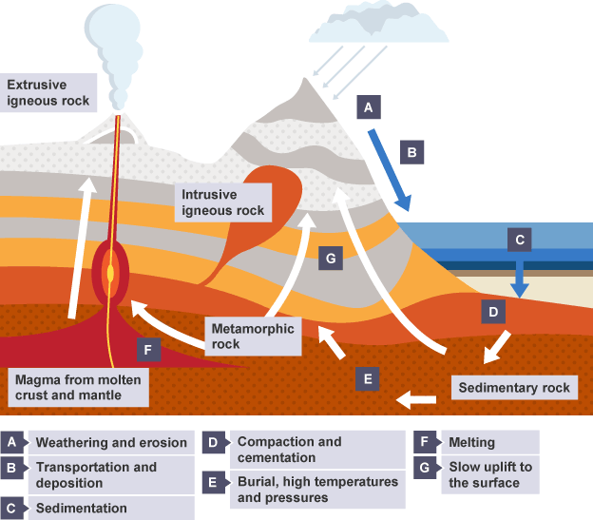
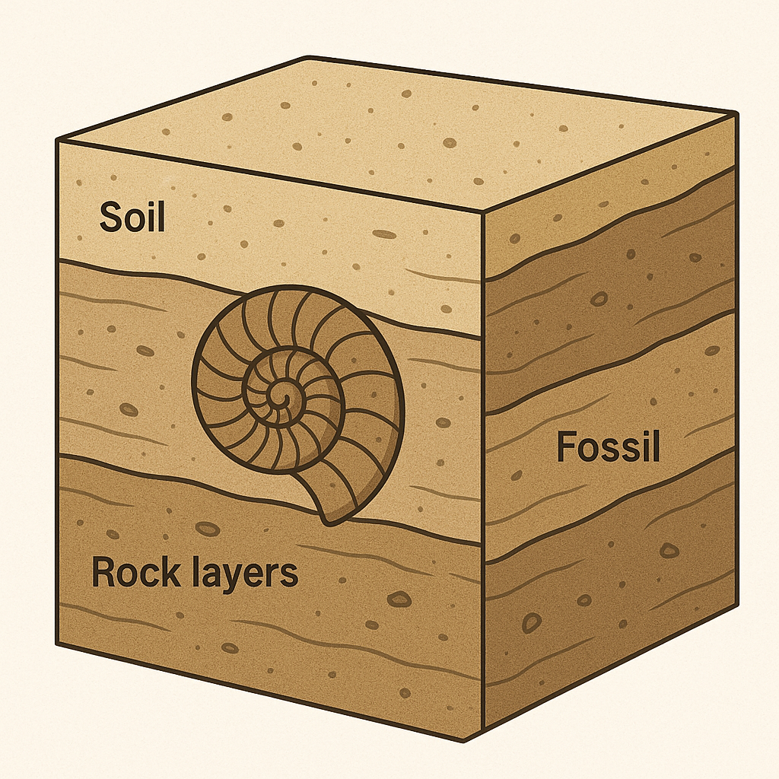
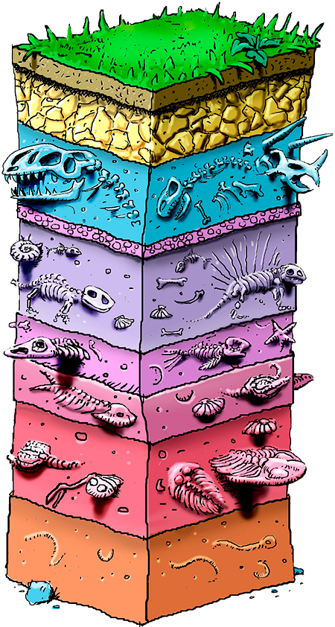
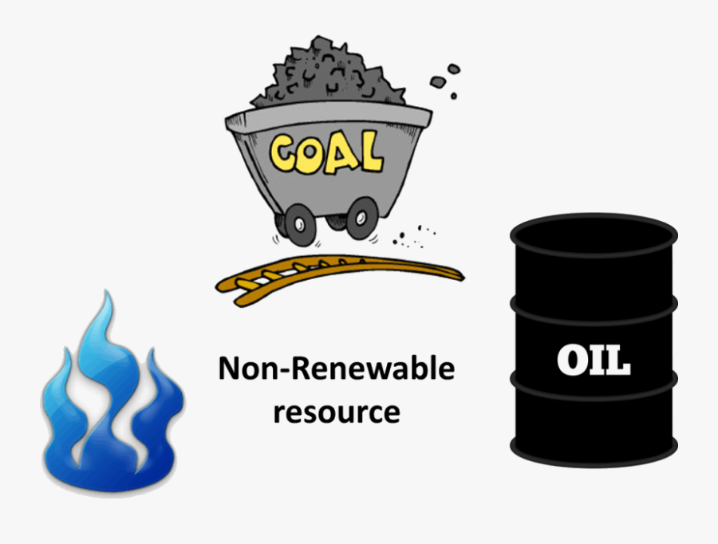

8.7 Geologist KO
6. Fossils
1. Core Knowledge
Fossils | Preserved remains of organisms; mostly found in sedimentary rocks.
6. Fossil fuels
Fossil Fuels | Formed from dead organisms; non-renewable; used for energy, but cause pollution.
5. Weathering and erosion
Weathering and Erosion | Weathering breaks down rocks; erosion moves them.
Chemical Weathering | Caused by acid rain, oxygen, or water reacting with minerals.
Air Quality | Pollutants include CO₂, SO₂, NOx, particulates; can affect health and climate.
Misconception: Weathering and erosion are the same (they are different processes)
Misconception: Fossils form in all rock types (they mostly form in sedimentary rocks)

Slide 3
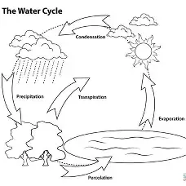
8.7 Geologist KO
🔑 Key Words for 8.7 – Geologist
Keyword | Definition (
Geologist | A scientist who studies the Earth, rocks, and how they change over time.
Mineral | A natural solid material with a definite structure found in rocks.
Rock | A mixture of minerals.
Sedimentary rock | Rock formed from layers of sediment that are pressed and stuck together.
Fossil | Remains or traces of ancient living things found in rocks.
Igneous rock | Rock formed when melted rock (magma or lava) cools and hardens.
Metamorphic rock | Rock that has been changed by heat and pressure.
Rock cycle | The process that shows how rocks can change from one type to another.
Weathering | The breaking down of rocks into smaller pieces.
Erosion | The movement of broken rock from one place to another.
Chemical weathering | When chemicals (like acids in rain) change or break down rocks.
Earth’s layers | Crust, mantle, outer core, and inner core – the structure of the Earth.
Tectonic plates | Large pieces of the Earth’s crust that move slowly.
Fossil fuels | Fuels made from dead plants and animals over millions of years.
Pollution | Harmful substances released into the environment.
Air quality | How clean or dirty the air is.
Water cycle | The continuous movement of water through evaporation, condensation, and rain.
Magma | Melted rock found beneath the Earth’s surface.
Lava | Melted rock that has reached the Earth’s surface.
Sediment | Small pieces of rock, sand, or organic material.
Water Cycle | Continuous movement of water through evaporation, condensation, precipitation.

Slide 4
8.7 Geologist KO
🔍 Core Knowledge & Misconceptions
What is a common misconception about the Earth's crust, and what is the correct idea?
Why is it incorrect to say weathering and erosion are the same process?
Why don’t fossils form in all types of rocks?
🦴 Fossils
In which type of rock do fossils mostly form, and why?
What conditions are needed for fossil formation?
What can fossils tell us about the past?
🌍 Structure of the Earth
What are the main layers of the Earth?
What is each layer of the Earth made of?
Which layer of the Earth is broken into plates?
⛽ Fossil Fuels
What are fossil fuels, and how do they form?
Why are fossil fuels considered non-renewable?
What are some environmental impacts of using fossil fuels?
🔄 Rock Cycle
What are the three main types of rock?
How can one type of rock change into another?
What role does heat and pressure play in the rock cycle?
What processes are involved in the formation of sedimentary rocks?
🌧️ Weathering and Erosion
What is the difference between weathering and erosion?
What are the three types of weathering?
How does weathering contribute to the rock cycle?
How does erosion move sediments?

