Slide 1
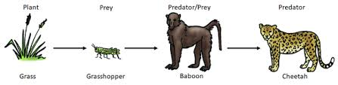
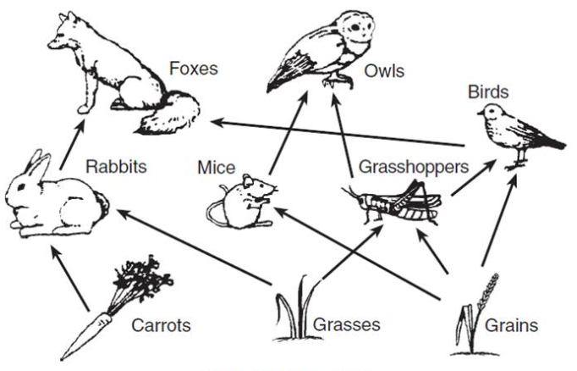
8.6 Ecologist KO
1.Food Chains
Show the flow of energy from producers to consumers.
Parts: Producer → Primary Consumer → Secondary Consumer.
Misconception Biodiversity just means “lots of animals” | Biodiversity refers to the variety of all living organisms – animals, plants, fungi, and microorganisms – in an area.
Producer – Start of a food chain. Produces glucose through photosynthesis.
Tertiary Consumer – Predates on secondary consumer.
Primary Consumer – Eats a producer. Prey of secondary consumer.
Secondary Consumer – Eats a primary consumer. Predator of primary consumer.
2. Food Webs
Show interconnected food chains.
A change in one population affects the entire web (e.g., removal of a predator).
Interdependence in Ecosystems
Organisms depend on each other for food, shelter, pollination, and seed dispersal.
Removal of one species can cause a trophic cascade.

Slide 2
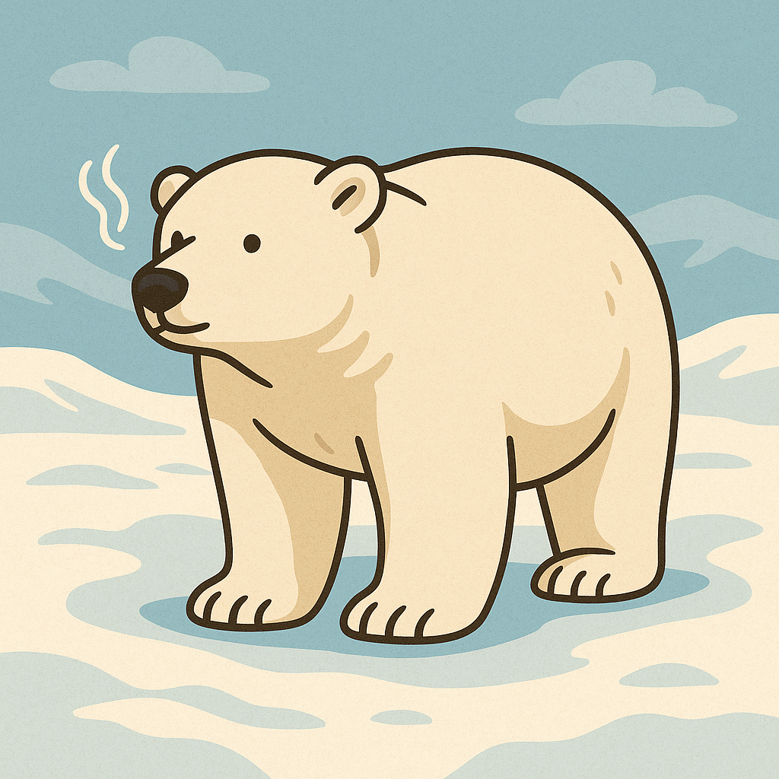
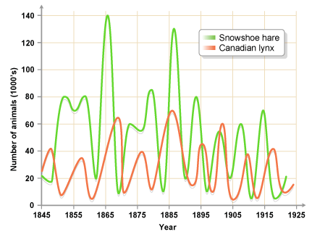
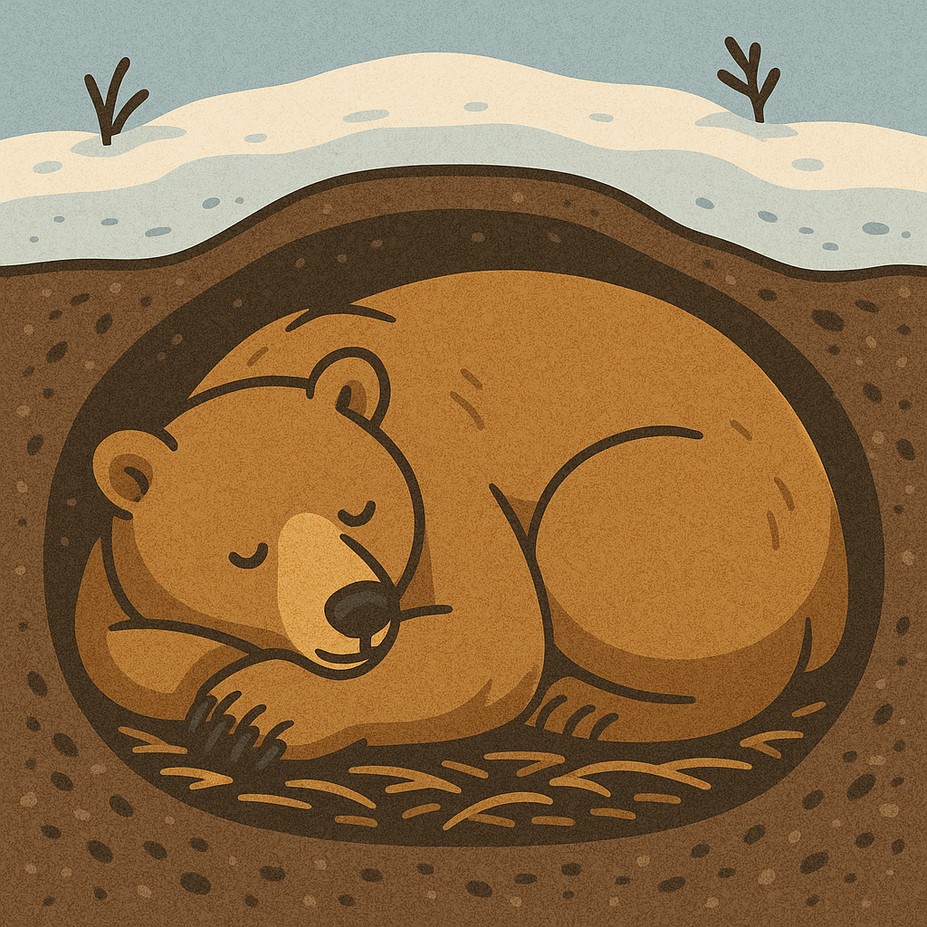
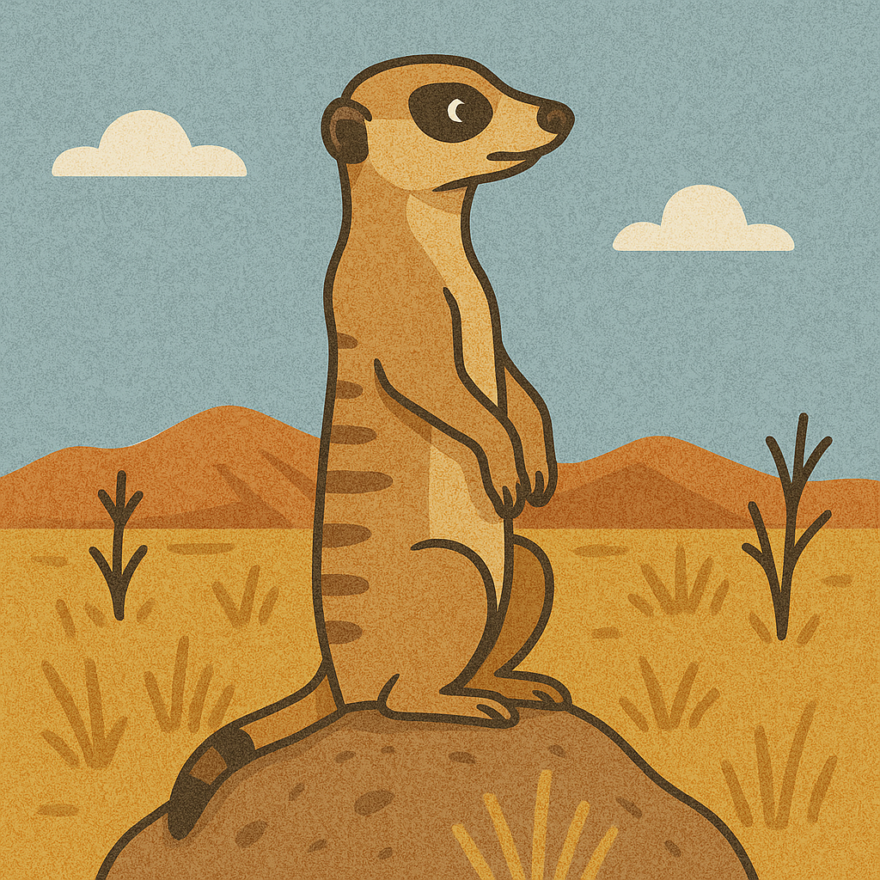
8.6 Ecologist KO
3.Habitats and Adaptations
Adaptations help organisms survive in their specific habitat (e.g., polar bears have thick fur).
Competition happens when resources are limited.
4.Adaptations
Structural Adaptations | Part of the body that helps the organism survive. e.g. polar bears have a thick layer of fat for insulation.
Functional Adaptations | How the body operates that helps the organism survive. E.g. camels do not sweat.
Behavioural Adaptations | A behaviour that helps the organism survive. e.g. desert rats stay in their burrows during the hottest parts of the day.
5.
Predator prey relationship
Predator-prey cycles
The population of the prey increases
More food is available for the predators, so their population increases.
There are more predators so the population of the prey decreases.
There is less prey to feed on so the population of predators decreases.
The cycle restarts from the beginning.
Misconception: Predators always keep increasing in number | Predator numbers depend on prey availability; if prey runs out, predator populations also fall.

Slide 3
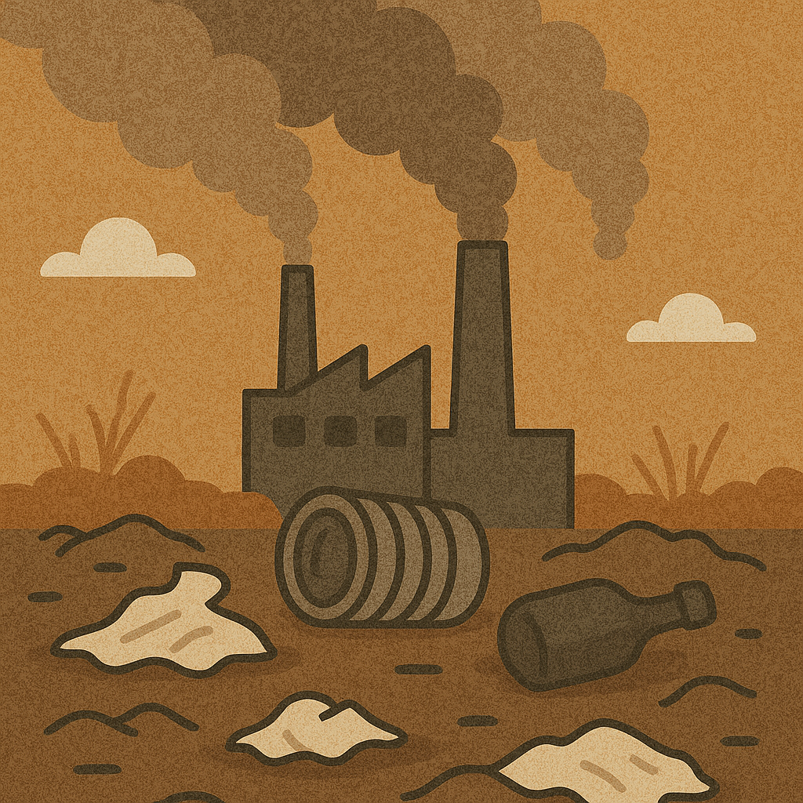
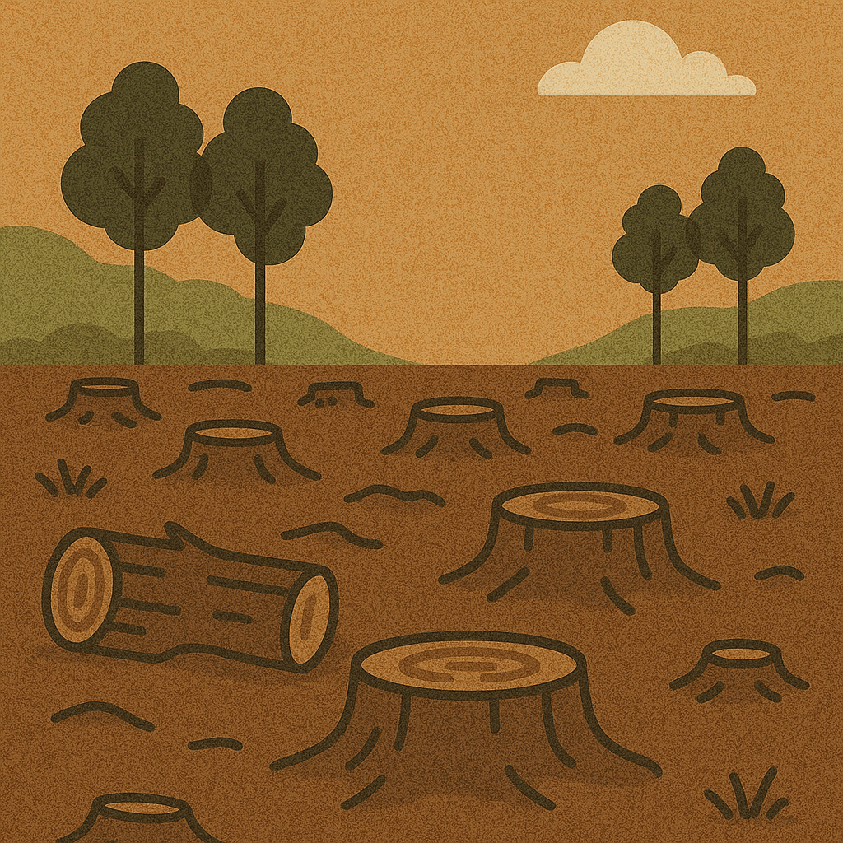
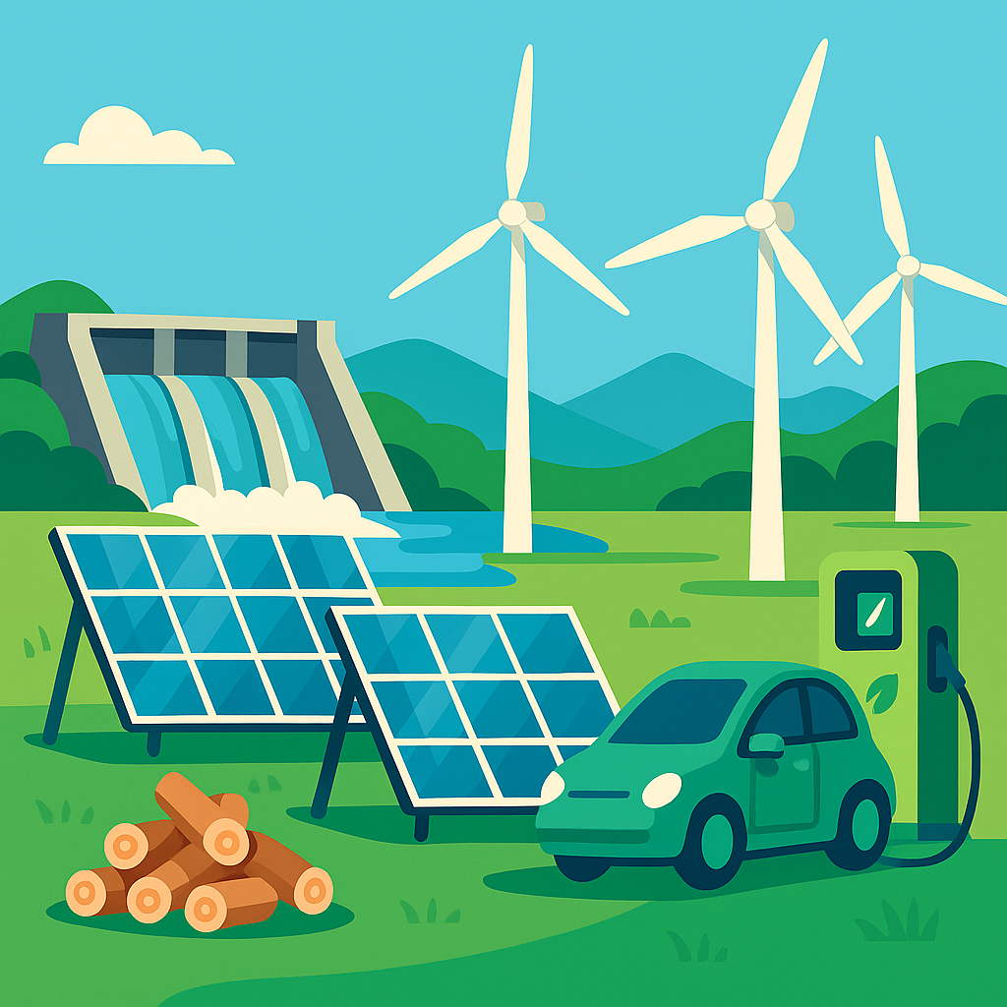
8.6 Ecologist KO
Key terms
Ecosystem | The interaction of a community of living organisms (biotic) with the non-living (abiotic) parts of their environment.
Habitat | The area in which an organism lives.
Community | Two or more different species in an ecosystem. A stable community is one where all the species and environmental factors are in balance so that population sizes remain fairly constant.
Population | The total number of organisms of one species in an ecosystem.
Competition | Plants often compete for light, space, water and mineral ions. Animals often compete for food, mates and territory
Interdependence | Within a community each species depends on other species for food, shelter, pollination etc.
Adaptations | A feature that an organism has that allows it to survive in its ecosystem.
Biodiversity | The variety of all the different species of organisms on Earth, or within an ecosystem.
5.Biodiversity and Human Impact
Biodiversity is important for healthy ecosystems.
Negative impacts: pollution, deforestation, habitat loss.
Positive impacts: conservation, habitat protection, reducing emissions.
6.Global Warming
Caused by greenhouse gases (e.g. CO₂, methane).
Effects: rising sea levels, habitat loss, extreme weather.
Solutions: reduce fossil fuel use, plant trees, renewable energy.
Misconception: Global warming and the ozone layer are the same issue
Global warming is caused by greenhouse gases trapping heat, while the ozone layer issue involves UV radiation protection.

Slide 4
8.6 Ecologist KO
1. Food Chains
- What is a producer and what does it do?
- What is the role of a primary consumer?
- How is energy transferred in a food chain?
- What is the role of a tertiary consumer?
Which organism starts a food chain?
4. Predator-Prey Cycles
- What happens to predator numbers when prey numbers increase?
- What causes prey numbers to decrease in the cycle?
- What happens when predator numbers get too high?
- What kind of pattern does a predator-prey cycle show?
- Why do predator and prey populations constantly change?
2. Food Webs and Interdependence
- What is a food web?
- How does removing one species affect a food web?
- What does 'interdependence' mean in an ecosystem?
- Give one example of how animals depend on each other.
- What is a trophic cascade?
5. Biodiversity and Human Impact
- What is biodiversity?
- Why is biodiversity important for ecosystems?
- Name two ways humans negatively impact biodiversity.
- Name two ways we can protect biodiversity.
- How does deforestation affect biodiversity?
3. Habitats and Adaptations
- What is an adaptation?
- How do adaptations help animals survive?
- Give one example of an animal adaptation and its purpose.
- What is competition in a habitat?
- Why might animals compete with each other?
6. Global Warming
- What causes global warming?
- Name two greenhouse gases.
- Give one effect of global warming on habitats.
- How can we reduce the impact of global warming?
- Why is planting trees helpful in fighting global warming?

