Slide 1
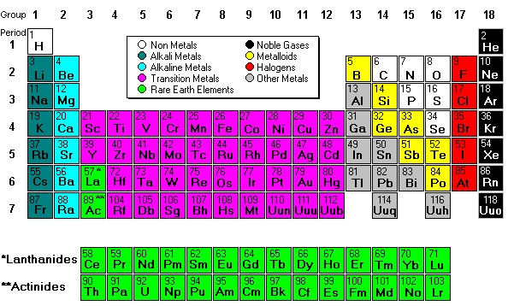
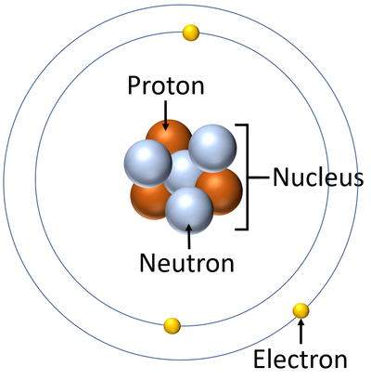
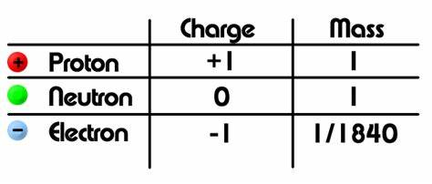
8.5 Periodic table KO
1. Atomic Structure Summary
Nucleus contains protons and neutrons.
Electrons orbit in energy levels/shells.
Most of the atom is empty space.
Bohr model shows electrons in fixed orbits (shells).
5.
2. Periodic Table Trends
Groups = similar chemical properties (e.g. Group 1 are reactive metals).
Periods = number of shells.
Metals on the left; non-metals on the right.
Reactivity trends:
  Group 1: increases down the group.
  Group 7: decreases down the group.
3.
Key Term | Definition / Explanation
Dmitri Mendeleev | Russian scientist who created the first useful periodic table in 1869.
Periodic Table | A table that arranges all known elements into groups based on their properties.
Atomic Mass | The mass of an atom. Mendeleev arranged elements in order of increasing atomic mass.
Patterns | Mendeleev noticed repeating patterns in the properties of elements.
Predicted Elements | Mendeleev left gaps for elements that hadn’t been discovered yet and predicted their properties.
Modern Periodic Table | Today's periodic table is based on atomic number, not mass, but follows Mendeleev's ideas.
4.

Slide 2
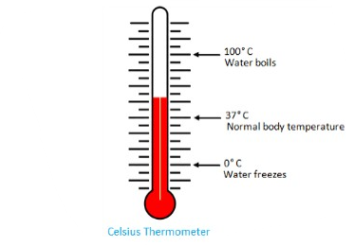
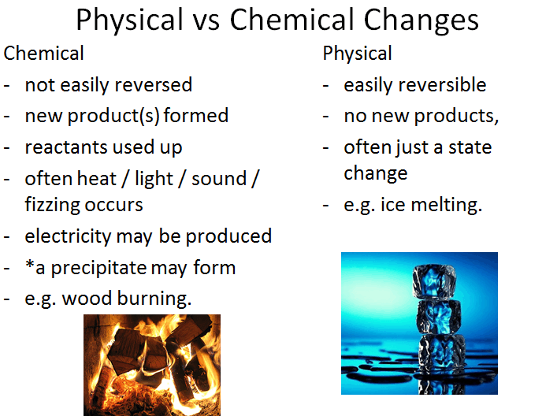
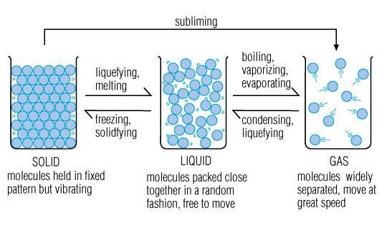
8.5 Periodic table KO
6.
5.
Melting point: the temperature that a substance changes from a solid to a liquid.
Boiling point:
The temperature that a substance changes from a liquid to a gas
7.

Slide 3
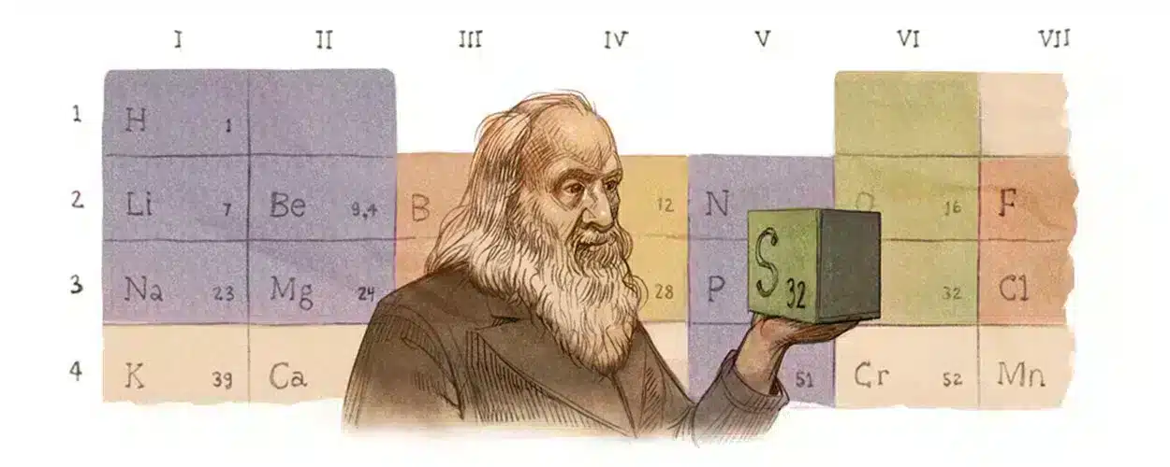
8.5 Periodic table KO
Keyword | Definition
Atom | The smallest particle of an element that retains the properties of that element.
Atomic Number | The number of protons in an atom.
Mass Number | The total number of protons and neutrons in an atom.
Element | A pure substance made up of only one type of atom.
Periodic Table | A table of elements arranged in order of atomic number.
Group | A vertical column in the periodic table – elements in the same group have similar properties.
Period | A horizontal row in the periodic table.
Mendeleev | Scientist who created the first version of the periodic table.
Chemical Reaction | A process in which substances change into new substances.
Physical Change | A change in which no new substances are formed.
Trend | A pattern observed in properties across a group or period in the periodic table.
Melting Point | The temperature at which a substance changes from solid to liquid.
Boiling Point | The temperature at which a substance changes from liquid to gas.
Reactivity | How easily an element reacts with others.
Prediction | Mendeleev used patterns to predict the properties of undiscovered elements.
Misconception | Clarification
Mendeleev’s table is the same as the modern periodic table | Mendeleev arranged elements by atomic mass, not atomic number. The modern table uses atomic number.
All elements in the same group look the same or have the same physical state | Elements in the same group share chemical properties, not necessarily physical appearance.
Atoms are the same as elements | An element is a substance made of one type of atom, but they are not the same thing.
The periodic table is just a list of elements | It is a powerful tool that shows patterns and trends in chemical behaviour.

Slide 4
🔬 1. Atomic Structure Summary
What particles are found in the nucleus of an atom?
Where are electrons found in an atom?
What is the charge of a proton, neutron, and electron?
Why is most of the atom considered empty space?
3. Chemical and Physical change
What type of change is usually easily reversible?
Which type of change involves new products being formed?
What is a common example of a physical change?
What is a common example of a chemical change
🔍 Questions on Periodic Table Misconceptions
What is the key difference between Mendeleev’s periodic table and the modern periodic table?
True or False: All elements in the same group of the periodic table look the same and have the same physical state.
Explain why atoms and elements are not the same thing.
What do elements in the same group have in common?
Why is the periodic table more than just a list of elements? What makes it a useful scientific tool?
📊 2. Periodic Table Trends
What do all elements in the same group have in common?
What does the period number represent?
Where are metals and non-metals found on the periodic table?
How does reactivity change in Group 1 from top to bottom?
How does reactivity change in Group 7 from top to bottom?
🌡️ 4. Melting and Boiling Points
What is the definition of melting point?
What is the definition of boiling point?
What happens to particles at the melting point?
What happens to particles at the boiling point?
How can melting and boiling points help identify substances?

