Slide 1
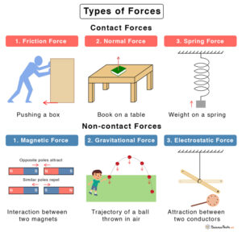
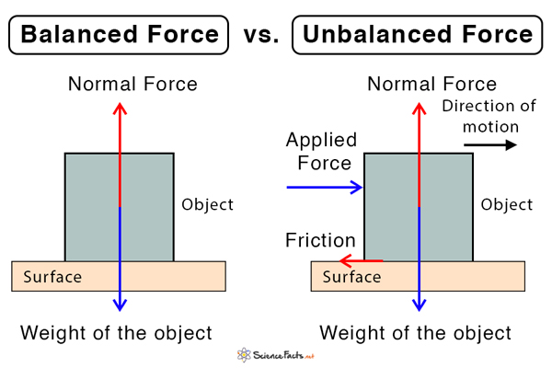
8.4 Motor sport engineer KO
1. Key Knowledge
Speed: Speed = Distance ÷ Time.
Motion graphs: Flat = stationary, straight diagonal = constant speed.
Resultant force: The net force acting on an object.
Drag: Streamlining reduces air resistance.
Mass & weight: Mass stays the same; weight changes depending on gravity.
Turning forces: Moment = Force × Distance from pivot.
3.
2.
“Mass and weight are the same thing” → ❌ Mass is constant; weight depends on gravity.
“A bigger object always has a bigger force” → ❌ It depends on the force applied, not just size.

Slide 2
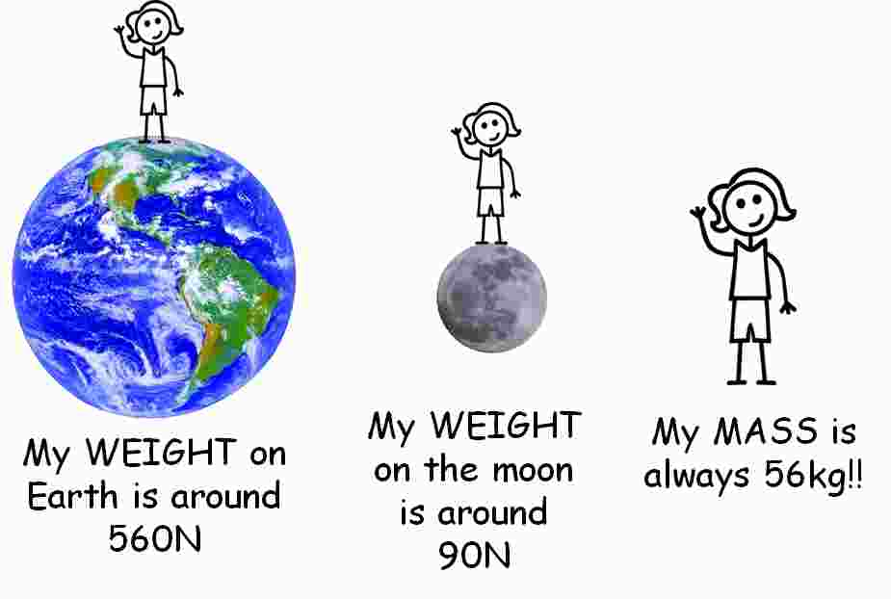
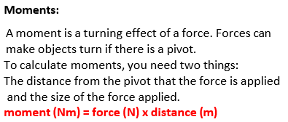
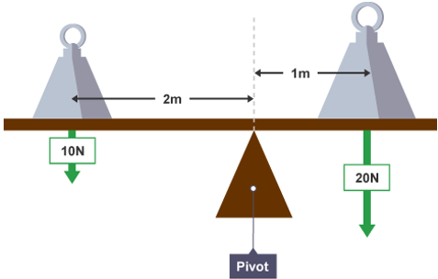
8.4 Motor sport engineer KO
4.Gravity vs mass
5.
Calculating Weight – Step by Step
Equation:
Weight = Mass × Gravity
Example Question:
An object has a mass of 20 kg. The gravitational field strength is 9.8 N/kg. What is the weight?
Step 1 – Write the equation:
Weight = Mass × Gravity
Step 2 – Fill in the numbers:
Weight = 20 × 9.8
Step 3 – Calculate it:
Weight = 196
Step 4 – Add units:
Weight = 196 N (Newtons)
Calculating Moment Equation:
Moment = Force × Distance
Question:
A spanner applies a force of 50 N at a distance of 0.3 m from the pivot. What is the moment?
Step 1 – Write the equation:
Moment = Force × Distance
Step 2 – Fill in the numbers:
Moment = 50 × 0.3
Step 3 – Calculate it:
Moment = 15
Step 4 – Add units:
Moment = 15 Nm (Newton-metres)

Slide 3
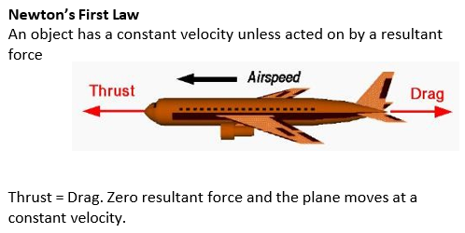
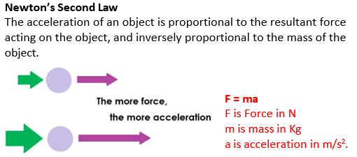
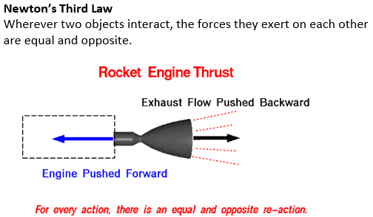
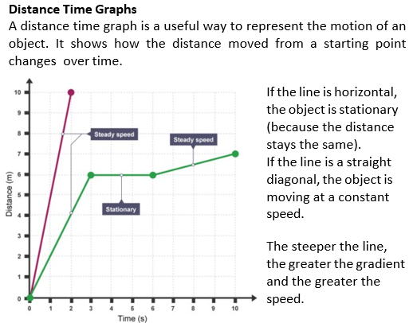
8.4 Motor sport engineer KO
8.
6.
7.
9.
Calculating Speed
Equation:
Speed = Distance ÷ Time
Question:
A car travels 1500 m in 60 seconds.
What is its speed?
Step 1 – Write the equation:
Speed = Distance ÷ Time
Step 2 – Fill in the numbers:
Speed = 1500 ÷ 60
Step 3 – Calculate :
Speed = 25
Step 4 – Add units:
Speed = 25 m/s
Distance
Question:
A bike travels at 10 m/s for 120 seconds.
How far does it go?
Step 1 – Rearrange the equation:
Distance = Speed × Time
Step 2 – Fill in the numbers:
Distance = 10 × 120
Step 3 – Calculate:
Distance = 1200
Step 4 – Add units:
Distance = 1200 m
Time
Question:
A runner travels 400 m at a speed of 8 m/s.
How long does it take?
Step 1 – Write the equation:
Time = Distance ÷ Speed
Step 2 – Fill in the numbers:
Time = 400 ÷ 8
Step 3 – Calculate it:
Time = 50
Step 4 – Add units:
Time = 50 seconds
10.

Slide 4
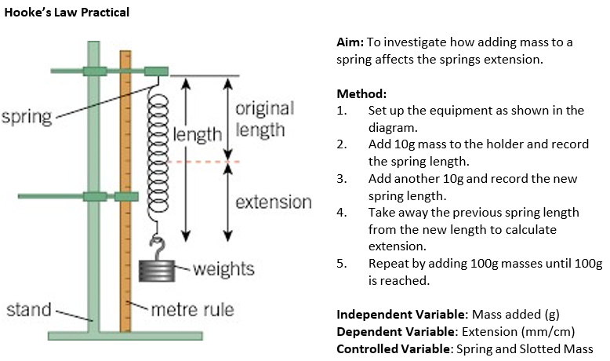
8.4 Motor sport engineer KO
Definitions
Velocity | Speed in a particular direction
Acceleration | Speeding up, rate of change of velocity
Terminal Velocity | Steady speed reached when weight and drag balance. Resultant force = 0N
Balanced | Two forces are equal and opposite so resultant force = 0N.
Resultant Force | The sum of all the forces acting on an object
Friction | A force that opposes the motion of a moving object.
Work Done (Mechanical) | Energy transferred when a force moves an object through a distance.
Drag | A force that resits motion through the air.
Lift | A force that uses motion to make objects rise up.
Upthrust | An upwards force pushing on an object in fluids.
Reaction or Normal Force | A force that stops you falling through the floor.
11.

Slide 5
8.4 Motor sport engineer KO
1. Speed
- What is the equation for speed?
- What are the correct units for speed, distance, and time?
- How does a speed-time graph show constant speed?
- If a car travels 600 m in 30 s, what is its speed?
6. Turning Forces (Moments)
- What is the equation for calculating moment?
- What is the unit for moment?
- How does increasing the distance from the pivot affect the moment?
2. Motion Graphs
- What does a flat line mean on a distance-time graph?
- What does a straight diagonal line show?
- How can you tell if an object is accelerating?
7. Gravity vs Mass
- What stays the same: mass or weight?
- What is the gravitational field strength on Earth?
- If gravity changes, what happens to your weight?
3. Resultant Force
- What is a resultant force?
- What happens to an object if the resultant force is zero?
- How can unbalanced forces affect motion?
8. Speed Calculations – Recap
- Rearrange the speed equation to calculate distance.
- Rearrange the speed equation to calculate time.
- A cyclist moves at 5 m/s for 300 s. How far do they travel?
4. Drag / Streamlining
- What is drag?
- How does streamlining help a racing car?
- Why is drag lower for smooth, narrow shapes?
9. Common Misconceptions
- Is mass the same as weight? Why or why not?
- Does a heavier object always apply a bigger force?
- Does more mass always mean more motion?
5. Mass and Weight
- What is the difference between mass and weight?
What is the equation for weight?
Why does an astronaut's weight change on different planets?

