Slide 1
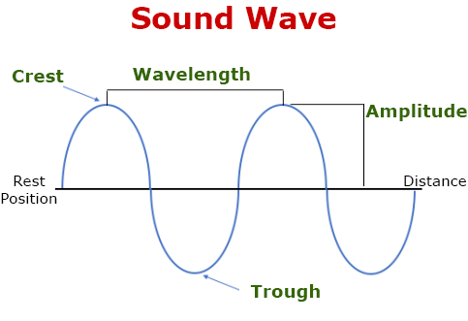
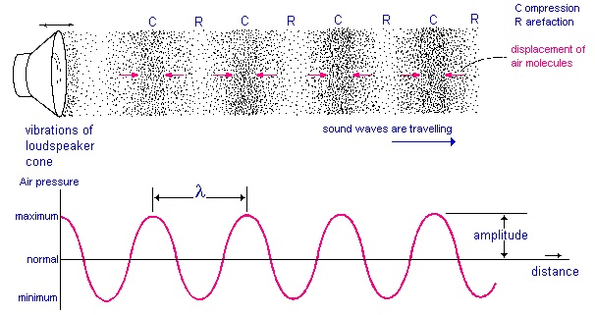
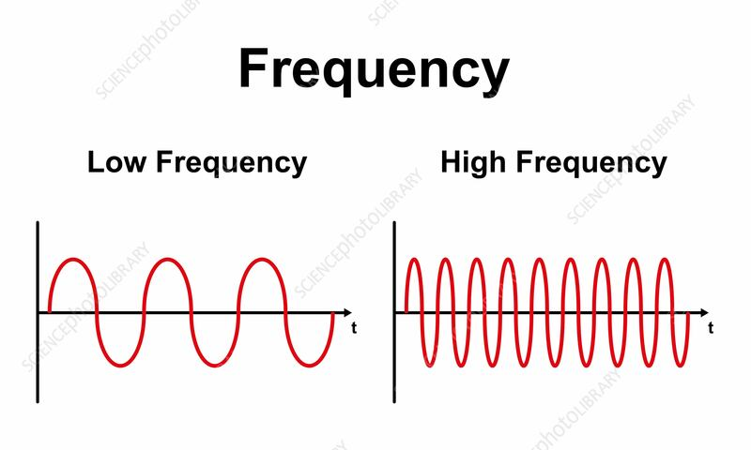
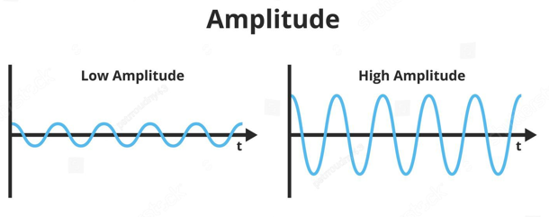
8.3 Light and sound KO
1.Key Knowledge Sound
Sound travels through vibrations in particles.
Sound moves fastest in solids, slower in liquids, and slowest in gases.
Louder sounds are caused by bigger vibrations; higher-pitched sounds are caused by faster vibrations.
Sound waves are longitudinal – particles move back and forth
6.Calculate speed
  Speed: Distance ÷ Time
  Distance: Speed × Time
  Time: Distance ÷ Speed
Example 1 – Finding Speed
Question:
A sound wave travels 300 m in 0.75 seconds.
What is the speed?
Formula:
Speed = Distance ÷ Time
= 300 m ÷ 0.75 s
= 400 m/s
Example 2 – Finding Distance
Question:
A light pulse travels at 3 × 10⁸ m/s for 0.000002 seconds.
How far does it travel?
Formula:
Distance = Speed × Time
= (3 × 10⁸ m/s) × (0.000002 s)
= 600 m
Example 3 – Finding Time
Question:
A wave travels 1200 m at a speed of 300 m/s.
How long does it take?
Formula:
Time = Distance ÷ Speed
= 1200 m ÷ 300 m/s
= 4 seconds
2.
3.
5.
4.
Common Misconceptions
“Sound can travel in space” → ❌ Sound needs particles to travel.
“All sounds travel at the same speed” → ❌ Speed depends on medium.

Slide 2

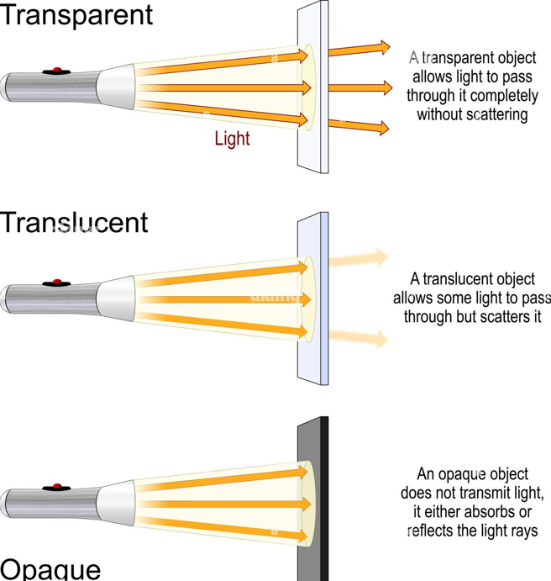
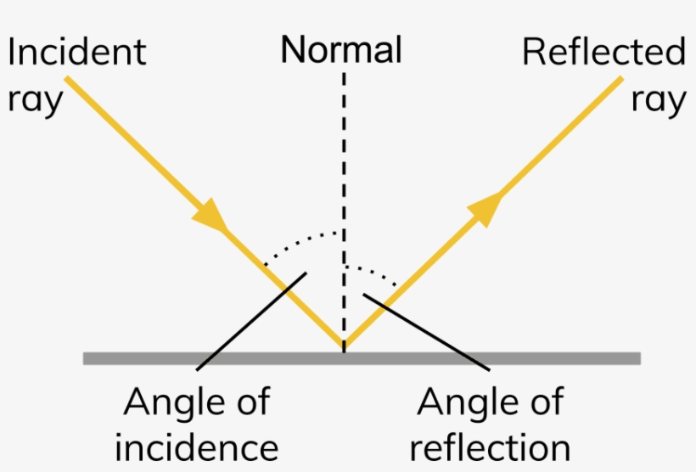
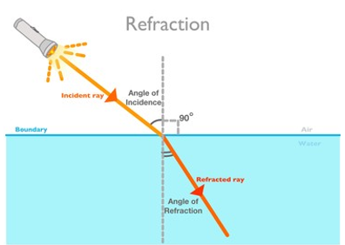
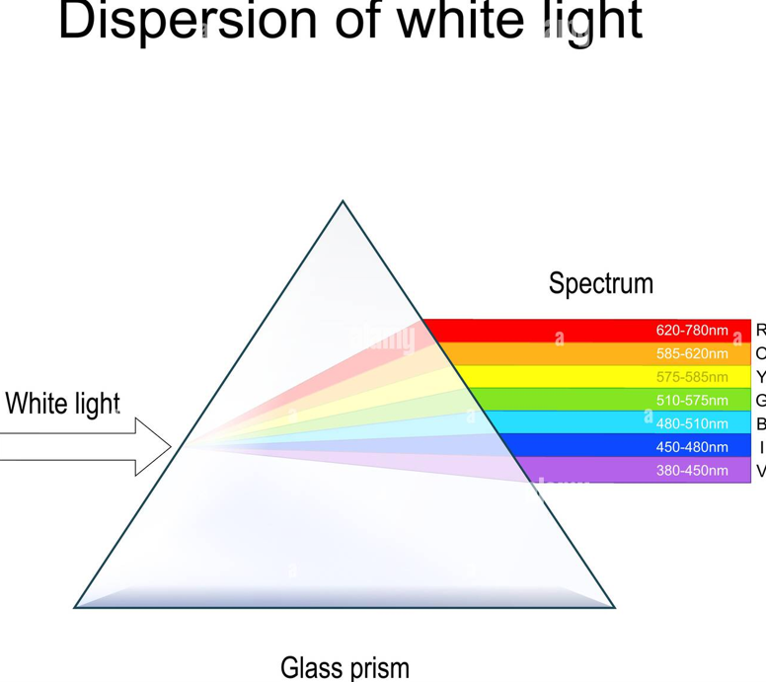
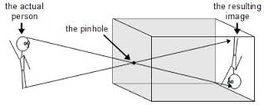
8.3 Light and sound KO
7.Key Knowledge
Light travels in straight lines.
Luminous objects give out light; non-luminous objects reflect it.
Law of reflection: Angle of incidence = Angle of reflection.
Refraction: Light bends when it passes from one material to another.
Dispersion: White light splits into spectrum colours using a prism.
Light can form images using pinholes, mirrors, and lenses.
8.
11.
9.
10.
12.
13.
Common Misconceptions
“We see things in the dark” → ❌ We need light to reflect off objects.
“Light bends on reflection” → ❌ Light bends during refraction, not reflection.

Slide 3
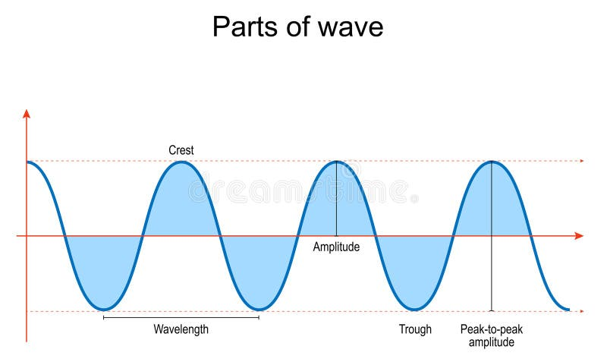
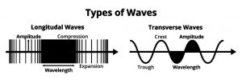
8.3 Light and sound engineer KO
Definitions
Reflection | Waves, including sound and light, can be reflected at the boundary between two different materials.
Refraction | Light changes speed and direction when it passes through a different density material
Normal | A line at right angles to a surface.
Angle of incidence | The angle between the normal and incident ray
Angle of reflection | The angle between the normal and reflected ray.
Spectrum | A band of colours, as seen in a rainbow, produced by separation of light, based on its wavelength.
Amplitude | The height of a wave.
Frequency | The number of waves per second.
Wavelength | The length of a wave – one complete cycle
Longitudinal | The vibrations are parallel to the direction of wave travel.
Transverse | The vibrations are at right angles to the direction of wave travel.
Wave | Waves transfer energy without transferring matter
Compression | Regions of high pressure due to particles being close together, in a longitudinal wave
Rarefaction | Regions of low pressure due to the particles being spread further apart
Speed equation | Speed = distance / time
Prism | A prism is a transparent optical element with flat, polished surfaces that refract light.
Primary colours | Red, Blue and Green (for light)
Waves
🔑 Key Knowledge
Transverse waves (like light): particles move up and down.
Longitudinal waves (like sound): particles move back and forth.
Both transfer energy

Slide 4
8.3 Light and sound engineer KO
1. Sound – Key Knowledge
What causes sound to travel?
In which state of matter does sound travel fastest: solid, liquid, or gas?
What kind of vibration causes louder sounds?
What kind of vibration causes higher-pitched sounds?
What type of wave is a sound wave?
How do particles move in a longitudinal wave
4. Light – Key Knowledge
In what kind of path does light travel?
What is the difference between a luminous and a non-luminous object?
State the law of reflection.
What is refraction?
What is dispersion?
Name three things that can be used to form images with light.
2. Sound – Common Misconceptions
Can sound travel in space? Explain why or why not.
Does sound always travel at the same speed? What does its speed depend on?
5. Light – Common Misconceptions
Why can't we see things in the dark?
Does light bend during reflection or refraction?
6. Waves – General
In a transverse wave, how do the particles move?
In a longitudinal wave, how do the particles move?
What do both types of waves transfer
3. Calculating Speed, Distance, Time
Write the formula to calculate speed.
A wave travels 250 m in 0.5 seconds. What is its speed?
A wave travels at 600 m/s for 3 seconds. How far does it go?
A wave travels 1800 m at 300 m/s. How long does it take?

