Slide 1
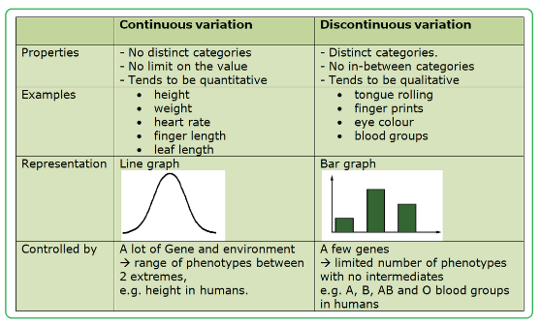
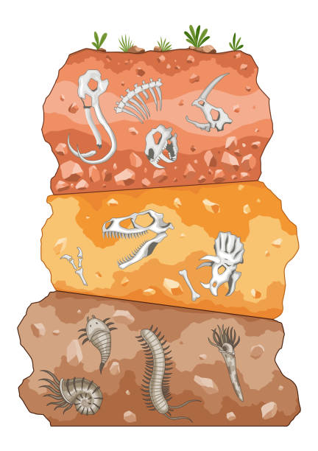
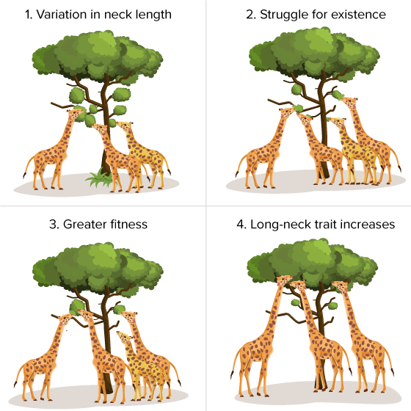
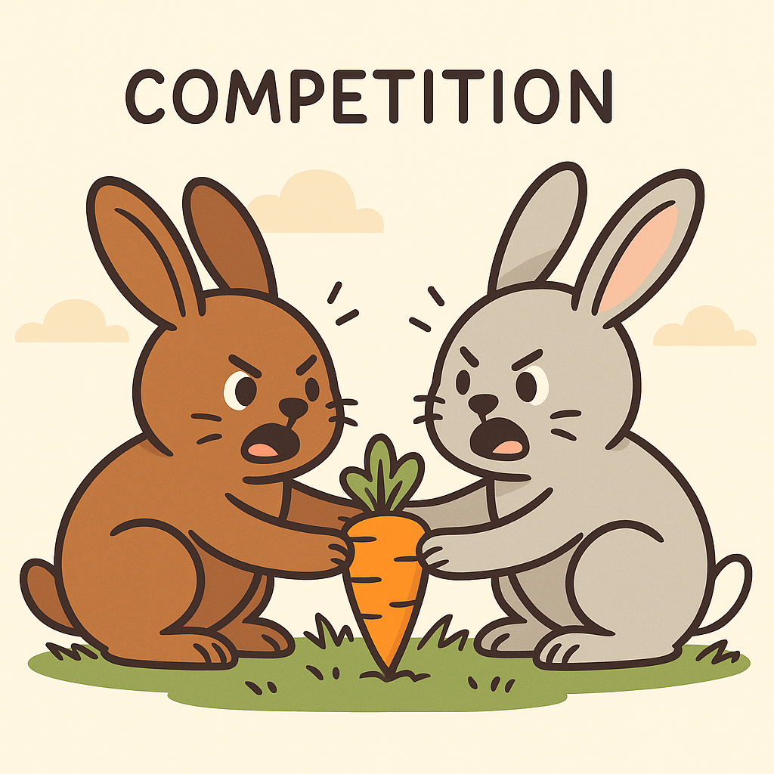
8.2 Evolution Scientist KO
1. Variation (Working Scientifically) Read histograms (continuous variation) and bar charts (discontinuous).
2. Fossil Layers and Changes Over Time
Fossils are found in rock layers. The lower down the fossil is, the older it is. By looking at fossils in different layers, scientists can see how animals and plants have slowly changed. This helps us understand how living things have evolved over time
3.Adaptations and Natural Selection
An adaptation is a feature that helps a living thing survive in its environment.
Adaptations happen through a process called natural selection. This means:
Animals and plants are all a bit different (variation).
Some have features that help them survive and have babies.
These features are passed on to their young.
Over time, the helpful feature becomes common in the species — this is an adaptation.
Variation means the differences between individuals of the same species.
4. Competition happens when living things fight for the same resources to survive. These resources can include food, water, light, space, or mates.
If there isn’t enough to go around, some organisms may not grow, reproduce, or survive.
Common Misconceptions
“Individuals evolve.” Evolution happens in populations over generations, not individuals.

Slide 2
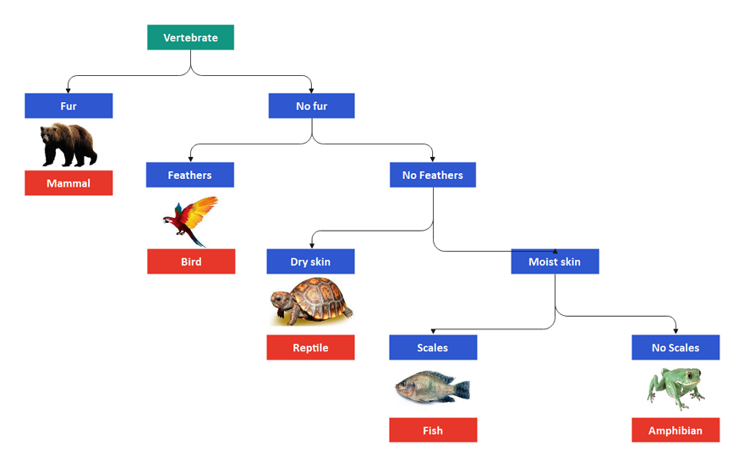
8.2 Evolution Scientist KO
5. dichotomous key is a chart that helps scientists identify and classify living things. It works by asking a series of yes or no questions about an organism’s features. Scientists use dichotomous keys to sort and group plants, animals, microorganisms, and other species based on their similarities and differences.
🧪 Example Dichotomous Key – Classifying Vertebrates
Does the animal have fur?
• Yes → Mammal
• No → Go to step 2
Does the animal have feathers?
• Yes → Bird
• No → Go to step 3
Does the animal have dry skin?
• Yes → Reptile
• No → Go to step 4
Does the animal have moist skin?
• Yes → Go to step 5
• No → (Not shown)
Does the animal have scales?
• Yes → Fish
• No → Amphibian
Structure Internal body processes that help an organism survive. These are often automatic or chemical changes | Behaviour A way an organism acts to help it survive. These are things the organism does. | Physiology A physical feature of an organism's body that helps it survive in its environment.
Large ears to lose heat | Hiding in burrows during the day | Producing concentrated urine to save water
Long eyelashes to protect eyes | Being active at night (nocturnal) | Tolerating high body temperatures
Thick fur on the soles of feet | Seeking shade during hottest parts | Slowing breathing to reduce water loss
Light-coloured fur for reflection | Travelling in groups to find food | Storing fat in a hump or tail for energy
Slim body to reduce heat gain | Staying still in the heat | Extracting water from food sources
6.adaptation is a feature or change that helps a living thing survive and reproduce in its environment.

Slide 3
8.2 Evolution Scientist KO
Definitions
Species | A group of organisms that can breed among themselves to produce fertile offspring.
Variation | Differences between individuals in a species.
Continuous data | Data that can take any value.
Discontinuous data | Data that has a particular value. There are no in-betweens. Eg. eye colour.
Environmental variation | Differences in characteristics caused by the environment/lifestyle.
Genetic variation | Differences caused by genes inherited from parents.
Genome | All the genetic material of an organism.
Fossil | The preserved impression/remains of an animal or plant whose living tissue has been replaced by minerals
Fossilisation | Process of organisms becoming fossils.
Fossil record | Set of fossilised remains that tells how organisms have changed over time.
Classify | Arrange in groups according to characteristics.
Classification | Process of classifying organisms.
Key | Series of questions to classify an organism.
Vertebrate | An organism with a backbone.
Evolve | Development of organisms over time.

Slide 4
8.2 Evolution Scientist KO
1. Variation (Working Scientifically)
What is variation and why does it occur?
What is the difference between continuous and discontinuous variation?
How can you identify variation as genetic, environmental, or both?
How are histograms and bar charts used to show different types of variation?
Give an example of continuous and discontinuous variation.
4.Competition
What is competition in biology?
What do plants compete for?
What do animals compete for?
What happens if an organism cannot compete successfully?
How can competition affect the survival of a species?
2. Fossil Layers and Changes Over Time
What are fossils, and where are they found?
What does the depth of a fossil tell you about its age?
How do fossils provide evidence for evolution?
What do scientists learn by comparing fossils from different layers?
Why are transitional fossils important?
5. Classification and Dichotomous Keys
What is a dichotomous key and how is it used?
What sort of questions do dichotomous keys ask?
How can scientists use features to identify and classify living things?
What’s the difference between using physical features and genetic data?
Use a dichotomous key to identify an unknown animal with given features.
3.Adaptations and Natural Selection
What is an adaptation?
How does natural selection lead to adaptations over time?
What are the steps of natural selection?
Why is variation important in natural selection?
What does it mean when we say a trait is passed on to offspring?
6. Adaptation for Survival and Reproduction
What is an adaptation
How does an adaptation help a living thing survive and reproduce?
Give an example of a structural, behavioural, and physiological adaptation.
Why do adaptations become more common over time?
How is this linked to the process of evolution?

