Slide 1
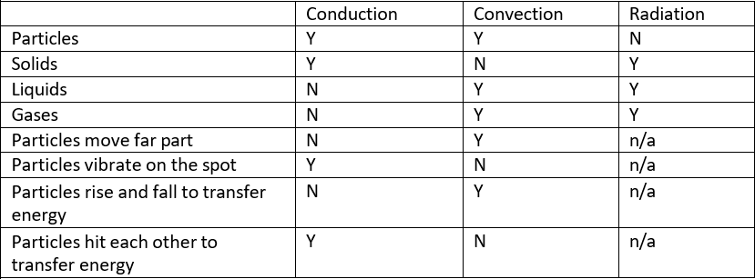
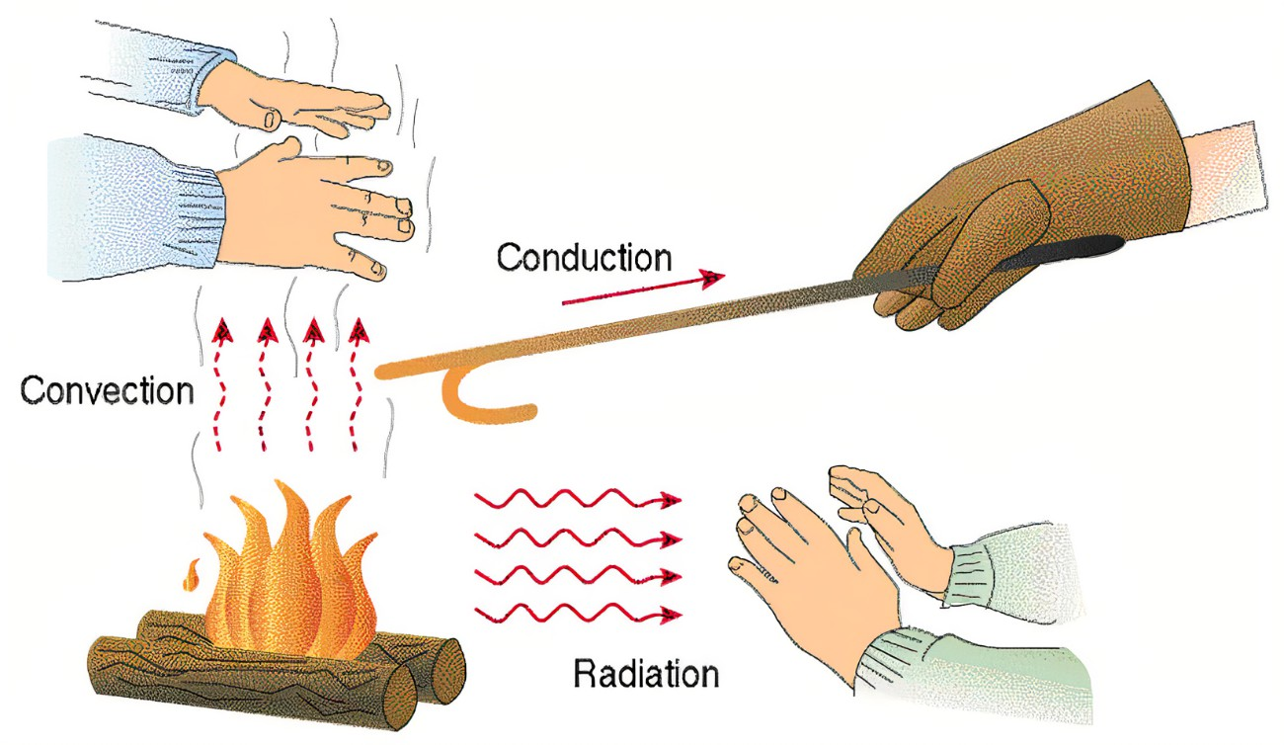
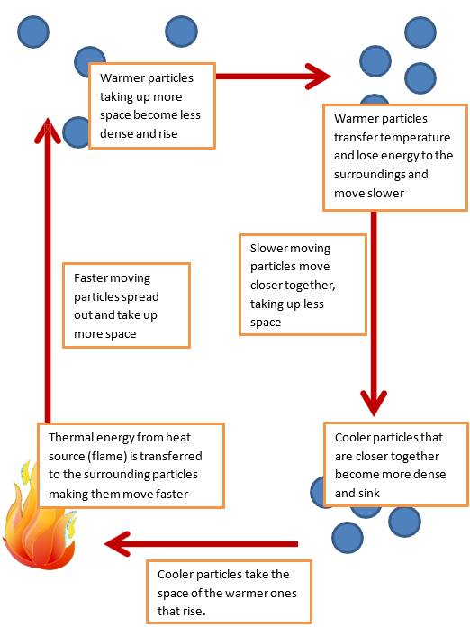
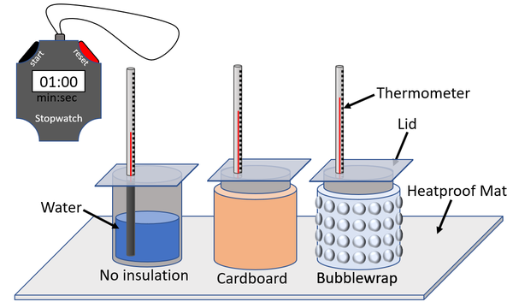
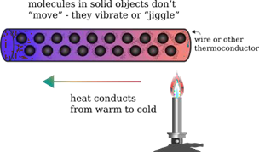
8.1 Heating engineer KO
1. Types of heat transfer
2. Convection
5. Difference between heat and temperature
4.Working scientifically: Designing an insulation experiment
Heat | Temperature
A type of energy | A measure of how hot or cold something is
Measured in joules (J) | Measured in degrees Celsius (°C)
Depends on mass and material | Depends on particle speed (kinetic energy)
Can move from hot to cold objects | Does not move
Example: A bath has more heat than tea | Example: Tea has a higher temperature
3. Conduction
Common Misconceptions
"Heat and temperature are the same" → Heat is energy; temperature measures energy.
"Metals are always hot" → Metals conduct heat well; they don’t generate it.

Slide 2
8.1 Heating engineer KO
Density = Mass ÷ Volume
Example Question:
A metal block has a mass of 600 g and a volume of 200 cm³. What is its density?
Equation : Density = Mass ÷ Volume
Working ( Substitute the values) : 600 g ÷ 200 cm³
Answer: = 3 g/cm
Definitions
Thermal conductor | A material that will let heat flow through it.
Thermal insulator | A material that will not let heat flow through it.
Conduction | The movement of heat (or electricity) through a substance. Heat is conducted due to particles vibrating and hitting each other
Convection | The transfer of heat through a liquid or gas (fluid) Convection occurs when particles with a lot of heat energy in a liquid or gas move and take the place of particles with less heat energy
Radiation | Heat can be transferred by infrared radiation. This is an electromagnetic wave and doesn’t use particles
Temperature | Temperature is a measure of how hot something is.
Heat | Heat is a measure of the thermal energy contained in an object.
Thermal energy | Energy that is due to particles moving and results in an object having a temperature. It is transferred as heat.
Thermal conductor | A material that will let heat flow through it.
Boiler | This has a large surface area to allow for large amounts of heat energy to be transferred to its surrounding through convection.
Double Glazing | Windows and doors with 2 planes of glass with air trapped between them (or a vacuum between them). Air is a poor conductor and there is no convection because the air is trapped and cannot for convection currents.
6. Density calculation
Pressure = Force ÷ Area
Example Question:
A force of 200 N is applied to a surface area of 2 m². What is the pressure?
Equation: Pressure = Force ÷ Area
Working:200 N ÷ 2 m² = 100 Pa
Answer:200 N ÷ 2 m² = 100 Pa
7. Pressure calculation
Change in Thermal Energy = mass × specific heat capacity × temperature change
Example Question:
A 2 kg block of metal is heated from 20°C to 60°C. The specific heat capacity is 500 J/kg°C.
How much thermal energy is transferred?
Working:
Change in temperature = 60°C − 20°C = 40°C
Thermal energy = 2 kg × 500 J/kg°C × 40°C = 40,000
8. Change in thermal energy calculation

Slide 3
8.1 Heating engineer KO
🔑 Key Questions for Retention
🔥 Heat Transfer ( Section 1,2,3 )
Name the three methods by which heat is transferred.
Which method of heat transfer occurs in solids?
Why does hot air rise in a room? Explain using the idea of convection.
📦 Density ( Section 6 )
What is the equation for density?
A block has a mass of 500 g and a volume of 250 cm³. What is its density?
Why do some objects float in water while others sink?
🧪 Working Scientifically ( Section 4 )
What variables would you need to control when designing an experiment to test the effectiveness of different insulating materials?
How would you measure the effectiveness of an insulator in an experiment?
⚖️ Pressure ( Section 7 )
Write down the equation for pressure.
A force of 100 N is applied to an area of 0.5 m². What is the pressure?
♨️ Change in Thermal Energy ( section 8 )
Write down the equation used to calculate the change in thermal energy.
A 1.5 kg block is heated from 30°C to 50°C. Its specific heat capacity is 420 J/kg°C. Calculate the thermal energy transferred.
❄️ Heat and Temperature ( Section 5 )
What is the difference between heat and temperature?
True or false: Metals produce heat on their own.
Why do some people mistakenly think that heat and temperature are the same?
⚠️ Misconceptions and Applications
Why is it incorrect to say that “metals are always hot”?
Why does a metal spoon feel colder than a wooden spoon at room temperature?

