Slide 1
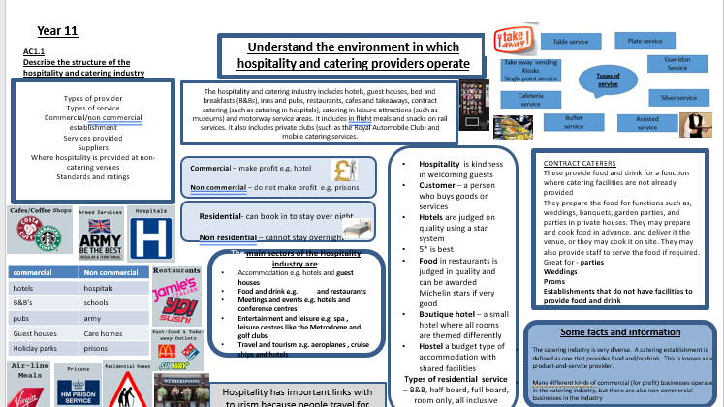

Slide 2
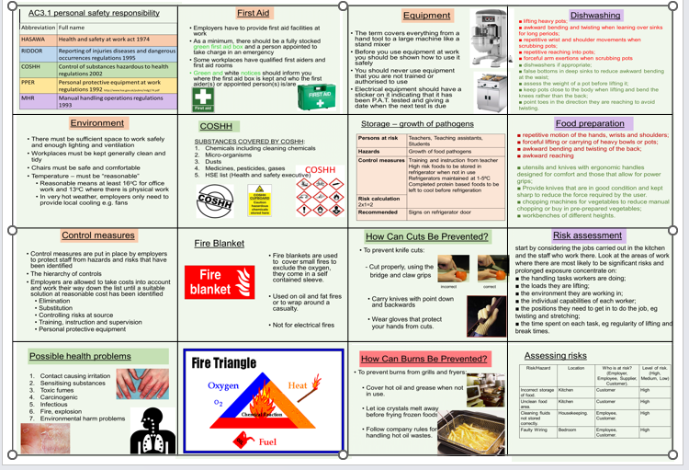

Slide 3
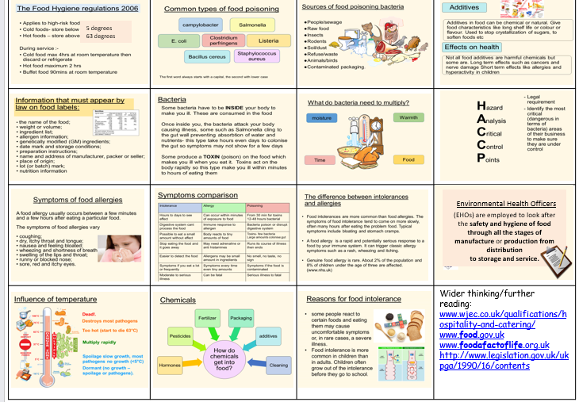

Slide 4



Year 10 Food– Knowledge Organiser
Use the correct colour coded boards to avoid cross contamination
RAW MEAT
FRUIT
VEGEATBLES FRUIT & SALAD
BREAD
.
Knife skills
Julienne
Chiffonade
Jardin
Macedoine
Brunoised
COOKING SKILLS
Simmer
Boil
Bake
Shallow fry
Deep fry
Reduce
METHODS OF COOKING
Heat transfers in three ways:
Conduction
Metal is a conductor of heat and carries the heat from the heat source to the food
Convection
When heated, gas or air particles expand and rise, causing colder particles to sink, creating convection currents which distribute heat.
Radiation
Heat is transferred directly onto the surface
Preparation skills
Knead
Mix
Whisk
Combine
Coagulate
“Cook from Scratch!”
Shortcrust pastry
Puff pastry
Homemade pasta
Homemade noodles
Homemade bread
Debone chicken thigh
Fillet a fish

Slide 5
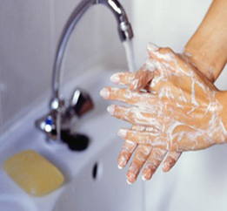

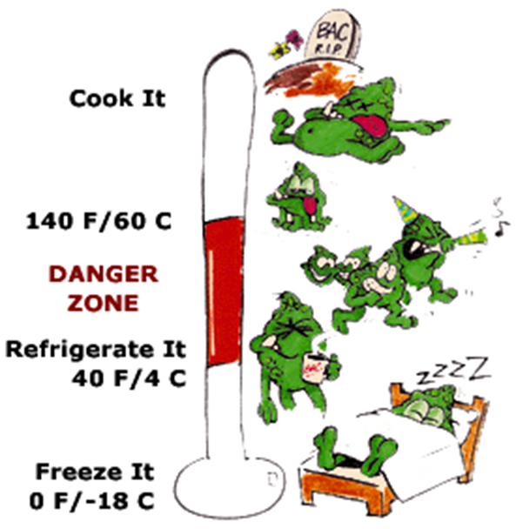
Don't cross-contaminate!
Keep raw meat, poultry,
fish, and their juices away
from other food. Wash
cutting board, utensils,
and countertops with hot,
soapy water after use.
Clean hands.
Hair tied back.
Wear an apron.
Wear blue plasters.
Don’t cough/sneeze over food.
Food should be cooked to high temperatures normally 75˚C
Bacteria loves temperatures between 5˚C and 63˚C this is the DANGER ZONE!
Food that goes into the refrigerator should be stored at 1 to 5˚C
Food that goes into a freezer should be stored at -18˚C

Slide 6
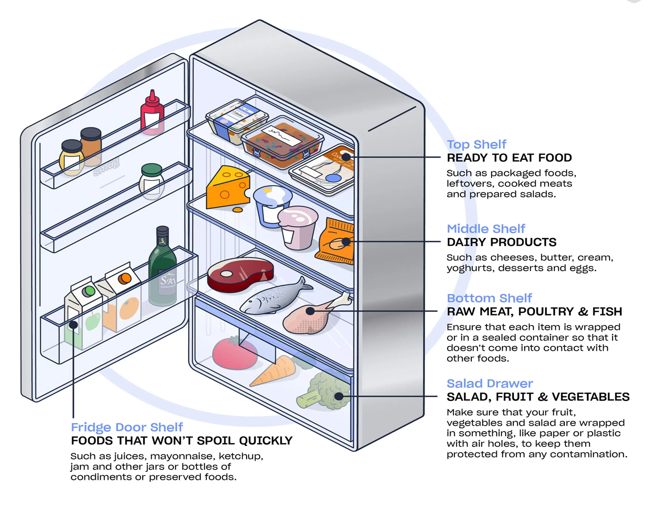
You should store meat and poultry on the bottom shelf of the fridge to prevent liquid dripping on to other food. Store in a clean, sealed container. Keep cooked and raw meats separate to avoid cross contamination. The fridge temperature should be between 1 and 4 degrees Celsius.

Slide 7
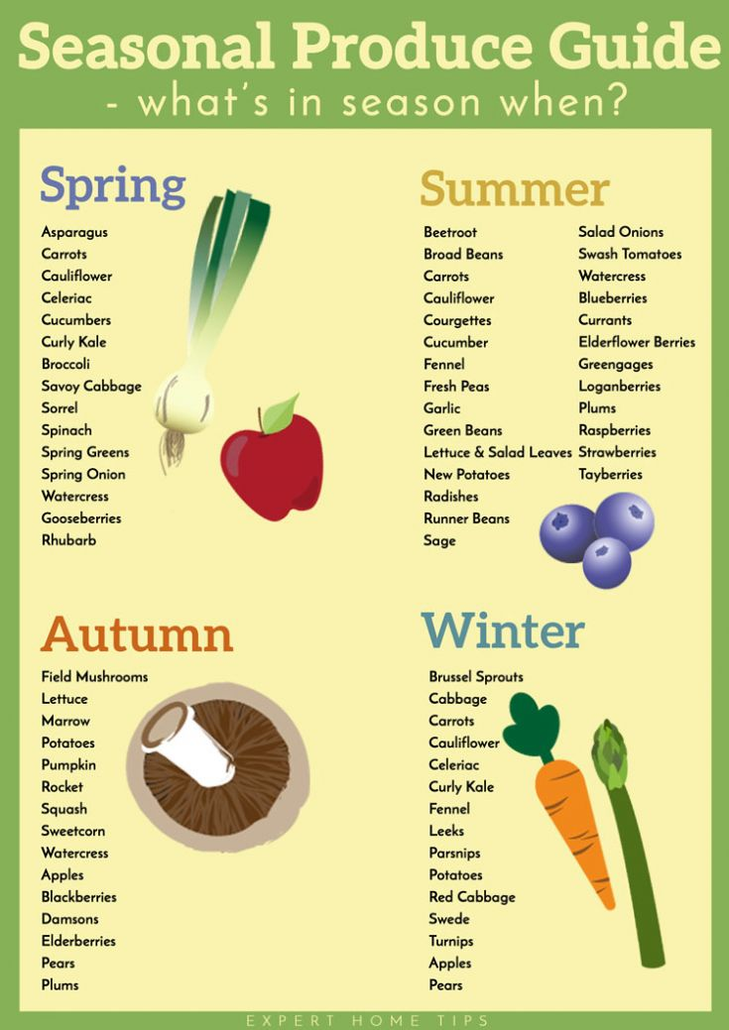


Slide 8
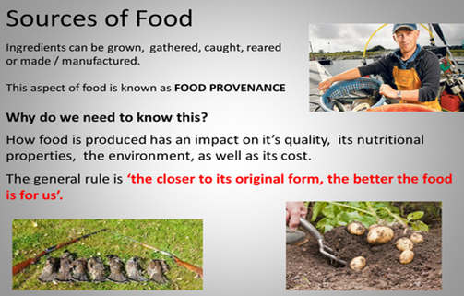

Slide 9
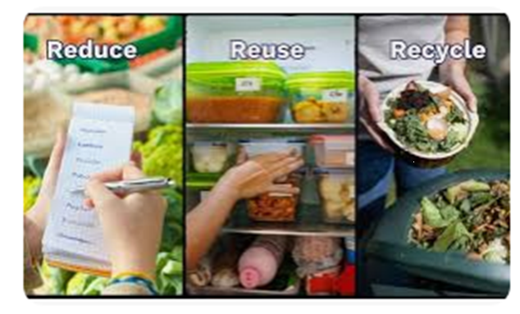
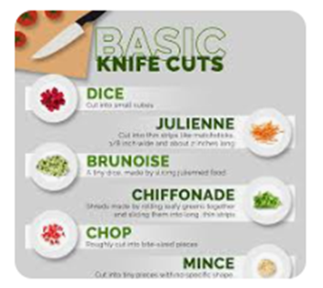
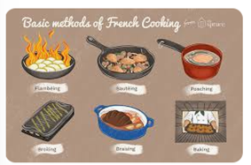
Organoleptic
How did your dishes:
Look (appearance)?
Taste (flavour and texture)?
Smell (aroma)

Slide 10
Reviewing dishes
Planning
Was the practical session plan in a logical order?
Discuss your strengths.
Discuss your weaknesses.
Suggest improvements.
Were you able to keep to the plan during the practical session? Discuss your strengths.
Discuss your weaknesses.
Suggest improvements.
Organisation
How did you organise your written tasks?
Discuss your strengths.
Discuss your weaknesses.
Suggest improvements.
How did you organise your workstation during the practical session?
Discuss your strengths.
Discuss your weaknesses.
Suggest improvements
Dish selection
Did your dishes contain the right nutrients for your two groups?
Were they expensive or cheap to produce?
Did they contain seasonal or local produce?
Hygiene
Did you follow all hygiene guidelines?
Did you wear correct PPE?
Did you wash up between jobs?
Health and safety
Were you able to use equipment safely?
Did you store ingredients correctly?

Slide 11
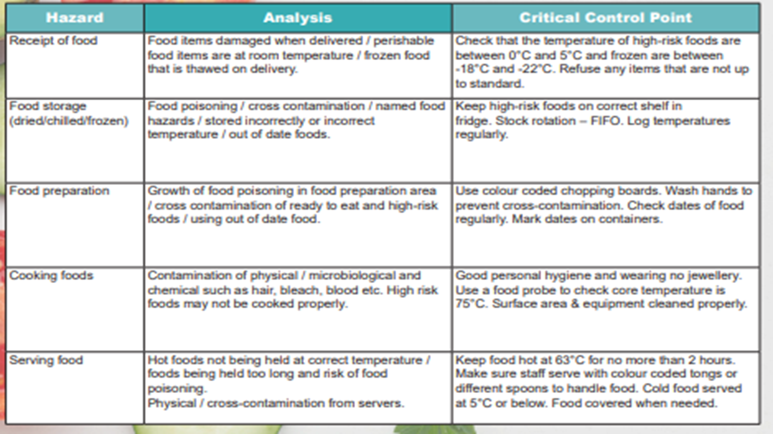

Slide 12
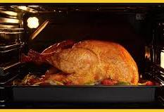
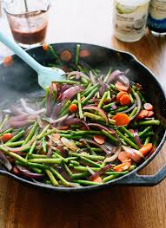
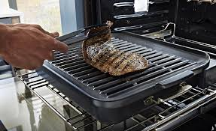
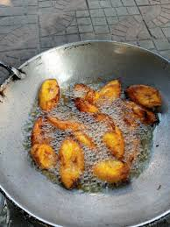
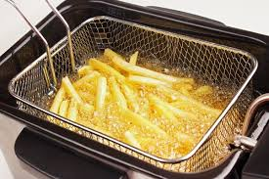
Roasting:
Vitamin B leaches out of the meat in the tray. The meat juices can be added to gravy to keep the nutrition in the diet. Roasting vegetables won't lose vitamins. For example, roasting chicken and potatoes.
Stir-frying
Stir-frying has a low-fat content this then means less fat-soluble vitamins will be lost .For example vitamin. For example, frying noodles and vegetable to make a stir-fry. This is a positive impact.
Grilling:
Grilling makes food taste better however will deduce vitamin B in food. Grilling can also cause carcinogenic cancer substances. For example, in meats and vegetables
Frying
Frying has a high fat content .fat soluble vitamins, for example A.B,E and K will think they are in the body and start to leach out into the oil. The oil will not be reused so therefore the nutrition will not go into the body. This is a negative impact for nutrition. Example of this if frying chicken or fish.

Slide 13
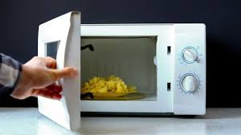
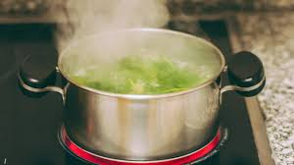
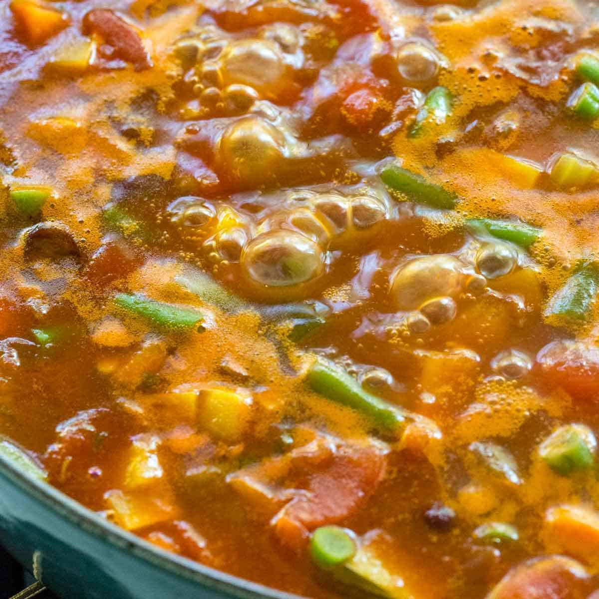
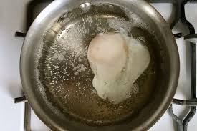
Boiling:
When you boil vegetables vitamins b and c (water soluble vitamins) will leach out of it and into the water. For example, when you boil broccoli 50% of its vitamins leaches out of it an into the water. You can keep the nutritional value by adding the boiling water into gravy to out onto of a roast dinner .This is putting the vitamins back into the body. This has a negative impact of the vitamins unless the boiling water gets reused. More example are carrots and also green beans.
Simmering:
When you simmer food the vitamins B and C (water soluble vitamins) will leach out of it. For example, in meat and vegetables. However, foods that get simmered are sauces, soups and curry, so they are automatically in the dish and the nutritional values got consumed. This is a positive impact and the vitamins are getting wasted and are still in the dish.
Poaching:
When poaching food vitamins leach out. and are in the water. An example of this is poaching fish will release omega 3.However is a better cooking method than boiling and poaching eggs.
Microwave:
Microwaving food is a quick and easy method. It has high temperatures and short cooking time reducing the amount of exposure the vitamins must lose. For example, microwaving broccoli or other vegetables.. This is a positive impact

Slide 14

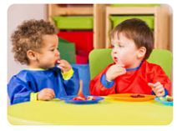
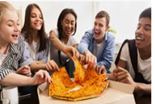

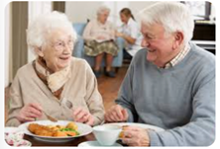
Specific groups | Nutritional needs/key information.
Children | Children need a diet which is eaten around the Eat well guide, to ensure they get the right nutrience . Need a good supply of protein. Along with vitamin A to help with growth and D to help repair teeth and bones. Also need minerals such as, calcium to help with strengthen teeth and bones as well as iron to help provide health blood cells.
Teenagers | Boys need more protein than girls as they grow later. After menstruation girls need more iron than boys to replace losses. Boys need extra iron to initially for growth and muscles. Increase in calcium for bone development in growth. Maintain good vitamins and minerals.
Adults | Balanced diet which consists of protein, fat and carbohydrate. Vitamins and minerals for a balanced diet. Women need additional calcium and iron to protect against anaemia and osteoporosis.
Older adults/elderly | Need protein to fix worn out body cells. Need a good source of vitamin D and calcium to help strengthen damaged teeth and bones. More fat in their diet to help provide warmth. Fruit and veg to help provide vitamins. Fibre to prevent constipation.
 | Complex carbohydrates and long-lasting protein and sugary snack for quick boost of energy. So, they can gain the strength they need.

Slide 15
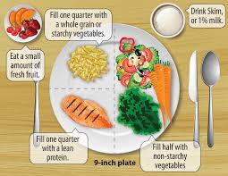
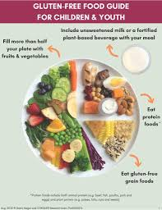
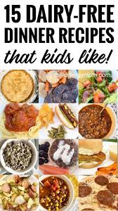
Active or leisure seekers | Complex carbohydrates and long-lasting protein and sugary snack for quick boost of energy. So, they can gain the strength they need.
Vegans and vegetarians | Protein and Calcium are the main nutrients to ensure they get consumed. Protein from nuts and soya beans. To make sure the essential amino acids are consumed.Calcum from nuts ,sees and dark leafy vegetables. Low amount of vitamin D to help absorb. Iron is also from leafy green vegetables .Lentils are a good source of vitamin c to ensure the body can process the iron. Vegetarians can't eat meat so therefore have a lack of HBV in protein, so they need different sources of protein.
Diabetes | Can not use glucose Limited amount of starch and sugary carbohydrates. Health Eat Guidelines will provide to have the right nutrient they need. Type 1 diabetes may need their carbohydrates calculated and Insulin need to be calculated. To measure their sugar level readings. Type 2 is controlled by low sugar and low carbohydrates without the need for insulin.
Coeliac | Intolerant to the protein gluten. Rice ,maize and potatoes are gluten free sources of starch carbohydrates. Other nutrients are available for gluten free sources.
Lactose and nut allergies. | Lactose- can't eat dairy or milk. Goat cheese and soya milk is a good source of calcium. Enough vitamin D to ensure calcium to fix the body. Nut allergy involves the immune system.

Slide 16
Clean hands. Hair tied back. Wear an apron. Wear blue plasters. Don’t cough/sneeze over food.
SPECIAL DIETS
Lactose intolerance. People must avoid milk, cheese butter , yogurt and processed foods that contain milk products.
Coeliac disease ( gluten intolerance). People must avoid wheat, wheat products, pasta, noodles, semolina, bread, pastry, sauces, rye, barley and oats (including breakfast cereals. They can eat rice, potatoes, corn and corn products.
Nut allergy. People must avoid nuts, blended cooking oils and margarines that contains nut oils.
Nutrient | Role in the body | Food Example
Carbohydrate | The main source of energy for the body. | Bread, rice, pasta, potatoes
Protein | Provides the body with growth and repair. | Meat, poultry, beans, eggs, lentils, tofu, fish
Fat | Provides the body with insulation and a small amount protects vital organs. Provides essential fatty acids for the body. | Butter, oil, cheese, cream, nuts, oily fish, crisps
Vitamins | General good health | Fruit, vegetables, meat, dairy
Minerals | General good health | Fruit, vegetables, eggs, meat, dairy
Diabetes. Diabetics find it difficult to control their blood sugar levels, so they need to eat starchy foods at regular intervals. They avoid foods high in sugar.
Vegans do not eat the flesh of any animal or any animal product e.g. cheese.
Lacto-vegetarians do not eat the flesh of any animal but they will eat eggs, milk, cheese, honey etc.
Muslims do not eat pork. They eat Halal meat.
Hindus do not eat beef.
Some Sikhs avoid meat and fish.
Wider thinking / further reading:
www.foodafactoflife.org.uk www.grainchain.com

Slide 17
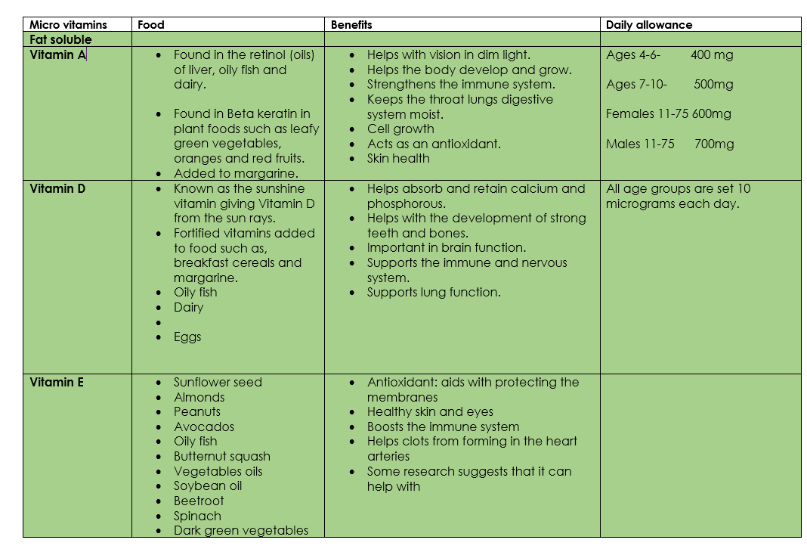

Slide 18
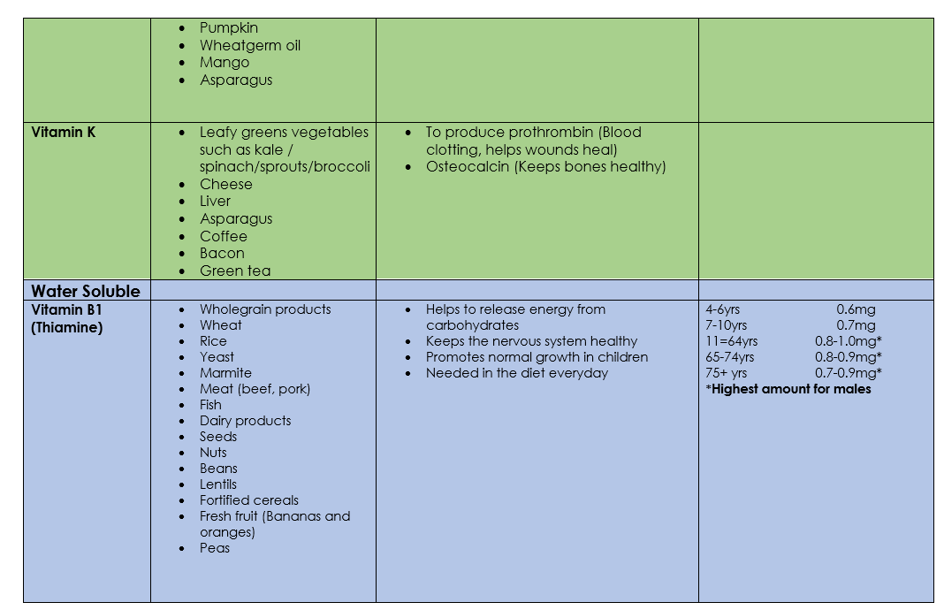

Slide 19
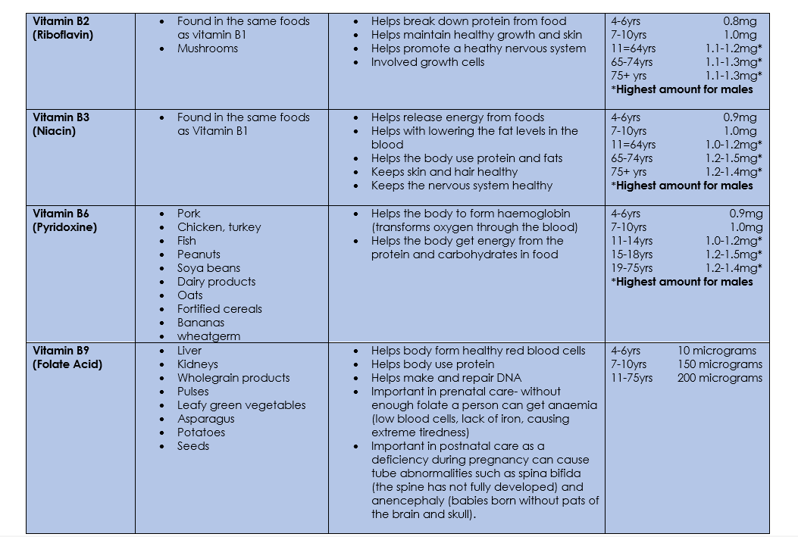

Slide 20
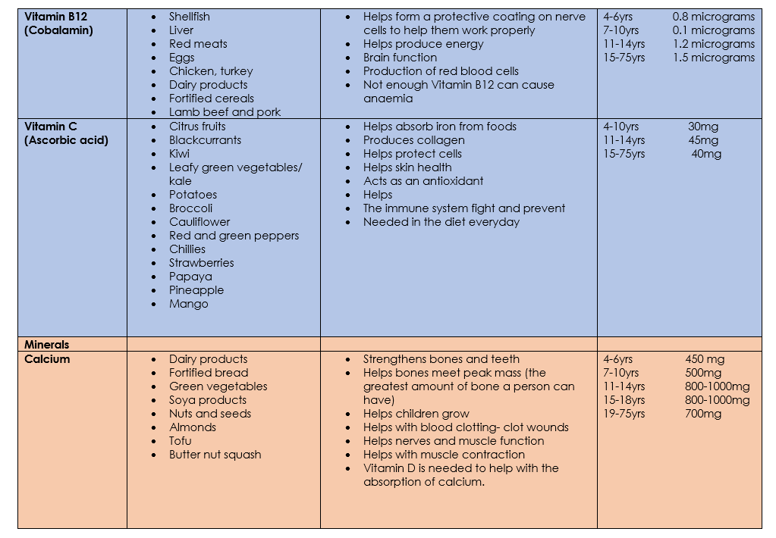

Slide 21


