Slide 1



Year 9 Food– Knowledge Organiser
Use the correct colour coded boards to avoid cross contamination
RAW MEAT
FRUIT
VEGEATBLES FRUIT & SALAD
BREAD
Don't cross-contaminate!
Keep raw meat, poultry,
fish, and their juices away
from other food. Wash
cutting board, utensils,
and countertops with hot,
soapy water after use.
Knife skills
Julienne
Chiffonade
Jardin
Macedoine
METHODS OF COOKING
Heat transfers in three ways:
COOKING SKILLS
Simmer
Boil
Bake
Shallow fry
Deep fry
Reduce
Preparation skills
Knead
Mix
Whisk
Combine
Coagulate
Conduction
Metal is a conductor of heat and carries the heat from the heat source to the food
Convection
When heated, gas or air particles expand and rise, causing colder particles to sink, creating convection currents which distribute heat.
Radiation
Heat is transferred directly onto the surface

Slide 2
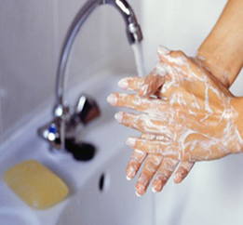

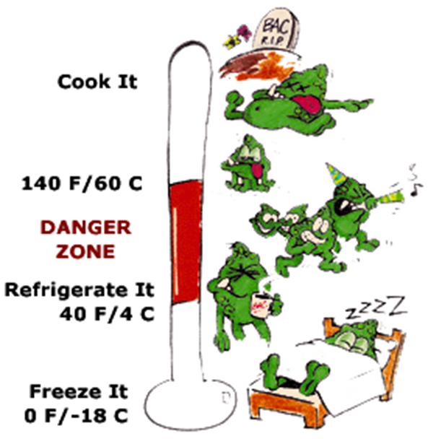
Don't cross-contaminate!
Keep raw meat, poultry,
fish, and their juices away
from other food. Wash
cutting board, utensils,
and countertops with hot,
soapy water after use.
Clean hands.
Hair tied back.
Wear an apron.
Wear blue plasters.
Don’t cough/sneeze over food.
Food should be cooked to high temperatures normally 75˚C
Bacteria loves temperatures between 5˚C and 63˚C this is the DANGER ZONE!
Food that goes into the refrigerator should be stored at 1 to 5˚C
Food that goes into a freezer should be stored at -18˚C

Slide 3
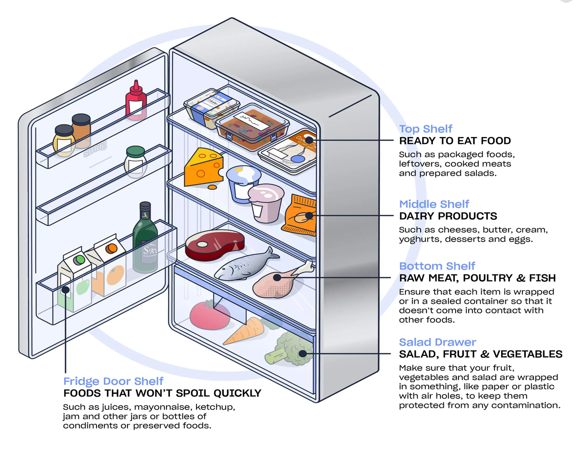
You should store meat and poultry on the bottom shelf of the fridge to prevent liquid dripping on to other food. Store in a clean, sealed container. Keep cooked and raw meats separate to avoid cross contamination. The fridge temperature should be between 1 and 4 degrees Celsius.

Slide 4
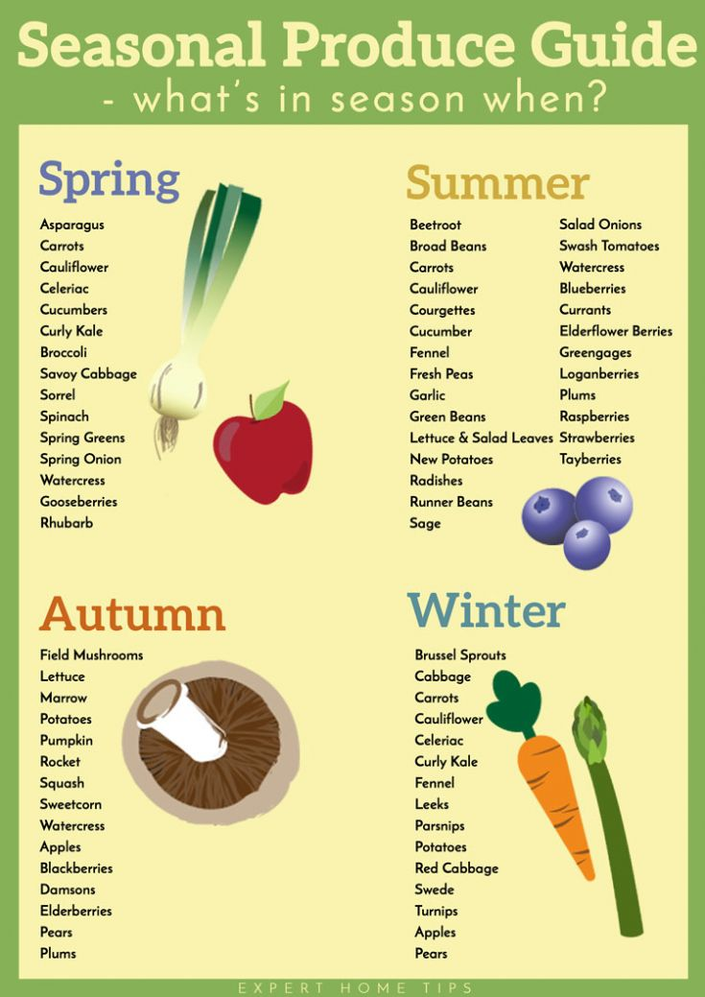


Slide 5
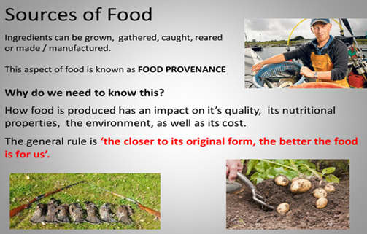

Slide 6
Clean hands. Hair tied back. Wear an apron. Wear blue plasters. Don’t cough/sneeze over food.
SPECIAL DIETS
Lactose intolerance. People must avoid milk, cheese butter , yogurt and processed foods that contain milk products.
Coeliac disease ( gluten intolerance). People must avoid wheat, wheat products, pasta, noodles, semolina, bread, pastry, sauces, rye, barley and oats (including breakfast cereals. They can eat rice, potatoes, corn and corn products.
Nut allergy. People must avoid nuts, blended cooking oils and margarines that contains nut oils.
Nutrient | Role in the body | Food Example
Carbohydrate | The main source of energy for the body. | Bread, rice, pasta, potatoes
Protein | Provides the body with growth and repair. | Meat, poultry, beans, eggs, lentils, tofu, fish
Fat | Provides the body with insulation and a small amount protects vital organs. Provides essential fatty acids for the body. | Butter, oil, cheese, cream, nuts, oily fish, crisps
Vitamins | General good health | Fruit, vegetables, meat, dairy
Minerals | General good health | Fruit, vegetables, eggs, meat, dairy
Diabetes. Diabetics find it difficult to control their blood sugar levels, so they need to eat starchy foods at regular intervals. They avoid foods high in sugar.
Vegans do not eat the flesh of any animal or any animal product e.g. cheese.
Lacto-vegetarians do not eat the flesh of any animal but they will eat eggs, milk, cheese, honey etc.
Muslims do not eat pork. They eat Halal meat.
Hindus do not eat beef.
Some Sikhs avoid meat and fish.
Wider thinking / further reading:
www.foodafactoflife.org.uk www.grainchain.com

Slide 7
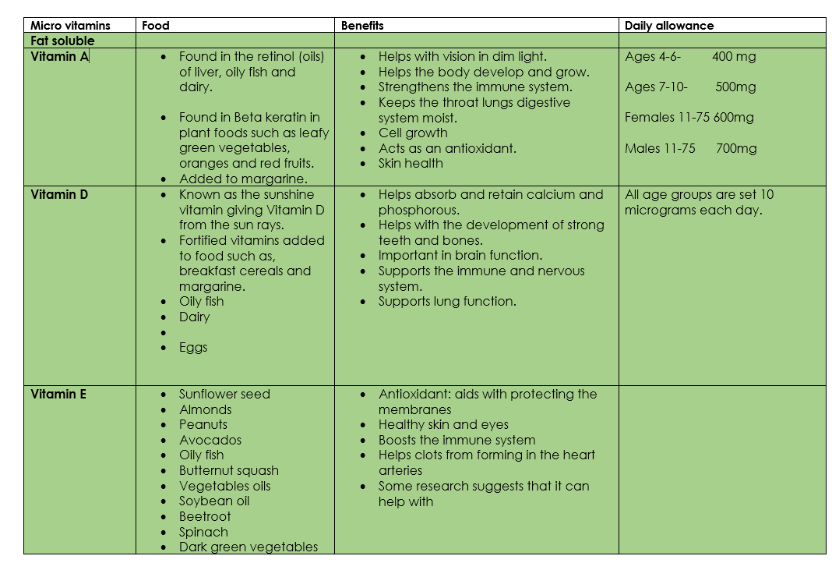

Slide 8
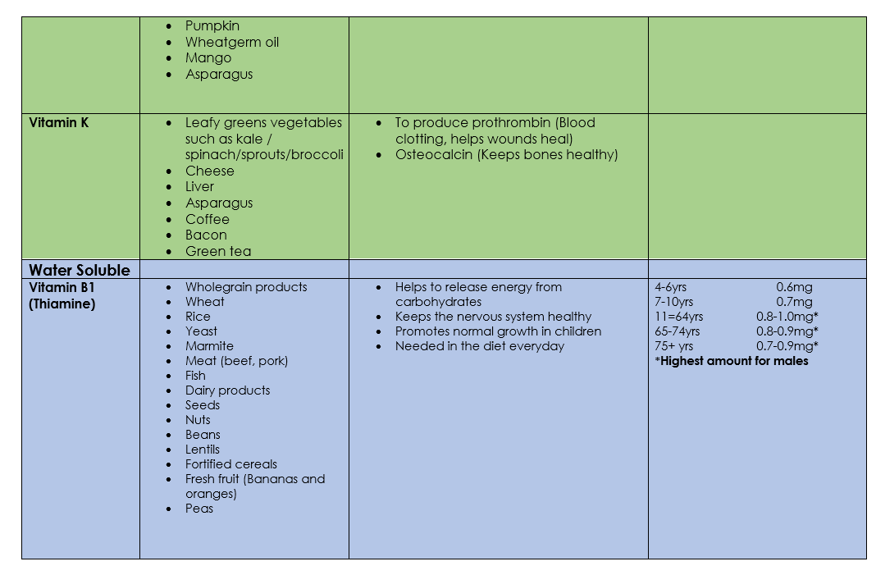

Slide 9
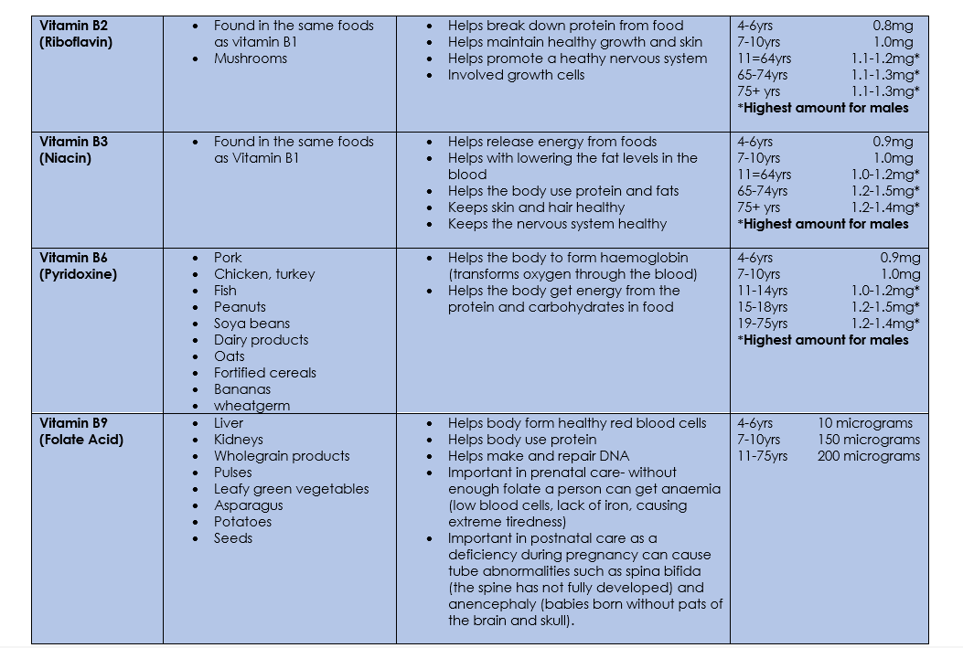

Slide 10
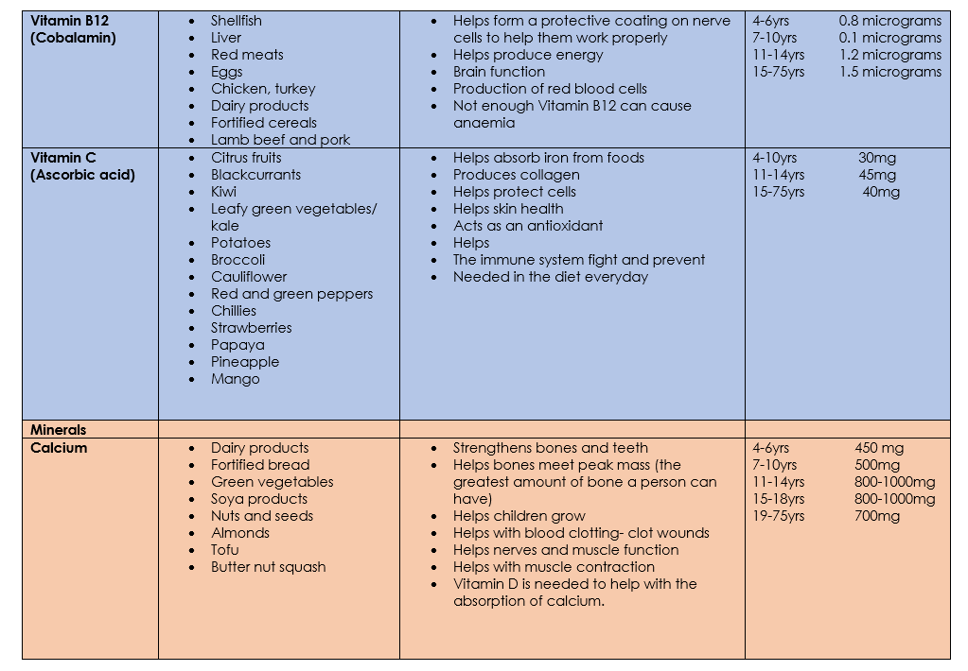

Slide 11


