Slide 1






Year 8 Food Studies – Knowledge Organiser
Use the correct colour coded boards to avoid cross contamination
RAW MEAT
FRUIT
VEGEATBLES FRUIT & SALAD
BREAD
KEY PROCESSES:
Kneading-
to work dough, to develop
the gluten that is found in
flour, this gives baked
goods their structure and
texture. When making
dough, the flour and other
dry ingredients are
combined with the wet
ingredients, usually warm
water, along with yeast.
Handling Raw Meat -
Always wash hands with
warm water and soap for
20 seconds before and
after handling raw meat.
Reducing – heating up a
sauce based product to
evaporate the water and
making the sauce thicker
in consistency.
Don't cross-contaminate!
Keep raw meat, poultry,
fish, and their juices away
from other food. Wash
cutting board, utensils,
and countertops with hot,
soapy water after use.
METHODS OF COOKING
Heat transfers in three ways:
Conduction
Metal is a conductor of heat and carries the heat from the heat source to the food
Convection
When heated, gas or air particles expand and rise, causing colder particles to sink, creating convection currents which distribute heat.
Radiation
Heat is transferred directly onto the surface
COOKING SKILLS
Chop
Fold
Roll
Knead
Shape
Simmer
Boil
Bake

Slide 2
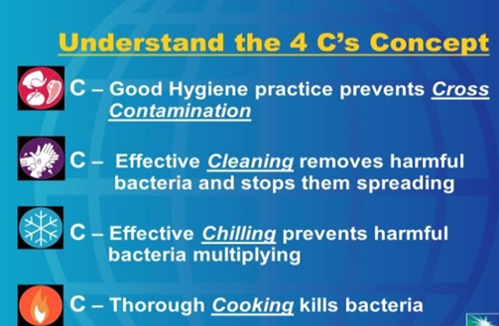
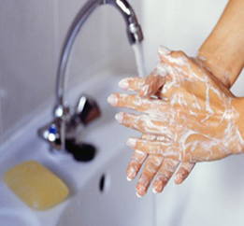

Clean hands.
Hair tied back.
Wear an apron.
Wear blue plasters.
Don’t cough/sneeze over food.
Don't cross-contaminate!
Keep raw meat, poultry,
fish, and their juices away
from other food. Wash
cutting board, utensils,
and countertops with hot,
soapy water after use.

Slide 3





Multicultural Foods
Pizza and Bolognese- Italy
Curry and Naan Bread- India Fajitas- Mexico
Wider thinking / further reading:
www.foodafactoflife.org.uk www.grainchain.com

Slide 4
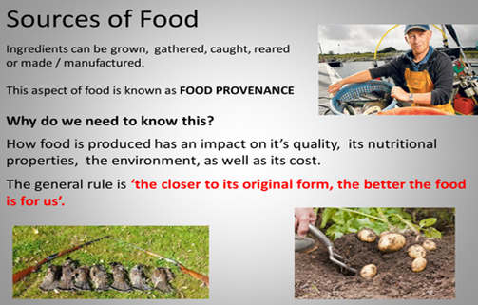

Slide 5
Clean hands. Hair tied back. Wear an apron. Wear blue plasters. Don’t cough/sneeze over food.
SPECIAL DIETS
Lactose intolerance. People must avoid milk, cheese butter , yogurt and processed foods that contain milk products.
Coeliac disease ( gluten intolerance). People must avoid wheat, wheat products, pasta, noodles, semolina, bread, pastry, sauces, rye, barley and oats (including breakfast cereals. They can eat rice, potatoes, corn and corn products.
Nut allergy. People must avoid nuts, blended cooking oils and margarines that contains nut oils.
Nutrient | Role in the body | Food Example
Carbohydrate | The main source of energy for the body. | Bread, rice, pasta, potatoes
Protein | Provides the body with growth and repair. | Meat, poultry, beans, eggs, lentils, tofu, fish
Fat | Provides the body with insulation and a small amount protects vital organs. Provides essential fatty acids for the body. | Butter, oil, cheese, cream, nuts, oily fish, crisps
Vitamins | General good health | Fruit, vegetables, meat, dairy
Minerals | General good health | Fruit, vegetables, eggs, meat, dairy
Diabetes. Diabetics find it difficult to control their blood sugar levels, so they need to eat starchy foods at regular intervals. They avoid foods high in sugar.
Vegans do not eat the flesh of any animal or any animal product e.g. cheese.
Lacto-vegetarians do not eat the flesh of any animal but they will eat eggs, milk, cheese, honey etc.
Muslims do not eat pork. They eat Halal meat.
Hindus do not eat beef.
Some Sikhs avoid meat and fish.

Slide 6
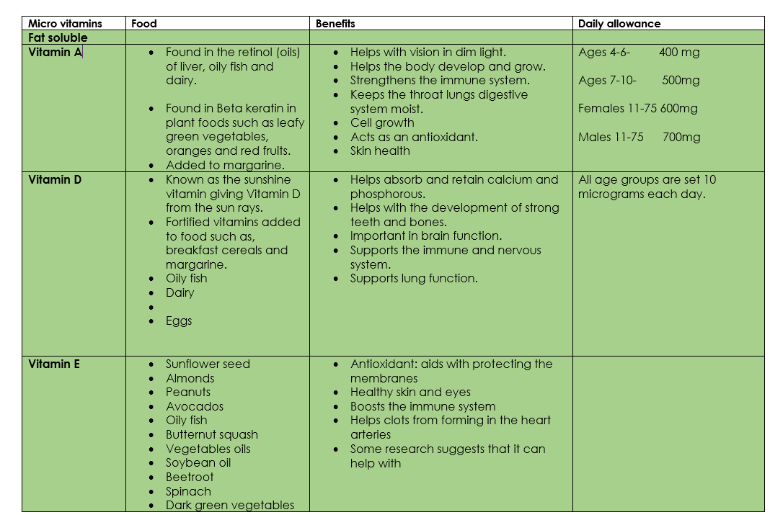

Slide 7
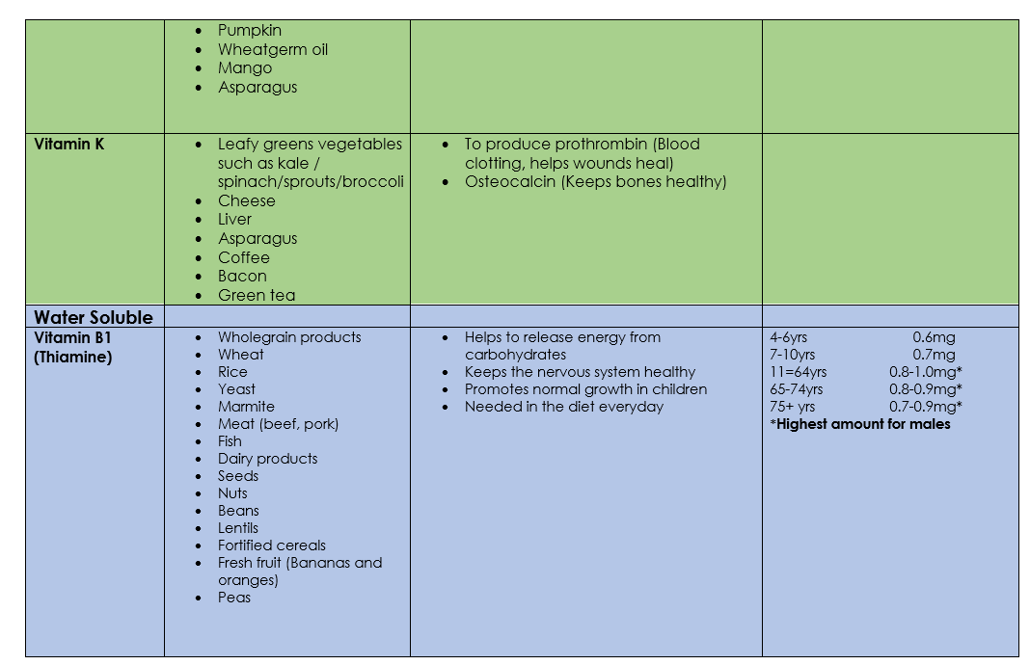

Slide 8
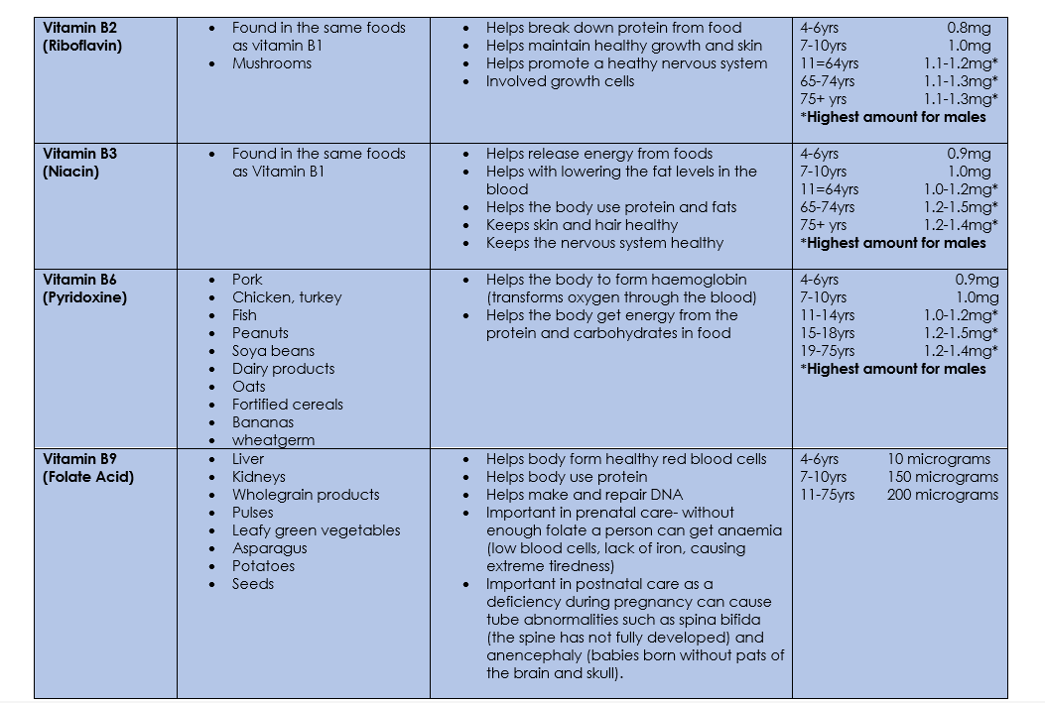

Slide 9
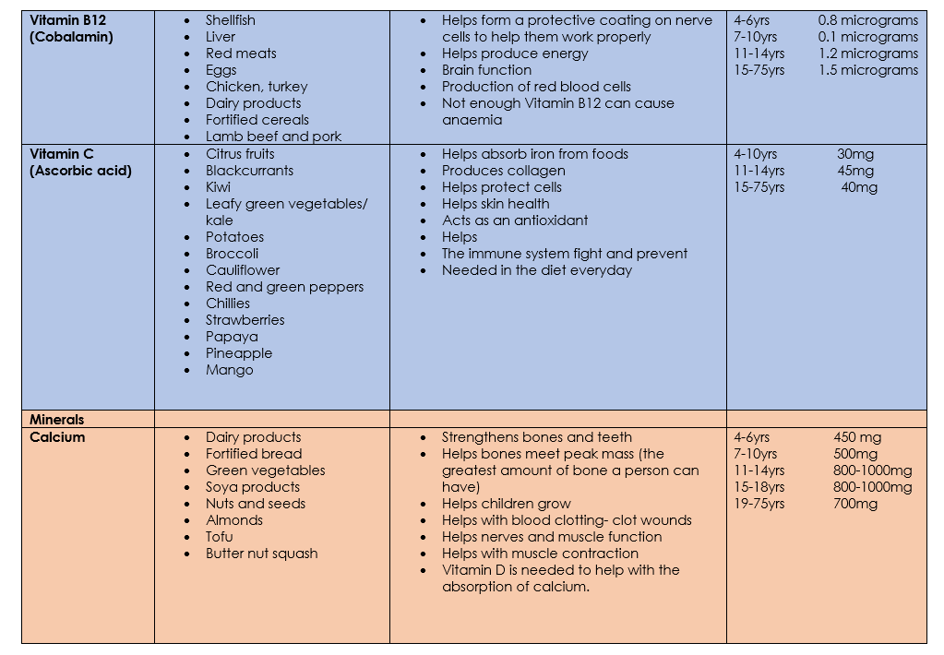

Slide 10


