Slide 1
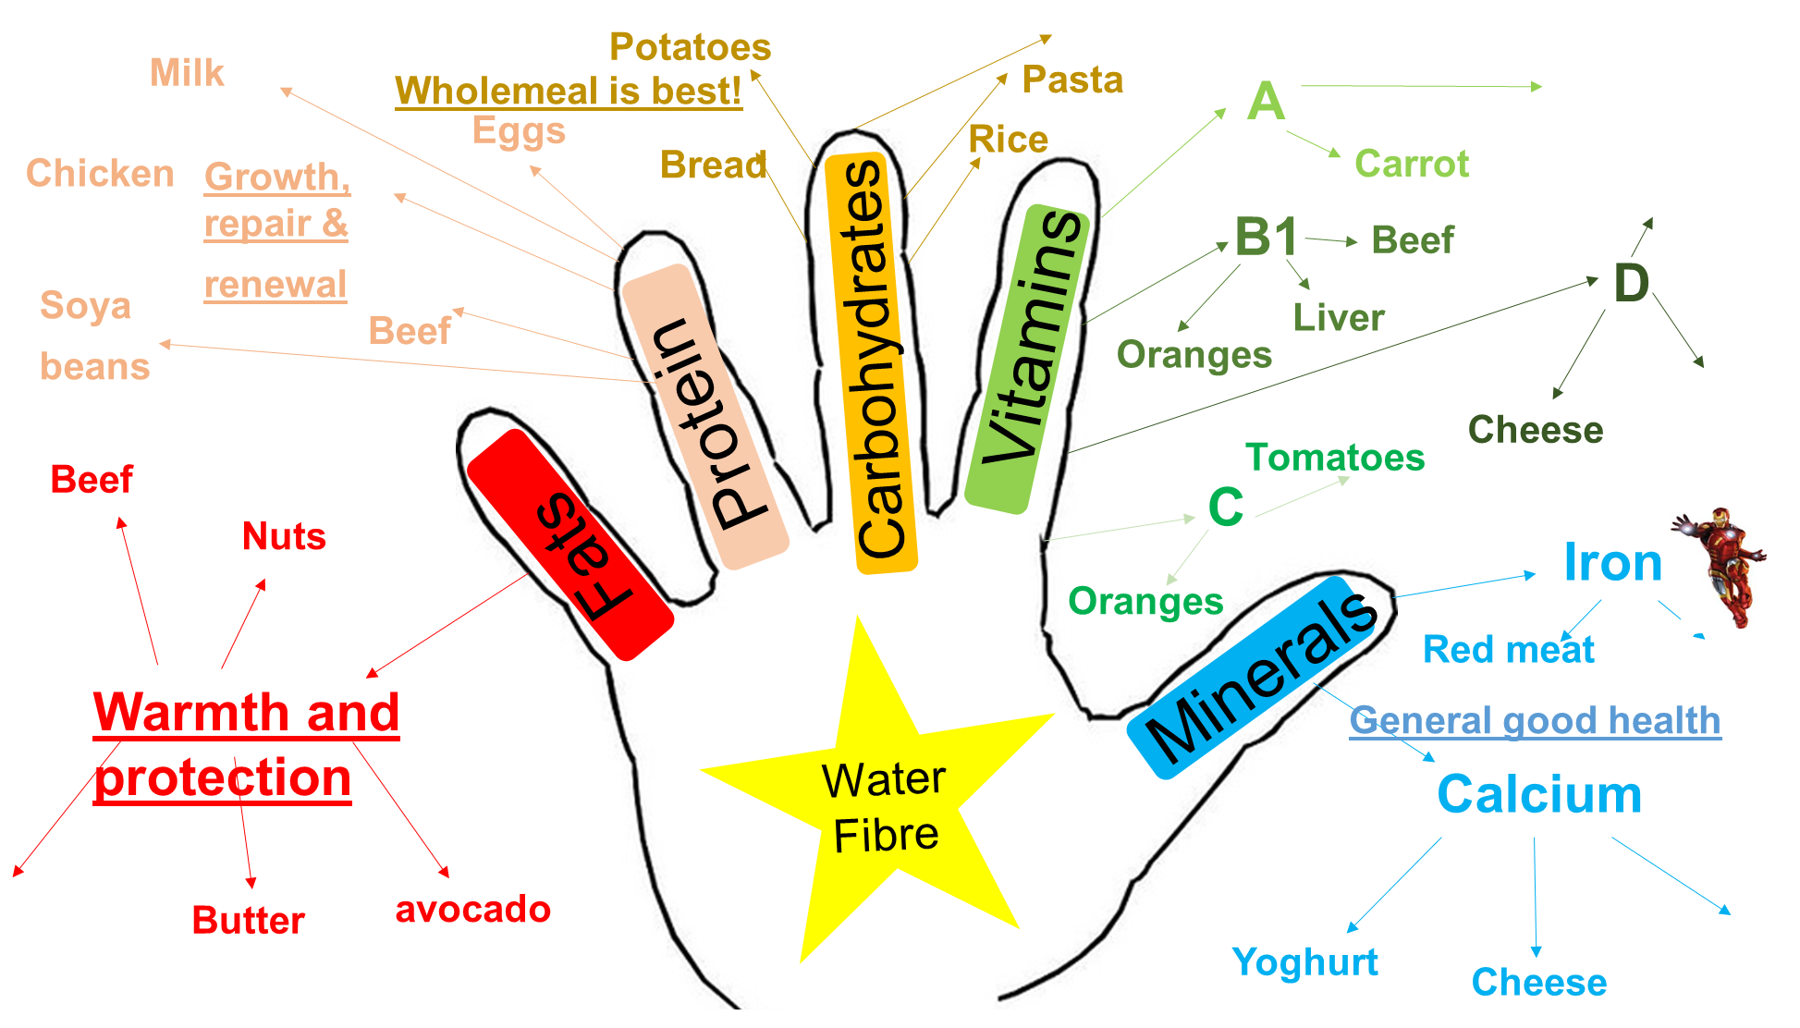
What are Nutrients?
Nutrients are the building blocks that make up food and have specific and important roles to play in the body. Some nutrients provide energy while others are essential for growth and maintenance of the body.

Slide 2
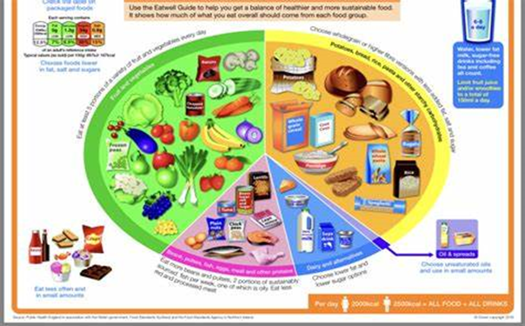
The Eatwell Guide
Carbohydrates
Fruit and vegetables
FATS
Dairy
Protein

Slide 3

Prevent cross contamination
Tie hair up
Wear an apron/protective clothing
Use the correct colour coded boards to avoid cross contamination
RAW MEAT
FRUIT
VEGEATBLES FRUIT & SALAD
BREAD
Clean hands
No Jewellery

Slide 4
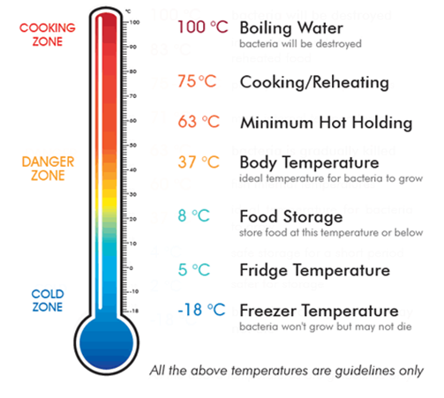
When bringing ingredients into school always put the cold ingredients into the fridges in the food technology classroom

Slide 5
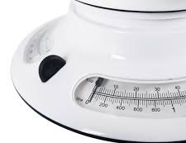
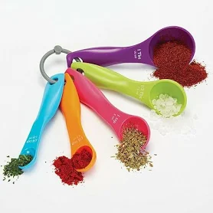
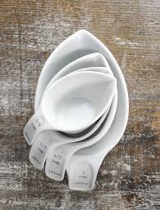
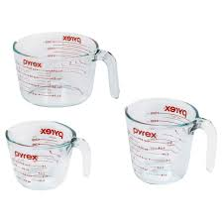
Weighing and Measuring
For good results in most recipes, accurate weighing and measuring is essential. When you are baking with flour, sugar and liquids, you must measure accurately, or your cooking will be spoiled. If you weigh out too much sugar or too little raising agent, your cakes will not rise or you could spoil the taste and/or texture.
Food can be weighed in Grams (g) There are 1000g in a Kilogram (kg). Liquid is measured in Millilitres (ml) or litres
Wider thinking / further reading: www.foodafactoflife.org.uk www.grainchain.com

Slide 6

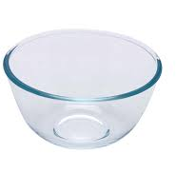
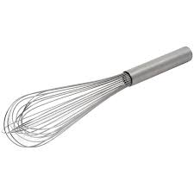
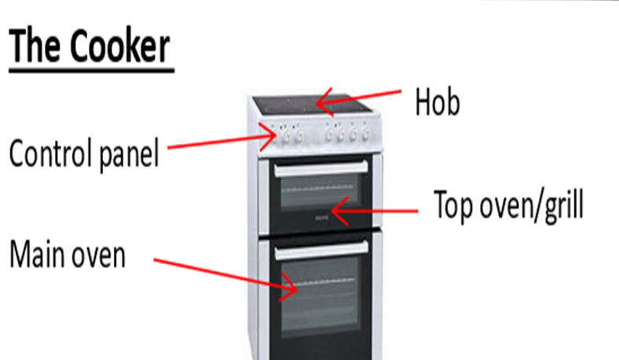
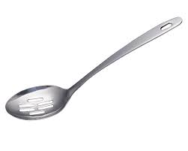

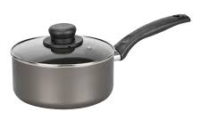
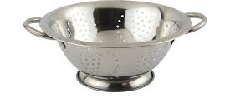
Equipment
Frying Pan
Spatula
Hand whisk
Mixing bowl
Saucepan
Slotted spoon
Wooden spoon
Colander

Slide 7
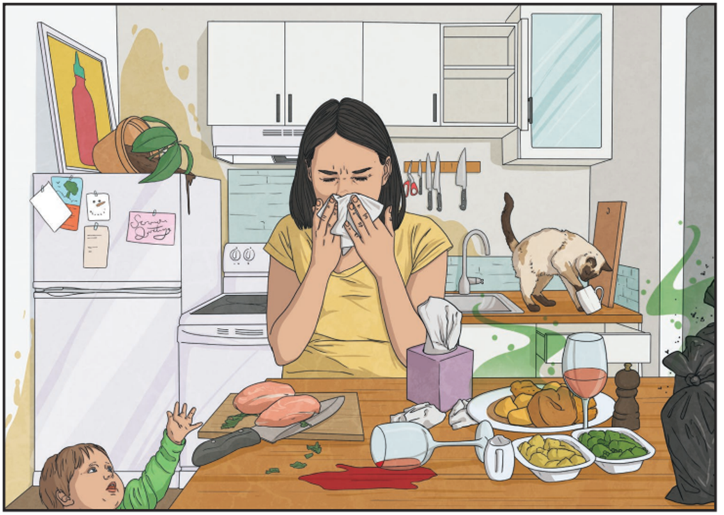
Hazards and hygiene in the kitchen
Cat on the countertop.
Toddler reaching for the knife/ raw chicken.
Cross-contamination with raw chicken and vegetables on the same chopping board.
Knocked over plant has spilt dirt over the fridge door.
Spilt drink hasn’t been cleaned up.
Used tissues by food that is being prepared.
Rotten food on the table by fresh food.
Full garbage bags on the table where food is being prepared.
Flies around the garbage bags in the kitchen.

